Slide 1
3D shapes

Slide 2
What shape am I?
I have no flat faces.
I have no straight edges.
I have just one curved face.
I am a …………?

Slide 3
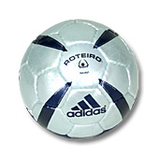
Well Done!
I am a sphere!

Slide 4
What shape am I?
I have one curved face.
I have one flat face.
My flat face is a circle.
I am a …………?

Slide 5
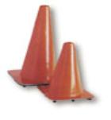
Great work!
I am a cone!

Slide 6
What shape am I?
I have 6 flat square faces
I have 12 straight edges
I have 8 corners.
I am a …………?

Slide 7
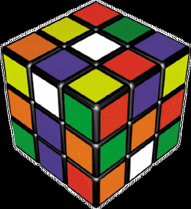
Fantastic!
I am a cube!

Slide 8
What shape am I?
I have one curved face
I have 2 flat circular faces.
I am a …………?

Slide 9

Well Done!
I am a cylinder

Slide 10
What shape am I?
I have 6 flat faces
My faces are all rectangles (square or oblong)
I have 12 straight edges and 8 corners.
I am a …………?

Slide 11

Brilliant!
I am a cuboid!

Slide 12
What shape am I?
I have 4 faces
My base is also triangle
I am a …………?

Slide 13
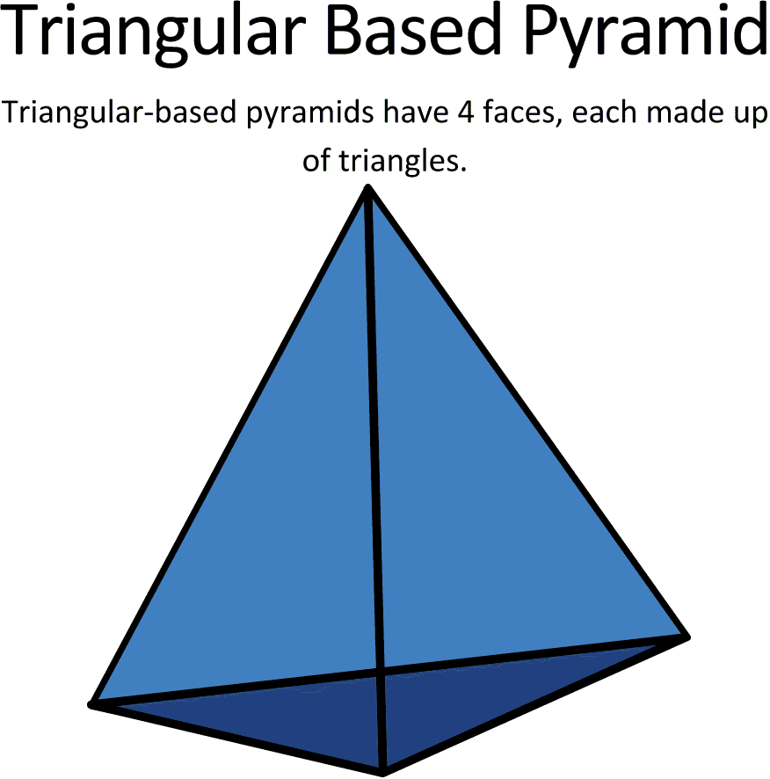
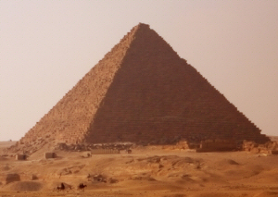
Brilliant!
I am a Pyramid!

Slide 14
What shape am I?
I have 6 faces and all are rectangle
I have 12 edges
I am a …………?

Slide 15
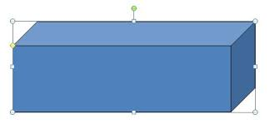
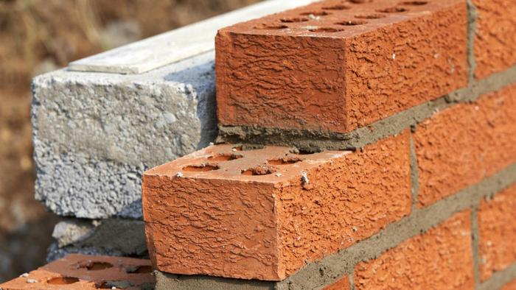
Brilliant!
I am a Rectangular Prism

