Slide 1

InsurAI
Corporate Policy Automation and Intelligence System
PRESENTED BY: TEAM B 1. NISHANT KUMAR 2. SUSHIL

Slide 2
Problem Statement – Current Challenges in Corporate Insurance
Manual & Time-Consuming Processes Policy management and claim handling are done manually, leading to delays and inefficiency.
Scattered Data & Poor Management Insurance data is stored across different systems, making tracking and access difficult.
Missed Renewals & Policy Tracking Issues Organizations struggle to track multiple policies, resulting in missed deadlines and financial loss.
Lack of Risk Analysis & Fraud Detection Existing systems do not provide intelligent insights for risk assessment and fraud prevention.
Low Transparency & Slow Decision-Making Employees have limited visibility into claim status, and decisions are often delayed.

Slide 3
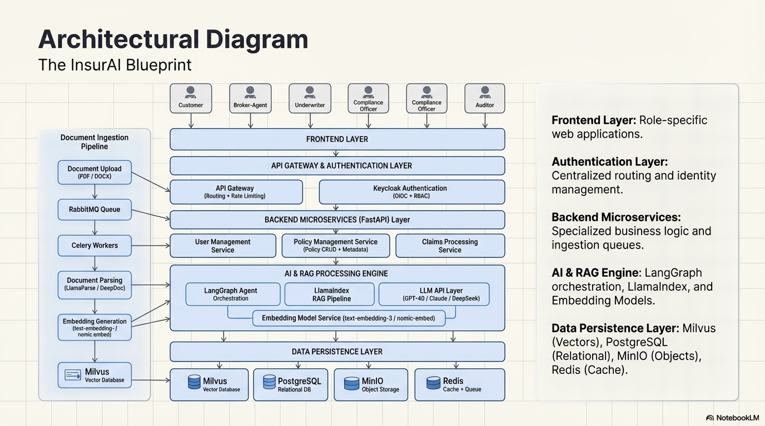
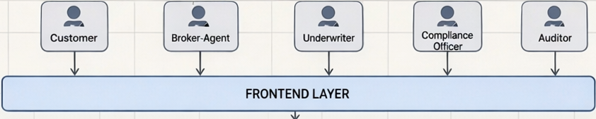

Slide 4
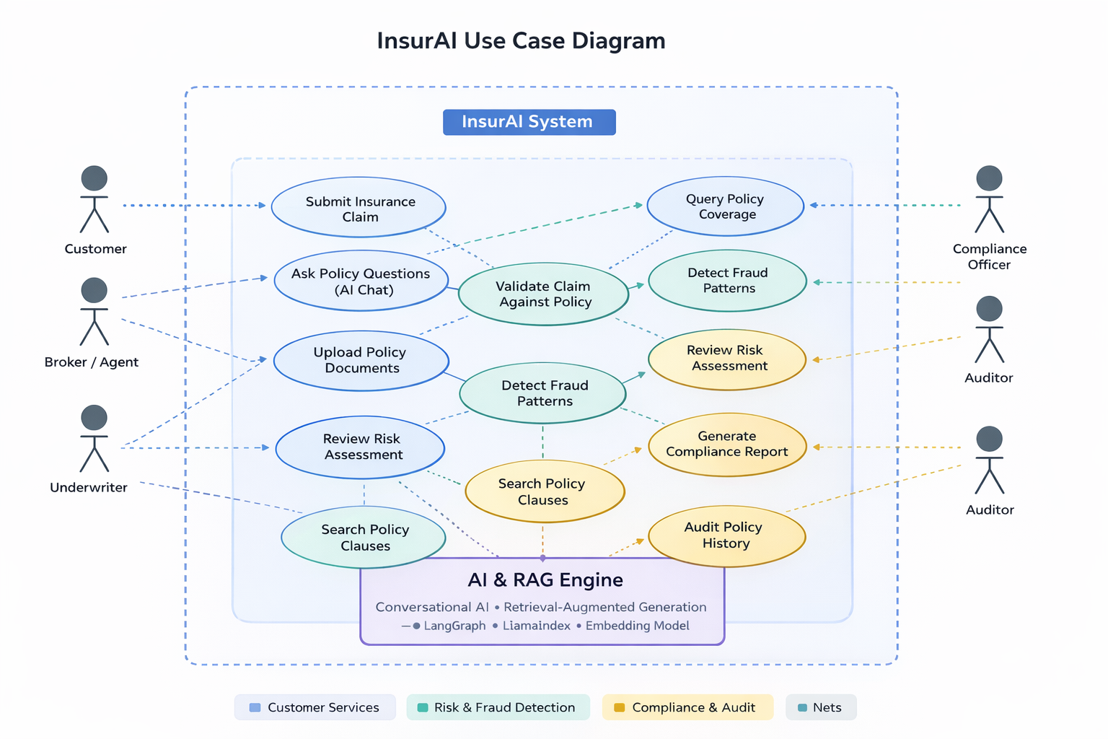
Use Case Diagram

Slide 5
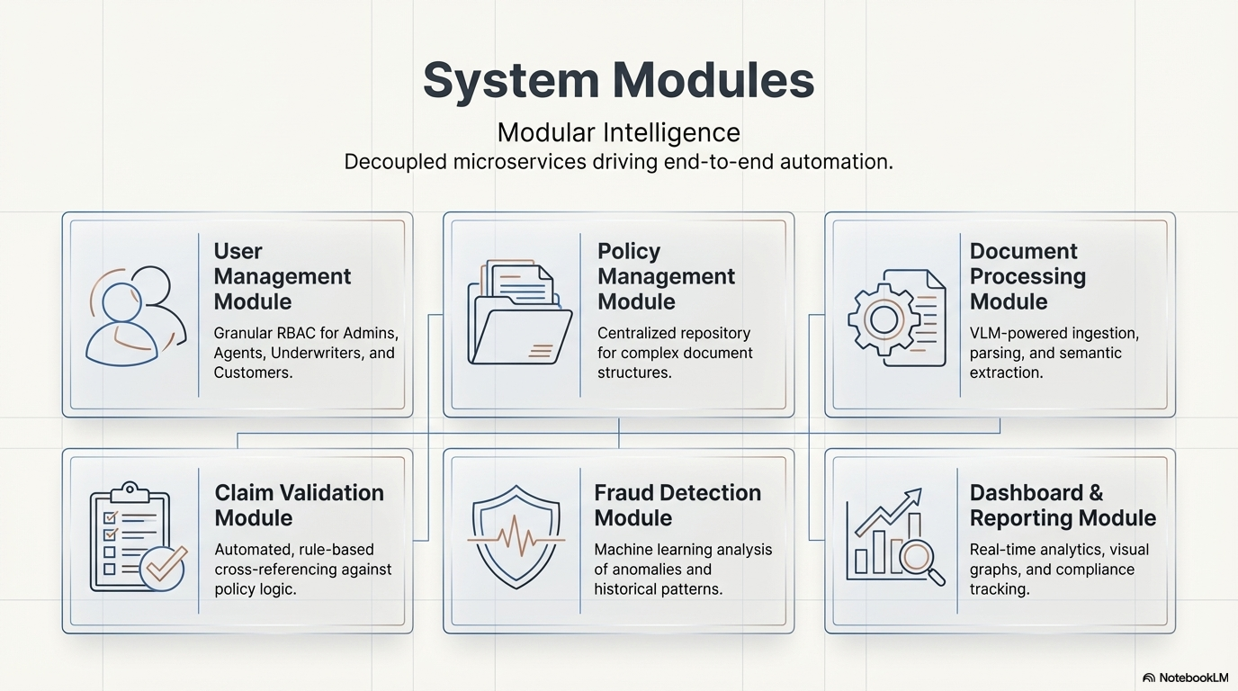

Slide 6

THANK YOU

