Slide 1

IoT based Weather Monitoring System
Presented by:
OM SINGH
NISHANT KUMAR
CHANDAN KUMAR
AYUSH KUMAR KESHRI
SHASHWAT
RIDDHI MISRA
G. AADESH KUMAR
Under the guidance of
Dr. Basudeba Behera

Slide 2
INTRODUCTION
The IoT-based Weather Monitoring System is a transformative solution leveraging IoT technology.
It aims to enhance the accuracy and accessibility of real-time weather data for various applications.
The system integrates sensor networks, data analytics, and cloud computing for comprehensive weather monitoring.
Deployment of sensors in diverse geographical locations captures meteorological parameters like temperature, humidity, air pressure, wind speed, and precipitation.
IoT devices connect these sensors to gather and transmit data efficiently.
This innovative system contributes to sectors such as agriculture, disaster management, and urban planning.- Real-time, accurate, and accessible weather data provided by the system facilitates informed decision-making
The documentation outlines the architecture, implementation, and potential applications, paving the way for further research in IoT-based environmental monitoring.

Slide 3
PROPOSED METHODOLOGY
Objective Definition:Clearly define the objectives of your weather monitoring project, such as measuring temperature, humidity, wind speed, and direction.
Equipment Selection:Choose appropriate weather meter equipment based on the parameters you aim to monitor. Consider factors like accuracy, range, and durability.
Site Selection: Identify suitable locations for installing weather monitoring stations. Ensure they represent diverse environments for a comprehensive understanding of weather patterns.
Installation of Equipment: Place the weather meters in the selected locations following manufacturer guidelines. Ensure proper calibration for accurate readings.
Power Supply: Ensure a reliable power source for continuous operation. Options include solar panels, battery backups, or a combination of both.
Maintenance Plan: Develop a maintenance plan to address equipment malfunctions, software updates, and any other issues that may arise over time.

Slide 4
EQUIPMENT
The main components of a weather monitoring system are:
Temperature sensor
Humidity sensor
Anemometer
Wind vane
Rain gauge
Wi-Fi module such as ESP8266

Slide 5
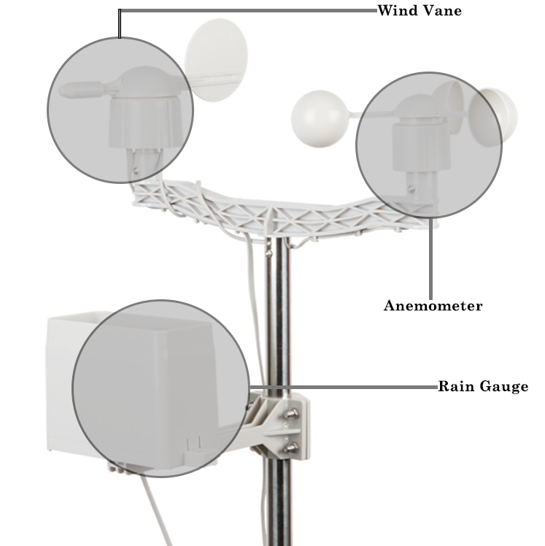
Fig
Fig.
Fig 1: Weather monitoring Kit

Slide 6
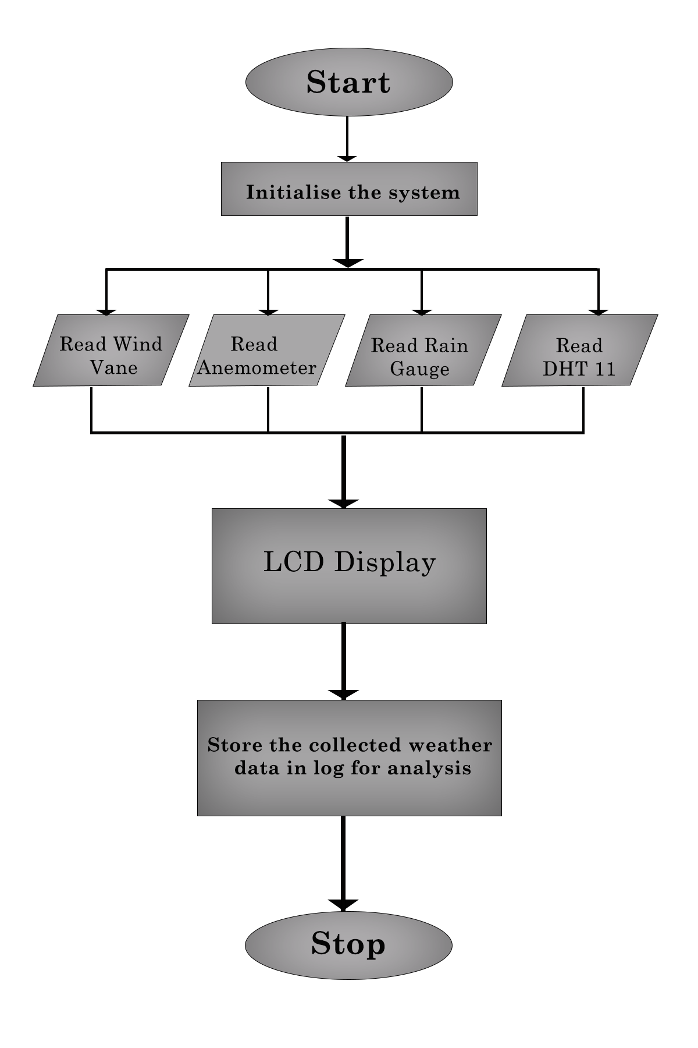
FLOWCHART

Slide 7
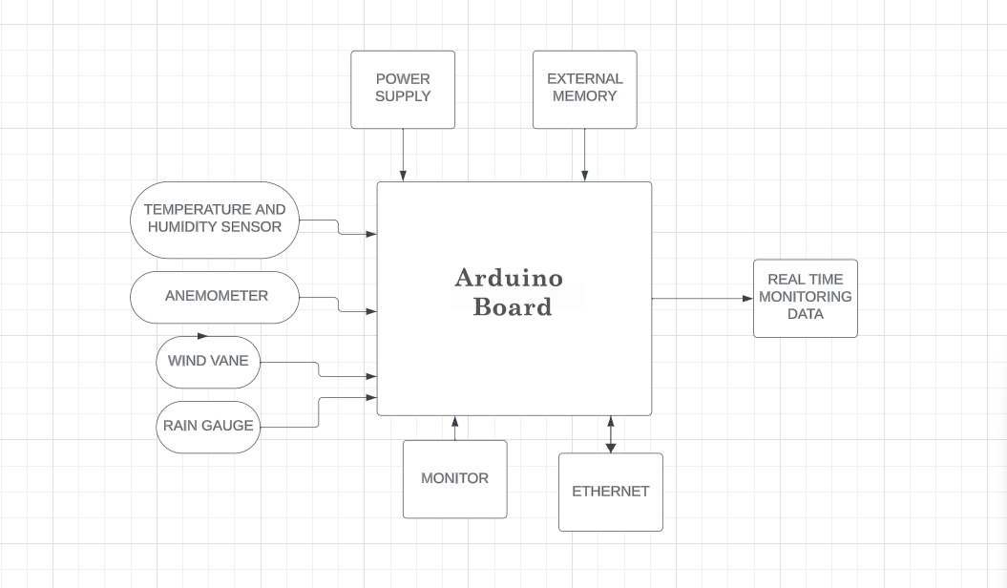
BLOCK DIAGRAM

Slide 8
RESULT
Accuracy and Precision
Data Transmission and Connectivity
Operational Stability
User Interface and Accessibility
Impact on Agriculture
Aviation Safety Enhancements
Disaster Management and Early Warning
Tourism Planning and Economic Impact

Slide 9
CONCLUSION
Purpose: The IoT-based weather monitoring system addresses limitations of traditional systems.
Components :
- Deployment of sensors
- Utilization of communication protocols
- Integration with cloud computing
Data Flow:
- Seamless data acquisition
- Efficient transmission
- Reliable storage
Benefits:
- High precision and reliability in data collection
- Improved accuracy in forecasting
- Crucial for agriculture, transportation, and disaster management
Real-Time Capability:
- Enables timely decision-making
- Facilitates response to dynamic weather conditions
- Scalability and Flexibility:
- Easily expandable to cover larger geographical areas
- Integration with other IoT applications for comprehensive environmental monitoring
User-Friendly Features:-
- Intuitive interfaces
- Accessibility of data
- Stakeholder Usability:
- Applicable for meteorologists and the general public.

Slide 10
Future Work :
Enhanced Sensor Technologies
Machine Learning Integration
Energy-Efficient Designs.
Blockchain for Data Security

Slide 11
REFERENCES
1. "IoT-Based Weather Monitoring System” by A. Ahmed, A. Haider, M. Awais, M. S. Hossain, in 2017 IEEE International Conference on Imaging, Vision and Pattern Recognition (icIVPR)
2. "An IoT-Based Architecture for Real-Time Weather Monitoring and Analysis” by A. Dey, A. Datta, A. Chatterjee, in 2018 3rd International Conference on Internet of Things: Smart Innovation and Usages (IoT-SIU)
3. "Design and Implementation of IoT-Based Weather Monitoring and Reporting System” by I. S. Alzahrani, S. M. A. Bhuyan, M. S. Hossain, in IEEE Transactions on Consumer Electronics
4. "Wireless Sensor Network-Based Weather Station with Remote Data Access using IoT” by S. K. S. Gupta, B. S. Rajpurohit, in 2017 International Conference on Computing, Communication and Automation (ICCCA)

Slide 12
Thank You

