Slide 1
Business Objective
New Accounts data
ML model scores the accounts
Defining right business strategies to reduce Risk
Data Preprocessing
Historical Accounts Delinquency data
Regression model for Statistical Analysis
Features relative impact Analysis
Transparency and explain ability of input data

Slide 2
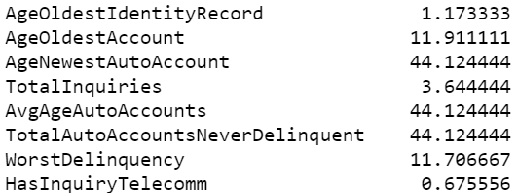
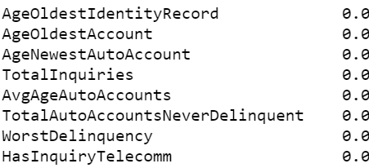
Data Imputation
MICE FOREST
MICE- MUTIPLE IMPUTATIONS by CONTINUOUS EQUATIONS

Slide 3
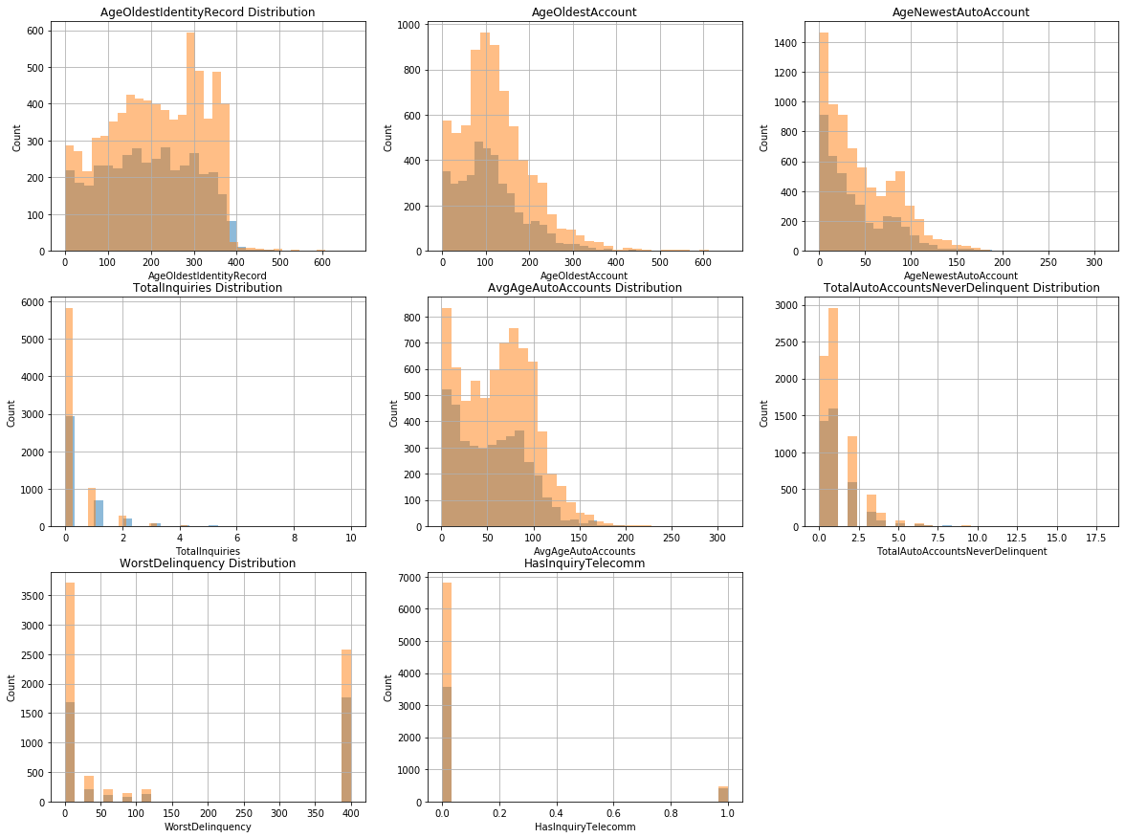
Exploratory Data Analysis

Slide 4
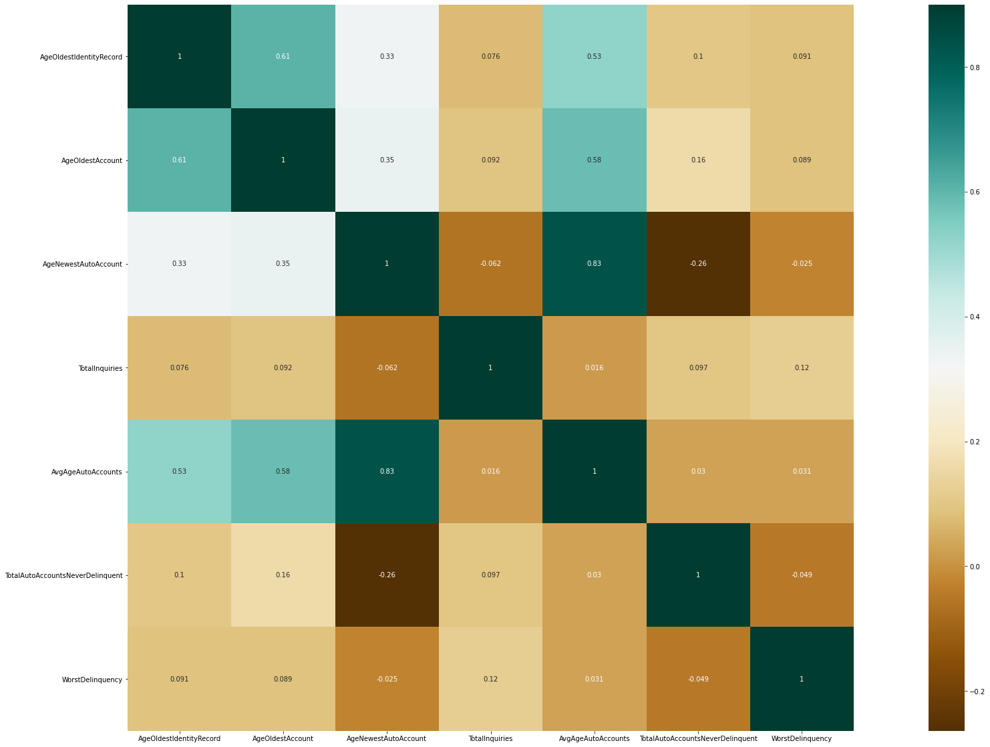
Correlation Heat Map

Slide 5
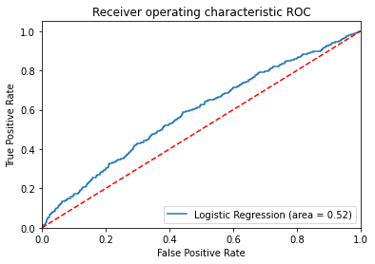
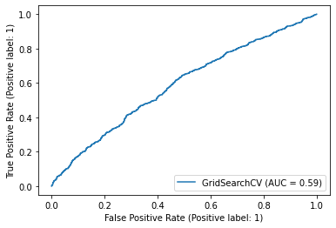
ML Models Comparison
Logistic Regression
Random Forest
Train Accuracy – 0.649
Test Accuracy – 0.655
Train Accuracy – 0.6486
Test Accuracy – 0.648
 | Prediction
Actual | LOW RISK | HIGH RISK
LOW RISK | 1412 | 43
HIGH RISK | 733 | 62
 | Prediction
Actual | LOW RISK | HIGH RISK
LOW RISK | 1450 | 5
HIGH RISK | 787 | 8

Slide 6
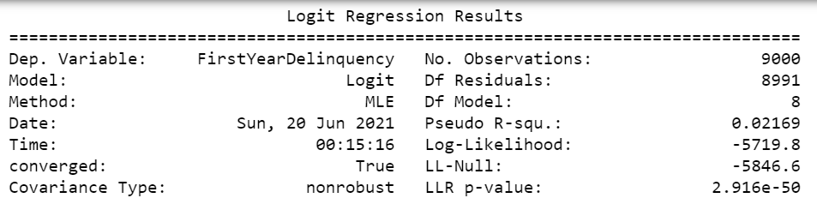
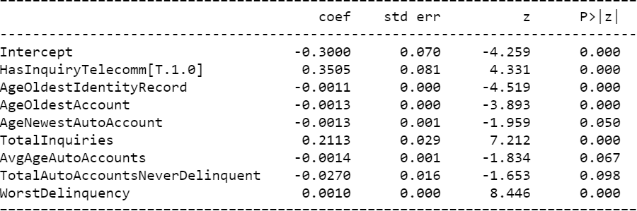
Predictive Logistic Model

Slide 7
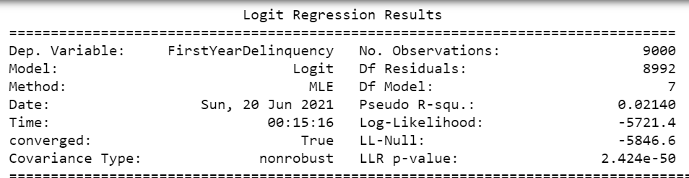
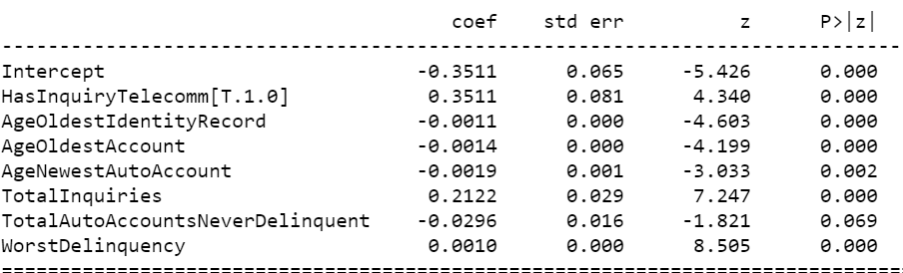
Corrected Model

Slide 8
Feature Impact Analysis
Impact on target when moved from left to right
Variables | % increase/decrease in odds of FirstYearDelinquency | Shifted Variables
HasInquiryTelecomm[1] | 42.06294 | HasInquiryTelecomm[0]
TotalInquiries | 23.63951 | TotalInquiries + 1
WorstDelinquency | 10.005 | WorstDelinquency + 100
AgeOldestIdentityRecord | -10.994 | AgeOldestIdentityRecord +100
AgeOldestAccount | -13.9902 | AgeOldestAccount + `00
AgeNewestAutoAccount | -18.982 | AgeNewestAutoAccount + 100
This does not indicate relative importance among features since all have different units.
Coeff* A(months) = Coeff * A(Days)

Slide 9
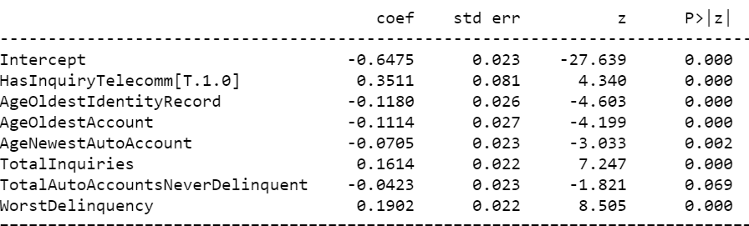
Feature Importance
Standardized coefficients
Features | % impact (Exp(coef)-1)*100)
HasInquiryTelecomm[T.1.0] | 42.06294
WorstDelinquency | 20.94915
TotalInquiries | 17.51549
AgeNewestAutoAccount | -6.80723
AgeOldestAccount | -10.5419
AgeOldestIdentityRecord | -11.1304

Slide 10
Operationalize
Read Accounts data input csv file
Data Preprocessing and Imputation
Trained ML model scores the accounts
Results are saved in output.csv file
Accounts are sorted in ascending order of risk
Scores combined with respective original accounts data.

Slide 11
Next Steps
Including strong predictor variables which can provide more valuable information.
Improving data quality by reducing missing data will help in getting more reliable results
Including more observation will make our Analysis more consistent

Slide 12


