Slide 1
URL SHORTENER | ENGINEERING DESIGN
Architecture, Design
& Validation
Python service • durable analytics • Kubernetes rollouts • governed SDLC
Implementation reference | 25 October 2026

Slide 2
1. What the system delivers
Core capabilities and design priorities
Short links
Validated HTTP/HTTPS destinations
Optional unique aliases and expiry
302 / 404 / 410 behavior
Durable analytics
Redirect event acknowledged by broker before 302
Idempotent PostgreSQL click persistence
Per-link daily and total counts
Governed delivery
Kubernetes health and resource controls
Blue/green and canary rollout gates
Human approval groups and audit lineage
Primary trade-off: redirect requests fail with 503 when durable event publication cannot be confirmed. This protects analytics integrity but reduces availability during broker outages.
This is a runnable prototype and measured reference—not a production HA/capacity certification.
2

Slide 3
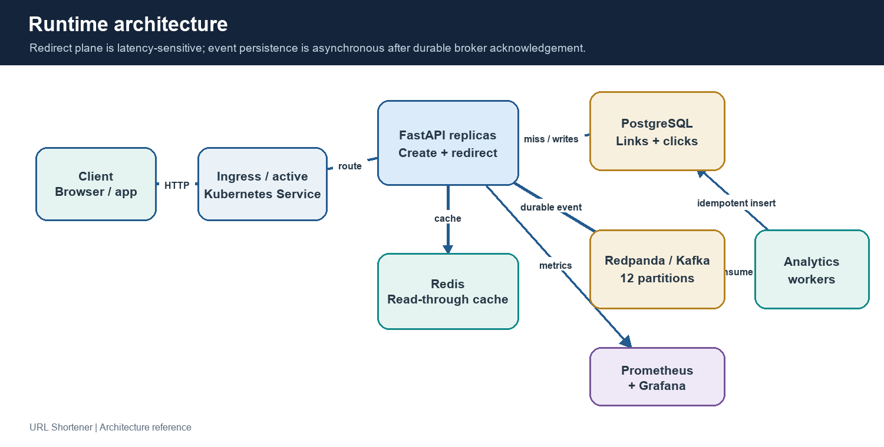
2. Runtime architecture
Stateless API with separate durable event ingestion
3

Slide 4
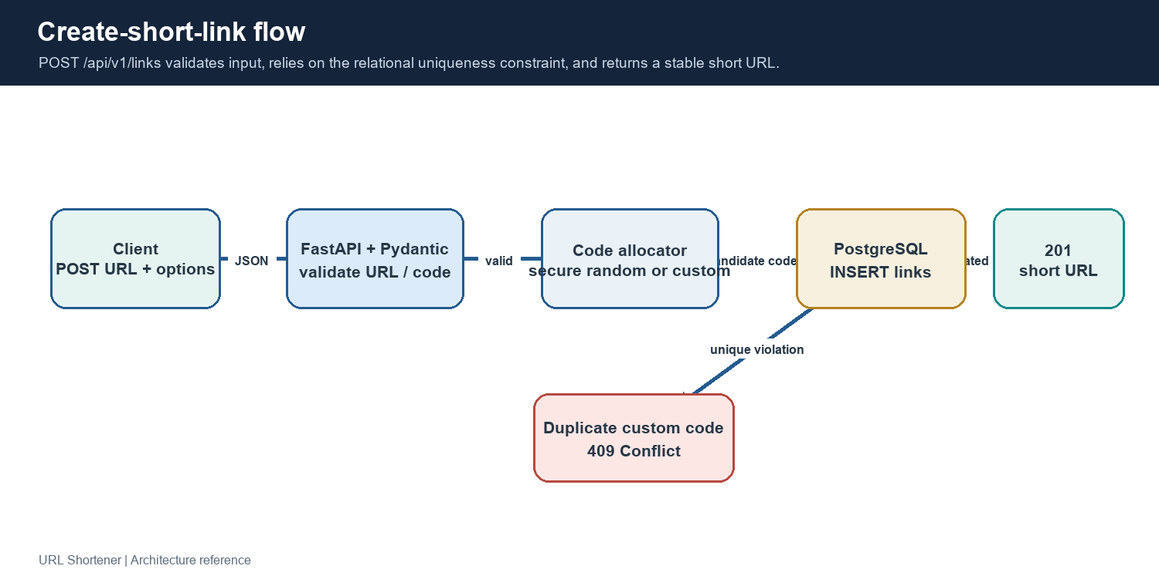
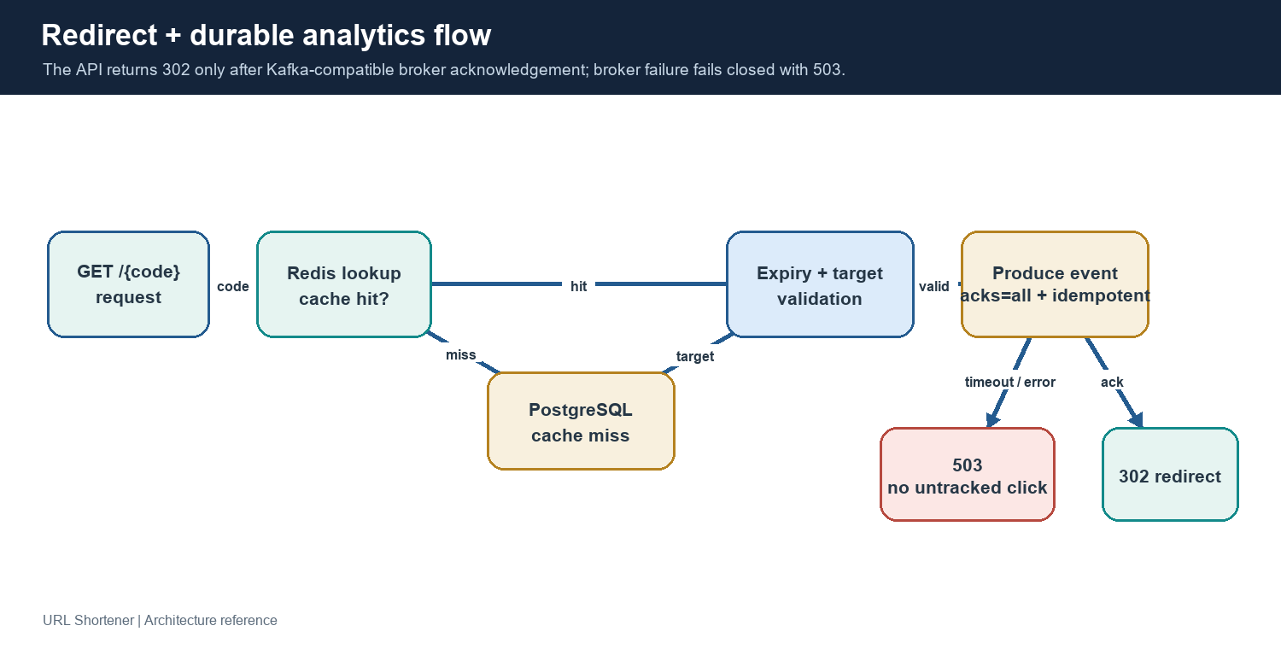
3. Create-link and redirect paths
Write flow plus consistency boundary on hot path
POST /api/v1/links
Pydantic validates; PostgreSQL key enforces uniqueness. Generated codes use secrets-based randomness.
GET /{code}
Redis → PostgreSQL fallback → expiry check → broker ack → 302. Broker failure returns 503.
4

Slide 5
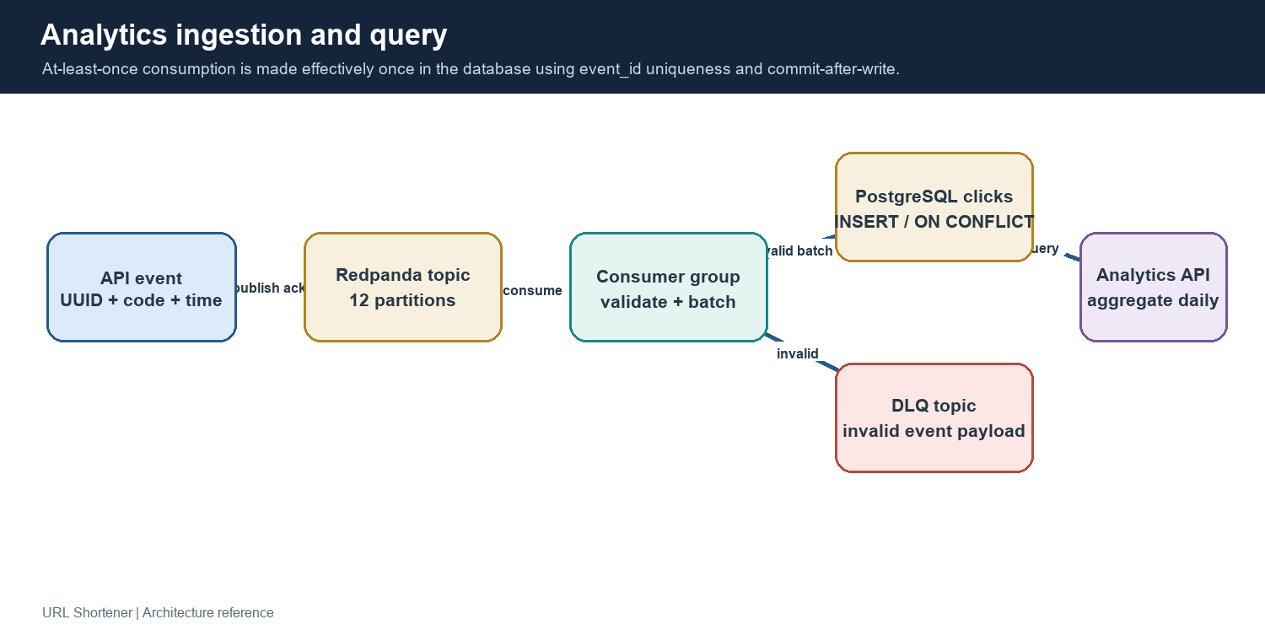
4. Analytics is durable and replay-safe
Broker acknowledgement is synchronous; database aggregation follows asynchronously
event_id primary key + ON CONFLICT DO NOTHING • offsets commit after DB writes • malformed events go to DLQ
5

Slide 6
5. Technology choices
Selected for a runnable prototype and clear reliability semantics
FastAPI + Pydantic
Async Python API, input contracts
Django REST adds batteries; Go/Java may suit different throughput/team needs.
PostgreSQL + asyncpg
Relational integrity + range analytics
NoSQL offers key-scale but complicates aggregation/transactions.
Redis
Shared TTL read-through cache
Process cache is non-shared; Memcached is viable but simpler.
Redpanda / Kafka API
Partitioned durable event log + replay
Managed Kafka reduces ops; RabbitMQ is more queue-oriented.
Kubernetes + Kustomize
Portable scheduling, overlays, resource controls
Helm offers packaging; managed PaaS lowers ops but reduces portability.
Argo Rollouts + GitOps
Traffic gates, analysis, promotion/undo
Flux/Argo CD are alternatives for reconciliation, not both on same resources.
6

Slide 7
6. Data model and consistency
PostgreSQL source of truth; click events are idempotent
links
code TEXT PRIMARY KEY
destination TEXT NOT NULL
created_at TIMESTAMPTZ
expires_at TIMESTAMPTZ NULL
clicks
event_id UUID PRIMARY KEY
code FK → links(code)
clicked_at TIMESTAMPTZ
Index (code, clicked_at DESC)
Redis cache entries are disposable and TTL is bounded by remaining link life.
Analytics rows are eventually visible after consumer commit.
Duplicate event delivery is suppressed by event_id; offsets commit only after database write.
7

Slide 8
7. Reliability, security, observability
Controls and important gaps
Reliability
Readiness / liveness / startup probes
PDB and resource budgets
Bounded event publish timeout
DLQ and consumer replay safety
Security
Non-root UID 10001
Read-only root filesystem
No added capabilities
TLS/network policy templates
Observability
Prometheus API + worker metrics
Grafana dashboard
Redirect latency/outcome signals
Workflow reliability metrics
Production gaps: authentication, rate limiting, TLS configuration, managed HA data services, backup/restore drills, metrics-server/HPA validation, and identity-backed approvals.
8

Slide 9
8. Kubernetes and release strategy
Base resources with local / canary / dedicated / production overlays
Availability controls
3 API + 3 worker baseline
HPA 3–20 / 3–12
PDB, probes, topology hints
CPU & memory requests/limits
Blue/green
Preview ReplicaSet
Prometheus pre-promotion analysis
Manual promote gate
Abort / undo with approval
Canary + GitOps
20% → analysis → 50% pause → 100%
Argo CD OR Flux
Protected repo and immutable image
Production metrics need version labels
Local dependencies are single replicas; Docker Desktop is one node. etcd belongs to the Kubernetes control plane—not this application.
9

Slide 10
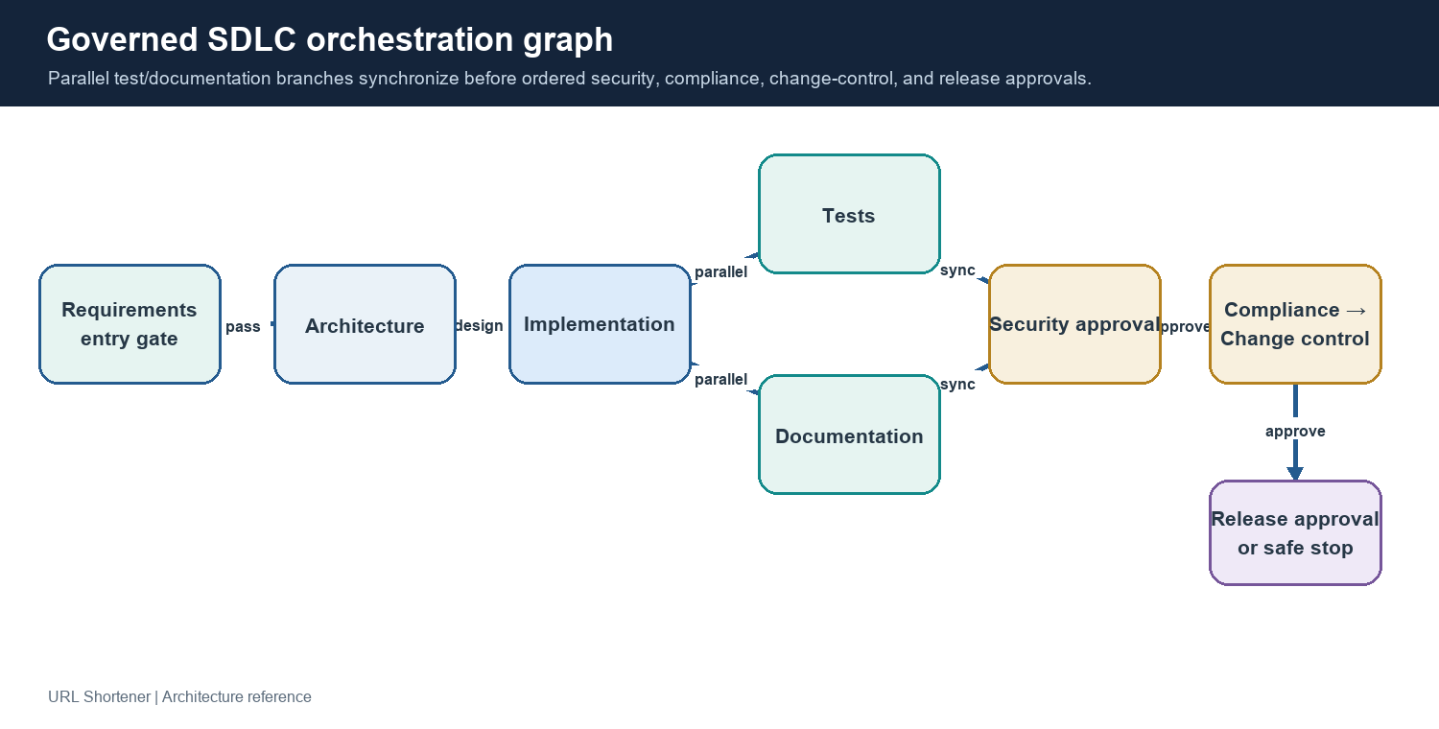
9. Governed SDLC orchestration
Stateful DAG with parallel validation, explicit lineage, and human gates
Distinct approvals: security → compliance → change control → release | retry / fallback / rollback / safe-stop / re-plan
10

Slide 11
10. Verification and test scenarios
Automated checks plus live local Kubernetes exercise
Unit + workflow
28 Python tests passed
Input validation and redirect behavior
DAG, parallelism and gates
Retries, fallback, rollback, re-plan
Manifests + container
5 Kustomize overlays rendered
Schema parity passed
Docker image build/non-root check
Manifest tests for rollout/security
Live K8s E2E
Blue/green promotion and undo
Canary analysis + manual pause
Preview create/redirect/analytics
Promoted active service healthy
Local one-node cluster: deployment behavior was exercised, but multi-node HA, production ingress/CNI policies, and CPU-driven HPA were not validated.
11

Slide 12
11. 1,000 redirects per second
Two 60-second constant-arrival runs through the Kubernetes active service
Run 1
60,001 successful 302 checks
0 failed HTTP requests
p95 6.96 ms
p99 508.42 ms — narrowly missed 500 ms
Warmed repeat
60,000 successful 302 checks
0 failed HTTP requests
p95 8.62 ms
p99 244.46 ms — thresholds passed
After both tests and smoke checks, PostgreSQL held 120,003 click records.
Observed single-machine results only; not a production capacity/SLO claim.
12

Slide 13
12. Production readiness priorities
Close the biggest safety, availability, and evidence gaps
1 Add identity, authentication, tenant authorization, rate limiting and URL-abuse controls.
2 Replace local single replicas with managed multi-zone PostgreSQL, Redis and Kafka-compatible services.
3 Validate sustained throughput with realistic traffic, multiple generators, resource and consumer-lag telemetry.
4 Enable metrics-server/adapter and prove HPA behavior; test backup/restore, failover and node disruption.
5 Make canary analysis version-specific; bind approvals to SSO/RBAC, protected changes and immutable artifacts.
6 Define click retention, DLQ replay, schema evolution, privacy controls, SLOs and runbooks.
After the recorded test, app/controller resources and port-forwards were removed; Kubernetes remained enabled.
13

