Slide 1
Car Price Prediction:
Shared Mehra : 0201CS171069
Shivam singh thakur: 0201CS171072
Devansh Tamrakar : 0301EC171017
Ashish Kumar Tiwari : 0201CS171018

Slide 2
Models Used
Linear regression
Polynomial regression
Random Forest regression

Slide 3
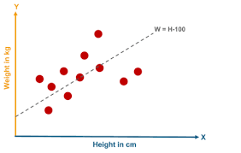
What is Linear Regression?
Linear regression in supervised learning technique which is been used in machine learning.
Its main task is to determine the relationship between an independent and dependent variable in which both are continuous.
In other words it is used for predicting a continuous quantity

Slide 4
First order linear model
Y = b1 + b2 X +e
Y= dependent variable
X=independent variable
b1=Y-intercept
b2=slope of the line

Slide 5
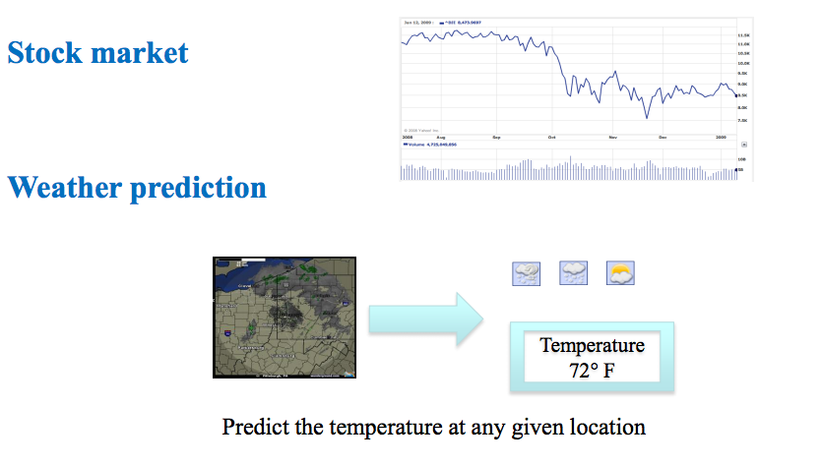
Regression Example

Slide 6
Advantages
Linear Regression performs well when the dataset is linearly separable. We can use it to find the nature of the relationship among the variables.
Linear Regression is easier to implement, interpret and very efficient to train.
Linear Regression is prone to over-fitting but it can be easily avoided using some dimensionality reduction techniques, regularization (L1 and L2) techniques and cross-validation.

Slide 7
Disadvantages
Main limitation of Linear Regression is the assumption of linearity between the dependent variable and the independent variables. In the real world, the data is rarely linearly separable. It assumes that there is a straight-line relationship between the dependent and independent variables which is incorrect many times.
Prone to noise and overfitting: If the number of observations are lesser than the number of features, Linear Regression should not be used, otherwise it may lead to overfit because is starts considering noise in this scenario while building the model.
Prone to outliers: Linear regression is very sensitive to outliers (anomalies). So, outliers should be analyzed and removed before applying Linear Regression to the dataset.
Prone to multicollinearity: Before applying Linear regression, multicollinearity should be removed (using dimensionality reduction techniques) because it assumes that there is no relationship among independent variables.

Slide 8
Polynomial Regression
Polynomial Regression is a regression algorithm that models the relationship between a dependent(y) and independent variable(x) as nth degree polynomial. The Polynomial Regression equation is given below:
y= b₀+b₁x₁+ b₂x₁²+ b₂x₁³+...... b_{n}x₁^{n}
It is also called the special case of Multiple Linear Regression in ML. Because we add some polynomial terms to the Multiple Linear regression equation to convert it into Polynomial Regression.

Slide 9
It is a linear model with some modification in order to increase the accuracy.
The dataset used in Polynomial regression for training is of non-linear nature.
It makes use of a linear regression model to fit the complicated and non-linear functions and datasets.
Hence, "In Polynomial regression, the original features are converted into Polynomial features of required degree (2,3,..,n) and then modeled using a linear model."

Slide 10
Need for Polynomial Regression:
The need of Polynomial Regression in ML can be understood in the below points:
If we apply a linear model on a linear dataset, then it provides us a good result as we have seen in Simple Linear Regression, but if we apply the same model without any modification on a non-linear dataset, then it will produce a drastic output. Due to which loss function will increase, the error rate will be high, and accuracy will be decreased.

Slide 11
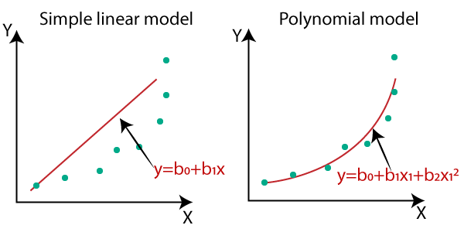
So for such cases, where data points are arranged in a non-linear fashion, we need the Polynomial Regression model. We can understand it in a better way using the below comparison diagram of the linear dataset and non-linear dataset.

Slide 12
Equation of the Polynomial Regression Model:
Simple Linear Regression equation:
y = b₀+b₁x .........(a)
Multiple Linear Regression equation:
y= b₀+b₁x+ b₂x₂+ b₃x₃+....+ b_{n}x_{n} .........(b)
Polynomial Regression equation:
y= b₀+b₁x + b₂x²+ b₃x³+....+ b_{n}x^{n} ..........(c)
When we compare the above three equations, we can clearly see that all three equations are Polynomial equations but differ by the degree of variables. The Simple and Multiple Linear equations are also Polynomial equations with a single degree, and the Polynomial regression equation is Linear equation with the nth degree. So if we add a degree to our linear equations, then it will be converted into Polynomial Linear equations.

Slide 13
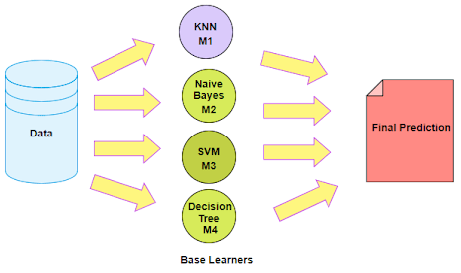
Ensemble Learning
An Ensemble method is a technique that combines the predictions from multiple machine learning algorithms together to make more accurate predictions than any individual model. A model comprised of many models is called an Ensemble model.

Slide 14
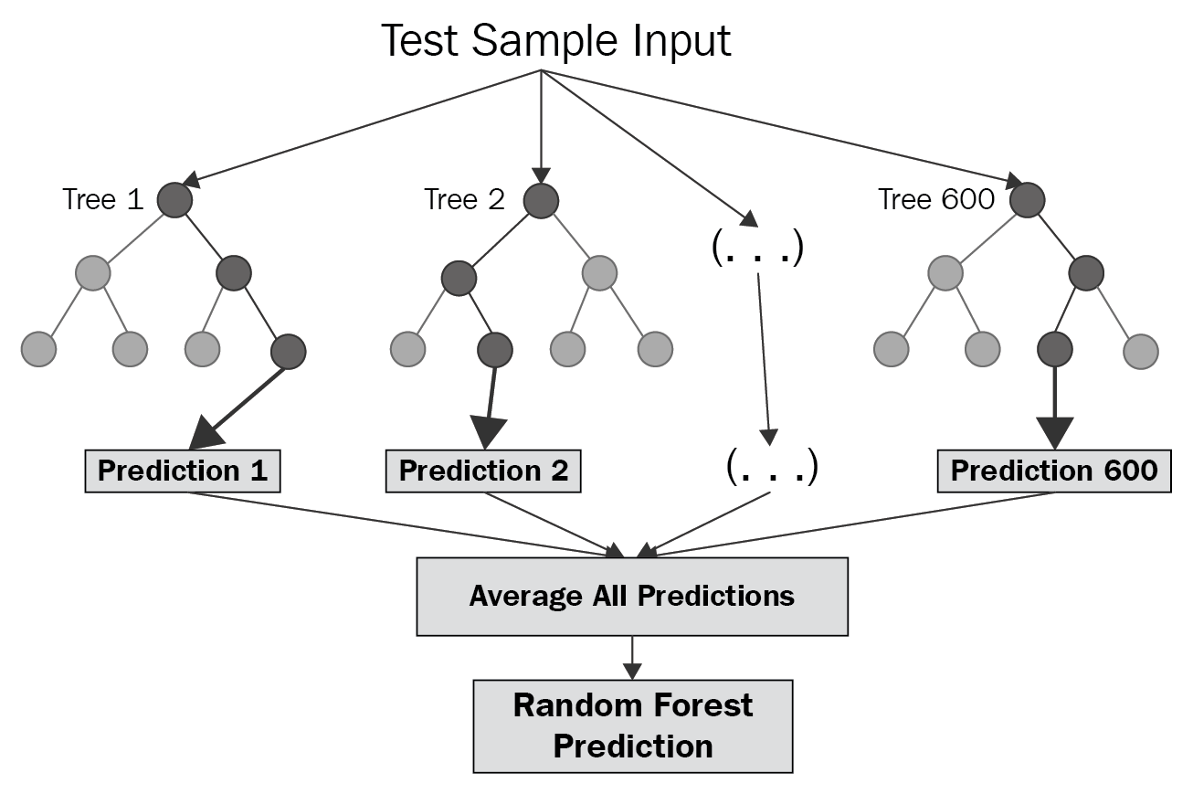
Random Forest

Slide 15
Feature and Advantages of Random Forest :
It is one of the most accurate learning algorithms available. For many data sets, it produces a highly accurate classifier.
It runs efficiently on large databases.
It can handle thousands of input variables without variable deletion.
It gives estimates of what variables that are important in the classification.
It generates an internal unbiased estimate of the generalization error as the forest building progresses.
It has an effective method for estimating missing data and maintains accuracy when a large proportion of the data are missing.

Slide 16
Our Results:
Linear Regression:
{'Training': 69.98540087299517,
'Testing': 71.80222574095788,
'Validation': 65.4375984594731}
Polynomial Regression:
{'Training': 85.22973807944595,
'Testing': 81.68387933283529,
'Validation': 82.00799174924249}
Random Forest Regression:
{'Training': 98.01942816882388,
'Testing': 88.11364981711414,
'Validation': 90.51418464901785}
References:
Dataset : kaggle
Dr. J.S. Thakur lecture notes
www.towardsdatascience

