Slide 1




Cancer Immunotherapy
(A case study from unit-6)
Nishant Parwani

Slide 2
Table of contents
01
04
02
05
03
06
Introduction
Statistics
Case study and brief explanation
Conclusion
Timeline & Literature review
Bibliography
01

Slide 3



01
Introduction to Cancer Immunotherapy
02

Slide 4
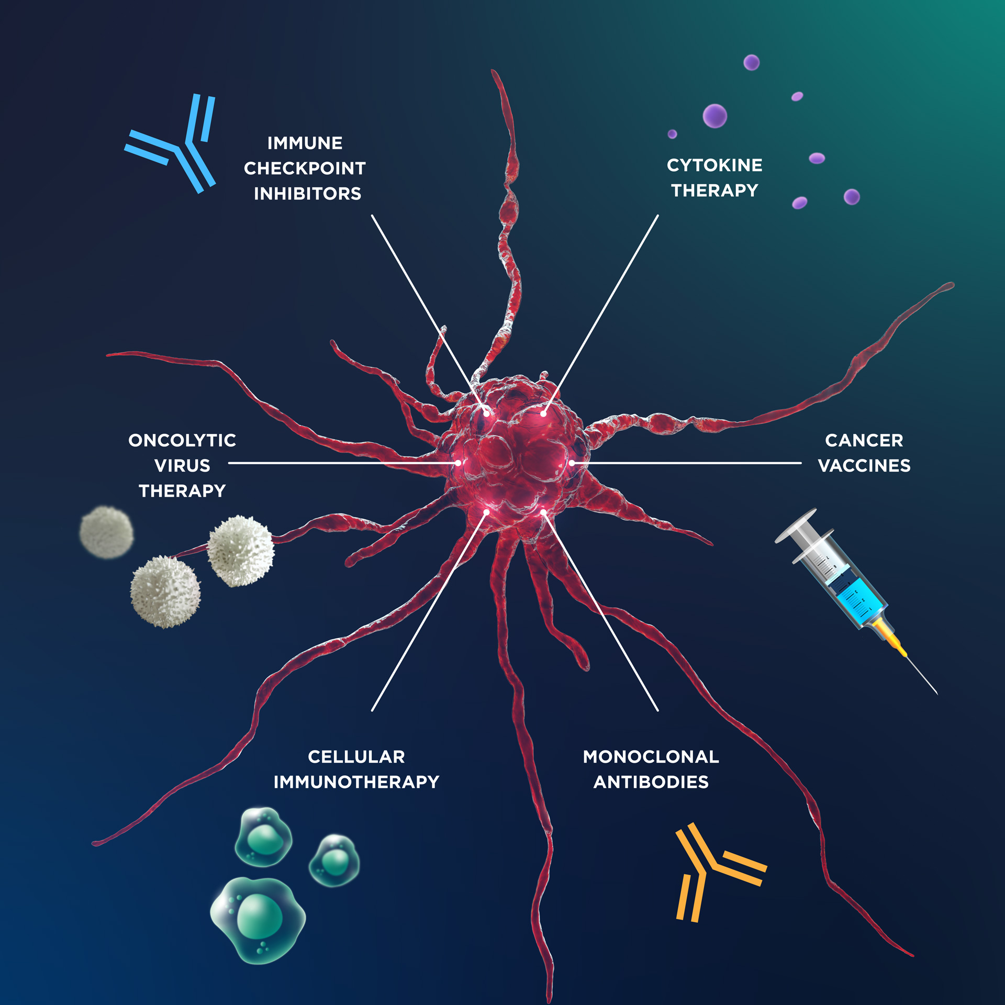
"Unleashing the Body’s Warriors: The Power of Cancer Immunotherapy"
Immuno-oncology, is a type of cancer treatment that stimulates the immune system to fight cancer. It enhances the immune system's natural ability to recognize and attack cancer cells.
It works by either stimulating the immune response or removing the barriers that prevent immune cells from targeting cancer. Immunotherapy offers a targeted, long-lasting approach with fewer side effects compared to traditional cancer treatments like chemotherapy and radiation.
03

Slide 5
Traditional treatment vs Cancer Immunotheraphy
Feature | Traditional treatment (chemo & radiation) | Cancer Immunotherapy
Effectiveness Over Time | Cancer may return or develop resistance | Can provide long-term protection (immune memory)
Long-Term Benefits | Temporary effect, often requiring repeated treatment | Can "train" the immune system for lasting cancer defense
Side Effects | Severe (hair loss, nausea, immune suppression) | Milder (some immune-related side effects)
Target Specificity | Affects both cancerous and healthy cells | Mostly targets cancer cells, sparing healthy tissue
Mechanism of Action | Directly attacks and kills cancer cells | Activates the immune system to target cancer cells
05

Slide 6

Case study and brief explanation
02
06

Slide 7
Types Of Immunotherapy
Cancer Immunotherapy
Immunestimulatory therapy
Cell based therapy
Targeted Immunotherapy
Checkpoint Inhibitors
Cytokine Therapy
Therapeutic Cancer Vaccines
CAR-T Cell Therapy
Adoptive Cell Therapy
Monoclonal Antibodies
Oncolytic Virus Therapy
Preventive Cancer Vaccines
07

Slide 8
Types Of Immunotheraphy
08

Slide 9
Case Study
Case Study: Immunochemotherapy for Metastatic cutaneous squamous cell carcinoma (CSCC) (a type of skin cancer)
Patient: A 70 Y/O male
Medical History/Allergies: None
Diagnosis: Traditional treatments were ineffective, leading to a referral for hospice care due to the extensive nature of the disease.
Treatment: Medical oncology recommended immunotherapy using cemiplimab, an immune checkpoint inhibitor, in conjunction with QUAD shot radiotherapy.
Outcomes:The lesion demonstrated a 75% reduction in size, significantly improving his condition.
This case underscores the potential effectiveness of immune checkpoint inhibitors like cemiplimab for patients with advanced
CSCC who have not responded to traditional therapies
09

Slide 10
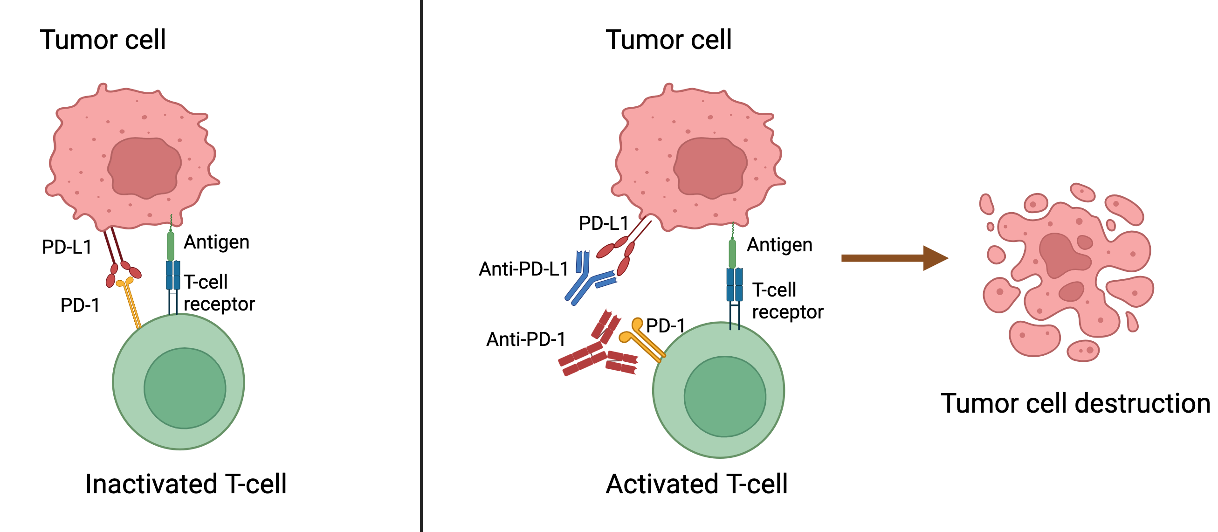
Case Study Cancer Immunotheraphy
10

Slide 11
Timeline & Literature review
03
11

Slide 12
Timeline upon development of Immunotherapy
1891
1982
2017
William Coley, began treating cancer patients with a mixture of heat-killed bacteria.
James and colleagues identified the first T cell antigen receptor.
The FDA approved pembrolizumab for various cancers based on genetic testing rather than tissue type.
2018
18-19th century
1967
2011
James Allison and Tasuku Honjo received the Nobel Prize for their work on immune checkpoint inhibitors.
It was the intial development of cancer immunotherapy where septic wounds were kept open to facilitate development of infection
The existence of T cells, crucial components of the immune system, was identified, which later became fundamental to immunotherapy
Ipilimumab became the first checkpoint inhibitor approved by the FDA for
advanced melanoma.
12

Slide 13



Statistics
04
13

Slide 14
3,95,400
3,95,400 deaths due to cancer were reported in India
Source: Statistics – ICMR – National Institute of Cancer Prevention and Research
14

Slide 15
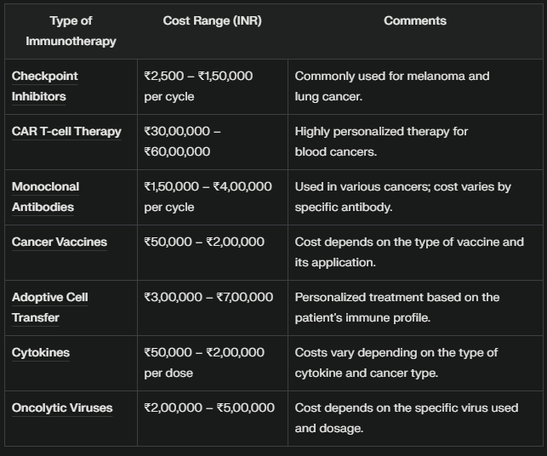
15
Source:https://saphaltaincancercare.com/services/immunotherapy-cost-in-india/

Slide 16
Let’s use some percentages
10.6%
50%
75%
Market-CAGR
Tumor Infiltaring Lymphocytes
CAR T-Cell
The CAGR of Immuno-oncology us 10.64%
TIL therapy have shown about 50% clinical efficacy in melanoma.
Success rate of CAR T-Cell in certain hematological malignancies
16
Courtesy: National Library Of medicine

Slide 17
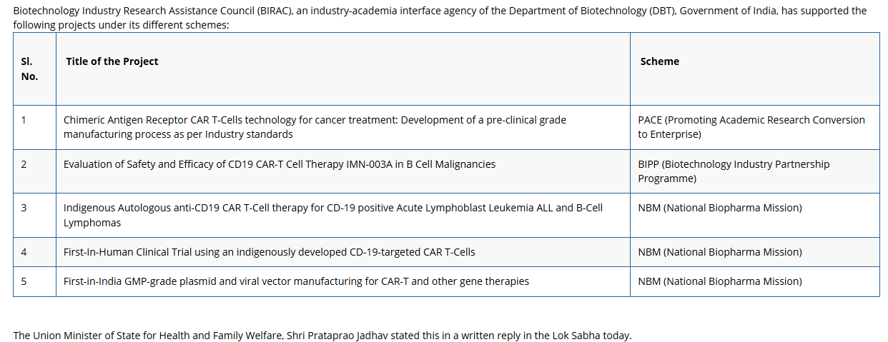
17
Source: https://mohfw.gov.in/?q=hi/node/7911

Slide 18
A study presented at ESMO 2024 reported that patients with early-stage triple-negative breast cancer receiving immunotherapy plus chemotherapy had a five-year overall survival rate of 86.6%/
In trials involving locally advanced colorectal cancer, 82% of patients treated with pembrolizumab(checkpoint inhibitor) showed significant tumor shrinkage, with over half achieving no evidence of cancer post-surgery.
Breast cancer remains the most prevalent cancer among women globally, with approximately 670,000 deaths due to breast cancer reported in 2022
Source: https://www.esmo.org/newsroom/press-and-media-hub/esmo-media-releases/studies-show-immunotherapy-improves-long-term-survival-in-growing-number-of-cancers
18

Slide 19
Conclusion
05
19

Slide 20
Transformative Impact: Immunotherapy boosts the immune system to target cancer precisely, offering durable responses (e.g., 75% tumor reduction in advanced CSCC cases).
Superiority: Outperforms traditional treatments with fewer side effects and higher survival rates (e.g., 86.6% 5-year survival in breast cancer trials).
Global Relevance: Critical for cancers resistant to chemotherapy/radiation (evident in melanoma, hematological malignancies).
Challenges: High costs and accessibility gaps in regions like India (3.95 lakh annual cancer deaths).
20

Slide 21
06
Bibliography
21

Slide 22
Bibliography
Research paper: Ghosh, S., Patil, P. D., & Kitture, R. D. (2019). Physically responsive nanostructures in breast cancer theranostics. In IOP Publishing eBooks (pp. 2–24). https://doi.org/10.1088/2053-2563/ab2907ch2
Citations:
https://www.frontiersin.org/journals/immunology/articles/10.3389/fimmu.2022.900119/full
[2] https://pmc.ncbi.nlm.nih.gov/articles/PMC9454552/
[3] https://www.personalizedmedonc.com/all-articles/657:case-studies-in-immunotherapy
[4] https://www.cancerresearchuk.org/about-cancer/treatment/immunotherapy/what-is-immunotherapy
[5] https://pmc.ncbi.nlm.nih.gov/articles/PMC6928196/
[6] https://www.cancer.org/cancer/managing-cancer/treatment-types/immunotherapy.html
[7] https://irepertoire.com/news-events/treatment-monitoring-case-study/
[8] https://www.cancerresearch.org/what-is-immunotherapy
[9] https://www.immunopaedia.org.za/clinical-cases/immunotherapy/keep-up-while-the-storm-is-raging/
[10] https://my.clevelandclinic.org/health/treatments/11582-immunotherapy
22

Slide 23
Bibliography
Citations:
https://pmc.ncbi.nlm.nih.gov/articles/PMC9967630/
[2] https://pmc.ncbi.nlm.nih.gov/articles/PMC10269390/
[3] https://saphaltaincancercare.com/services/immunotherapy-cost-in-india/
[4] https://drvikeshshah.com/immunotherapy-cost-in-india/
[5] https://mohfw.gov.in/?q=hi/node/7911
[6] https://thecancernews.org/immune-checkpoint-inhibitors/
[7] https://www.esmo.org/newsroom/press-and-media-hub/esmo-media-releases/studies-show-immunotherapy-improves-long-term-survival-in-growing-number-of-cancers
[8] https://youtube.com/shorts/QOeuSoxQ0DI?si=Y9pPCMm0sLq18TVP
[9] https://www.immunopaedia.org.za/clinical-cases/immunotherapy/keep-up-while-the-storm-is-raging/
[10] https://my.clevelandclinic.org/health/treatments/11582-immunotherapy
23

Slide 24

Thanks!

