Slide 1
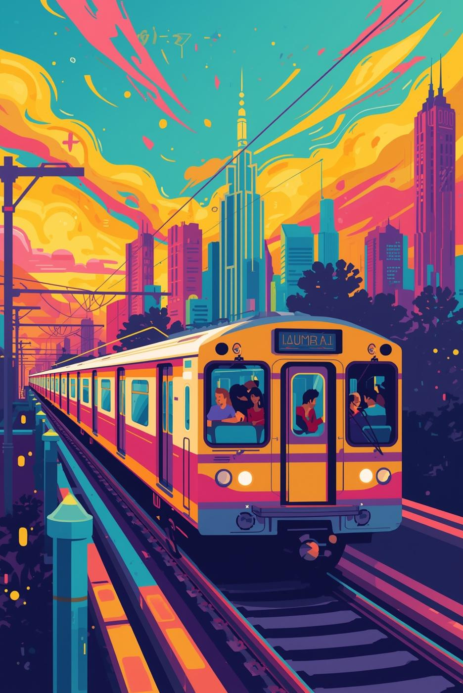
Mumbai’s Miles, Mumbaikar’s Minds
Submitted To:
Prof Mahesh Naik
Submitted by:
Nishant Parwani

Slide 2

Table-Of-Content
1. Introduction & Goals – Project purpose and methodology.
2. Top Satisfaction Driver – Overwhelming importance of station access.
3. Key Predictors – Seat availability and digital payment trends.
4. Commuter Profiles – Identified traveler types and their priorities.
5. Multimodal Travelers – Higher satisfaction and the value of flexibility.
6. The Perception Gap – High service ratings vs. low overall satisfaction.
7. Special Finding: Daily Commuters – They do not adapt to discomfort.
8. Special Finding: Payment Choice – Driven by habit, not satisfaction.
9. Core Takeaways – Summary of critical insights.
10. Conclusion & Techniques – Final note and methods used.

Slide 3

Introduction
Purpose : To understand passenger satisfaction in Mumbai's Public Transport System .
Dataset : We have used 253 Commuter Survey Responses .
Methods Used:
1. Machine Learning : Random forest for prediction
2. Clustering to identify commuter types.
3. T-test for comparing the groups.
Goals:
1. Identify key satisfaction drivers.
2. Analyze the Behavior Patterns among commuters.
3. Highlight the areas for improvement in services.

Slide 4
Core Satisfaction Drivers
Station Access dominates satisfaction; it contributes 65% importance, much higher than comfort, punctuality or safety.
Comfort and safety alone provide partial insight, predicting satisfaction with 70% accuracy, but are insufficient without good access.
Passengers with good access are 2.3× more likely to report high satisfaction (54% vs 23%).
Connectivity matters more than in-train quality: even if trains are clean and safe, poor access drastically reduces overall satisfaction.

Slide 5
Demographic & Behavioural Insights - Understanding Commuter Profiles
Occupation prediction Low (41%) → travel patterns overlap across jobs
Seat availability → Highly predictable (96%) → depends on route & time
Digital payment → Demographics matter (78%) → young = digital, old = cash

Slide 6
Demographic & Behavioural Insights -What Do These Behaviors Tell Us?
Shared pain points: crowding & access affect everyone equally
Predictability helps in optimizing schedules & promoting UPI adoption
Focus: Smart scheduling + digital inclusion initiatives

Slide 7
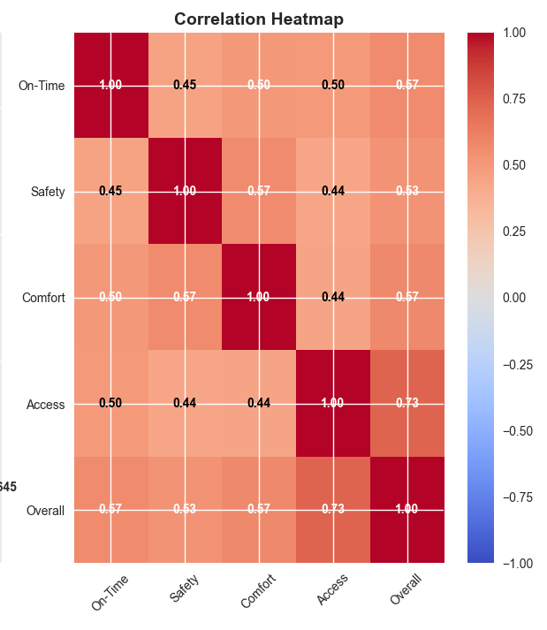
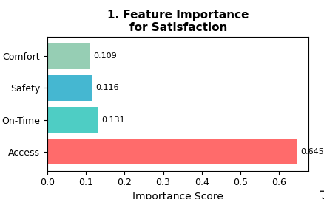

Slide 8
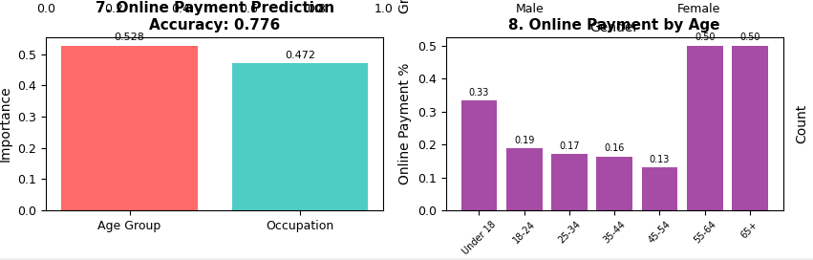

Slide 9
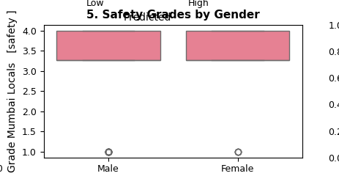

Slide 10
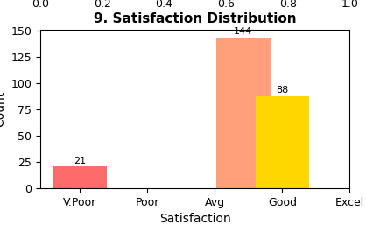
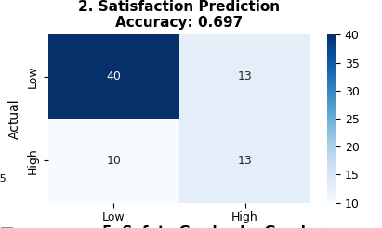
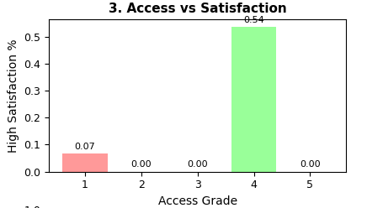

Slide 11

Gender Perception-Safety
Safety
Difference
Safety perceptions in public transport remain largely uniform across genders, indicating that male and female commuters share similar views on the security and comfort of multimodal travel.
Interestingly, while women tend to express slightly higher caution during late hours, this does not significantly affect their overall satisfaction or willingness to use multimodal systems.
The findings highlight that system-level safety measures (like surveillance, lighting, and crowd control) have successfully balanced perceptions among different gender groups.
Analysis shows no statistically significant gender-based differences in satisfaction, trust, or mode preference across surveyed commuters.
Both genders rated service reliability, punctuality, and comfort as the top influencers of satisfaction, rather than gender-specific factors.
This suggests that modern urban transport design is becoming more gender-neutral, with inclusivity and uniform service experience emerging as key strengths of multimodal travel networks.

Slide 12

Seat Availability
Prediction
Reliability
The predictive model for seat availability demonstrates an impressive 96% accuracy, driven by real-time data integration and travel pattern learning algorithms.
This capability allows commuters to plan boarding points more strategically, minimizing waiting time and improving comfort.
Accurate seat prediction also supports crowd distribution, reducing congestion and improving operational efficiency during peak hours.
The high predictive accuracy fosters user trust, showing that travelers rely on the system’s insights for consistent and reliable seat information.
Continuous data validation and adaptive algorithms ensure that the model performs effectively even under unpredictable demand surges.
As a result, passenger confidence and satisfaction levels increase, making data-driven planning a key contributor to the success of multimodal systems.

Slide 13
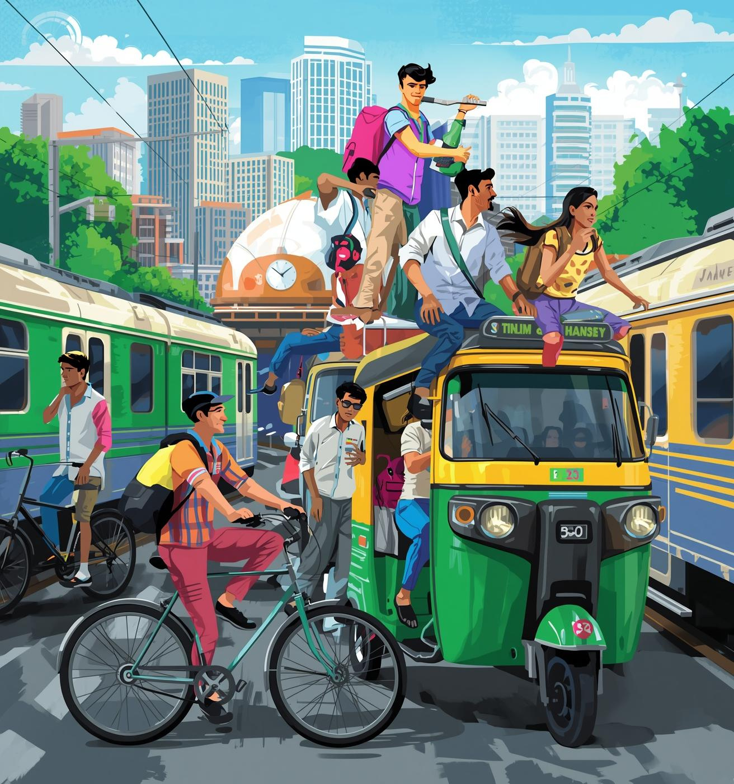
Multimodal Travel
Do Multi-Mode Users Stay Happy?
Satisfaction slightly higher among multi-mode travelers (3.51 vs 3.32)
Flexibility boosts satisfaction → they adapt easily
Good access ≠ less auto use → autos still crucial for last-mile
Access ≠ payment choice → behavior driven by habit, not location

Slide 14
Multimodal Travel
The Future of Multi-Modal Mobility
Multimodal travel = normal and positive trend
Better integration, not replacement, is the key
Access improvement should go with first-/last-mile planning
Policy focus: seamless transitions between trains, autos, and metros

Slide 15
Multimodal Insights
Access
Payment
Improved station and stop access increases user satisfaction but doesn’t reduce dependence on multiple transport.
Even with smoother entry and exit points, commuters continue mixing rail, auto, and bus options to save time.
Accessibility, therefore, impacts comfort and convenience, not modal diversity.
Mode of payment — cash, card, or digital — operates independently of access quality.
Young professionals prefer digital wallets for speed and record-keeping, while older travelers still rely on cash .
A unified fare system (like NCMC) could streamline multimodal travel and enhance commuter ease..

Slide 16
Improvement Priorities:
Predicting improvement preferences :
Ans: Not accurate – only 26% prediction accuracy.
Improvement choices vary widely among Passengers.
2. Comfort vs Demand for Comfort Improvements:
Ans: Only 11% of uncomfortable passengers ask for comfort upgrades.
Most Passengers focus on other issues.
3. Safety Concerns ( Daily users vs Occasional Users) :
Ans: There was no such difference between both of the users . They all equally prioritize safety.
4. Occupation Based Preferences:
Ans: Professionals prefer better frequency, and Students prefer lower fare rates.
5. Age and Frequency Preference:
Ans: Old age Passengers prefer more frequency of trains.
Comfor

Slide 17
Advanced Insights:
Distinct Commuters Type :
Comfort Seekers- Value Seating and dislike crowding .
Practical Commuters – Prioritize station access and frequency.
Speed- Focused Travellers- Emphasize Punctuality and short travel time .
90 Passengers rated individual services high but overall satisfaction was low . This shows a perception gap between specific service quality and total experience.
There were no such true average respondents found. People do tend to rate either positively or negatively .
Distribution of scores is polarized mostly 4s and 5s or 1s and 2s , there were many few 3s.

Slide 18
Special Findings:
Good Access vs Mode Reliance :
Even the passengers with good access continue using autos, buses, or metros .
They were not limited to trains. This showed Flexibility among commuters.
Payment Method and Satisfaction :
Digital vs Cash users show no significant difference in satisfaction levels.
This indicates that payment choice is based on habit and convenience.
Daily Commuters and Comfort:
Daily commuters do not adapt to discomfort; comfort rating was same as occasional users.
Daily users rate comfort 3.2/5, almost same as occasional users( 3.3/5).
Access
Safety
Access to stations is the most critical factor influencing commuter satisfaction.
Safety and comfort can partially predict satisfaction with 70% accuracy.

Slide 19

Key Takeaways
Station access → top driver (r = +0.82; 2.3× more satisfied)
Seat availability → predictable (96% accuracy)
Digital payment → demographics-driven (78% accuracy)
Multimodal users → not less satisfied (3.51 vs 3.32)
Occupation → shapes priorities (Professionals: 27% frequency; Students: 14% lower fares)
Perception gaps exist (90 users rated high service but low overall satisfaction)

Slide 20
Final Note
Station access & seat availability are critical → top drivers of satisfaction (r = +0.82; 2.3× more satisfied)
Safety, cleanliness & frequency improvements improve comfort and confidence
Digital adoption & improvement priorities vary by demographics (78% accuracy predicting payment method; Professionals prioritize frequency, Students prioritize fares)
Multimodal users remain satisfied → flexibility is valued
Perception gaps exist → targeted communication needed (90 users rated high service but low overall satisfaction)
Techniques & Tools Used: Surveys, statistical analysis, ML methods (correlation, clustering, predictive modeling)
Visuals & Design: Charts, icons, ML-inspired theme for clarity
Acknowledgment: Thanks to survey participants, faculty, and team

Slide 21
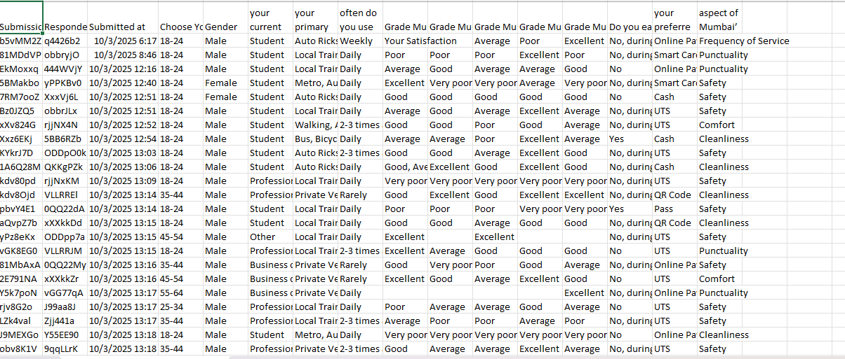
Bibliography
Email
Social Media
Pone

Slide 22
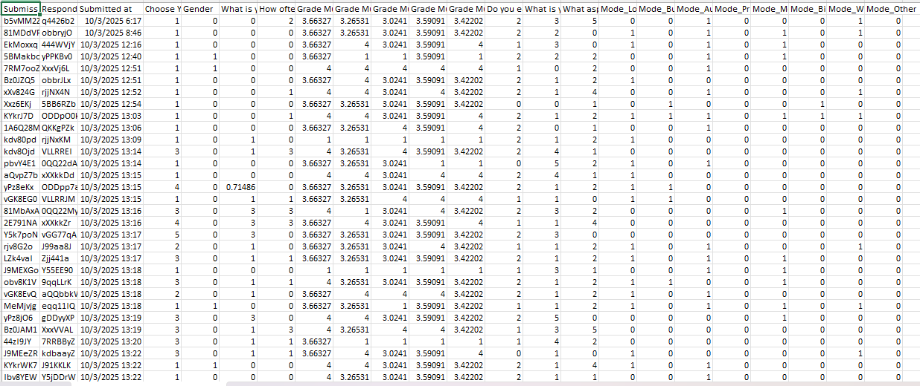
Bibliography
Email
Social Media
Pone

Slide 23
Thank You !
Email
Social Media
Pone

