Slide 1

Recommenders for Social Places (Restaurants, Bars, etc.)
Phase 2 | Group 7
Nishant Pathare | Disha Patel

Slide 2
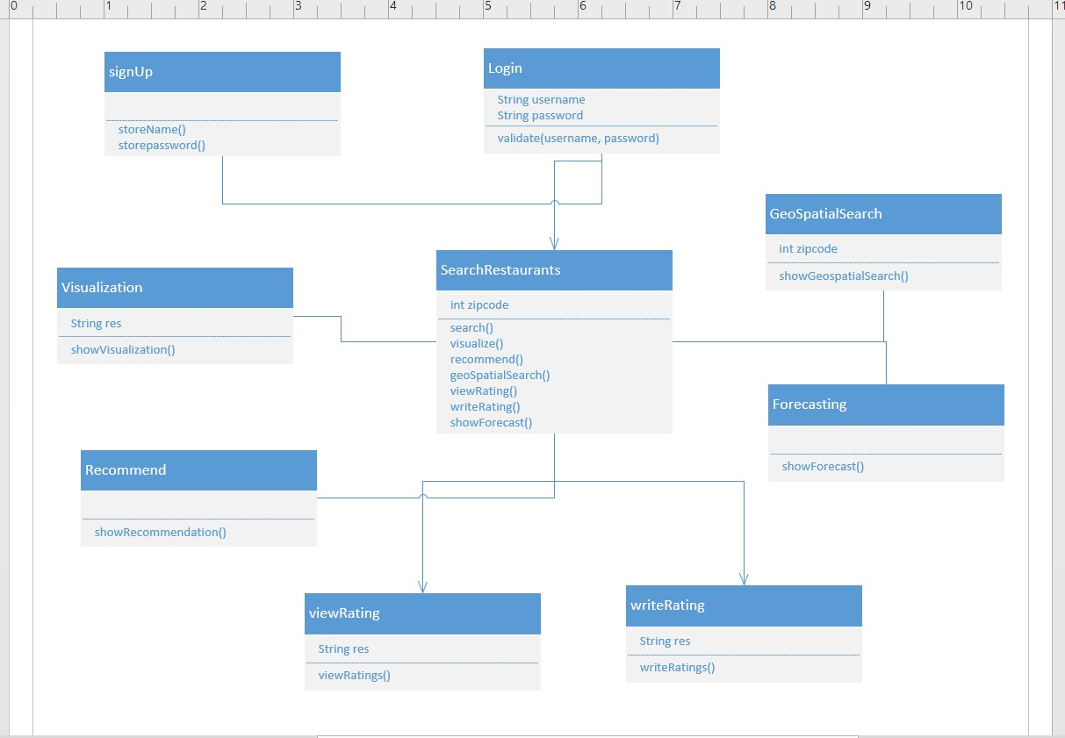
Class Diagram

Slide 3
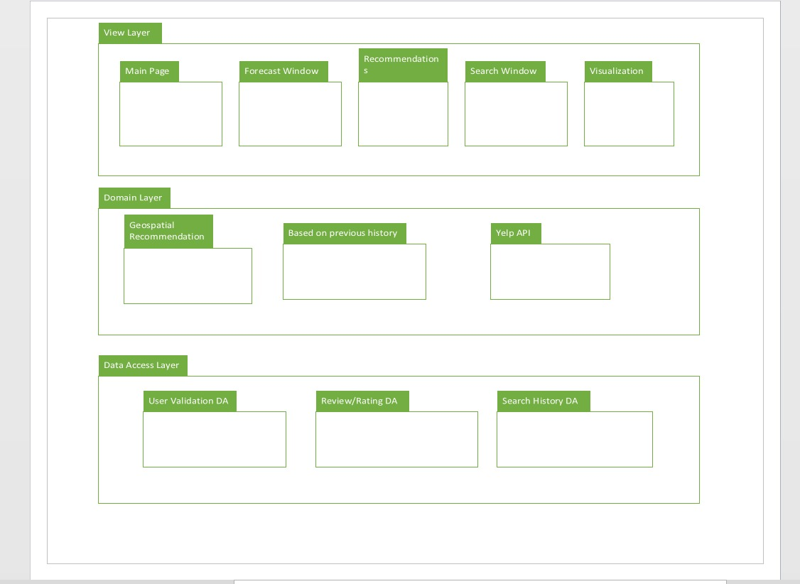
Package Diagram

Slide 4
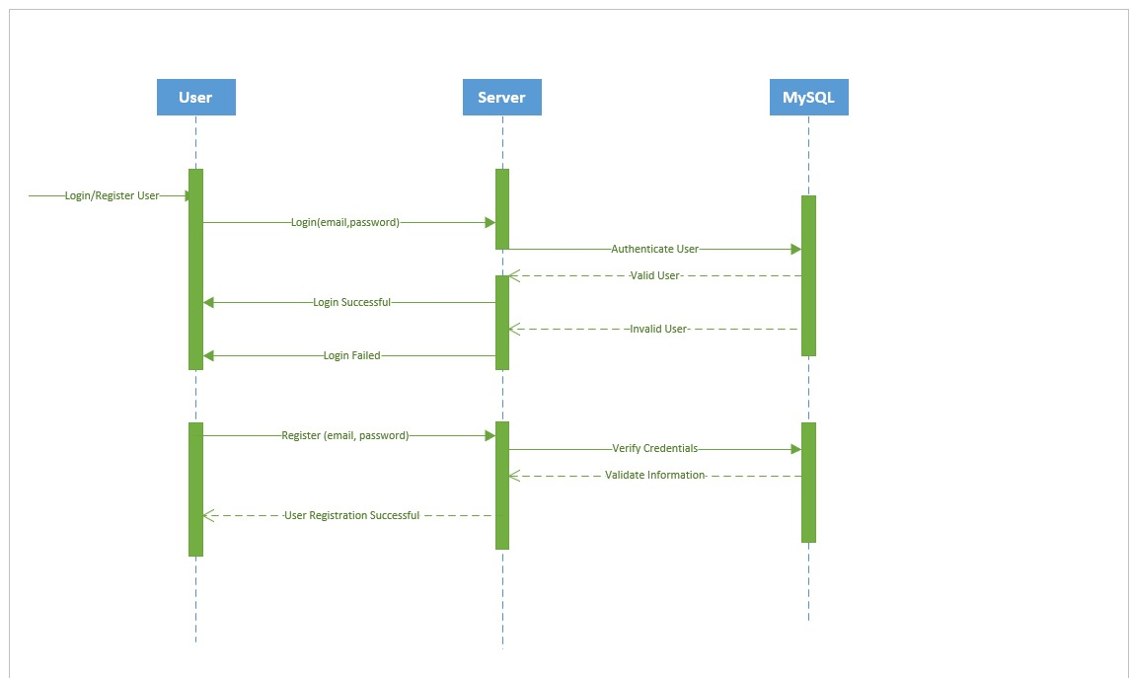
Sequence Diagram ( User Login & Register)

Slide 5
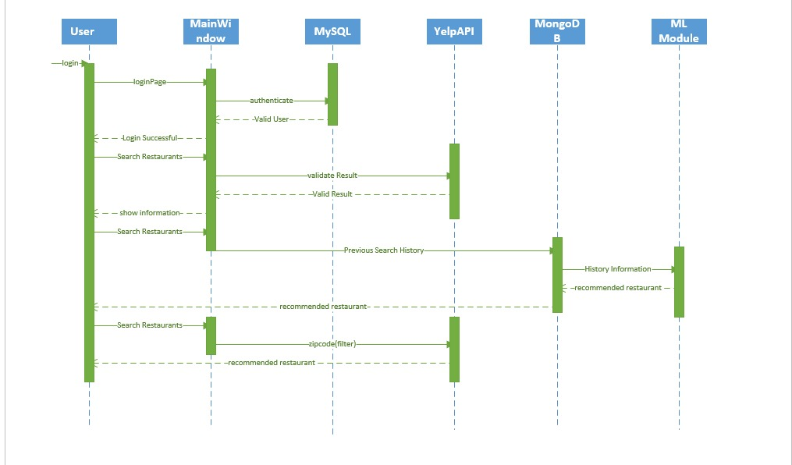
Sequence Diagram (Search Restaurants)

Slide 6
Thank You

