Slide 1

Recommenders for Social Places (Restaurants)
Phase 3 | Group 7
Nishant Pathare | Disha Patel

Slide 2
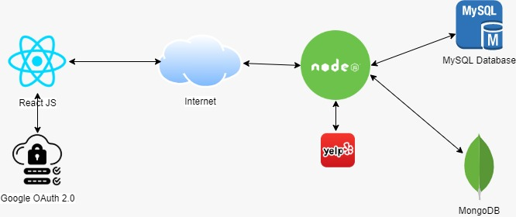
Architecture

Slide 3
Feature List
Search restaurants
Show recommended restaurants based on user history
Geospatial search compatibility
View review/ratings using bar chart, pie chart, etc

Slide 4
Usecase List
No | Use Case | Description
1 | Register a user | User can register using userid and password
2 | Login | User can access the content of the website using valid credentials
3. | Search Restaurants | User can search for restaurants
4. | View Recommendations | User can view recommended restaurants based on search history, zipcode
5. | Give/View ratings | User can view ratings as well give ratings
6. | View visualization | User can view the visualization of ratings

Slide 5
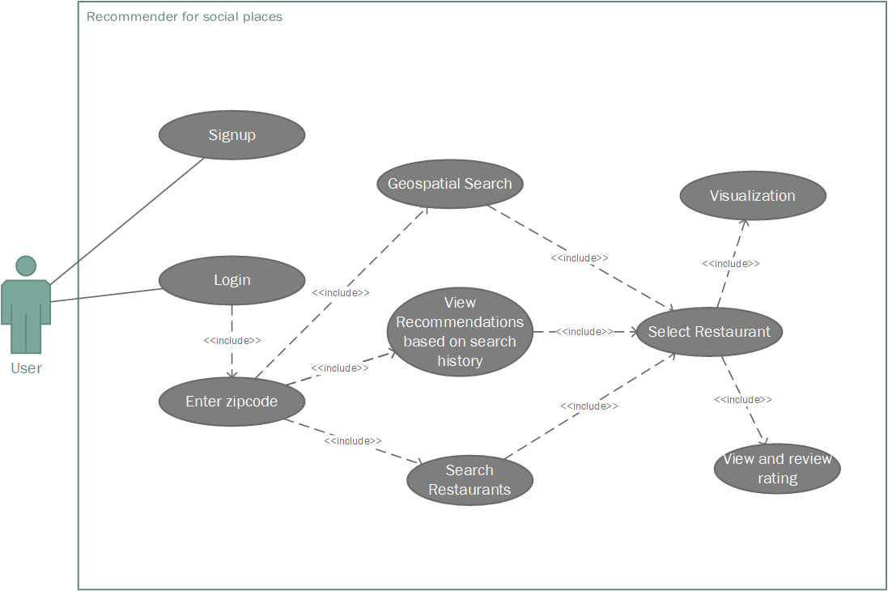
Usecase Diagram

Slide 6
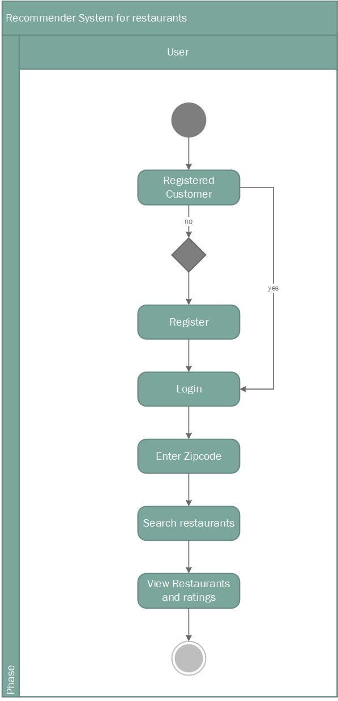
Activity Diagram

Slide 7
Technology Stack
Front-End : React JS
Back-End : Node + Express JS
Analytics : Python
Relational Database : MySQL
NoSQL Database : MongoDB

Slide 8
Thank You

