Slide 1
Data set is related to : use of AI by students in Indian
AI Tool Usage by Indian College Student
Number of column :- 16
3614 responses from Indian college students
Top tools: ChatGPT, Bard, GitHub Copilot
High usage for assignments, coding, and interview preparation
Major users: Science & IT students
Devices used: Mostly Laptop
State column has 1614 missing values

Slide 2
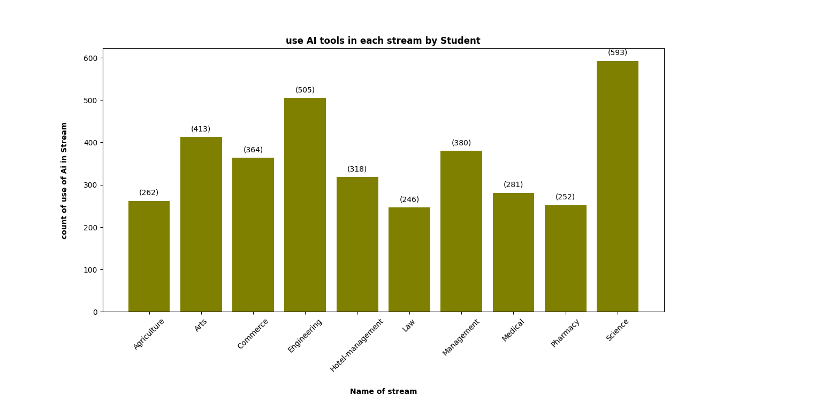

Slide 3
Key Insights :-
Major users of AI Science & Engineering stream Students, they are use for assignment , learn new skill, interview preparation ,coding etc.
Minor user of AI from Law stream students research, writing, analysis, and productivity

Slide 4
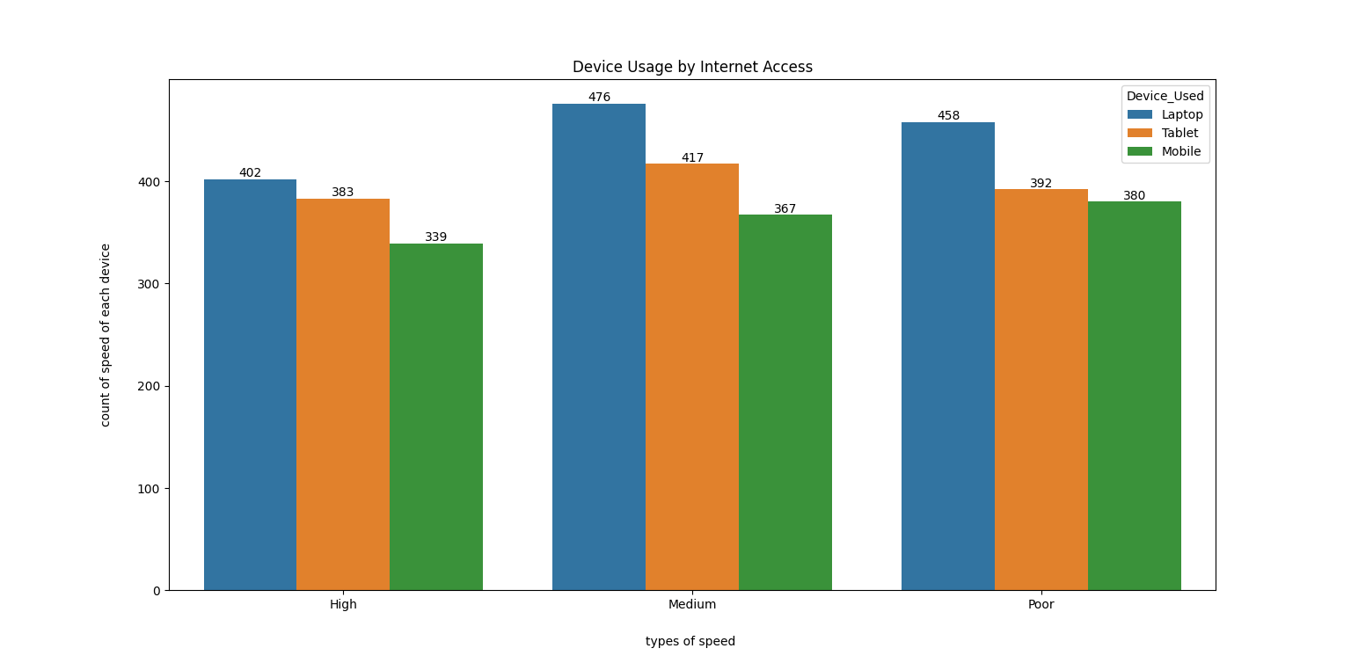

Slide 5
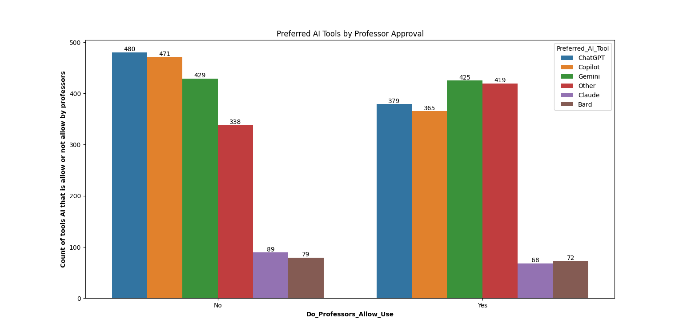

Slide 6
keys Insights :-
Professor most approach to use Gemini.
Because Gemini make summary of what will you ask for AI and make assignment ,mock test .
Copilot & ChatGPT refers by professor for build new skill , interview preparation, research etc.
Some professors allow AI tools like Gemini and ChatGPT, mainly for grammar and paraphrasing. But tools like ChatGPT and Bard are not always allowed, especially for final assignments or exams.
Recommendation:-
Use ChatGPT/Bard to understand concepts, not for direct answers.
Discuss with your professor before using AI in your project.
for designing use other AI tools discuss with your professor And friend that have knowledge about Ai.

Slide 7
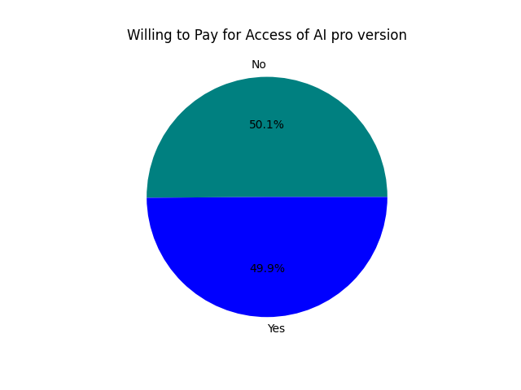

Slide 8
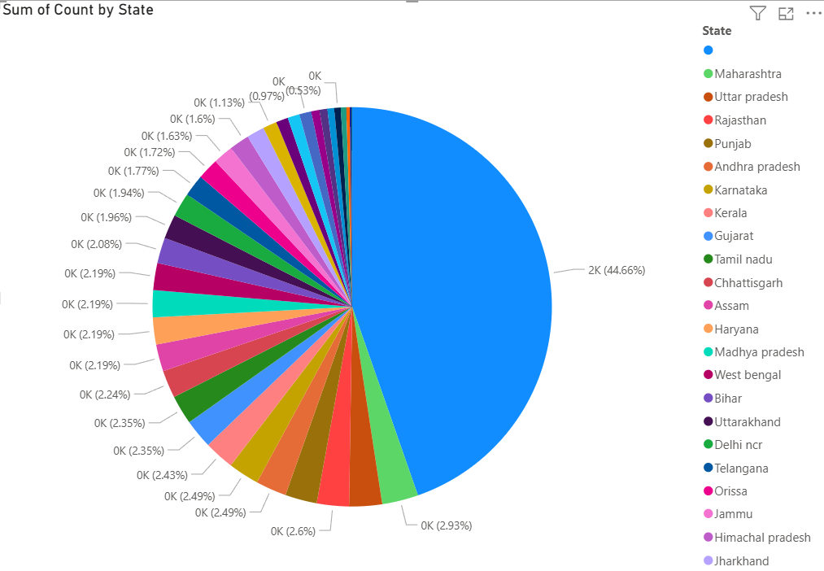

Slide 9
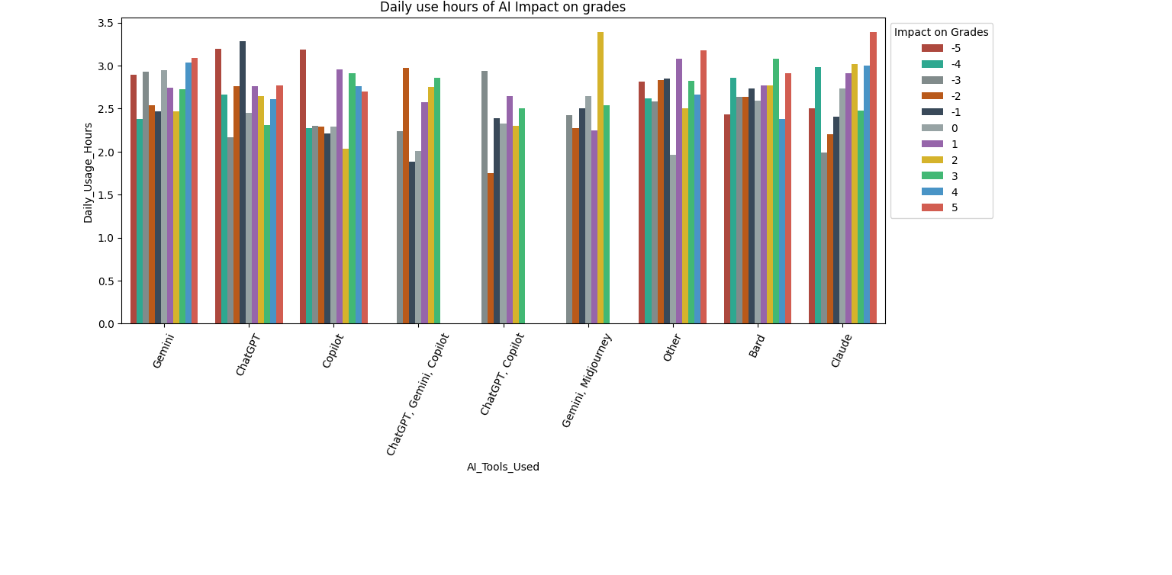

Slide 10
Key Insights
Students who use AI daily report:
Higher confidence in completing assignments.
Better time management for studies.
A perception of improved understanding of concepts
Recommendation
Cross-verify AI answers to avoid misinformation.
Daily use of Ai . It is beneficial for you otherwise not.
It will give more information according to you question that is help in exam , interview etc.

Slide 11
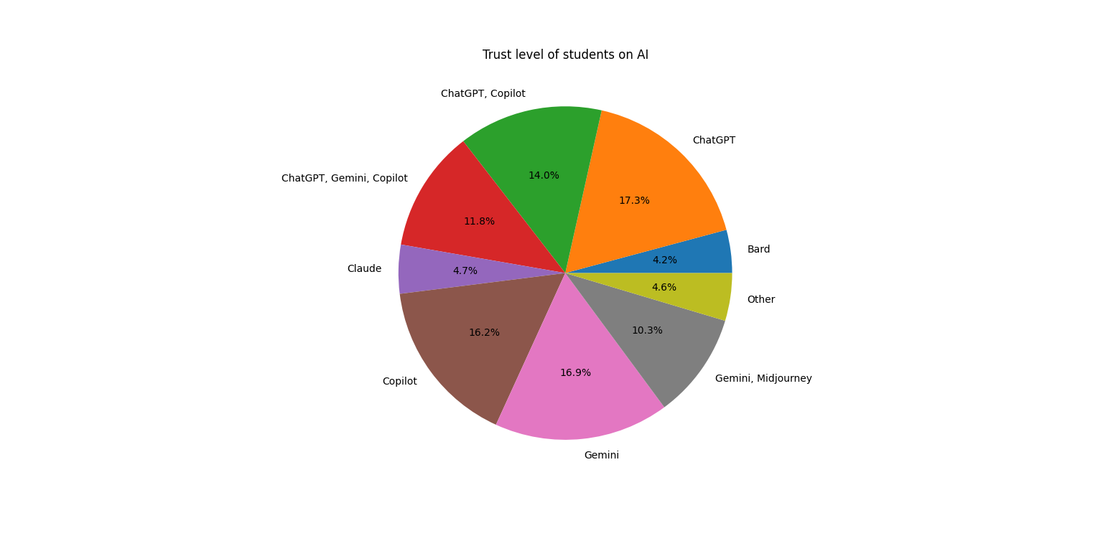

Slide 12
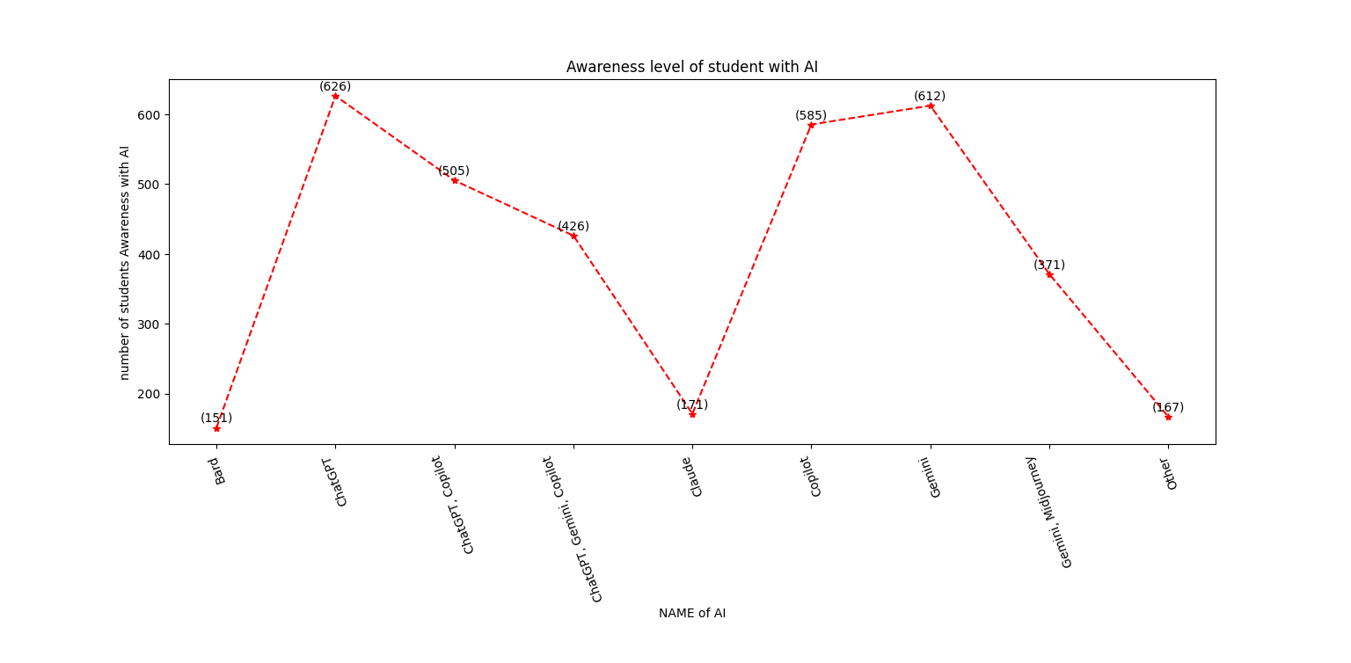

Slide 13
Recommendations
We can use AI tools in a smart and ethical way:-
Use it to learn, not to copy answers.
Don’t use AI in exams unless allowed.
Always check the information, and don’t depend 100% on AI.
Ask teachers if you’re not sure about using AI for an assignment
To conclude, AI is a great tool for learning and saving time. But we should use it wisely, ethically, and under teacher guidance.

Slide 14


