Slide 1
The dataset is related to Gwalior’s influencer and vlogger of Instagram
In Gwalior 59 famous influencer that have more than 10K followers
There are four columns ['Username', 'key_services', 'Followers', 'Views', 'viral_video']
Top influencer Fitness(@iakhileshchandra )and comedy (@gwalior_wale_ )is most viral videos
Flop influencer Family/Couple Vlogs(@svarakshakala ) and Motivation / Self-help(@vichar_niyam ) is not viral videos.

Slide 2
Column_name Description
Username Instagram id name
key_services Content & trend
Views how many people watch
viral_video which video has most comment, like , shear and views

Slide 3
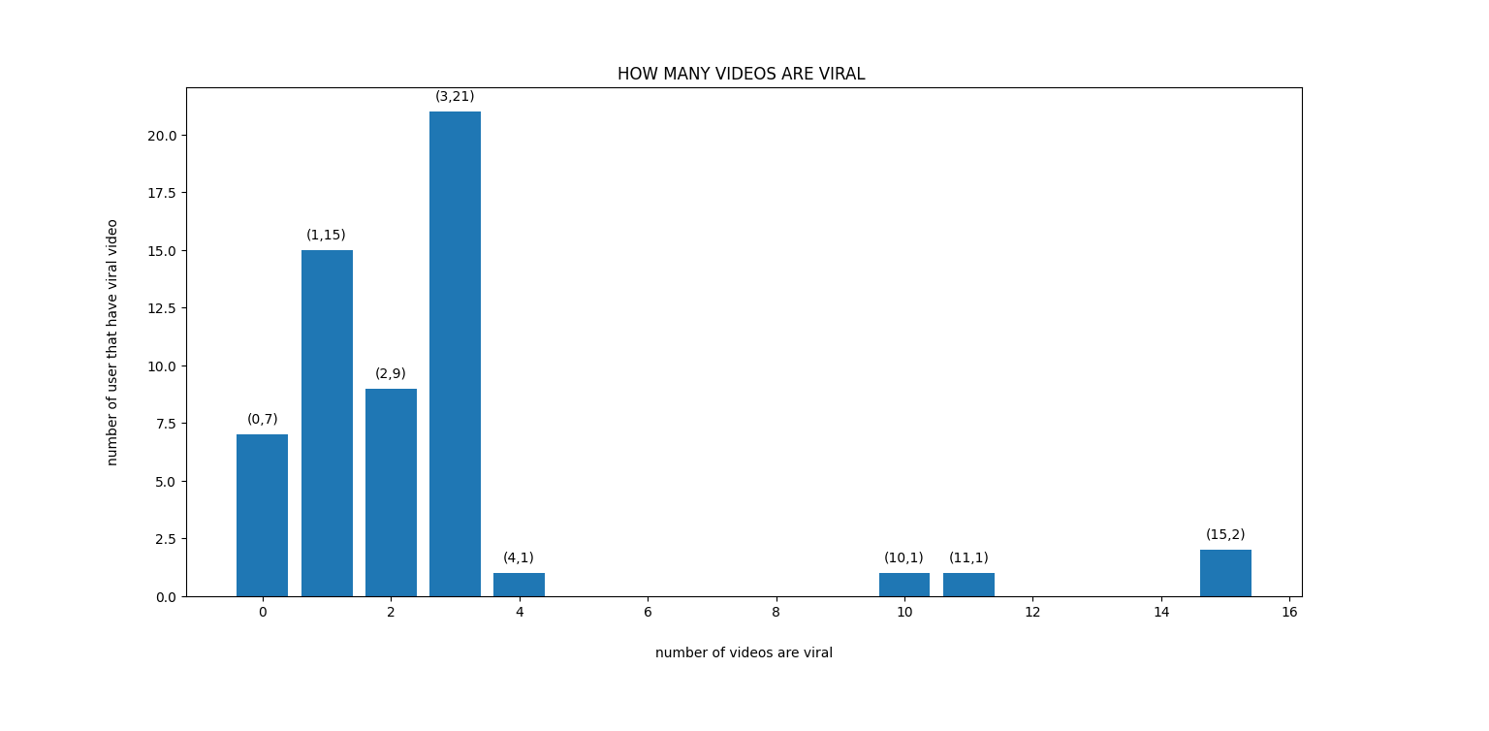

Slide 4

Views on video
Max_view
(1M)
Avg_view
(91.1K)
Min_view
(3K)

Slide 5
Key Insights
Content and Consistency is more important
High-quality visuals (photo and videos)
Video editing
Use Stories with polls, mentions, and countdowns to build connection.
Collaborate with followers, not just brands.

Slide 6
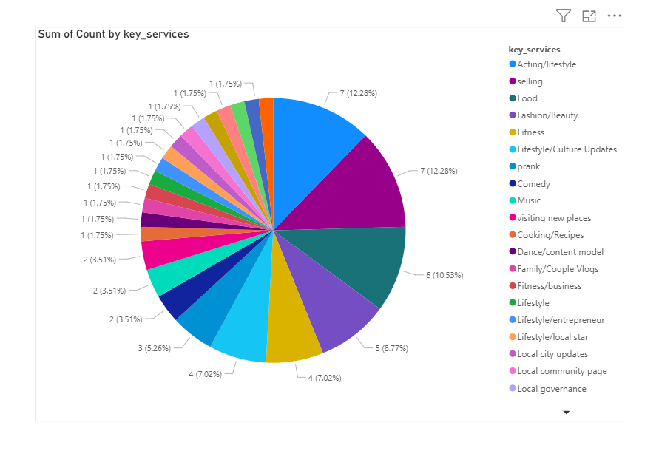

Slide 7
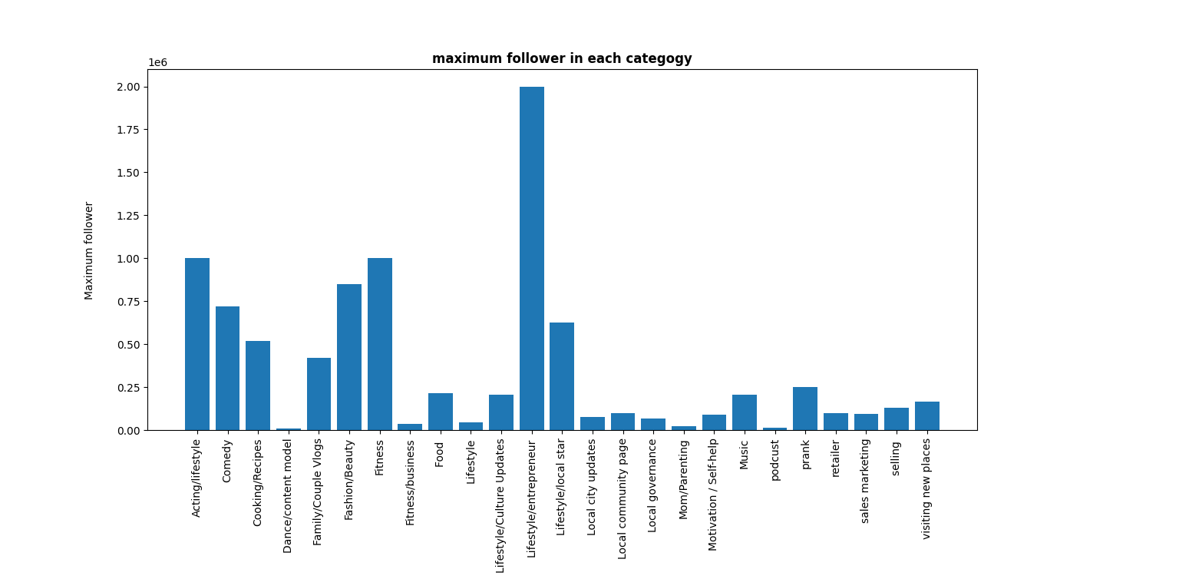

Slide 8
Method | Minimum_earning | Notes
Brand Deals/Sponsored Reels | $50 – $200 per post | Brands love comedy for high engagement & relatability
Reels Bonus (if invited) | $0 – $100+ per month | Instagram sometimes pays creators per views, invite only
Affiliate Marketing (comedy-themed) | $0 – $300/month | Promote funny gifts, merch, apps, or tools
Shoutouts/Promotions | $10 – $50 per shoutout | You can charge smaller pages for exposure
Sell Own Merch (funny quotes/tshirts) | $100+ possible/month | Comedy creators do well selling branded items
Live Badges (IG Live tips) | $10 – $50 per stream | Go live, entertain your fans, and get tips
Subscriptions (fan-exclusive content) | $1 – $5 per subscriber/month | Offer bonus bloopers, behind-the-scenes, etc.

Slide 10
Recommendations
Instagram is a good platform for career.
There are multiple options for making videos.
Good content
Audience friendly content
Collaborate with Brand Deals/Sponsored.
Other then this we can dm any influencer to be video editor for him/her

Slide 11
