Slide 1
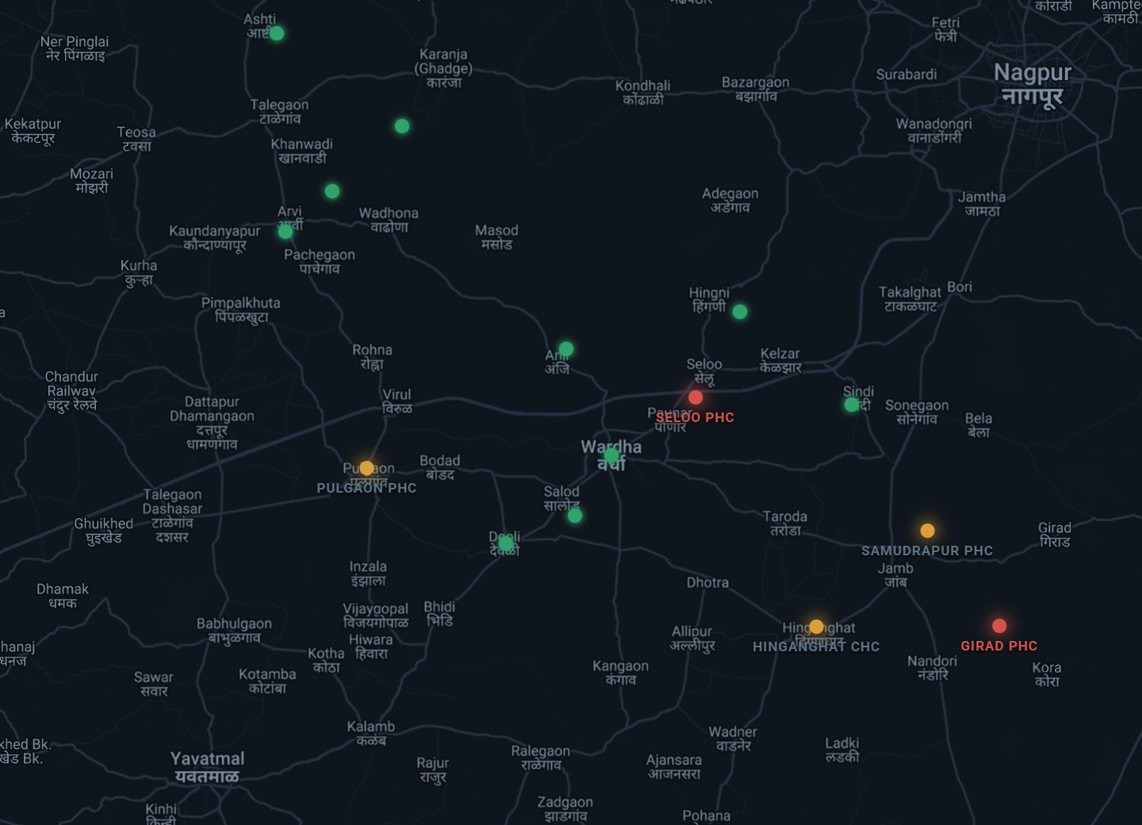
HealthGrid AI
An AI command center for district public healthcare.
HMIS records what happened.
HealthGrid decides what to do next.
Build with AI · Code for Communities — Smart Health track
Nishant Rajpathak · Saatvik
Notes:
Open cold: 'This is a live district. Every dot is a health facility scored in real time. Two of them are in crisis — and the system already knows what to do about it.'

Slide 2



THE PROBLEM
India's primary healthcare runs blind between monthly reports
25,000+
~30 days
Too late
PHCs track medicines, beds and staff on paper registers
before facility data reaches the district through monthly HMIS reporting
stock-outs and staffing gaps are discovered after patients are turned away
Notes:
The data that could prevent stock-outs exists — it's just trapped at the facility on paper, and arrives at the district a month late as an aggregate.

Slide 3
THE INSIGHT
HMIS records what happened. HealthGrid decides what to do next.
HMIS · DVDMS
HealthGrid AI
Same-day action
Existing systems of record — monthly reporting, drug logistics. Unchanged.
→
The decision layer: live scores, forecasts, guarded transfer recommendations.
→
One-click approved interventions with a full audit trail.
No rip-and-replace: HealthGrid ingests the records districts already keep — and fills the real-time gap between reports from the frontline itself.
Notes:
Judges reward solutions that plug into the existing stack. We are a lens and a decision layer, not a replacement HMIS.

Slide 4
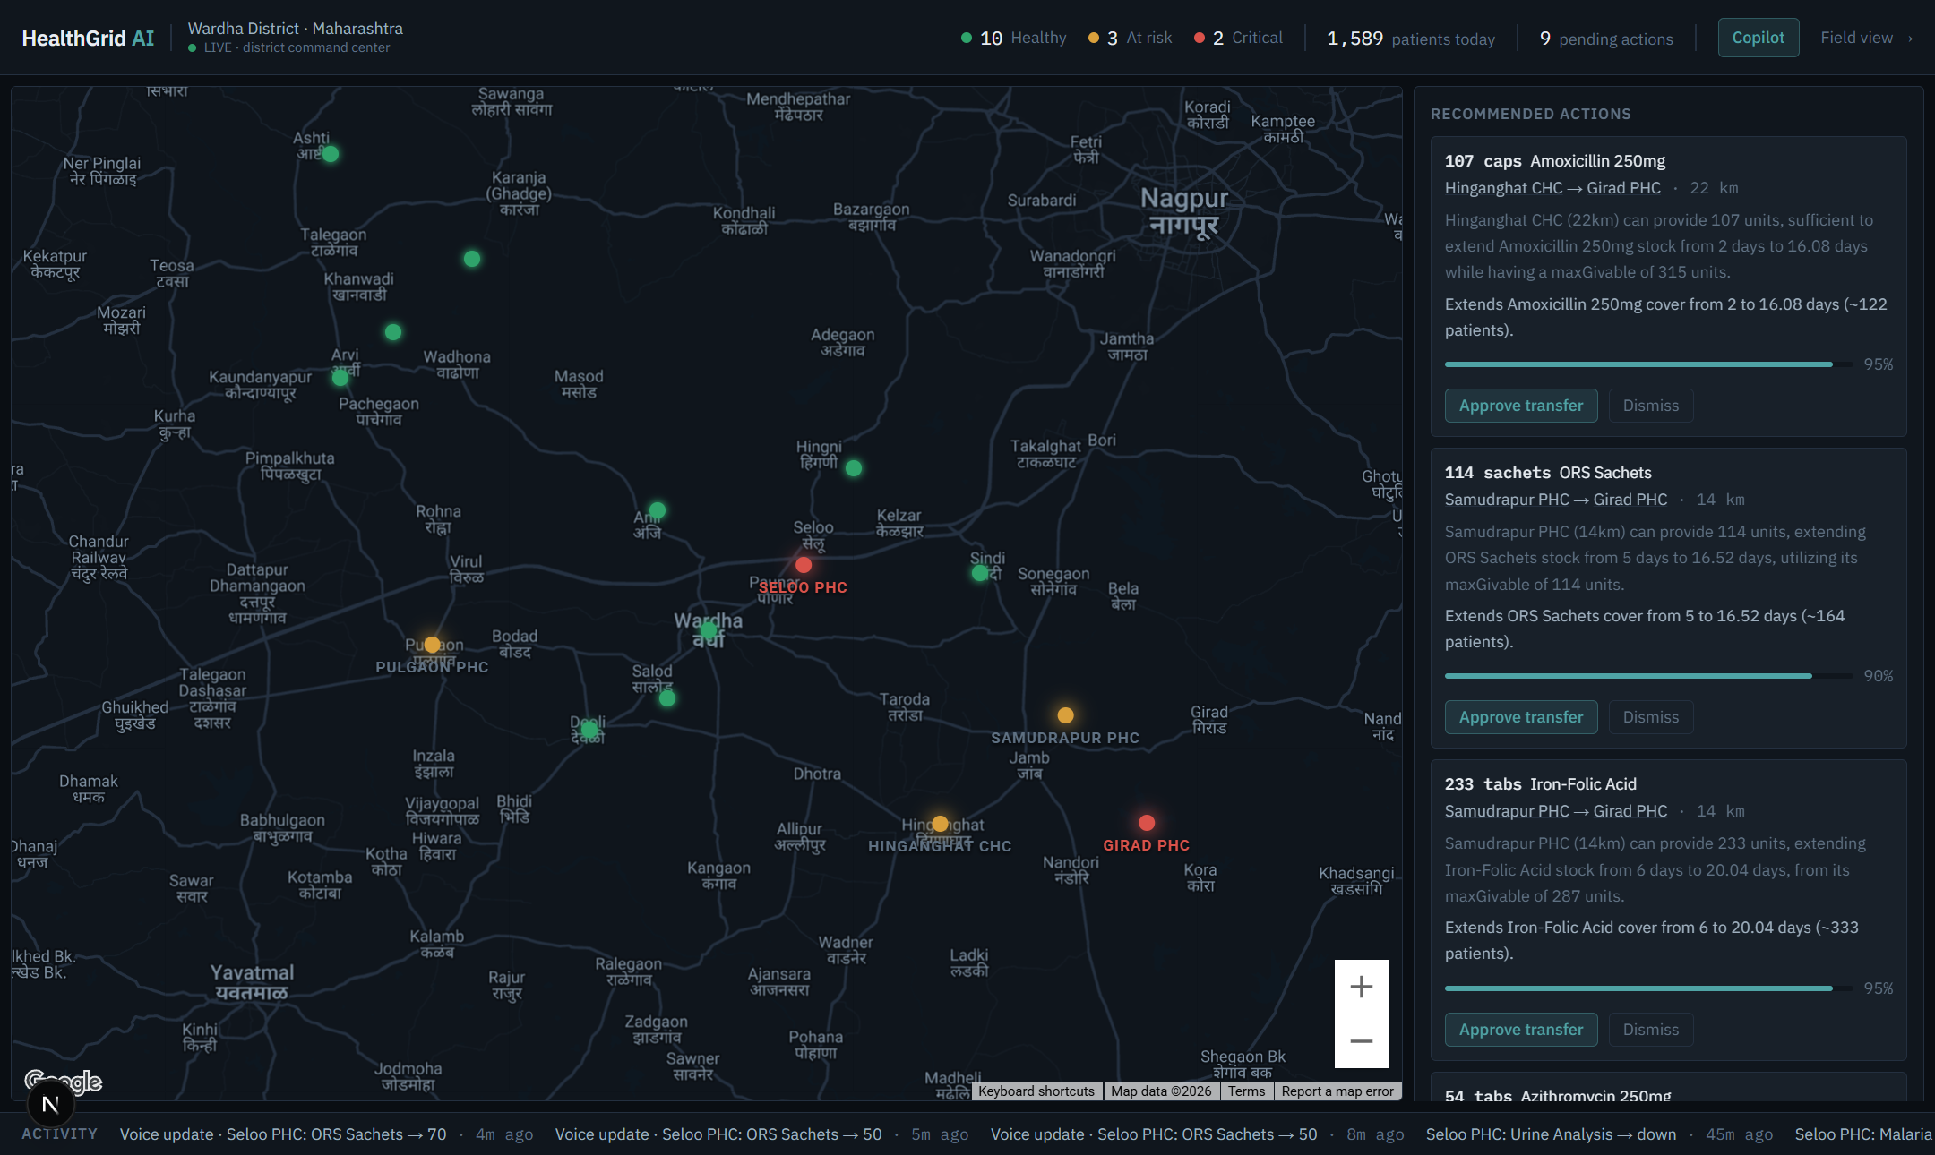



THE PRODUCT · DISTRICT COMMAND CENTER
Live digital twin
15 facilities scored 0–100 on medicines, staffing, beds, surge, diagnostics.
AI that explains & acts
Root-cause analysis and guarded transfer plans — approved in one click.
Realtime, no refresh
Every field update re-scores the district in seconds via Firestore sync.
Notes:
This is a real screenshot, not a mockup. Wardha district, Maharashtra — real geography, synthetic-but-calibrated operational data, labeled as such.

Slide 5
WHY THE AI HOLDS UP UNDER SCRUTINY
Deterministic engines decide the numbers. Gemini does what LLMs are actually good at.
DETERMINISTIC & TESTED
GEMINI, WHERE IT EXCELS
Risk scoring — 5 weighted components, 0–100
Burn-rate stock-out forecasts per medicine
Transfer guardrails: donor keeps 14+ days, max 40%
74 unit tests · reproducible seed & simulations
Grounded root-cause explanations — every claim cites data
Structured transfer proposals, validated server-side
Copilot with function calling over live engines
Hindi / Marathi / English speech → structured updates
Observe → Understand → Predict → Recommend → Approve → Execute → Monitor
Notes:
Anticipate the 'is the AI real?' question: predictions are our math, the LLM never invents a number, and nothing writes to the database without human confirmation.

Slide 6
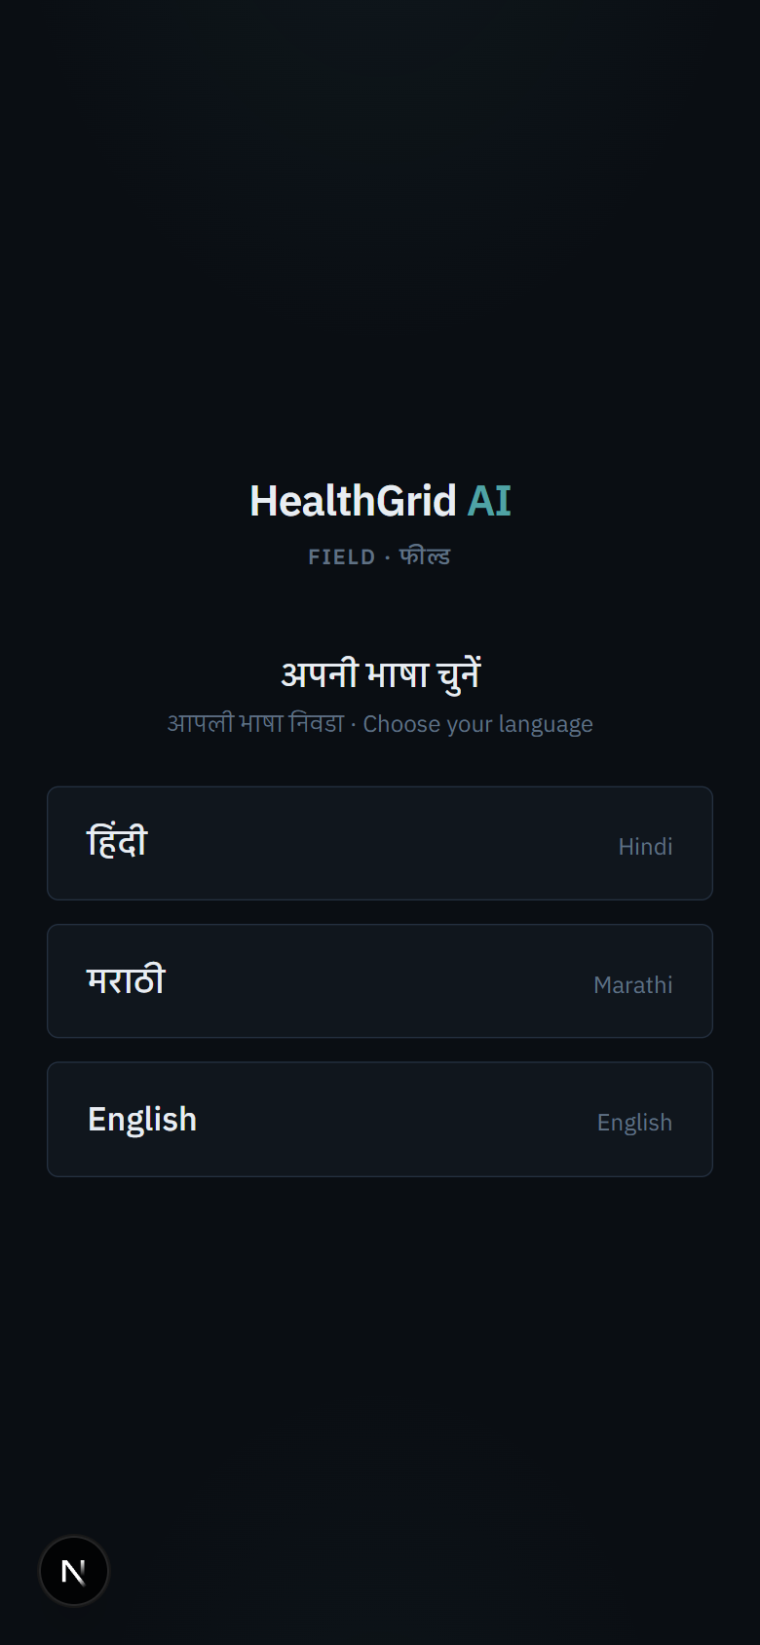

THE FRONTLINE · VOICE-FIRST FIELD UPDATES
A health worker speaks.
The district reacts in seconds.
“आज ओआरएस का स्टॉक 50 बचा है”
Gemini audio → structured update → worker confirms → live re-score
Language-first onboarding: हिंदी · मराठी · English — whole UI localizes
Handles mixed speech and maps medicine names to inventory ids
Nothing is written without on-screen confirmation by the worker
No forms. No paperwork. No English required.
Notes:
This is the emotional peak of the demo video — a real spoken Hindi sentence becoming a structured inventory update with the map reacting live.

Slide 7
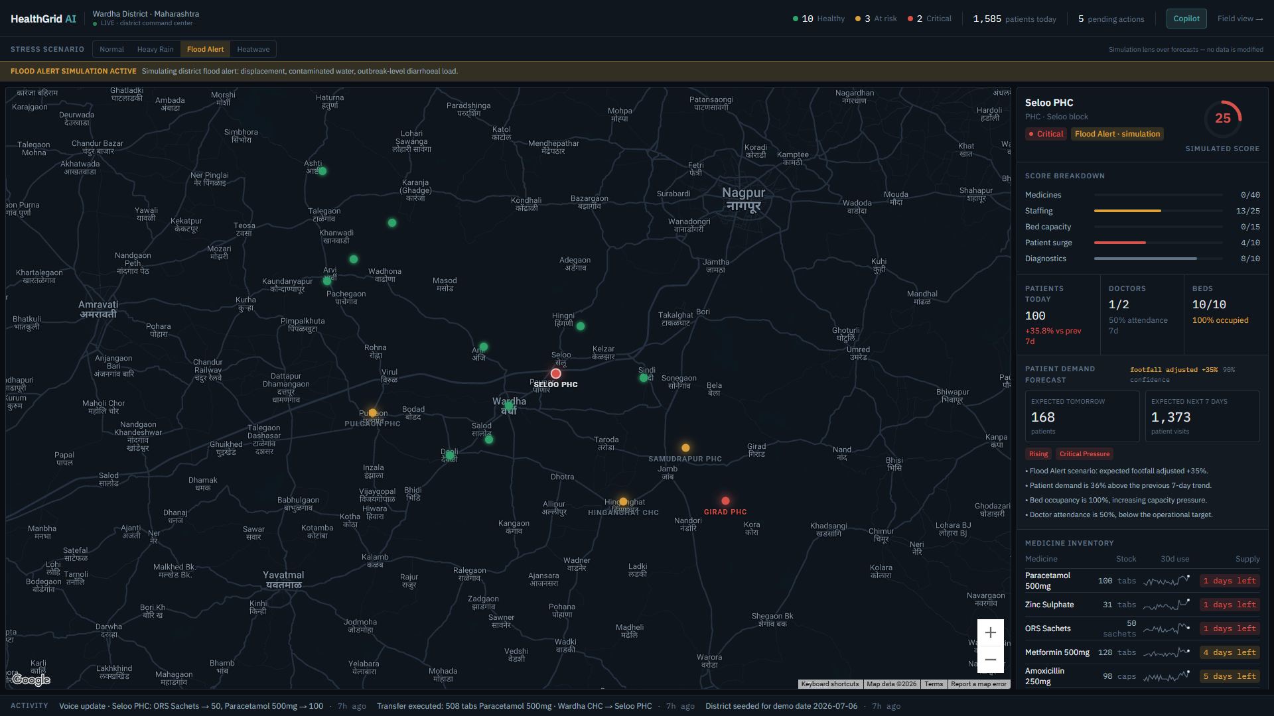



NEW · WEATHER & DISASTER STRESS MODE
Flood Alert
ORS ×1.8 · zinc ×1.7 · footfall +35% — outbreak-level diarrhoeal load
Heatwave
ORS ×1.9 · IV fluids ×1.6 — dehydration and heat stroke pattern
A reversible lens
Forecasts, scores and the queue re-rank under stress. Switch back — baseline restores exactly. No data touched.
Multipliers follow WHO first-line response patterns — built to be replaced by live IMD weather signals.
Notes:
Districts don't just need today's picture — they need to know what a flood does to next week's supply. This is preparedness planning with the same deterministic engines.

Slide 8
MEASURED IMPACT — SIMULATED, REPRODUCIBLE
One month, one district, existing stock only:
54 → 0
31
5,157
₹0
projected facility-medicine stock-out days, next 30 days
guarded transfers between facilities
units of existing district stock redistributed
new medicine purchased
Counterfactual simulation over the seeded 90-day history + 30-day projection, using the exact engines and guardrails that run in the product. Judges can reproduce it: npx tsx scripts/impact-sim.ts
Notes:
The medicines to prevent every projected stock-out already exist inside the district. What's missing is visibility and coordination — that's the product.

Slide 9
BUILT ON GOOGLE
Gemini is the interface. Deterministic engines are the authority.
Gemini API
Cloud Firestore
Structured outputs · function calling · audio understanding · multilingual · TTS (demo narration)
Realtime listeners power the live map — no polling, no refresh
Google Maps Platform
Firebase
The district digital twin on real Wardha cartography, custom dark style
Admin SDK transactions, security rules, hosting path
Next.js 16 · TypeScript · 74 unit tests · quota-aware Gemini model rotation
Notes:
Every Gemini capability the challenge highlights is used somewhere real: structured outputs everywhere, function calling in the copilot, audio understanding in voice, TTS in the demo video.

Slide 10
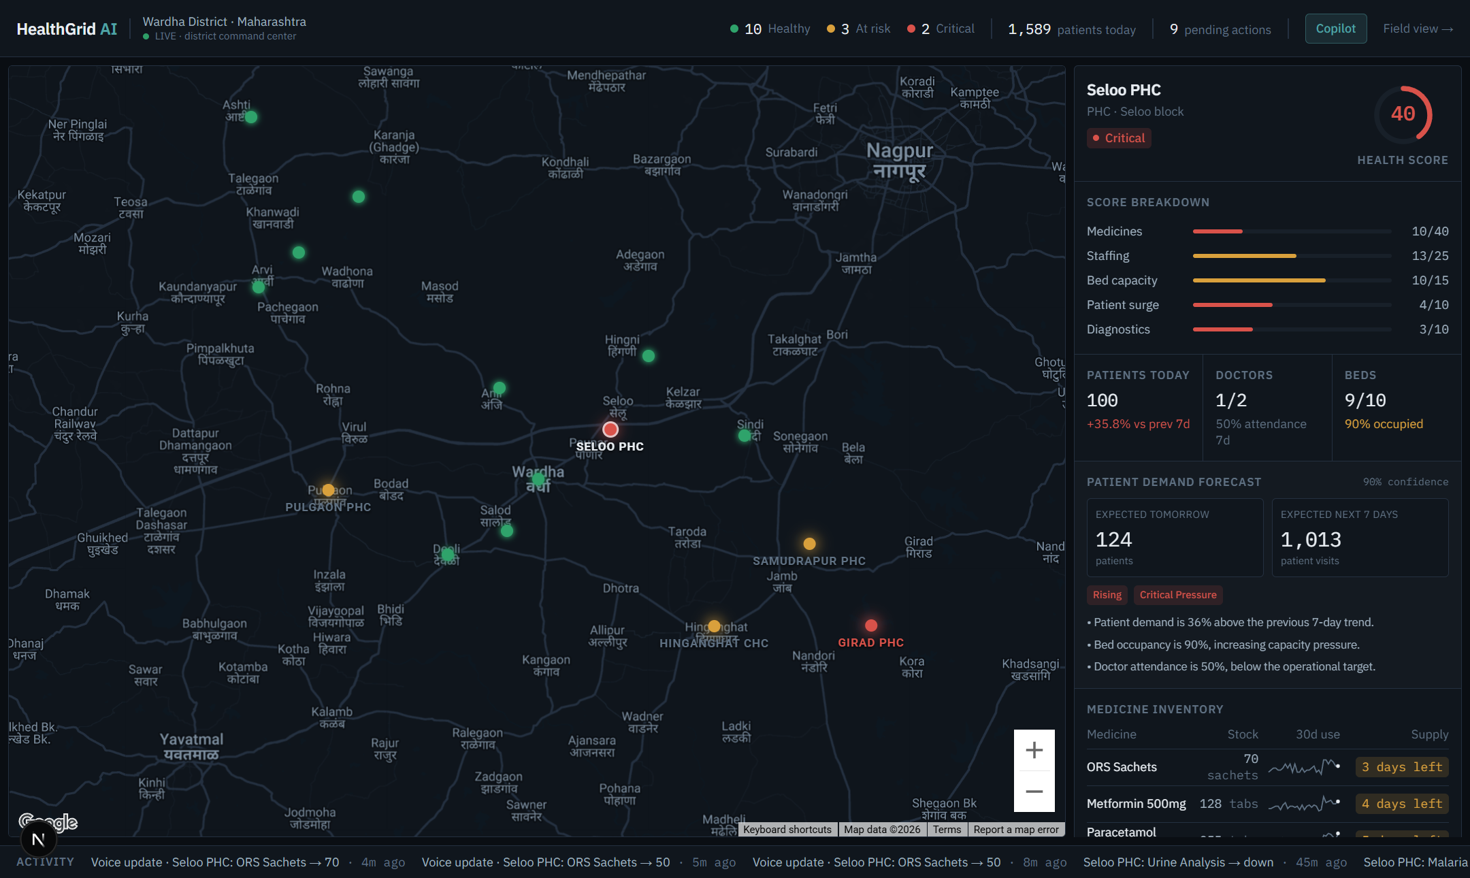
From a health worker's voice
to a district's decision — in seconds.
One district today. 36 in Maharashtra. The decision layer India's HMIS data has been waiting for.
HealthGrid AI · github.com/nishantr14/healthgrid · Nishant Rajpathak & Saatvik
Notes:
Close on the loop: observe, understand, predict, recommend, approve, execute, monitor. Thank the judges. Offer the live demo link.

