Slide 1


Nebula Aether – AI-Powered GPU Orchestrator
"Turning fragmented GPU resources into a unified smart fabric."
A self-improving orchestration system that transforms distributed GPU infrastructure into an intelligent, adaptive compute fabric.
Notes:
1

Slide 2
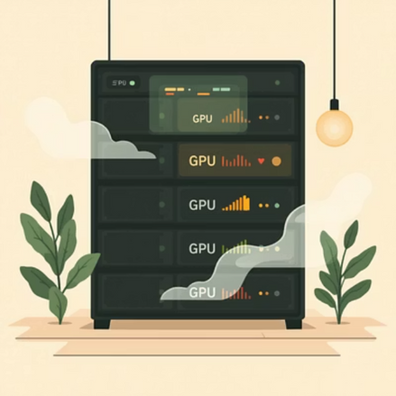
The GPU Utilization Crisis
Critical Inefficiencies
GPUs often sit underutilized → stranded compute capacity
Conflicting jobs cause kills, system instability
Static schedulers fail to adapt in real-time
30-50%³
27-33%²
176 TWh¹
GPU idle time in typical data centers
Performance improvement potential from better scheduling
US data center energy consumption in 2023
Traditional GPU schedulers struggle with dynamic AI/ML workloads, leading to significant inefficiencies due to their inability to adapt, predict, or optimize resource allocation in real-time.
¹Lawrence Berkeley National Laboratory 2024 | ²George Mason University GPU Scheduling Survey 2025 | ³Harbin Institute of Technology Deep Learning Job Scheduling Research 2024
Notes:
2

Slide 3
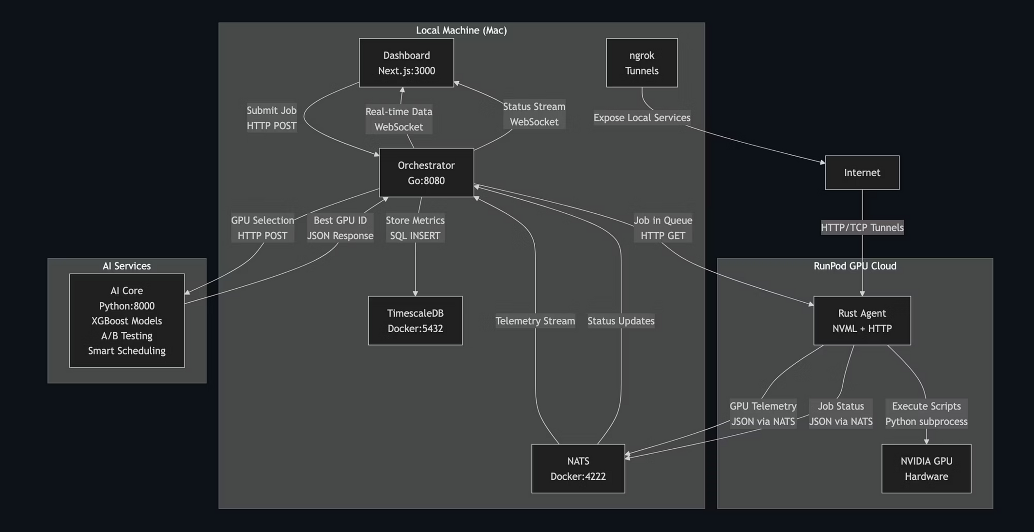
System Architecture
End-to-end orchestration: from real-time GPU telemetry → intelligent scheduling → reliable execution
Notes:
3

Slide 4

AI-Powered GPU Scheduling
01
Telemetry Input
13 GPU metrics: utilization, memory, thermal, clocks, power
02
AI Decision Matrix
6 specialized models for training, inference, compute-heavy workloads
03
Smart Assignment
assign_now | queue_short | queue_long decisions
04
Continuous Learning
A/B testing with auto-promotion of better models
"Think of this as a Smart Gearbox for jobs – adapting to GPUs of different health, load, and capabilities."
Notes:
4

Slide 5

Nebula Aether in Action
1
Real-time Monitoring
GPU telemetry streams to dashboard
2
Job Submission
Orchestrator consults AI Core
3
Intelligent Assignment
AI chooses optimal GPU instantly
4
Live Execution
Agent runs workload with status feedback
Notes:
5

Slide 6


Expanding the Smart Orchestration Layer
Multi-cloud Orchestration
AWS, Azure, GCP integration
Predictive Scheduling
Reinforcement learning algorithms
Edge Computing Integration
Distributed GPU clusters at edge locations
Advanced Security Layer
Zero-trust GPU access controls
"Nebula Aether is designed to scale with the future of AI infrastructure."
Notes:
6

Slide 7

Nebula Aether – The Software Smart Fabric
Maximized Utilization
No stranded GPUs
AI-Powered Scheduling
Smarter than static policies
Conflict Prevention
No more job kills
Thank You
Questions?
Self-Improving System
Learns from every job
"Just as Astera Labs builds the hardware fabric for AI, Nebula Aether builds the orchestration fabric."
Questions?
Notes:
7

