Slide 1

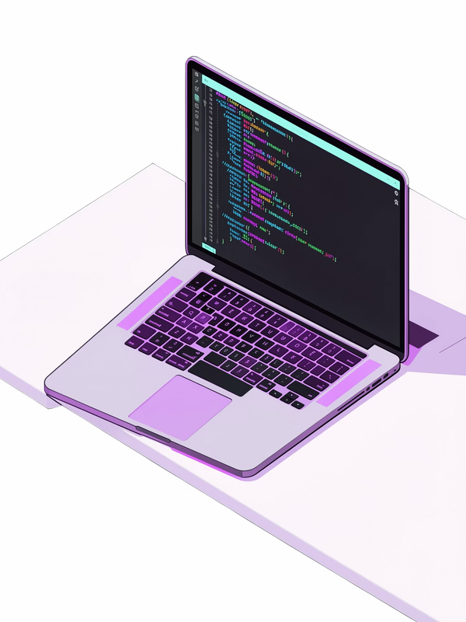
Web Development Internship Presentation
DepartmentofComputerScience&Engineering,IILMUniversity,Greater Noida
Company
Sieve Capital
Presented By
Nishant Rajput · Roll No. 25SCS1003000970
Program
B.Tech – Computer Science & Engineering
Internship Period
15 May 2026 – 15 August 2026

Slide 2

About the Internship
The internship provided practical exposure to modern web development and frontend engineering.
Website Contribution
Contributed to the development of the company's official website.
Design to Code
Converted design concepts into working web interfaces.
Responsive Layouts
Created responsive layouts for different screen sizes.
Frontend Components
Worked on reusable and structured frontend components.
Testing & Debugging
Assisted with testing, debugging, and performance improvements.

Slide 3

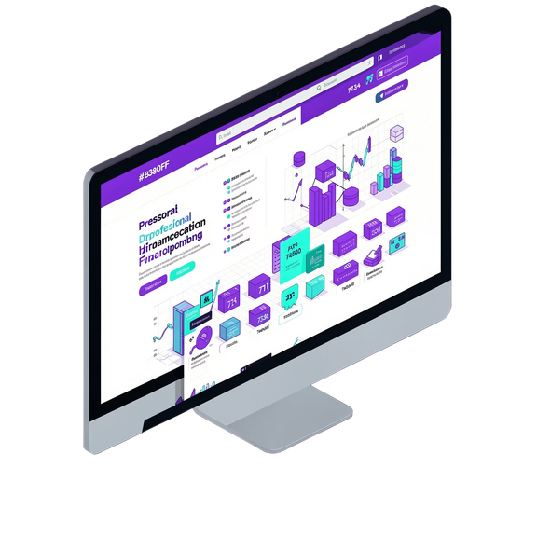
Project Background
Sieve Capital Website
The main project during the internship was the development and improvement of the official Sieve Capital company website.
Project Requirements
Professional and modern website interface.
Easy navigation and clear information structure.
Responsive experience across desktop, tablet, and mobile devices. Consistent visual identity throughout the website.
Fast-loading and optimized web pages.
Development Approach
The website was developed using a component-based frontend approach to make the code organized, reusable, and easier to maintain.

Slide 4














Technologies & Development Environment
Frontend Technologies
Supporting Tools
HTML5
Web page structure
CSS3
Styling and responsive layouts
Git & GitHub
Version control and collaboration
Visual Studio Code
Development environment
JavaScript ES6+
Interactive functionality
React.js
Component-based frontend development
Chrome DevTools
Debugging and testing
Figma
Understanding UI/UX designs
Tailwind CSS
Utility-based styling

Slide 5
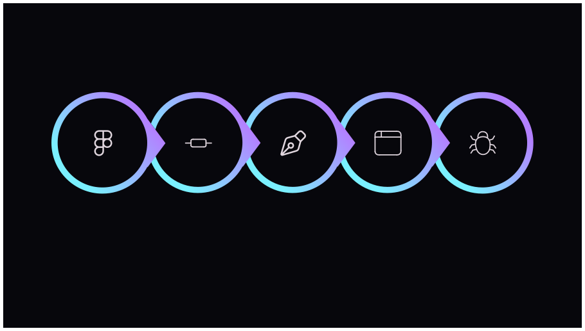
Website Development Process
Design
Debugging &
Component
Styling &
Testing
Understandi ng
Creation
Layout
Improvemen t
Each phase built upon the previous, ensuring a structured and maintainable codebase from design handoff to final delivery.

Slide 6
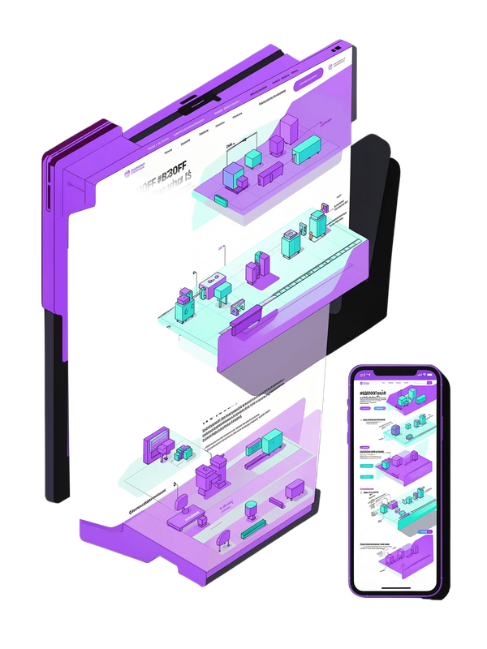
Key Features Implemented
Major Website Components
UI/UX Improvements
The implementation focused on maintaining visual consistency while ensuring that the website remained simple, accessible, and easy to navigate.
Responsive navigation/header Structured landing page sections
Responsive content grids Call-to-action buttons Reusable React components Mobile-friendly layouts Consistent typography and spacing
Optimized images and web assets

Slide 7

Learning & Internship Outcomes
React.js Development
Improved understanding of React.js development and component architecture.
Responsive Design
Learned practical responsive web design techniques for all screen sizes.
Tailwind CSS
Developed better knowledge of utility-first styling with Tailwind CSS.
Debugging
Gained experience in identifying and resolving frontend issues efficiently.
Real-World Practices
Experienced real-world software development practices and workflows.
Git Workflows
Understood Git branching and pull-request workflows in a team setting.
Code Quality & Teamwork
Learned the importance of code quality, collaboration, and communication.
Project Management
Improved project planning and task management skills in a professional environment.

Slide 8

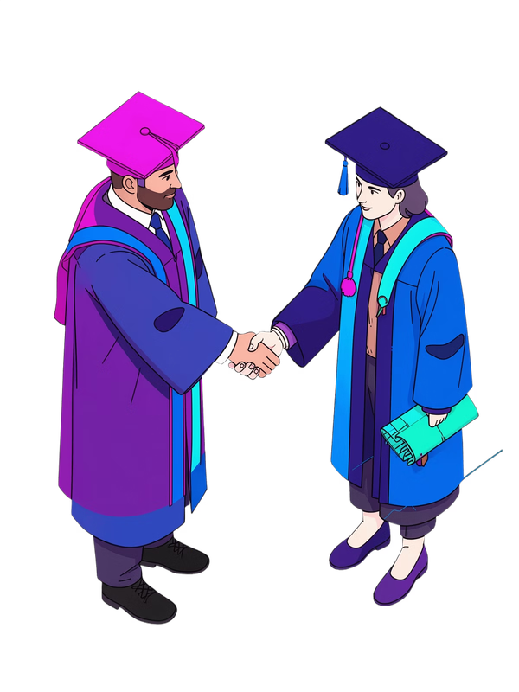


Conclusion & Thank You
The internship at Sieve Capital provided valuable practical experience in frontend web development. Working on the company's official website helped bridge the gap between academic concepts and real- world development.
The project improved my technical knowledge, problem-solving ability, and understanding of professional development workflows.
Nishant Rajput
B.Tech – Computer Science & Engineering IILM University, Greater Noida
Questions & Discussion
Open for questions, feedback, and discussion.

