Slide 1

Project Title -Seasonal Agriculture Performance Analysis
Nishant Sahay
Motilal Nehru National Institute of Technology
AICTE STU ID : STU6a68b9ca98df5178524820203:39 PM

Slide 2

PROBLEM STATEMENT
Agricultural activities are influenced by seasonal variations in environmental conditions,
farming practices, resource availability and market conditions. As a result, agricultural
performance may differ from one season to another.
However, raw agricultural data does not clearly explain how agricultural performance changes
across seasons or what patterns can be observed in different seasonal conditions.
The problem is to analyze the given agricultural dataset and investigate seasonal differences
in agricultural performance by identifying meaningful patterns, trends, relationships and
variations within the available data.
data.

Slide 3
Project Description
Seasonal Agriculture Performance Analysis is a data analytics project that studies how agricultural performance varies across different seasons. It analyzes factors such as rainfall, temperature, soil conditions, irrigation, fertilizer usage, crop yield, production, water efficiency, and profit. The project uses Python, Pandas, Matplotlib, and statistical techniques to identify seasonal patterns and provide data-driven insights for better agricultural planning.

Slide 4

WHO ARE THE END USERS?
Farmers – to understand seasonal conditions and improve farming decisions.
Agricultural planners – to plan farming activities based on seasonal trends.
Agricultural researchers – to study patterns in crop performance and environmental factors.
Government/agriculture departments – to support evidence-based agricultural planning.
Agribusiness stakeholders – to understand production, resource usage, and economic performance.

Slide 5

Technology Used
  Python – Main programming language.
  Pandas – Data cleaning, handling missing values, duplicates, and data manipulation.
  NumPy – Numerical calculations and data processing.
  Matplotlib – Creating graphs and visualizations.
  SciPy – Statistical analysis and hypothesis testing.
  Jupyter Notebook – Writing and documenting the complete analysis.
  Microsoft Excel – Data viewing, organization, and supporting analysis.

Slide 6
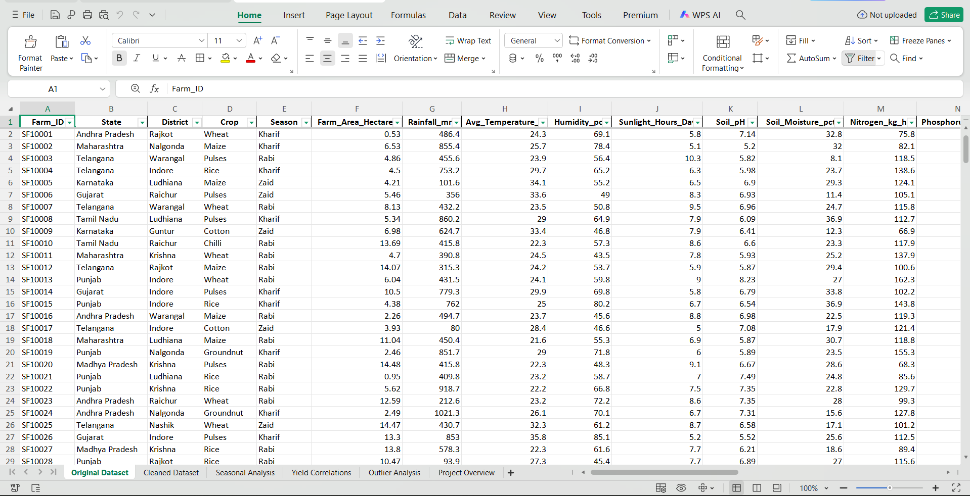
RESULTS

Slide 7
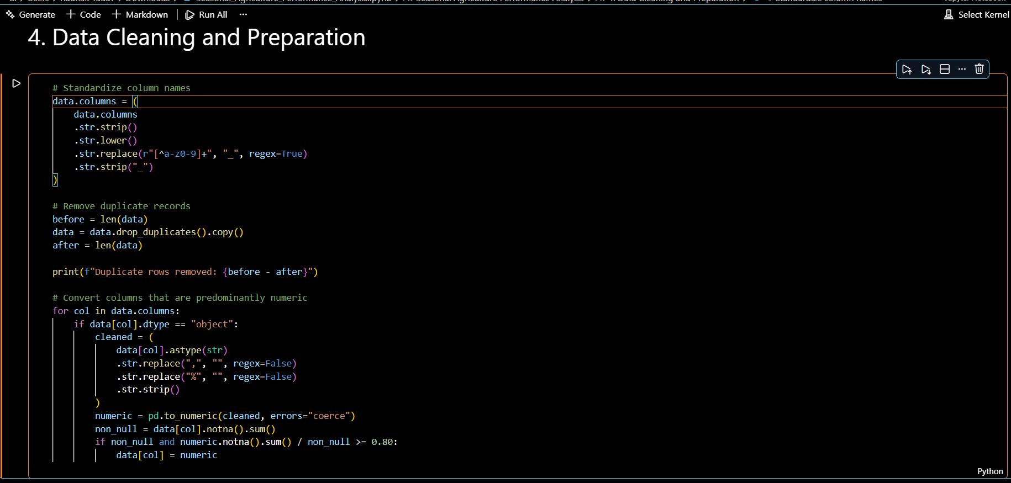
RESULTS

Slide 8
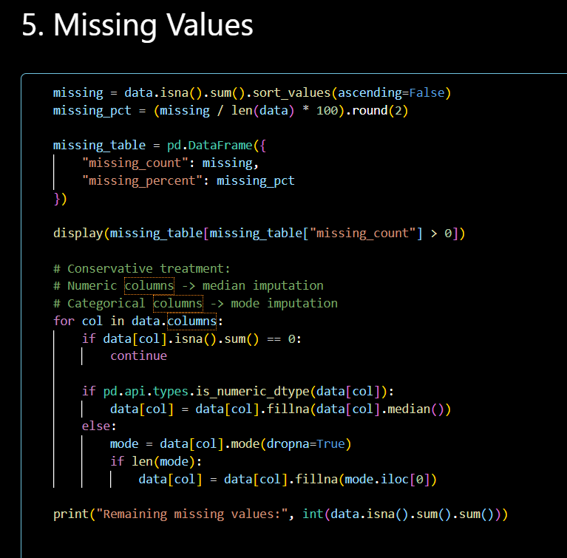
RESULTS
[Add screen shots of your code ]

Slide 9
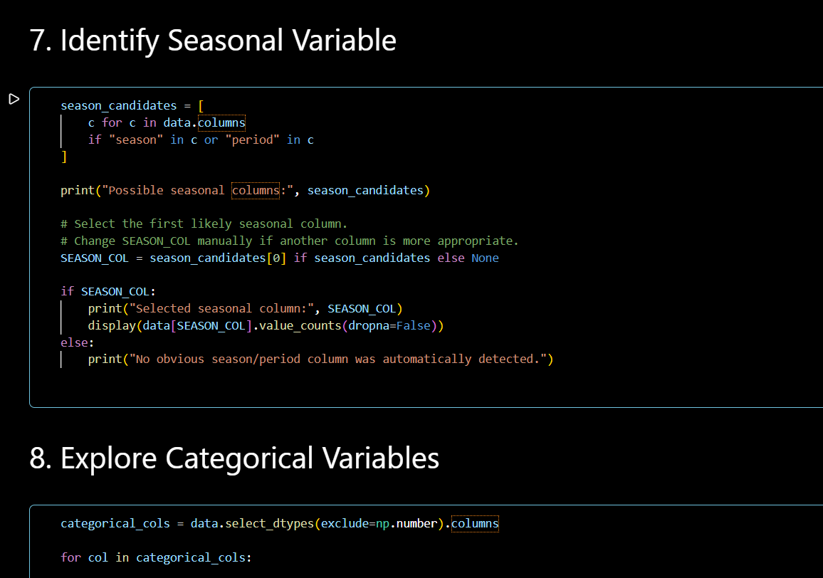
RESULTS
[Add screen shots of your code ]

Slide 10
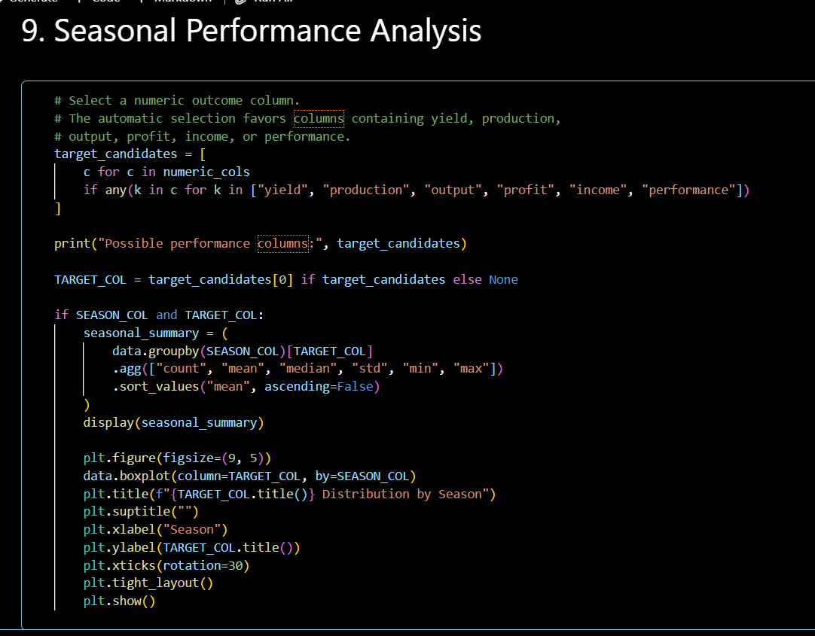
RESULTS
[Add screen shots of your code ]

Slide 11
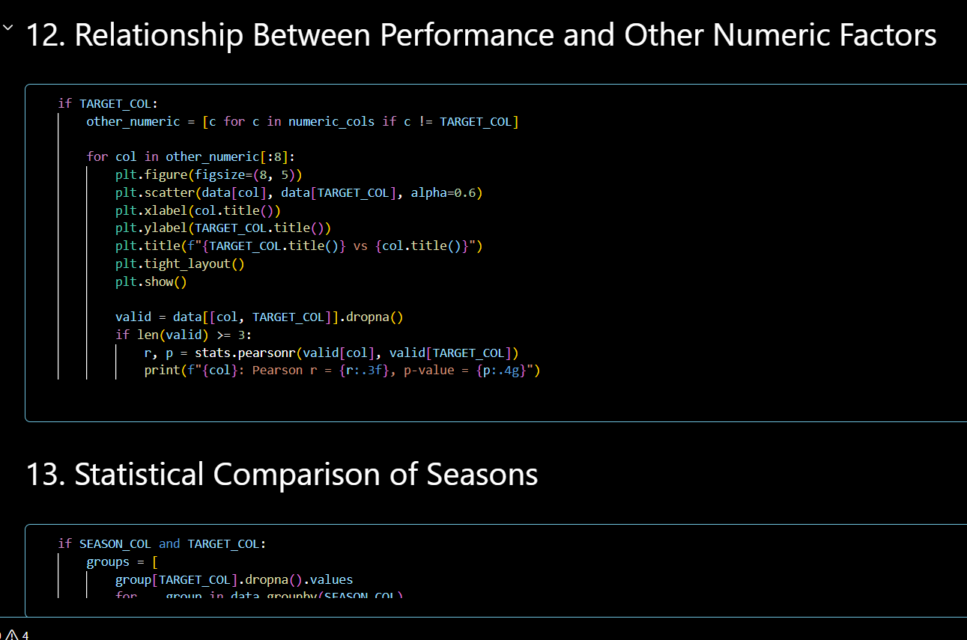

Slide 12
Future scope
Machine Learning: Predict crop yield based on seasonal and environmental factors.
Weather Prediction: Integrate real-time weather data for better seasonal planning.
Crop Recommendation: Recommend suitable crops for specific seasons and conditions.
Smart Irrigation: Develop a system to optimize water usage.
Real-Time Dashboard: Create an interactive dashboard to monitor agricultural performance.
Early Risk Detection: Predict disease, pest, and low-yield risks in advance.
Mobile Application: Provide farmers with easy access to analysis and recommendations.

Slide 13
GitHub Link
https://github.com/nishantsahay03/Seasonal-Agriculture-Performance-Analysis-

Slide 14
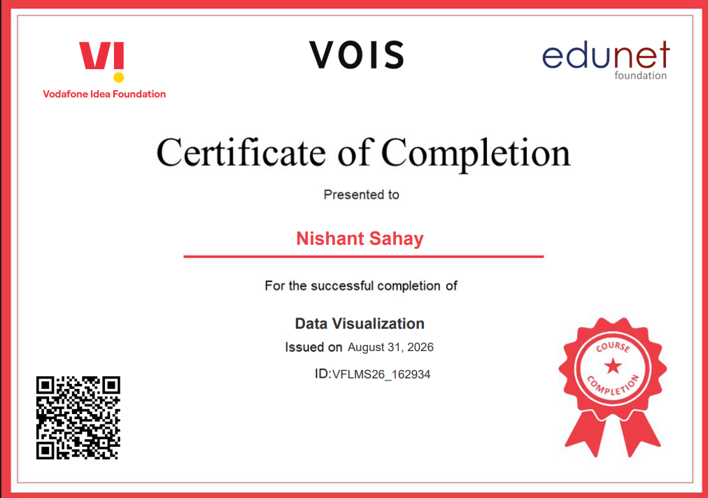
VOIS Course completion certificate -
Course name- Data Visualization

Slide 15
Thank you
.
.

