Slide 1
Sentiment Analysis- Measuring Your Corporate Reputation Stakeholder Presentation
Nishant Saurabh
1/12/2021

Slide 2
Motivation
Increasing number of users interacting with companies through social media
Real-Time social media as a medium to analyze customer Satisfaction and sentiments towards a company
Summarize company from customer’s perspective.
Valuation of company assets and its services.
A solution which can give Instant projection and can be modified to fit other industry domains.
Solution
Using data-driven concept to automate analytics process.
Proactive interaction with customers. No delay related to analysts labelling tweets manually
Use of Machine Learning to analyze massive data automatically

Slide 3
High Level Approach
Understand the problem
Get the data
Explore and clean Data
Perform EDA and build Visualizations
Decide on model type and build/train
Understand clear organizational need
Identify and engage different actors necessary to getting your project from design to production
Define timelines and KPIs
Analyze format of data ( Flat File/RDBMS?)
Identify ways & tools to access data.
Connect to the data
Gather enough data
Explore what attributes you have and data types
Identify dependent and independent variables.
Handle missing values.
Identify Dummy variables
Look at each column and ensure homogeneity and cleanliness
make data and project are compliant with data privacy regulations.
Identify balance or imbalance in data set.
Explore and build graphs.
Identify trends and relationships and share with client.
Decide if it’s a classification or regressions problem.
Supervised or unsupervised.
Pick models to try.
Perform parameter optimization through cross validation.
Pick the best model and parameters.
Identify most influential attributes.
Share results with client

Slide 4
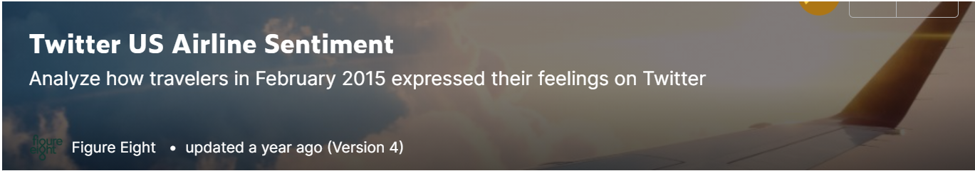
Dataset Use Case
Twitter Data from US Airline companies
Data set hosted on Kaggle
Data was scrapped from February of 2015.
Contains 14,500 tweets, and 15 columns with sentiments labeled as positive, negative or neutral.

Slide 5

Classical Learning model using state-of-the-art results to classify data
Can generates real-time results
Can also be used by stakeholders/investors to gauge a company’s current valuation and future potential/worthiness to invest money
Tailored to meet Airline Industry but with minor modifications can be diversified to meet any other consumer driven industry who are interested in below:
Customer Satisfaction score.
Identify gaps in internal processes.
Better serve customers.
Corelate between feedbacks through survey platforms and social media feedback .
Product Developed

Slide 6
Sentiment Analysis Classification Technical Presentation
Nishant Saurabh
1/12/2021

Slide 7
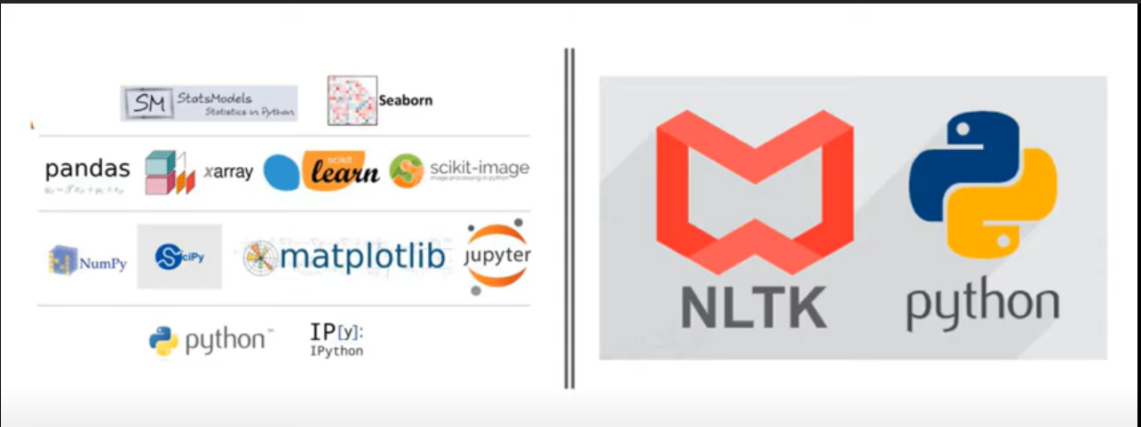
Libraries Used

Slide 8
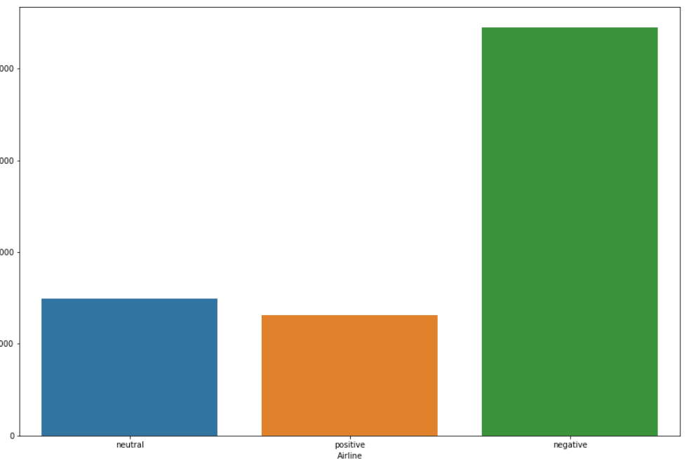
Initial Data Exploration
15 Features; ~14,500 tweets; No missing data on text feature
Data was scrapped from February of 2015.
Contains sentiments labeled as positive, negative or neutral.
Unbalanced Data Set ( 62% Negative, 22 % Neutral, 16 % Positive )

Slide 9
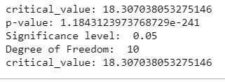
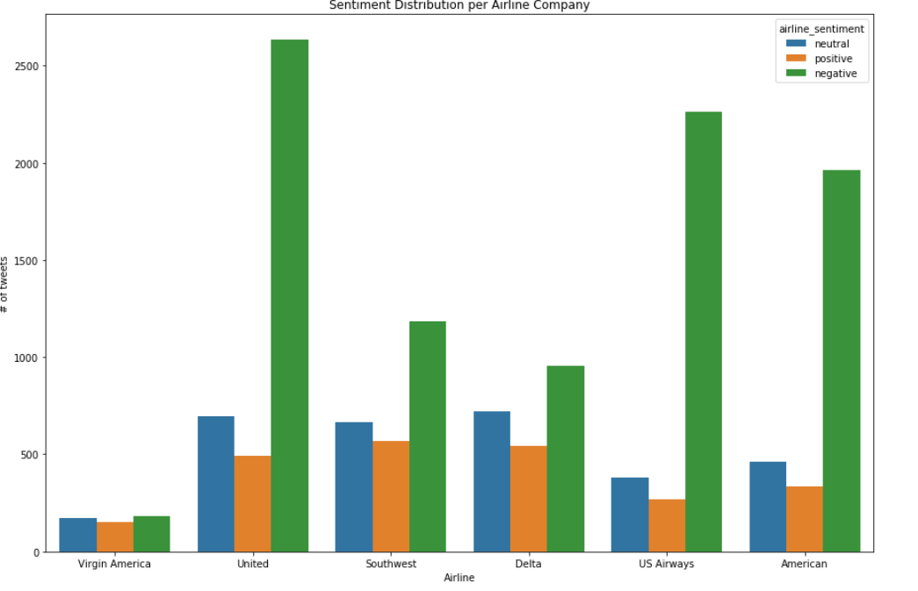
Data Exploration- Hypothesis 1
Hypothesis | P Values | Result
There is a relationship between Airlines Company and proportion of feedbacks | 1.1843123973768729e-241 | Accepted

Slide 10
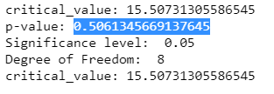
Data Exploration- Hypothesis 2
Hypothesis | P Values | Result
Proportion of tweet feedbacks do change with US time Zones | 0.5061345669137645 | Retained

Slide 11
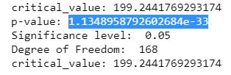
Data Exploration- Hypothesis 3
Hypothesis | P Values | Result
Proportion of tweet feedbacks do not change with time Zones | 1.1348958792602684e-33 | Rejected
Interesting findings : Seems When we compare just the Tweets in US time zone, we do not find any dependency between tweet proportions but when we consider all the time zones there is a relationship between Time Zone and proportion of feedbacks

Slide 12
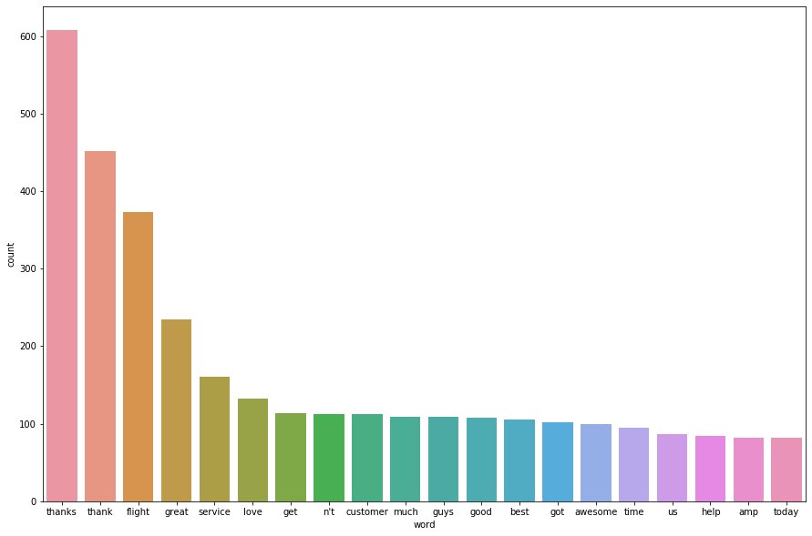
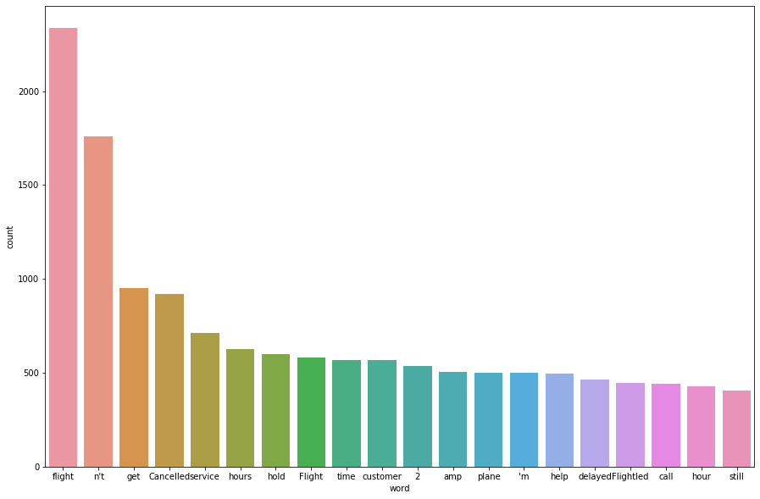
Words Relevance
Positives
Negatives

Slide 13
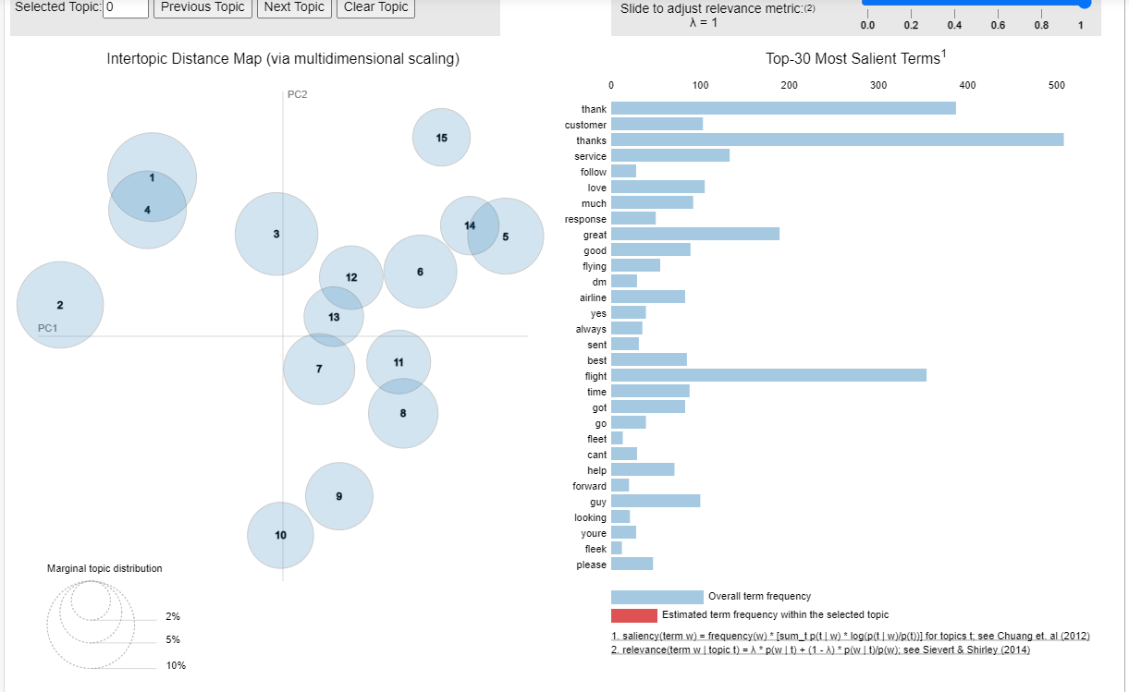
Words Relevance

Slide 14
Feature Engineering and ETL – Bag of Words
Data Cleaning
Tweet
Lowercase, Removing URLs, Hashtags
Stemming
Tokenization using Twitter specific Methods
Label to Indicate presence of emoticon and its sentiments
Feature Extraction
Input to Classical models
Bag of Words (TF-IDF and Countvect)
Polarity Scores using Opinion Lexicon

Slide 15
Model Definition and Training
Experimented with different Classical algorithms
Cross Validation with variety of features
Best Model : LinearSVC
Model Name | Best Parameters | Score
MultinomialNB | Best params: {'clf__alpha': 0.5, 'clf__fit_prior': False, 'feats__text__tfidf__binary': None, 'feats__text__tfidf__max_df': 0.5, 'feats__text__tfidf__ngram_range': (1, 1), 'feats__text__tfidf__use_idf': False} | 0.7748161764705882
LinearSVC | Best params: {'clf__C': 0.5, 'clf__class_weight': 'balanced', 'clf__loss': 'squared_hinge', 'feats__text__tfidf__max_df': 0.5, 'feats__text__tfidf__ngram_range': (1, 2), 'feats__text__tfidf__use_idf': False} | 0.7890625
RandomForestClassifier | Best params: {'feats__text__tfidf__max_df': 1.0, 'feats__text__tfidf__ngram_range': (1, 1), 'rf__bootstrap': True, 'rf__class_weight': None, 'rf__max_features': 0.7, 'rf__n_estimators': 50} | 0.7467830882352942
Simpletransformers | No CV tried – Considering low scores | 0.6135110294117647

Slide 16
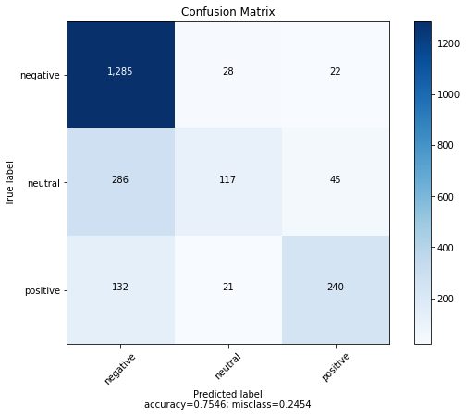
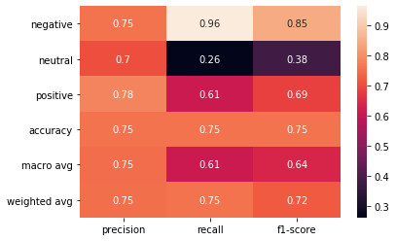
MultinomialNB-Model Evaluation

Slide 17
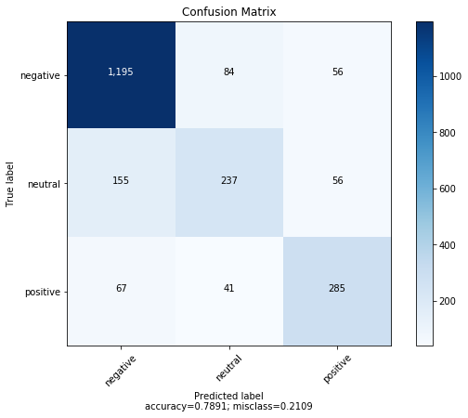
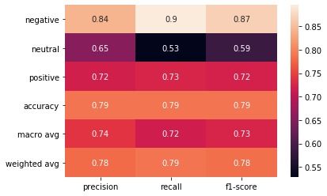
LinearSVC-Model Evaluation

Slide 18
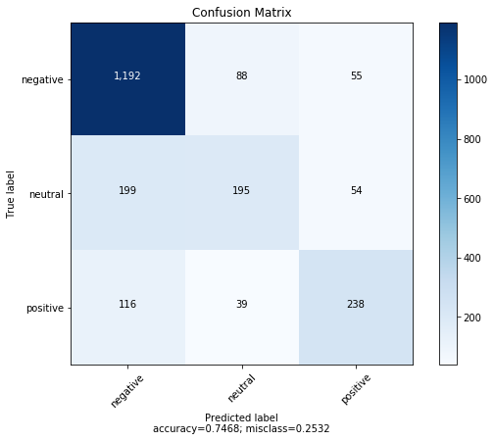
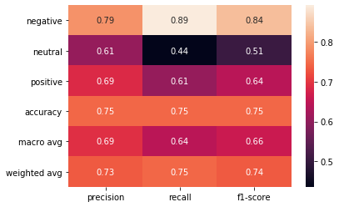
RandomForestClassifier-Model Evaluation

Slide 19
Future Work
With above conclusions I will end my model building process. We always have rooms for improvement, and I will always love if someone ( Or me in near future) may be able try few of below and check if we can make this model perform even better
Try Deep Learning models
Include more features like ( Geography/Time of Tweet etc)-
Feature engineering like np.log(X), np.exp(X), np.sqrt(X)

