Slide 1
HR Analytics- Who should we promote
Nishant Saurabh
6/9/2020

Slide 2
Problem Statement
A large MNC with 9 broad verticals across the organization is facing problems around identifying the right people to promote.
The current process being followed are time consuming, very manual and are contributing to delays in employee transitions to their new roles.
Problem Statement
Armed with client provided multiple attributes ( And associated data ) around Employee's past and current performance along with demographics, build a machine learning model to predict whether a potential promotee at checkpoint in the test set will be promoted or not after the evaluation process.
Solution

Slide 3
High Level Approach
Understand the problem
Get the data
Explore and clean Data
Perform EDA and build Visualizations
Decide on model type and build/train
Understand clear organizational need
Identify and engage different actors necessary to getting your project from design to production
Define timelines and KPIs
Analyze format of data ( Flat File/RDBMS?)
Identify ways & tools to access data.
Connect to the data
Gather enough data
Explore what attributes you have and data types
Identify dependent and independent variables.
Handle missing values.
Identify Dummy variables
Look at each column and ensure homogeneity and cleanliness
make data and project are compliant with data privacy regulations.
Identify balance or imbalance in data set.
Explore and build graphs.
Identify trends and relationships and share with client.
Decide if it’s a classification or regressions problem.
Supervised or unsupervised.
Pick models to try.
Perform parameter optimization through cross validation.
Pick the best model and parameters.
Identify most influential attributes.
Share results with client

Slide 4
Dataset Description
Variable | Definition | Variable Type 1 | Variable Type 2
employee_id | Unique ID for employee | Discrete | Independent
department | Department of employee | Nominal | Independent
region | Region of employment (unordered) | Nominal | Independent
education | Education Level | Ordinal | Independent
gender | Gender of Employee | Nominal | Independent
recruitment_channel | Channel of recruitment for employee | Nominal | Independent
no_of_trainings | no of other trainings completed in previous year on soft skills, technical skills etc. | Discrete(Or Call it Numeric) | Independent
age | Age of Employee | Discrete | Independent
previous_year_rating | Employee Rating for the previous year | Discrete | Independent
length_of_service | Length of service in years | Discrete | Independent
KPIs_met >80% | if Percent of KPIs(Key performance Indicators) >80% then 1 else 0 | Ordinal(Binary) | Independent
awards_won? | if awards won during previous year then 1 else 0 | Ordinal | Independent
avg_training_score | Average score in current training evaluations | Ordinal | Independent
is_promoted | (Target) Recommended for promotion | Ordinal(Binary) | Target Variable (Dependent)

Slide 5
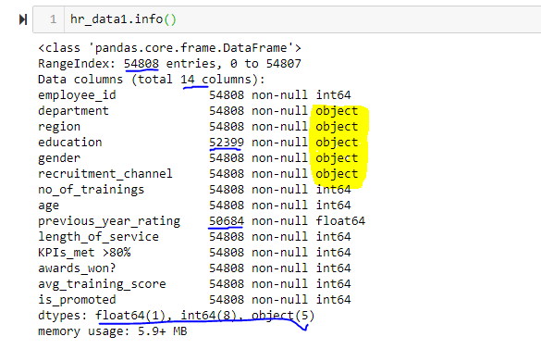
Get-Explore-Clean Data - 1
The data I had was in CSV format. I loaded the data through read_csv function and performed below steps to get the feel of the data and to handle missing values.
Step 1 : As soon as I loaded the data I ran info function and had below observations
Dataset had 14 columns and 54808 rows.
I noticed 2 columns (‘Education’ and ‘previous_year_rating’) with missing values.
5 columns (highlighted in yellow below) were of type Object and may need conversion to ‘Categorical’ data type
Dataset had in today 3 data types ( Float, Int and Object)

Slide 6
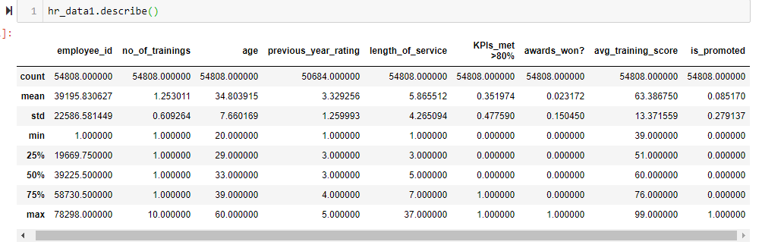
Get-Explore-Clean Data - 2
Step 2: Next I ran a describe function on the data set to get the feel on spread of the data.
Below were my observations:
Employee_ID max value was 78298 but count of employee_id was 54808. So either dataset was not complete for many rows were deleted or employee_id was not assigned in sequence.
I had an imbalanced data set as for my dependent variable( (is_promoted) even 3rd quartile has value 0. (Also right skewed)
50% or more of people had not got KPI > 80.(Right Skewed Data)
No_of_training data showed 75% of employees had not done more than 1 training and data was right skewed
Similarly I also ran .describe(include='all') function to find unique values for my categorical data.
Ang_trainig_score seemed almost uniform spread with mean value close to median..
Awards_won showed 75% of employees had not won any awards and data was right skewed
Length_of_service shows uniform spread of data with Mean very close to median.
Age showed a similar case as length_of_service(Uniform spread).

Slide 7
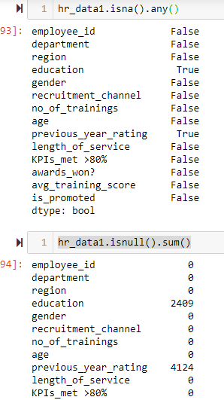
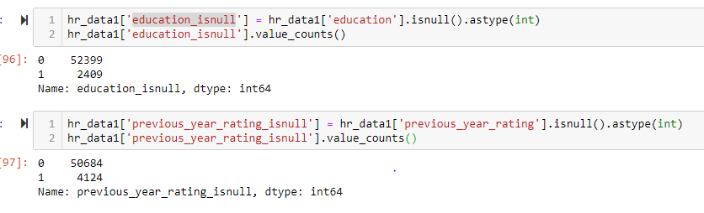
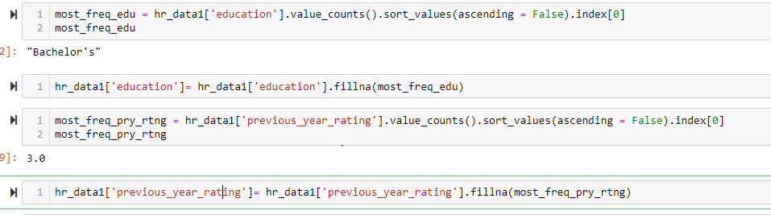
Get-Explore-Clean Data - 3
Step 3: Then I used isna and sum functions to confirm on how many columns had NULL values and count of NULL values in each column
Step 4: Now before filling the NULL values for columns identified having NULLs, I created a new column with details on which row had a NULL value and which not for future reference.
Step 5: Now for missing columns Education and previous_year_rating Imputed with the most frequently occurring data in the respective columns. Filled Education with ‘Bachelor’s’ and previous_year_rating with 3.0.

Slide 8
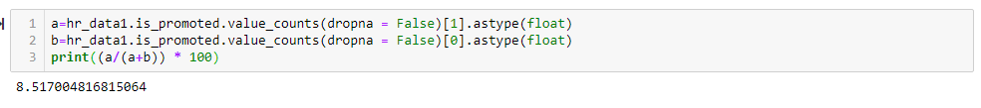
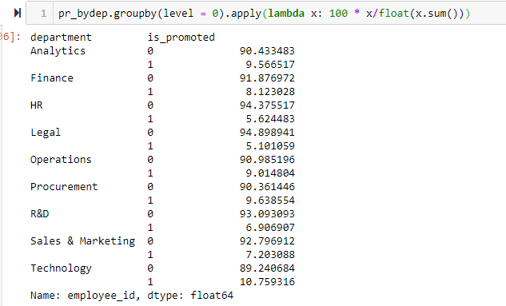
Get-Explore-Clean Data - 4
Step 6: Then to confirm the imbalanced dataset I checked the % ratio of positive values for my dependent variable is_promoted to negative values. A 9% positive values confirmed a imbalanced dataset.
Step 7: Now to do some exploratory data analysis. I checked the % of people promoted for each department and region to check if they impact my dataset or not. Each department seemed to have uniform % or promotions but regions data did highlight an non uniformity on promotion %.

Slide 9
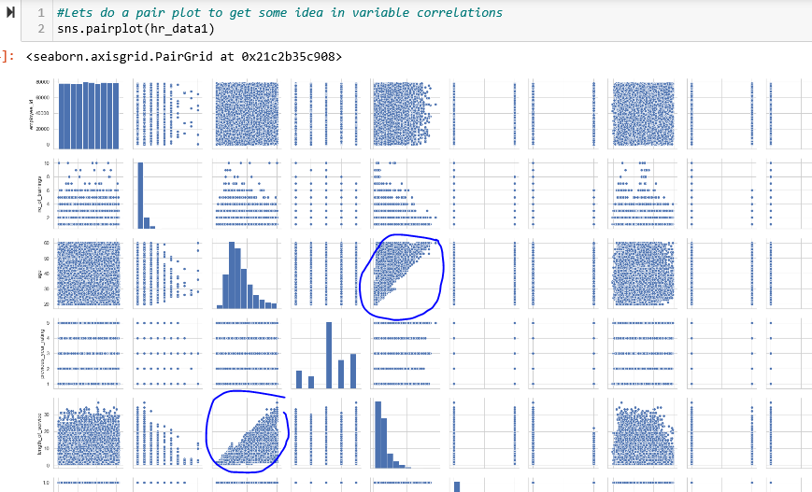
Statistical Data Analysis - 1
After exploring visual descriptions of data using plots, as a next step I took a deeper dive into data to find out what is going behind them and if I can arrive on some conclusions with (un)certainty!
Considering I have a huge dataset(54K records) and armed with a few great pieces of advice from my mentor I choose the frequentist approach. Below I describe the steps I took:
Step 1: I generated a pair plot to get some idea in variable correlations. Below is the screenshot of the same

Slide 10
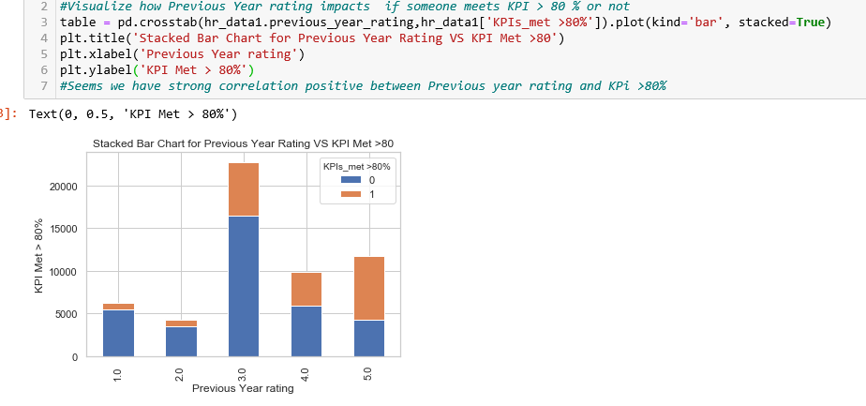
Statistical Data Analysis - 2
Step 2: Visualizing the data and looking at some other deep data analysis, I conceptualized two NULL hypotheses and performed the frequentist approach to prove/disprove the same. I will detail out one of them in the below steps.
Step 3: One of correlation I noticed through visualization was between Previous year ratings and how it influences if someone met there KPI > 80%.

Slide 11
Statistical Data Analysis - 3
Through Visualizing and analyzing I conceptualized the below NULL Hypothesis for further research:
My NULL Hypothesis: Previous Year rating has no influence on if someone meets KPI > 80 % or in other words there is no statistical significance between both the variables.
Since both the variables in consideration were categorical variables - I used to Chi Squared Test
Step 4: I went ahead with Significance level (Alpha) of 0.05 and would accept the NULL hypothesis with below conditions being true:
If my P value is greater than or equal to Alpha
If my chi_square_statistic is less than equal to critical_value

Slide 12
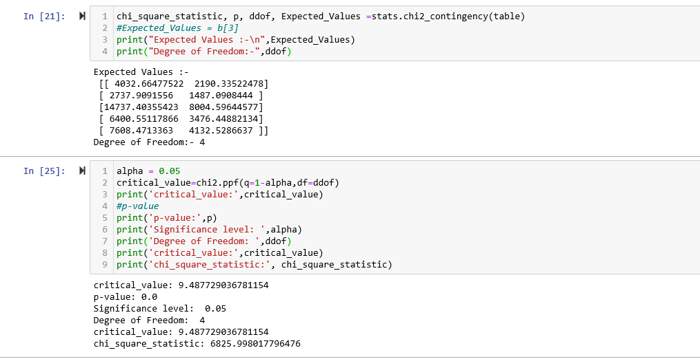
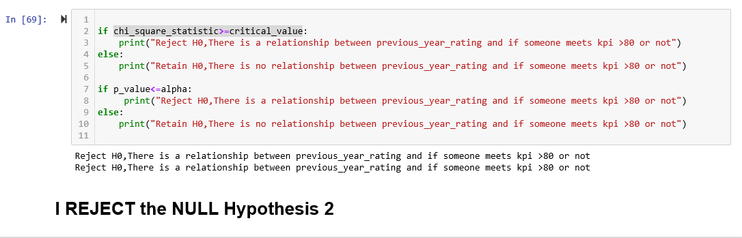
Statistical Data Analysis - 4

Slide 13
Statistical Data Analysis - Conclusions
Conclusions: As we can refer above. Both my P Value(0.0) was less than my Alpha of 0.05 and Chi Squared Static (6826) was greater than my critical value (9.48). This led to me to conclude that the NULL hypothesis has to be rejected.
Or in other words the data that we visualized showing dependency between Previous Year Ration and KPI Met >80 was not just any random observation and did had some statistical significance to the same.
With the above observation I moved on to my next step - Machine Learning.

Slide 14
Machine Learning - Approach
My Approach
Being a classification problem I will try below machine learning algorithms and then pick the best performing model out of same.
SVC
Random Forest
Logistic regression
KNN
XGBoost
For each of methods above I will try different parameter values to get the most optimized parameter combinations (Parameter Tuning)
Being imbalanced data set Accuracy Score may be misleading.
I will have to rate the model performance based on how well it will predict who got promoted
I will look for Precision/Recall and F1 Score for promoted = 1

Slide 15
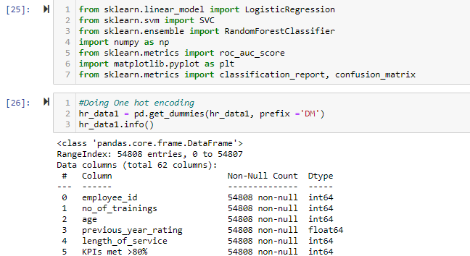
Machine Learning – Data Prep 1
Before we start will perform below data preparation steps:
Perform one hot encoding for categorical variables

Slide 16
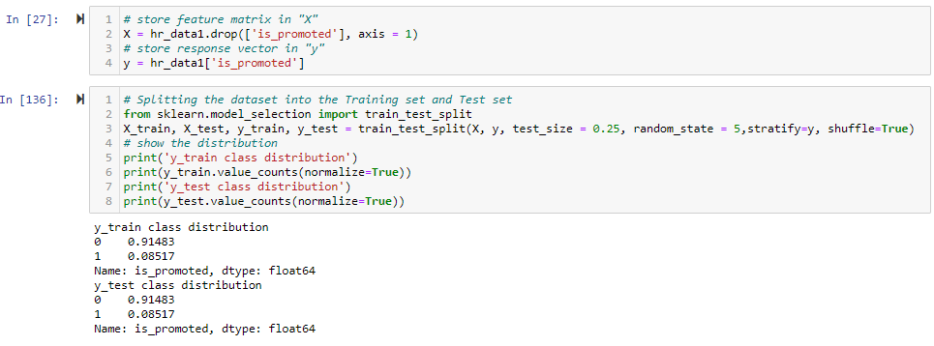
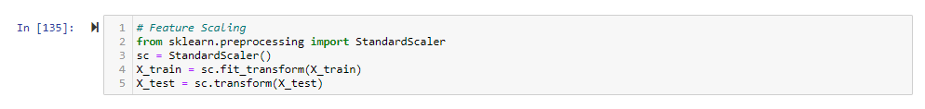
Machine Learning – Data Prep 2
Store feature matrix and response vector
Next, I will go for Feature scaling to make sure all my features are of similar scale

Slide 17
Machine Learning – Logistic Regression 1
What is Logistic regression : Logistic regression is the appropriate regression analysis to conduct when the dependent variable is binary. Like all regression analyses, the logistic regression is a predictive analysis and is used to describe data and to explain the relationship between one dependent binary variable and one or more nominal, ordinal, interval or ratio-level independent variables.
Some details on important parameters I will use for tuning
Penalty:
This hyper-parameter is used to specify the type of normalization used. Few of the values for this hyper-parameter can be l1, l2 or none. The default value is l2.
Inverse of regularization(C):
This hyper-parameter is denoted as C. Smaller values of this hyper-parameter indicates a stronger regularization. Default value is 1.0
Solver:
This indicates which algorithm to use in the optimization problem. Default value is lbfgs. other possible values are newton-cg, liblinear, sag, saga.

Slide 18
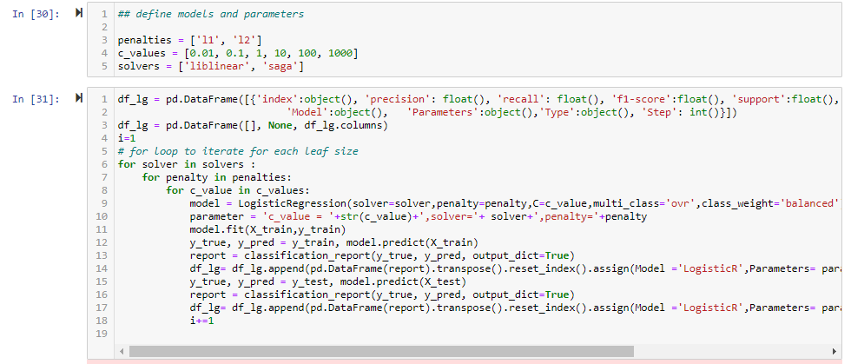
Machine Learning – Logistic Regression 2
To Start with I will define some model parameters
Next, will use a for loop to iterate through all possible parameter combinations and store classification report results in a dataframe

Slide 19
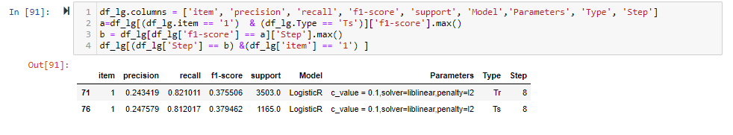
Machine Learning – Logistic Regression 3
Next, I will get the best training and test score for Is_promoted = 1 for Logistic regression model
Model Performance analysis
With a score F-Score of 37% I do not find this as a suitable model to predict if someone should be promoted or not.
Model seems to be generalizing well though, as F-Score of Test and Train set are almost similar

Slide 20
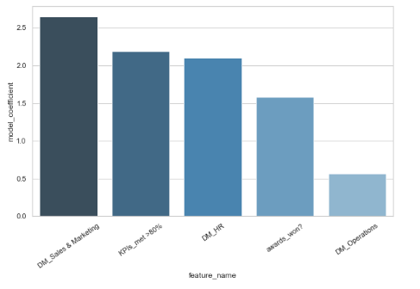
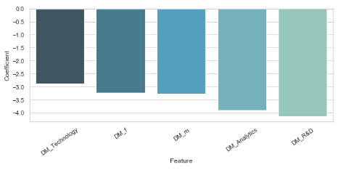
Machine Learning – Logistic Regression 4
As a last step I will try to visualize the coefficients that have the largest positive and negative impact on the probability of getting promoted
We can see from these graphs that the odds are brightest for people who are in Sales & Marketing department and have met KPI>80 %
Also if you work with R&D or Analytics department, it negatively impacts your promotion.
I will advice my client on looking into these disparities based on department

Slide 21
Machine Learning – XGboost 1
What is XGboost : XGBoost is an algorithm that has recently been dominating applied machine learning and Kaggle competitions for structured or tabular data. XGBoost is an implementation of gradient boosted decision trees designed for speed and performance.
Some details on important parameters I will use for tuning
max_depths:
The maximum depth of a tree and used to control over-fitting as higher depth will allow model to learn relations very specific to a particular sample.
min_child_weights:
Defines the minimum sum of weights of all observations required in a child
gammas:
A node is split only when the resulting split gives a positive reduction in the loss function. Gamma specifies the minimum loss reduction required to make a split.
colsample_bytrees:
Denotes the fraction of columns to be randomly samples for each tree.
learning_rates:
Makes the model more robust by shrinking the weights on each step

Slide 22
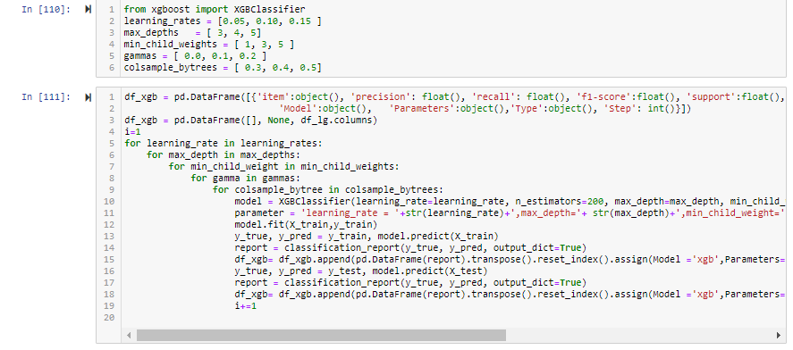
Machine Learning – Xgboost 2
To Start with similar to Logistic regression I will define some model parameters
Next, will use a for loop to iterate through all possible parameter combinations and store classification report results in a dataframe

Slide 23
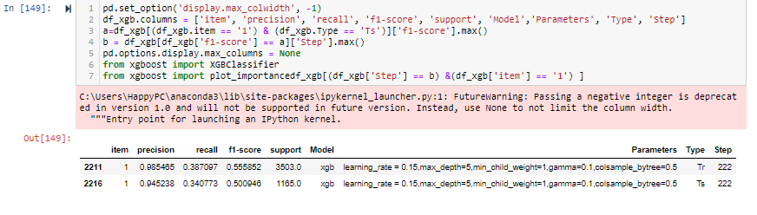
Machine Learning – Xgboost 3
Next, I will get the best training and test score for Is_promoted = 1 for Logistic regression model
Model Performance analysis
With a score F-Score of 50% I do not find this as a suitable model to predict if someone should be promoted or not.
Model doesn’t seem to be generalizing well though, as F-Score of Test and Train set are not so similar (Overfitting)

Slide 24
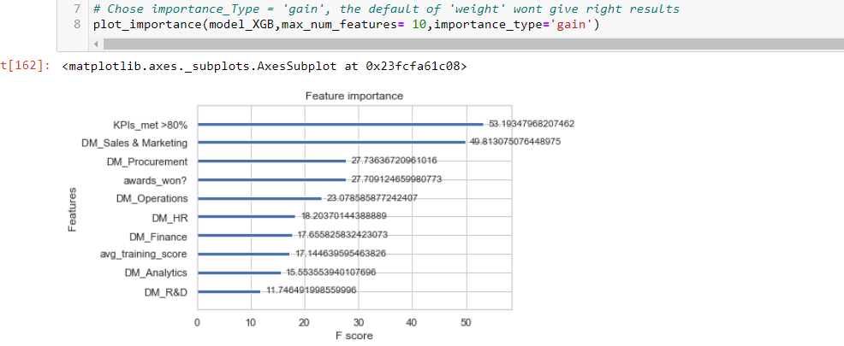
Machine Learning – Xgboost 4
Now I will try to visualize the feature importance graph to find out what impacts the most in deciding if someone gets promoted or not.
We will also check if the same matches to what we noticed in Logistic regression
We can see from these graphs that its very much like Logistic regression, odds are brightest for people who are in Sales & Marketing department and have met KPI>80 %

Slide 25
Machine Learning – Conclusion
Best Model
XGBoost
Best Parameters
(learning_rate=0.15, n_estimators=200, max_depth=5, min_child_weight=1, gamma=0.1
Who are most likely to get promoted
People working in Sales and Marketing department and/or have met KPI>80 are more likely to get promoted

Slide 26
Future Work
Future Work
With above conclusions I will end my model building process. We always have rooms for improvement
and I will always love if someone ( Or me in near future) may be able try few of below with my Features(X) and check if we can make this model perform even better
np.log(X)
np.exp(X)
np.sqrt(X)
X**
X***
X1*X2(Multiply top 2 most impacting features)

