Slide 1
Mycar Dream Assignment SUBMISSION
Prabhakar Srivastav
DDA1610218

Slide 2
Business Goal
Problem Statement:
Nowadays, the automobile market has become very dynamic as the buyers have varied preferences. Customers look for various features (brand value, mileage, model_year etc) in their dream car. In order to fulfill it's customer requirement, Mycar Dream wants to automate the process of predicting the car mileage which fits the customer preferences, based on the dataset of car features and attributes obtained by market surveys.
The data set contains the following details about cars:
The aim here is to predict the city-cycle fuel consumption in miles per gallon, in terms of 3 multivalued discrete and 5 continuous attributes. Below is the data dictionary to be used for the dataset.

Slide 3
CRISP-DM
Business Understanding
Data Preparation
Modelling
Evaluation
Deployment
Data Understanding

Slide 4
Data Understanding
We Note that the data set has 9 variables in totality with 398 observation, where the variable Cylinders, Model_year and Origin should be a factor and the rest 5 variables excluding Car name(nominal variable), should be of numeric/integer type.
We will ensure that the dataset is imported in the correct format. So, will check the structure of the carmileage dataset.
We notice that the "Cylinders","Model_year" and "Origin" are not of factor type by default, and also we see that "Horsepower" variable is not of numeric/integer type by default.
We also need to check for data granularity, so we will check for unique key in our data set, and to check for duplicate values in car name.
We see that there are 93 duplicate value in car name so car name cannot be our unique key, but if we combine model_year and car name. we are getting only two duplicates, so car_name and model_year is our unique key.
We see that the “Horsepower” and “Acceleration” are having outliers, at 97% and 98% for “Horsepower”, and 0% to 1% and 98% to 99% for “Acceleration”.

Slide 5
Data Preparation
So, we have change the type of "Cylinders","Model_year" and "Origin" variable to factor and Horsepower to Numeric.
We also notice that while converting horsepower to numeric, “NA” values was introduced, for values "?". So, we have replaced the “na” values with the mean of horsepower .
We see that there are two duplicate if we combine car_name & model_year at row 175 and 343, having car name "ford pinto" and "plymouth reliant“. So we have removed those two rows from our datasets.
Next we have removed the outliers from “Horsepower” and “Acceleration”.
We have Created 3 new level for Cylinder as low(3,4,5), mid(6) and high(8) .
We have also created 3 new level for "Model_year" as old(2003:2006),mid(2007:2010) and new(2011:2015).
We have also grouped car_name into brand name of 30 levels. And remove the car_name variable from our data set.
We need to create dummy variables for all the categorical variables.
Dummy variables basically convert categorical values to integers so that models can perform mathematical operations on them.
Since dummy variable are created separately, I have made a function that will automate the process of creating dummy variable of factor class from a given data set and the number of levels (n) will be n-1. I have place the source code for the function at Github :-#install_git("https://github.com/prk327/AtConP").
We will use the above function to create dummy variables of all the factor class. And Cbind all the dummy variable to the carmileage df.
We have split the data into training and testing data in 70-30 ratio. Since the carmileage_1 dataframe has 396 observations, we'll have 277 training and 119 testing observations.

Slide 6
Data Modelling
Given the business objective, the dependent variable for the model is MPG.
So, we have build the first model and store it in a variable model_1.
The Adjusted R-squared: 0.845 for model_1 which has too many insignificant variables so we have use step method and p-value mehod to reduce the number of variables to 5 in model_3:-
model_3 <- lm(formula = MPG ~ Horsepower + Weight + `Cylinders : mid` + `Model_year : Old_Model` + `Model_year : Mid_Model`, data = train)

Slide 7
Model Results
The Adjusted R-squared of the train model is 82%
The Adjusted R-squared of the test model is 84%

Slide 8
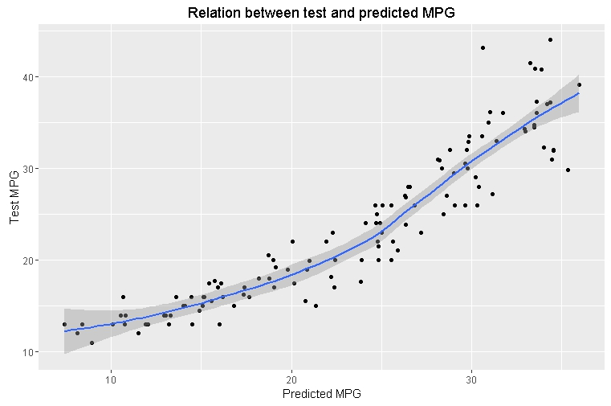
Results

Slide 9
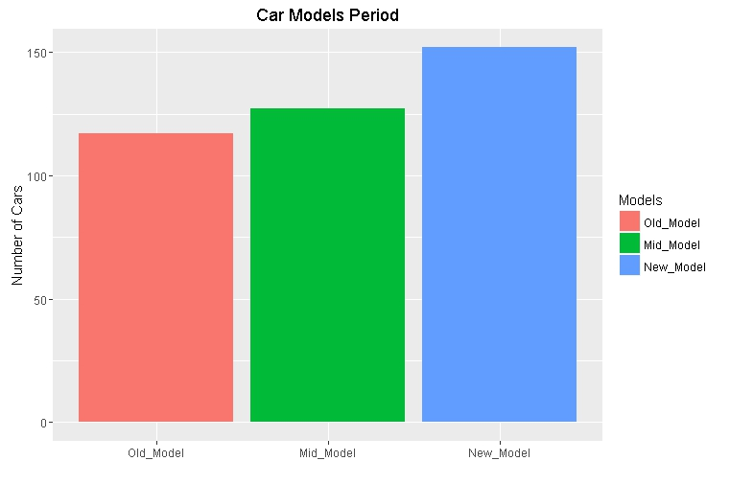
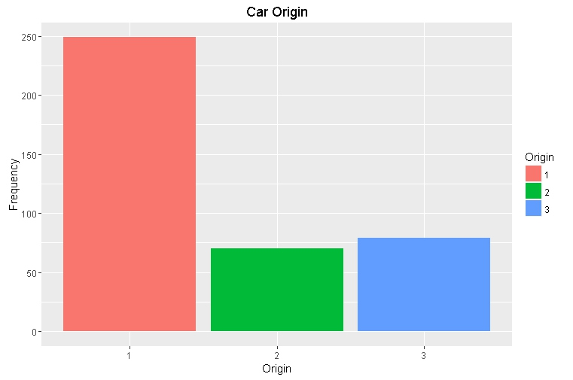
Results

Slide 10
Conclusions
So, We have successfully created a model that can take car features and attributes to predict the car MPG,
The accuracy of the train model is ~83% while the accuracy of the test model is ~84%, which is good for our analysis.

