Slide 1
Telecom Churn Case Study SUBMISSION
Prabhakar Srivastav
DDA1610218

Slide 2
<Conclusion>
Checkpoint-1: Data Understanding and Preparation of Master File
The final number of rows are 7032 with 32 columns
Checkpoint 2: Exploratory Data Analysis
We see that there is high number of people who are using the services for more than a year.

Slide 3
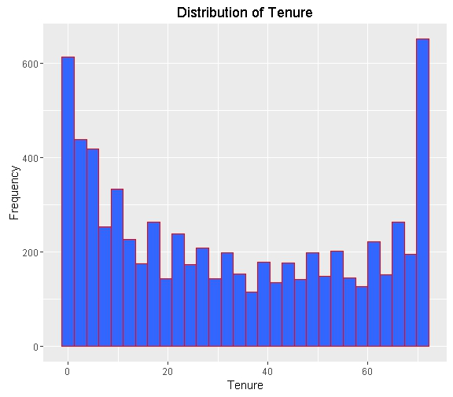
<Conclusion>

Slide 4
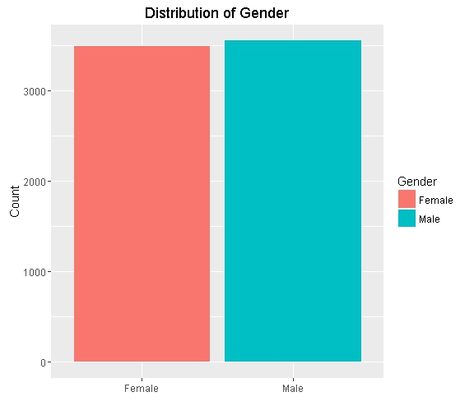
<EDA plots and insights>
we see that there is more of a equal distribution of male and female

Slide 5
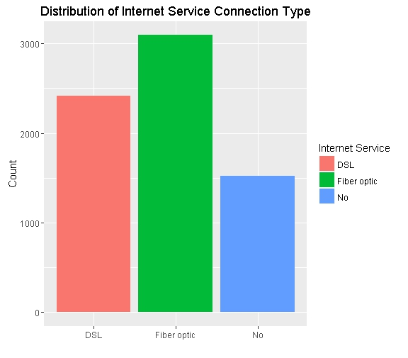
<EDA plots and insights>
we see that about 1500 customers don't use internet service

Slide 6
<K-NN model insights and results>
After continuous iteration we found that at k=47 we are getting a accuracy of 80, Sensitivity of 87% and Specificity of 61%, which is the highest in each metrics, if we are increasing any more iteration we are either getting lower accuracy, or lower sensitivity or lower specificity. So we conclude that 47 will be the optimal value for k.
We can also see the optimal value of K in the ROC curve which is shown below.
Threshold value | Values (Numeric)
Overall Accuracy | 80
Sensitivity | 87
Specificity | 61
AUC | 75

Slide 7
< Naïve Bayes model insights and results >
Report the final performance metrics and discuss the results and their implications.
Threshold value | Values (Numeric)
Overall Accuracy | 70
Sensitivity | 65
Specificity | 83
AUC

Slide 8
< Logistic Regression model insights and results>
We have converted the dependant variable with 0 and 1, Since Logistic regression takes numeric variables as inputs.
The coefficients of our model are:- `Contract : Month-to-month` + `Dependents : No` + `DeviceProtection : No internet service` + `InternetService : DSL` + `MultipleLines : No` + `OnlineSecurity : No` + `PaperlessBilling : No` + PaymentMethod : Electronic check` + `StreamingTV : No` + `TechSupport : No` + TotalCharges. We observe that `DeviceProtection : No internet service` has -1.67553 as coefficients, which means if the customer have no internet service his probability of churning will be very less, which makes sense, also we see that Contract : Month-to-month has 1.06600, which means that if the customer is on a month to month contract his changes of churning will be very high, which completely makes sense.

Slide 9
< Logistic Regression model insights and results >
Calculate c-statistic and KS-statistic. What can you tell about the model based on their values?
We see that the c-statistic for test data is 8.36, which is close to 1, we can safely say that our model has good discriminative power.
Our ks-statistic is at 0.40 which is good, in 4th decile in test data set.
Train Dataset |  | Test Dataset
C-statistic | 8.37 | C-statistic | 8.36
KS-statistic | 0.51 | KS-statistic | 0.54
Model Evaluation (write Accept or Reject) |  | Accept

Slide 10
<SVM Model insights and results>
Report the final performance metrics and discuss the results and their implications.
Threshold value | Values (Numeric)
Overall Accuracy | 0.50
Sensitivity | 0.90
Specificity | 0.51
AUC

