Slide 1
Spark Fund Investment Analysis
Group Name:
Prabhakar Srivastav & DDA1610218
Anshul Joshi & DDA1610234
Ankit Kumar & DDA1610286
Deepika Srinivas & DDA1610027

Slide 2
Spark Fund Investment Analysis (Data sets “companies & round2”)
Unique Companies Present in the both the data sets were 66368
Permalink in companies file and company_permalink in the round2 file are synonyms
There is no other companies present in both the files while doing our analysis
There are approximately 105802 observation are present in master file after doing inner merge

Slide 3
Spark Fund Investment <Problem solving methodology>
Import Data Files
Cleaning the Data by using trim and tolower the variable
Checking for Data Granularity
Removing of Duplicate values based on key variable
Merging of data using unique column from each data sets
Checking of any outliers values in our master data sets
Replacing of outliers values with the most nearest value
Checking for any NA values and replacing them with the mean of the total value
Master File ready for analysis

Slide 4
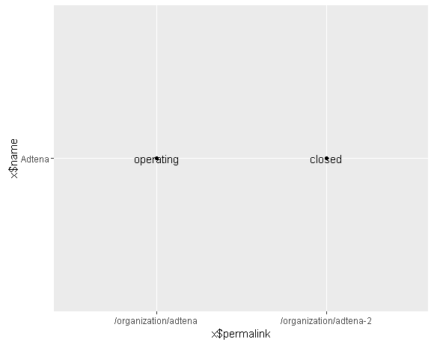
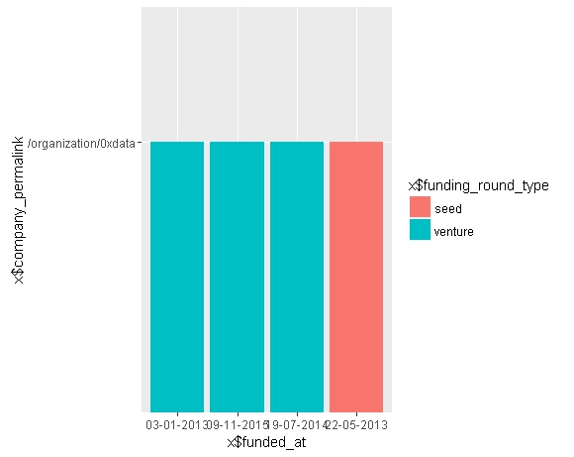
Duplicate Analysis
Company date frame has duplicate base on key column “permalink” & “Status” this can be clear by below plot
Round2 data frame has duplicate base on key column “company_permalink”,”funding_round_type” & “funded_at” this can be shown with the below plot

Slide 5
Analysis of Nominal variable
While doing our analysis we found that while mapping main sector we have left with 55 variable which are not present in the primary sector, so we looked at the DF of 55 obs and found that about 36 unique variable are missing the sector category in mapped file.
So for our analysis we have replace all the 55 obs with the most occurred sector from the master file i.e “other”.
Again we found that there a blank sector in our dimension file so we have replace the blank sector with the most occurred sector.

Slide 6
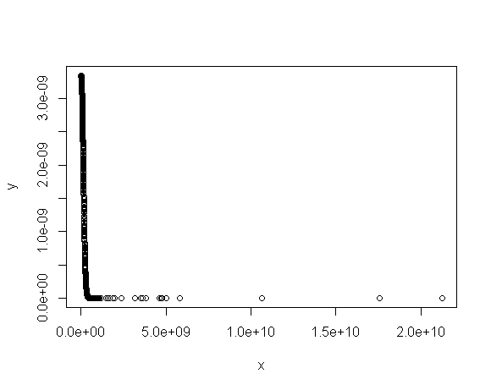
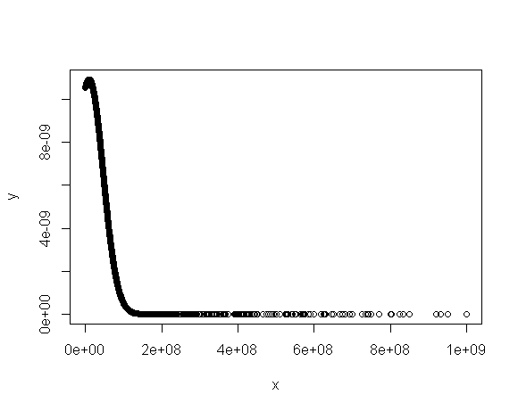
Analysis of missing & outliers
For our analysis we have observed that there exist an investment more that billion dollar USD and which is coursing the huge variation min the mean of the raised amount USD, so for our analysis we have replace all the investments more than billion dollar USD with $999,999,999.
Below is the normal distribution curve to illustrate the same before and after replacement.

Slide 7
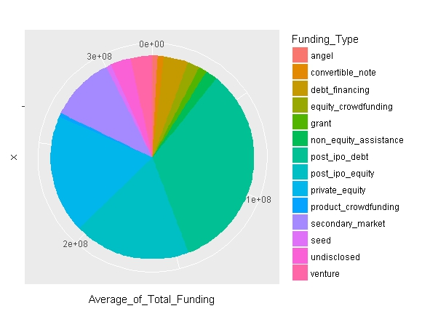
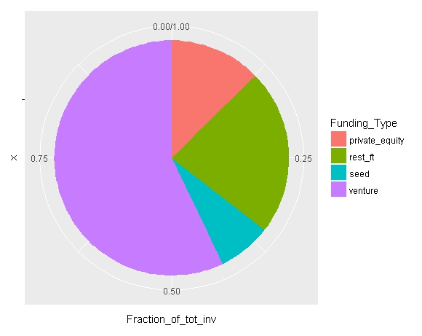
Pie chart showing the fraction of total investments (globally) in venture, seed and private equity and the average amount of investment in each funding type.

Slide 8
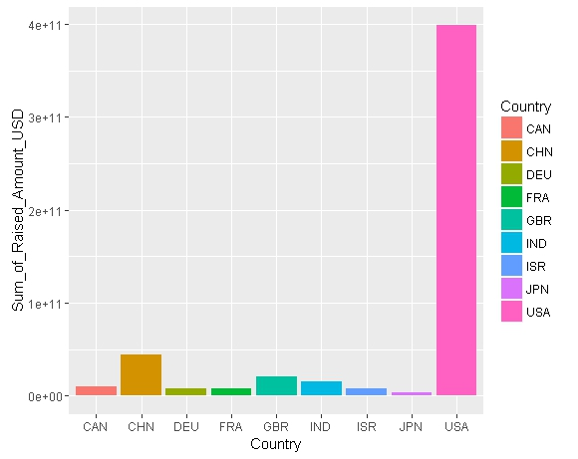
One bar chart showing top 9 countries against the total amount of investments of funding type FT. This should make the top 3 countries (Country 1, Country 2 and Country 3) very clear.

Slide 9
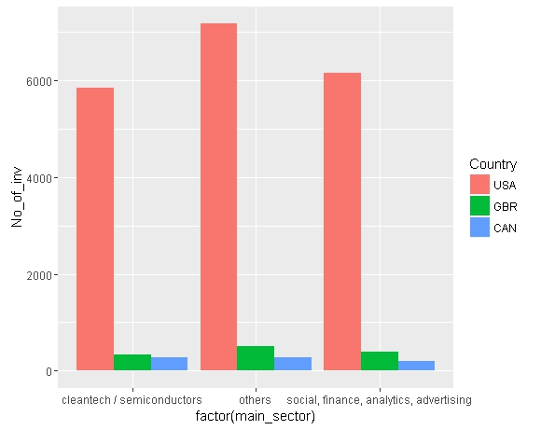
This should show the number of investments in the top 3 sectors of the top 3 countries on one chart (for the chosen investment type FT).

Slide 10
Conclusions
After all the analysis we came to the conclusion that the most suitable invest time in “Venture” and the most suitable geography is “United State of America” and the most suitable sector is “social, finance, analytics, advertising”.

