Slide 1
Gramener Case Study SUBMISSION
Group Name:
Prabhakar Srivastav & DDA1610218
Anshul Joshi & DDA1610234
Ankit Kumar & DDA1610286
Deepika Srinivas & DDA1610027

Slide 2
Cross Industry Standard Process for Data Mining
Business Understanding
Data Understanding
Data Preparation
Modeling
Evaluation
Deployment

Slide 3
Business Understanding
Business Understanding?
Business Objective:
The finance company is looking for the attributes in a applicant profile which can help them is deciding whether to approve or decline the loan application.
Goal of Analysis:
To find out the relation between the different attributes and their impact on loan default. And suggest which attributes contributes a significant difference in Loan Default.
2. Where did we get the data from?
Let's assume that the company has provided you the data set for analysis. It can be downloaded
from the link below. It contains complete loan data for all loans issued through the time period
2007 t0 2011.

Slide 4
Data Understanding
The company has come across some important attributes in order to understand behavior of their approved loan customers w.r.t. loan default. Thus, the lending company has decided to work only on these variables to mitigate the future risk. The driver variables consider for this case study are:
annual_inc - Annual Income of applicant
loan_amnt - The listed amount of the loan applied for by the borrower
funded_amnt - The total amount committed to that loan at that point in time
int_rate - Interest Rate on the loan
Grade - LC assigned loan grade
Dti - Debt to income ratio
emp_length - Employment length in years
Purpose - A category provided by the borrower for the loan request.
home_ownership - The home ownership status provided by the borrower during registration
loan_status - Current status of the loan

Slide 5
Data Cleaning and Preparation
We loaded the file loan.csv in r and found that there are 42542 observation and 111 variables, since in our data understanding stage we have already identified our driver variable we will be focusing our analysis on those variables.
We found that ID is the unique variable, so we have check for any duplicate in our data sets and found that there are only blanks which are showing as duplicates, so we check for blanks in each driver variables and removes all the blanks rows from all the driving variables.
We found that there are 4 NA variables are present in annual_inc and 1112 n/a values in emp_length so we have first remove the 4 NA rows from annual_inc and impute the 1112 n/a values with the mode of emp_length which is "10+ years“.
We have removed the fully paid loan_status from our data sets as it was not require for our analysis, we have convert all the character variable to factor variable, and label them as per the instruction provided and created new variables with new labels on which we will perform our analysis.

Slide 6
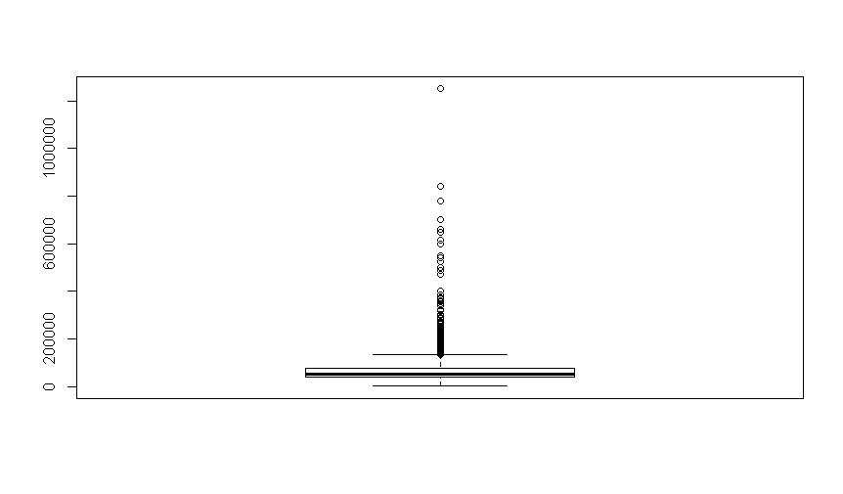
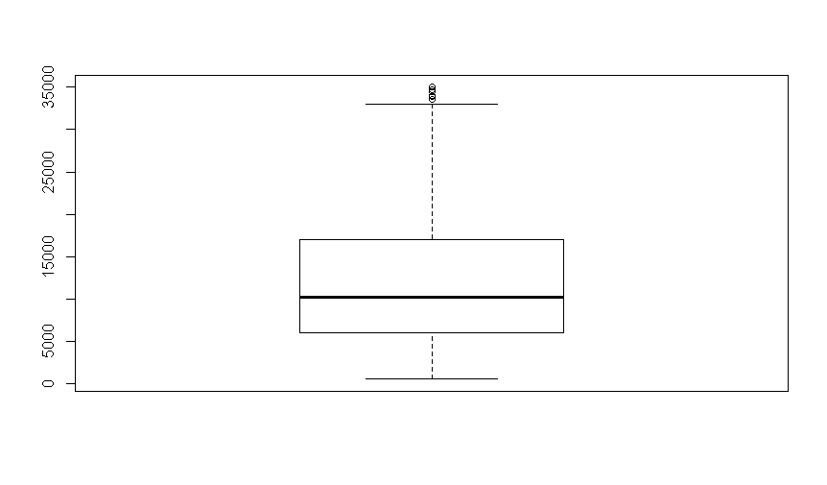
Exploratory Data Analysis: Univariate Analysis:
Outlier detection of Annual Income, and funded amount have outliers present
The plot shows the presence of outliers in the data sets

Slide 7
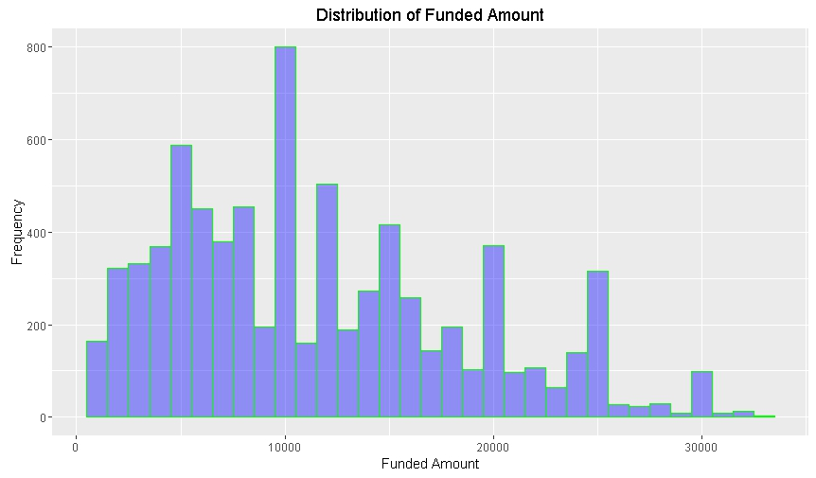
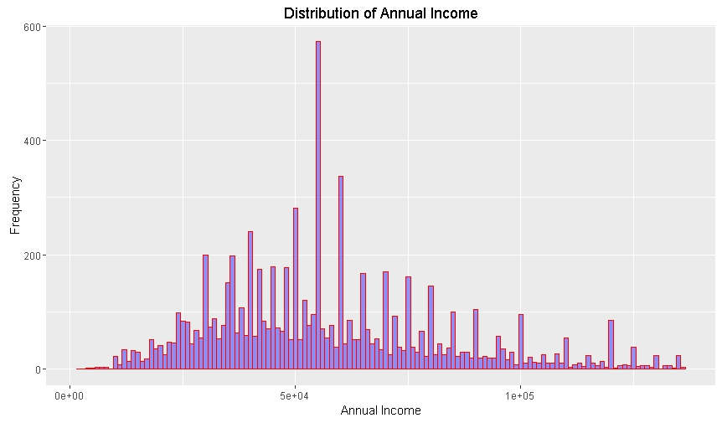
Exploratory Data Analysis: Univariate Analysis:
We have remove the outliers values with the median of the annual_inc and funded_amt respectively

Slide 8
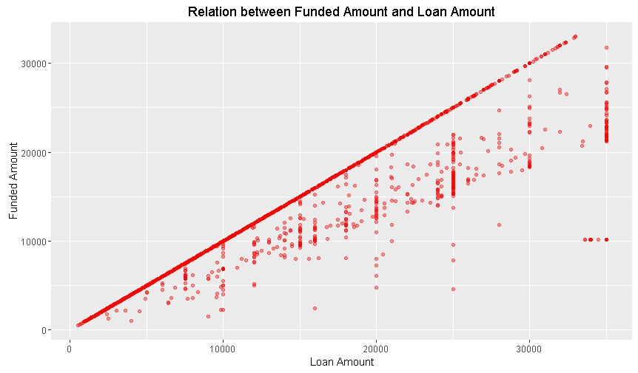
Exploratory Data Analysis: Multivariate Analysis
We have checked for multiple variable and found that there is correlation between funded_amt & Loan_amt, which means %increase in funded_amount will tends to %increase in loan_amount.

Slide 9
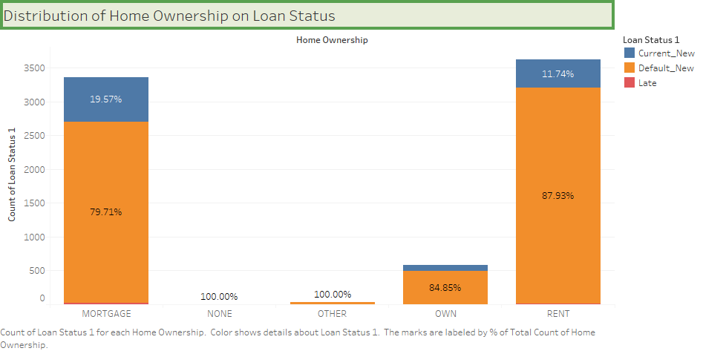
Exploratory Data Analysis: Multivariate Analysis
We see that about 88% of the applicant tends to default when they have rented accommodation.

Slide 10
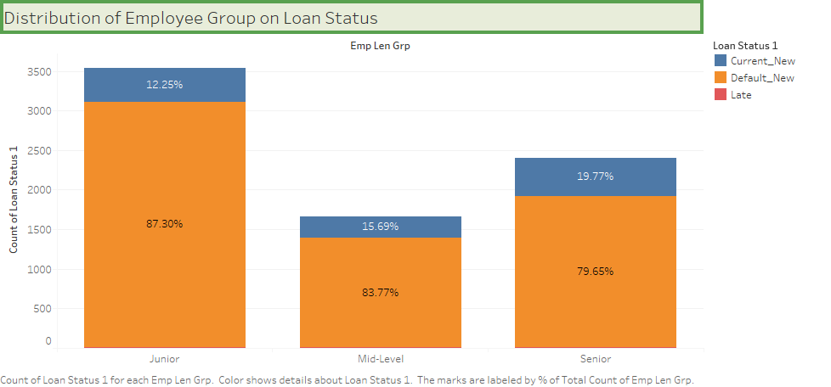
Exploratory Data Analysis: Multivariate Analysis
We also see that about 87% of the loan taken by Junior tends to default.

Slide 11
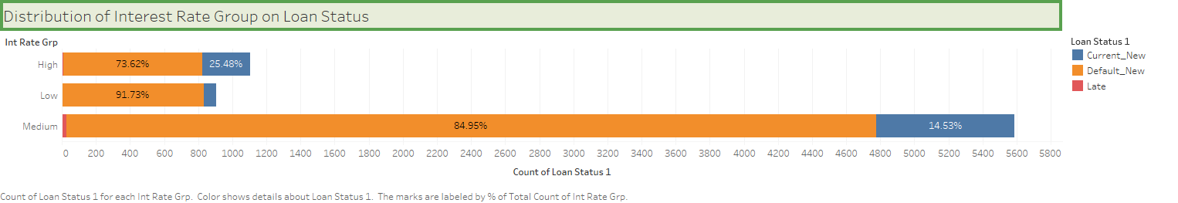
Exploratory Data Analysis: Multivariate Analysis
We see that about 91% of the loan taken at a low interest rate are default and about 85% of the loan taken at medium interest rate also default

Slide 12
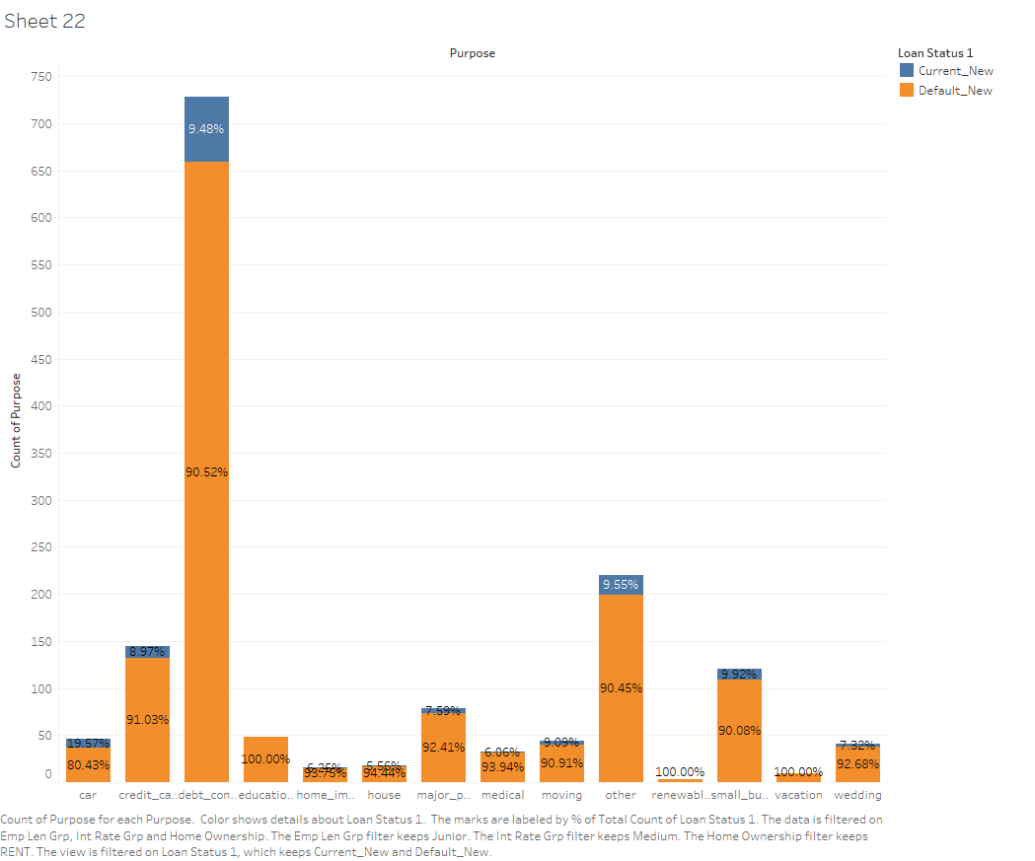
Exploratory Data Analysis: Multivariate Analysis
We see that about 100% of loan taken for education, renewable and vacation by Junior at a medium interest rate tends to default. And If we consider only purpose then 100% of loan for education tends to default

Slide 13
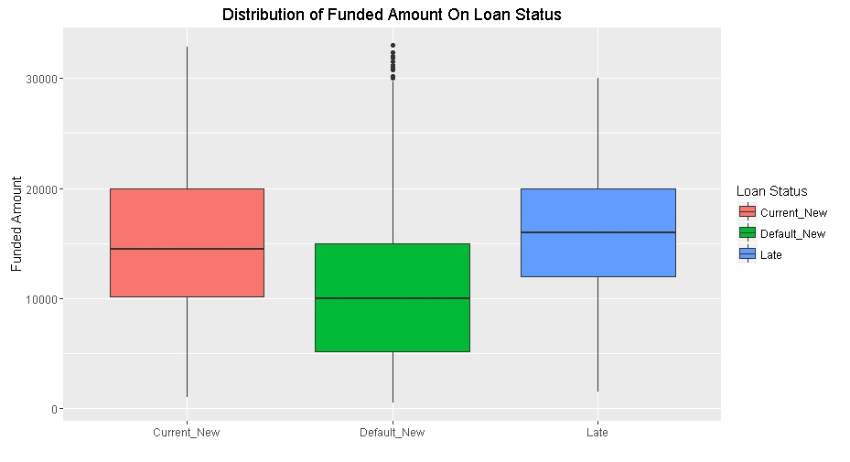
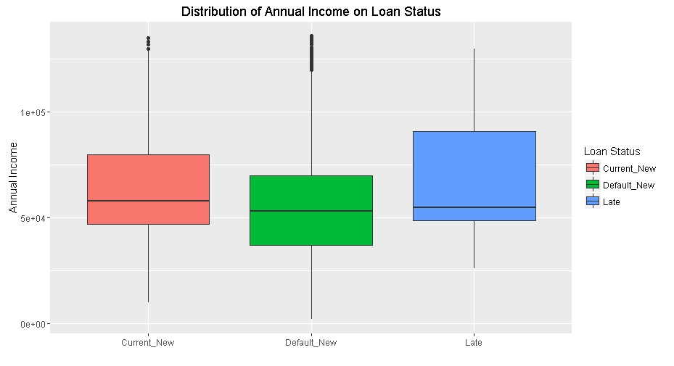
Hypothesis Testing: Continuous variables
We have conducted our hypothesis test on continuous variables base on two different categorical variables, and we found that there is significant difference between all continuous variables. Below are some of the plots:

Slide 14
Conclusion:
Since we have seen significant difference between the Annual Income, Funded Amount etc., we can conclude that it we concentrate our decision to give loan to only those income group which do not fall under default_new we can escape from crating type 1 error.
Since we found that Junior account for 48% of the default, we can decide which employment group should be given loan.
We have also found that 100% of the loan given for education, followed by renewable energy 95%, moving 93 are default, So we can refrain ourselves from giving loan for these purposes.

