Slide 1

INDIVIDUAL HOUSEHOLD ELECTRIC POWER CONSUMPTION
Nishant Singh
12216370

Slide 2

Introduction
Rising electricity consumption worldwide has led to concerns about energy scarcity and sustainability. Developing efficient household power consumption models is crucial to optimize energy use and combat wastage. With population growth and improved standards of living, household energy consumption is increasing. Data-driven approaches are necessary for insights and decision-making. Forecasting electricity demand is essential due to the inability to store electric energy, involving multivariate time series analysis.

Slide 3

About the dataset
Description:
This dataset comprises 2,075,259 measurements collected from a household in Sceaux, France, over 47 months (December 2006 to November 2010).
Energy Consumption Calculation:
Active energy consumption per minute (in watt-hours) is derived using a specific formula.
Missing Values:
Approximately 1.25% of the dataset contains missing values.

Slide 4

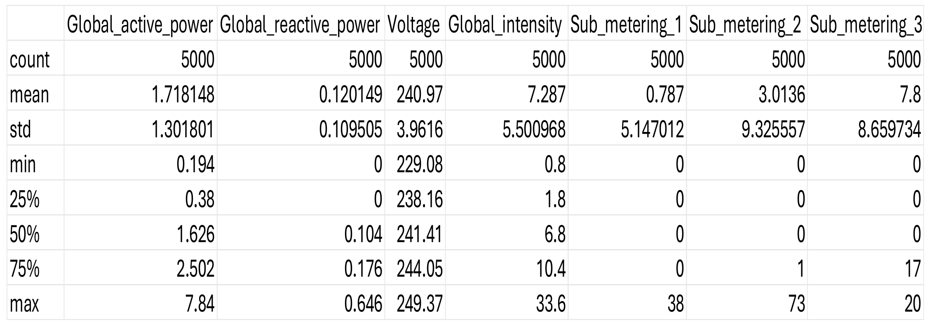
Data cleaning
Dataset Statistics

Slide 5

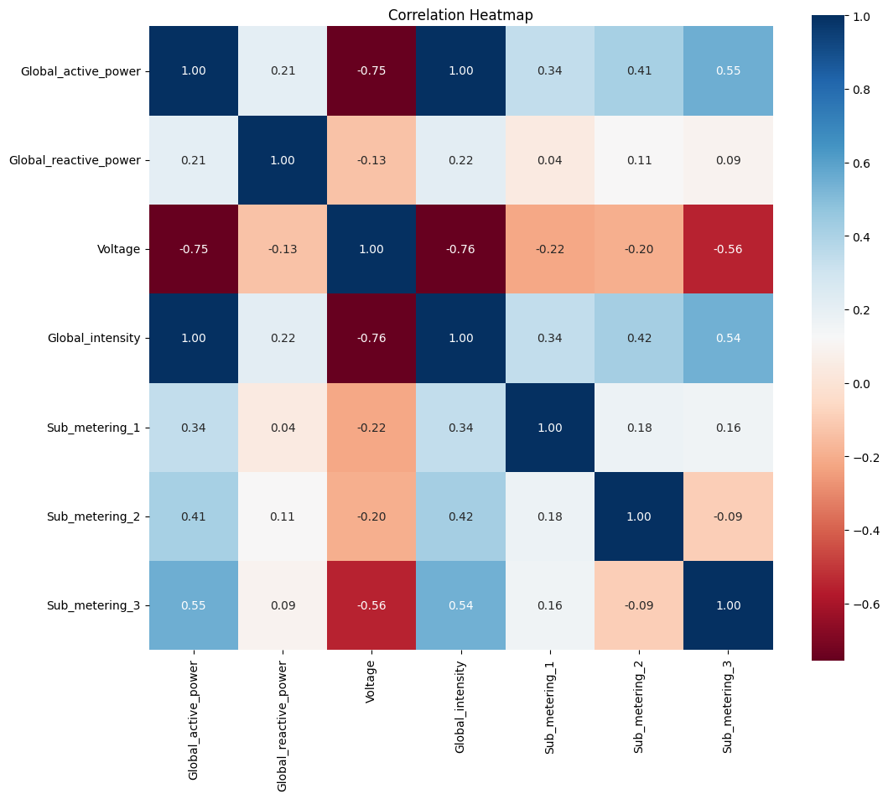
heatmap
The correlation heatmap reveals relationships between attributes in household power consumption data:
Global Active Power and Voltage: Strong negative correlation (-0.75), indicating an inverse relationship.
Global Active Power and Global Intensity: Strong positive correlation (1.00), indicating a direct relationship.
Global Active Power and Sub-metering 1/2/3: Positive correlations, suggesting increased active power usage corresponds to higher sub-metering readings.

Slide 6
Linear Regression
Linear regression reveals the linear relationship between dependent and independent variables, useful for prediction and understanding relationships in data analysis.
Linear regression analyzed the relationship between attributes like global active power, voltage, and global intensity with active energy consumption per minute in the household. By fitting a linear regression model, it revealed how these attributes influence energy consumption patterns over time.

Slide 7
Decision Tree
Decision tree regression creates a tree-like structure to predict the target variable by recursively splitting the dataset based on attribute values. In the dataset, it could analyze how attributes like global active power and voltage relate to energy consumption. This method aids in understanding and predicting household energy usage patterns by determining the most influential attributes and their impact on energy consumption.

Slide 8
Random Forest
Random forest regression is an ensemble learning method that combines multiple decision trees to make predictions. Each tree is trained on a random subset of the dataset and makes independent predictions. The final prediction is the average (for regression) of the predictions from all trees. In the dataset, random forest regression could analyze relationships between attributes and energy consumption, providing more accurate predictions by reducing overfitting compared to a single decision tree.

Slide 9

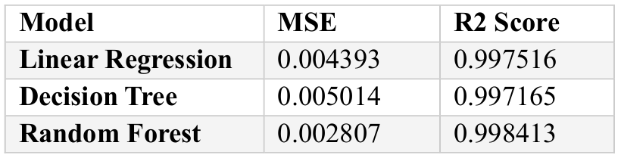
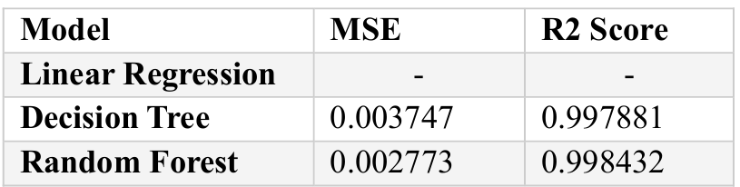
Results comparison before and after hyperparameter tuning
Hyperparameter tuning: Hyperparameter tuning is the process of selecting the best hyperparameters for a machine learning model to optimize its performance.
Process: Involves systematically searching a predefined space of hyperparameter values to find the combination resulting in the best model performance.
Techniques: Grid search, random search, and advanced optimization algorithms are commonly employed for hyperparameter tuning.
Results Before Hyperparameter Tuning
Results After Hyperparameter Tuning

Slide 10
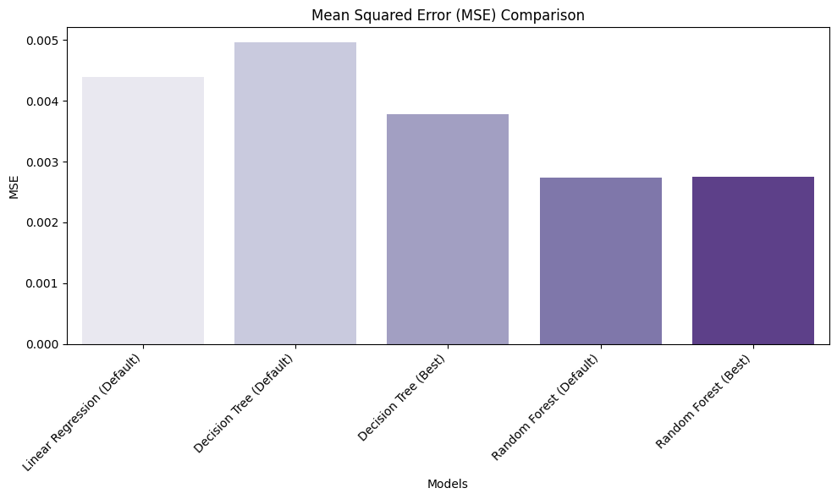
COMPARISON OF MSE

Slide 11
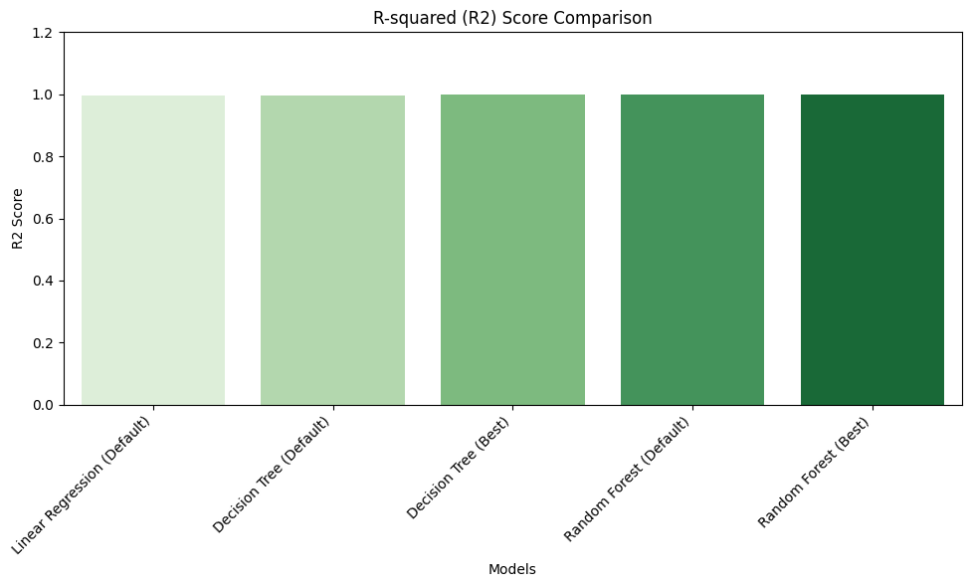
COMPARISON OF R2-SCORE

Slide 12
THANK YOU

