Slide 1

Pizza Sales Analysis
Presented by:
Nishant Singhal

Slide 2
Introduction to Pizza Sales Analysis
Pizza sales analysis is crucial for understanding customer preferences and optimizing sales strategies. By analyzing various factors such as popular toppings, size trends, and seasonal variations, we can make informed decisions to enhance profitability and customer satisfaction.

Slide 3
Market Overview and Trends
Online Ordering
Health-Conscious Choices
Increased demand for online pizza orders and deliveries.
Rise in demand for healthier pizza options, including gluten-free crusts.
Plant-Based Options
Artisanal Pizza Trends
Growing interest in plant-based pizza toppings and meat alternatives.
Emergence of artisanal pizza makers
using high quality, unique ingredients.

Slide 4
Sales Data and Statistics
Big_Meat_S is the best salling Pizza: 1811
The_Greek_xxl is the lowest Selling Pizza: 28
This Year Sales 801944.7

Slide 5
Monthly Sales Data and Statistics
Monthly Sales Figures
The sales data shows consistent growth over the past year, with an increase in pizza sales every month.
Insights:
July stands out with the highest sales volume, indicating a peak in business activity during this month.
Conversely, oct records the lowest sales, suggesting a potential slowdown in customer demand towards the end of the year.

Slide 6
Hourly Sales Data and Statistics
Sales Trend Throughout the Day:
Peak Sales: 12:00 PM
Shop Hours: 9:00 AM - 11:00 PM
Insights:
High sales observed during lunch hours.
Shop operates from 9:00 AM to 11:00 PM, covering peak sales periods.

Slide 7
1
Best-Selling Pizzas
Top 10 Best-Selling Pizzas
Top Pizza: The Classic Deluxe Pizza
Insights:
These 10 pizzas are the top-selling item, reflecting strong customer demand.
Identifying top-selling pizzas enables targeted efforts to optimize production and marketing strategies.

Slide 8
1
Pizza Size Preference Analysis
Understanding Customer Preferences
Most Selling Size: Big_Meat_S (18.86%)
Least Selling Size: the_greek_XXL (0.29%)
Insights:
The large size (L) pizza dominates sales, accounting for 18.86% of total sales.
The extra-extra-large (XXL) size is the least popular, making up only 0.29% of total sales.

Slide 9
Analysis of popular pizza toppings
Pepperoni
Margherita
A classic favorite, pepperoni provides a savory and slightly spicy flavor that appeals to a wide range of pizza lovers.
This simple but delicious combination of tomatoes, mozzarella, and basil is a timeless choice for those who love traditional flavors.
Mushrooms
Barbecue Chicken
With their earthy and rich taste, mushrooms are a popular topping choice that complements a variety of pizza styles and sauces.
A fusion of smoky barbecue sauce, tender chicken, and melted cheese, this topping has gained popularity for its unique and flavorful profile.

Slide 10
Month wise in pizza preferences
1
January
In January, customers tend to favor classic toppings like pepperoni and cheese.
2
June
During the summer months, preferences shift towards lighter toppings such as vegetables and mushrooms.
3
November
In the colder months, there is a rise in demand for heartier toppings like sausage and bacon.

Slide 11



Factors influencing pizza sales
Product quality
1
Fresh ingredients and unique flavors
Marketing efforts
2
Effective advertising and promotional campaigns
Customer experience
3
Convenient ordering and exceptional service

Slide 12
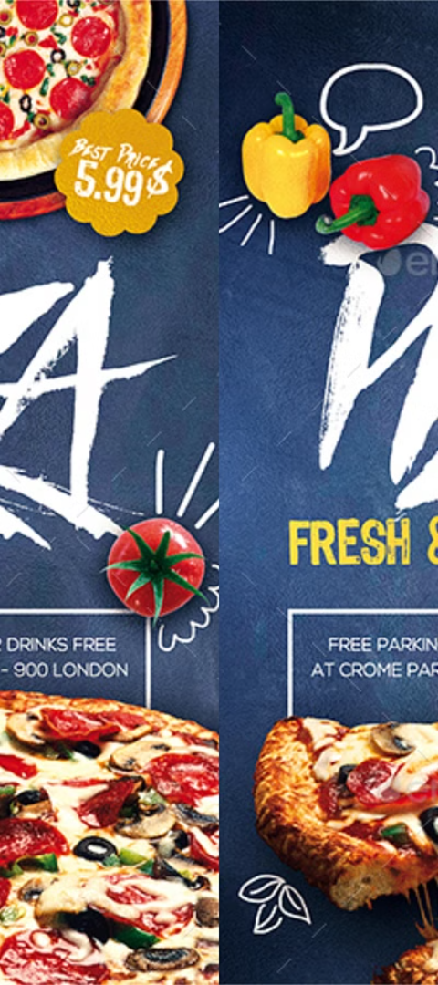



Strategies for increasing pizza sales
Online Ordering Optimization
Streamline the online ordering process for a user-friendly experience.
Special Promotions and Deals
Introduce attractive deals and promotions to attract new customers.
Community Engagement Events
Host community events to build brand recognition and loyalty.

Slide 13

Conclusion and key takeaways
Consumer behavior: Analyze trends in consumer preferences and behavior to tailor pizza offerings.
Market share: Evaluate competitive landscape and target areas for increasing market share.
Strategic initiatives: Implement marketing strategies and promotions based on sales analysis.

Slide 14
Thank you for your attention!

