Slide 1
AdaLovelacehack
Team Nishant and Shreenidhi
Team Size = 2 Members

Slide 2


Nishant Sharma
Shreenidhi Kulkarni

Slide 3
Roles and Experties Area
@Shreenidhi – 1) Cleaning and arranging data into proper form to use.
2) Optimizing the model .
@Nishant - 1) Building the model
2) Reading Research papers and exploring internet

Slide 4
Technologies and Platforms
Python
NLP
Tensorflow
Google Colab

Slide 5
Data Exploration
Working with the data wasn’t easy . First we had to load the dataset into the google colab then comes the splitting part where we splitted the data by <eos> tag given in the dataset and finally we performed the tokenization using tensorflow so as to put a count on the different kind of words in the given dataset .

Slide 6
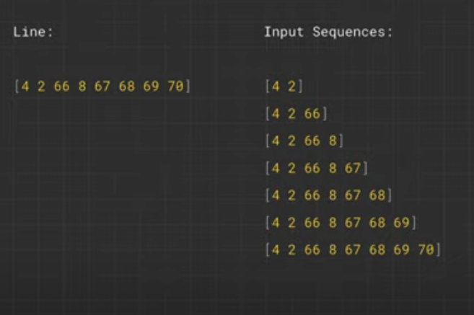
Preparing the model
We prepared the model using python library tensorflow . Here we have taken individual tokenized line from starting and created the n-grams in order to predict the next word. In the figure there is a tokenized line and using n-grams method we have created lists from the tokenized line like first two , first three and so on. The reason behind this is that we want to predict the next word after the first two , first three words and so on , by training the model on this algorithm , the machine can predict the next word when it will see these two words together or these three words together and similarly. In order to put the list of input sequences in the same dimension we have padded the lists according to the line of maximum length in the dataset.

Slide 7
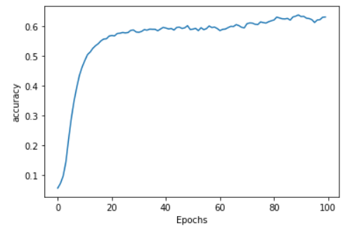
Visualization
The figure shows the accuracy graph increasing as the Epochs increases
We got accuracy around 57% to 60%

