Slide 1
Shortening Url
The source code with readme is uploaded at https://github.com/nishantsny/url_shortener
To shorten url, I will create a database in mysql with four columns which are –
● Id ( primary key with auto increment)
● Actual url (which is to be shortened)
● Shortened url
● Time stamp
Shortened Url is a permutation of the characters 0,1,2,…,9 and a,b,c,…z except a,e,i,o,u (the vowels) , 31 characters in total, reasons are –
● Vowels are not used to remove any formation of unintended meaningful words.
● Capital alphabets are not used as it removes confusion and makes url easily memorable
● Each id value corresponds to an unique shortened url and vice versa.

Slide 2
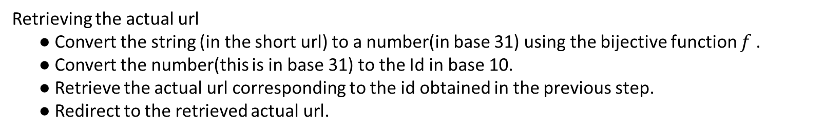
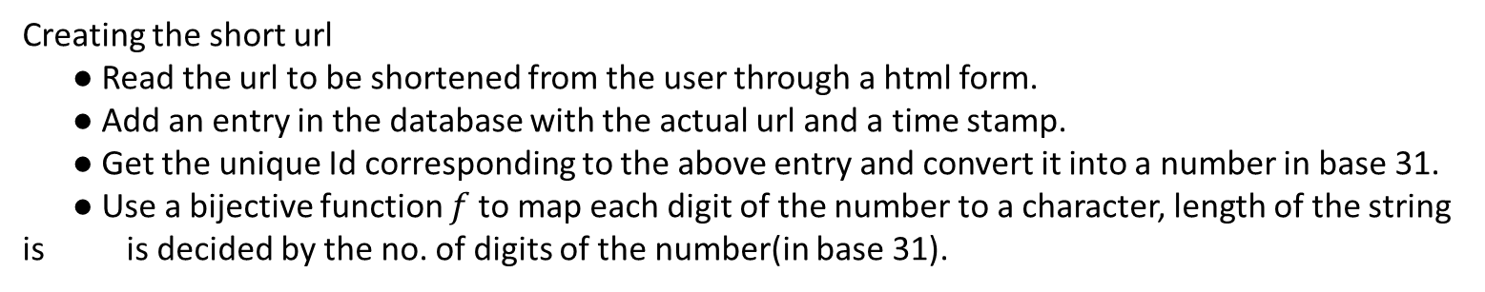
Shortening Url
Creating the short url
● Read the url to be shortened from the user through a html form.
● Add an entry in the database with the actual url and a time stamp.
● Get the unique Id corresponding to the above entry and convert it into a number in base 31.
● Use a bijective function $f$to map each digit of the number to a character, length of the string is is decided by the no. of digits of the number(in base 31).
Retrieving the actual url
● Convert the string (in the short url) to a number(in base 31) using the bijective function $f$.
● Convert the number(this is in base 31) to the Id in base 10.
● Retrieve the actual url corresponding to the id obtained in the previous step.
● Redirect to the retrieved actual url.

Slide 3
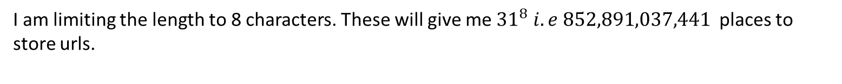
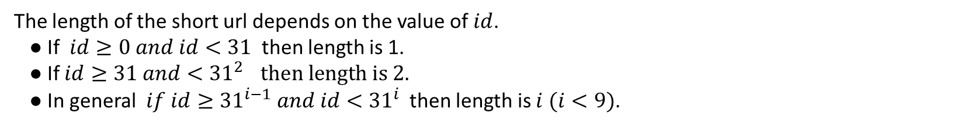
The length of the short url
The length of the short url depends on the value of $id$.
● If $id≥0 and id<31$ then length is 1.
● If $id≥31 and<{31}^{2 } then length is 2.$
● In general $if id≥{31}^{i−1} and id<{31}^{i}$ then length is $i$ $(i<9)$.
I am limiting the length to 8 characters. These will give me ${31}^{8} i.e 852,891,037,441$places to store urls.
I can extend my code to 52 base including all capital alphabets (excluding vowels) if in case the no.
of urls increase the above limit.

Slide 4
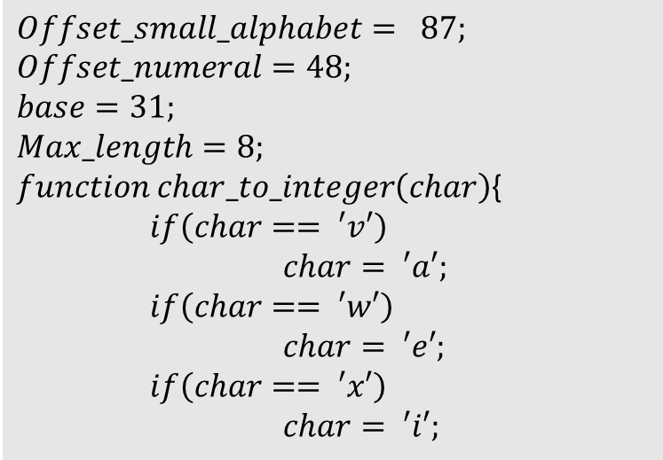

The Bijective Function $f$
This function maps the characters to a number from 0 to 31 by offsetting their ASCII values by an appropriate amount. The last 5 if conditions are to accommodate the void created by leaving out the vowels.
$$Offset_small_alphabet= 87;$$
$$Offset_numeral=48; \\ base=31;$$
$$Max_length=8;$$ $function char_to_integer\left(char\right)${
$if\left(char== ′v′\right)$
$char= ′a′;$
$if\left(char== ′w′\right)$
$char= ′e′;$
$if\left(char== ′x′\right)$
$char= ′i′;$

Slide 5
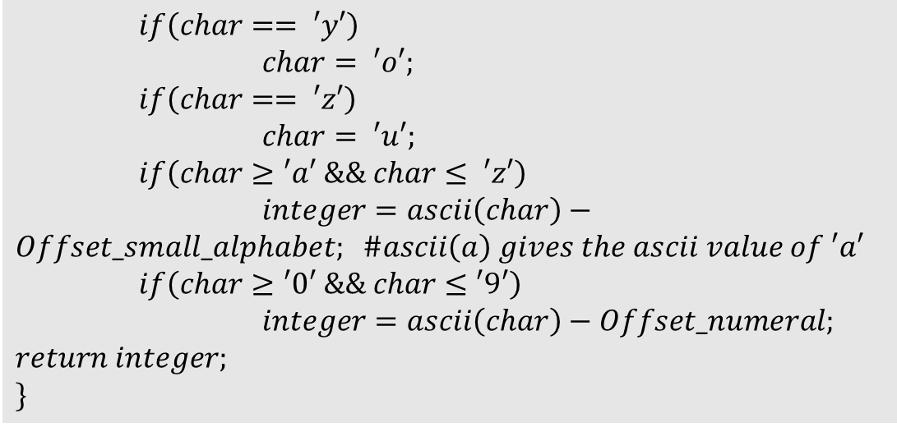
$if\left(char== ′y′\right)$
$char= ′o′;$
$if\left(char== ′z′\right)$
$char= ′u′;$
$if\left(char≥′a′ \&\& char≤ ′z′\right)$ $integer=ascii\left(char\right)−Offset_small_alphabet; \#ascii\left(a\right) gives the ascii value of ′a′$
$if\left(char≥′0′ \&\& char≤′9′\right)$
$integer=ascii\left(char\right)−Offset_numeral;$
$$return integer;$$
$$\}$$
Below is the function for reverse mapping of a digit in base 31 to the corresponding character.

Slide 6
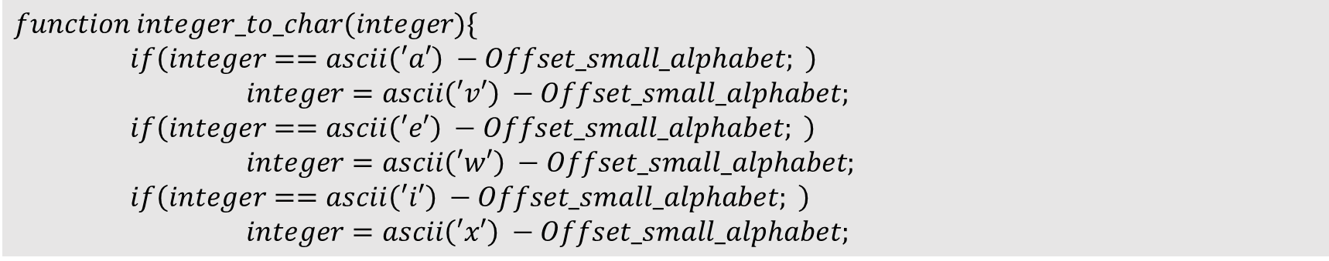
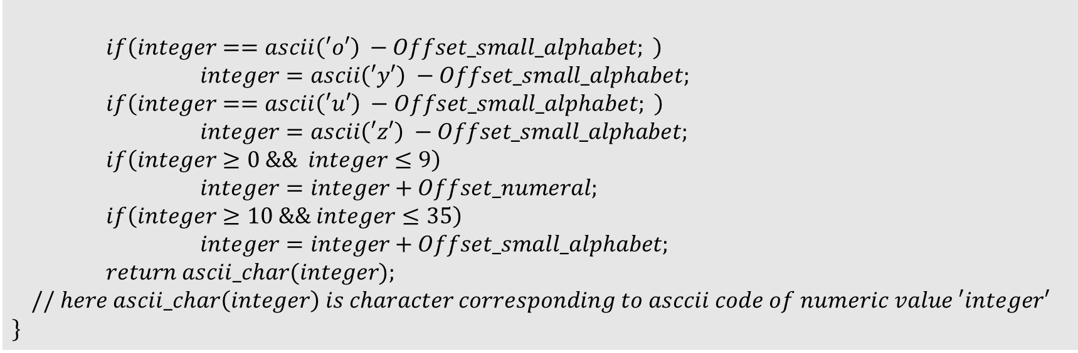
$$function integer_to_char(integer)\{$$
$if\left(integer==ascii\left(′a′\right) −Offset_small_alphabet; \right)$
$integer=ascii\left(′v′\right) −Offset_small_alphabet;$
$if\left(integer==ascii\left(′e′\right) −Offset_small_alphabet; \right)$
$integer=ascii\left(′w′\right) −Offset_small_alphabet;$
$if\left(integer==ascii\left(′i′\right) −Offset_small_alphabet; \right)$
$integer=ascii\left(′x′\right) −Offset_small_alphabet;$
$if\left(integer==ascii\left(′o′\right) −Offset_small_alphabet; \right)$
$integer=ascii\left(′y′\right) −Offset_small_alphabet;$
$if\left(integer==ascii\left(′u′\right) −Offset_small_alphabet; \right)$
$integer=ascii\left(′z′\right) −Offset_small_alphabet;$
$if\left(integer≥0 \&\& integer≤9\right)$
$integer=integer+Offset_numeral;$
$if\left(integer≥10 \&\& integer≤35\right)$
$integer=integer+Offset_small_alphabet;$
$return ascii_char(integer);$
$$// here ascii_char\left(integer\right) is character corresponding to asccii code of numeric value ′integer′$$
$$\}$$

Slide 7
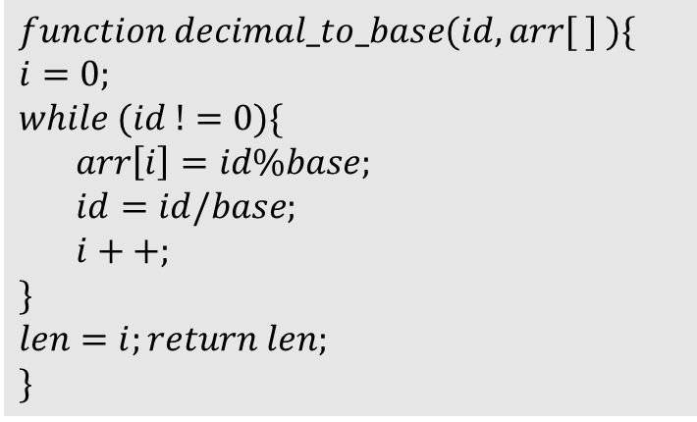
Following code changes the unique id into a number in base 31 and stores its no. of digits in the variable $len$.
$$function decimal_to_base(id,arr[ ] )\{$$
$$i=0;$$
$$while (id !=0)\{ \\ arr\left[i\right]=id\%base; \\ id=id/base; \\ i++; \\ \} \\ len=i;return len;$$
$$\}$$

Slide 8
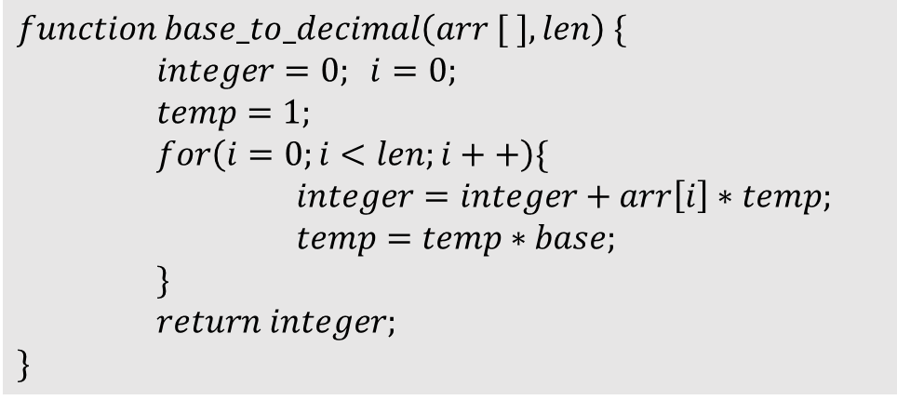
The following code changes a number in base 31 stored in an array of length $len$ to a number in decimal base.
$$function base_to_decimal\left(arr [ ],len\right) \{$$
$integer=0; i=0;$
$temp=1;$
$for\left(i=0;i<len;i++\right)\{$
$integer=integer+arr\left[i\right]∗temp;$
$temp=temp∗base;$
$\}$
$return integer;$
$$\}$$

Slide 9
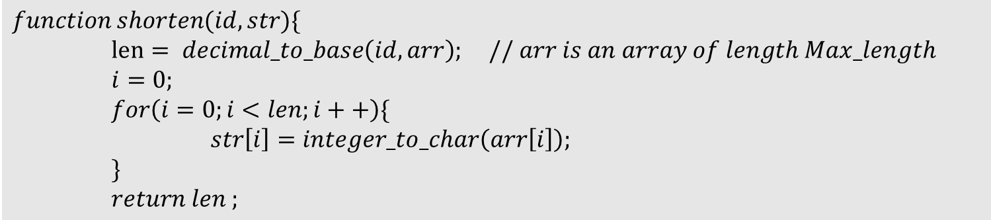
Following functions shortens the actual url stored in $database with$id = $id$ and stores the resulting string in array $str$ whose length is still $len$.
$$function shorten(id,str)\{$$
$len= decimal_to_base\left(id,arr\right); // arr is an array of length Max_length$
$i=0;$
$for\left(i=0;i<len;i++\right)\{$
$str\left[i\right]=integer_to_char\left(arr\left[i\right]\right);$
$\}$
$return len ;$

Slide 10
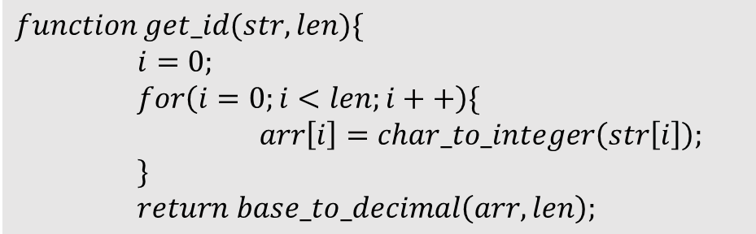
The following code retrieves the id corresponding to a shortened url stored in array $str$ with length $len$.
$$function get_id(str,len)\{$$
$i=0;$
$for\left(i=0;i<len;i++\right)\{$
$arr\left[i\right]=char_to_integer\left(str\left[i\right]\right);$
$\}$
$return$ $base_to_decimal\left(arr,len\right);$
The remaining syntax is of mysql commands to maintain and update the database and php commands to obtain the actual url convert it to short url or to redirect to the actual url which I am omitting here.

