Slide 1
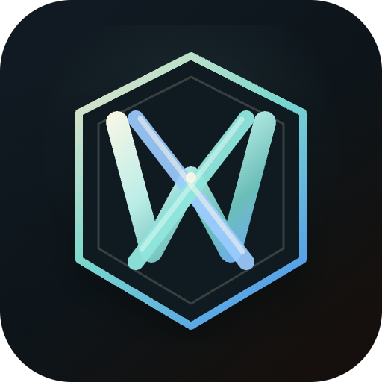
WREXLYN
USE CASES
One AI teammate. Seven everyday jobs, done end to end.
Code
Documents
Research
Automation
by Nishant Prabhakar

Slide 2
WREXLYN
USE CASES
HOW TO READ THIS DECK
One system. Many kinds of work.
Wrexlyn is one AI teammate you give plain-English instructions to. It plans the work, does it inside your own files and tools, checks its own result, and shows you the proof — across four broad kinds of work.
💻
📄
🔍
🔌
Code
Documents
Research
Automation
Fix, build, and ship software
Real Word, Excel & PowerPoint files
Answers backed by real sources
Acts inside your everyday tools
© 2026 Nishant Prabhakar
02 / 12

Slide 3
WREXLYN
USE CASES
USE CASE 1 · SOFTWARE ENGINEERING
💻
Ship working code, not just suggestions
“Fix a bug, add a feature, or clean up messy code — and prove it actually works.”
HOW IT WORKS
IN PLAIN WORDS
1
Reads your actual codebase first, so changes fit how your project already works.
You ask: “Fix the login bug and make sure nothing else breaks.”
You get back a tested, working patch — with the test results to prove it.
2
Makes the change directly in your files — no copy-pasting code out of a chat window.
3
Runs your real tests and build before calling the job done, and can undo everything with one click if something's wrong.
© 2026 Nishant Prabhakar
03 / 12

Slide 4
WREXLYN
USE CASES
USE CASE 2 · BUSINESS DOCUMENTS
📄
Get a finished file, not a wall of text
“Turn a request into a real Word report, Excel model, or PowerPoint deck.”
HOW IT WORKS
IN PLAIN WORDS
1
Produces actual formatted documents — headings, tables, a working table of contents — not markdown pasted into a text box.
You ask: “Build a 10-slide investor deck from this research.”
You get an actual .pptx file, ready to open and present — today.
2
Excel comes out with live, recalculating formulas, not numbers typed in by hand.
3
PowerPoint slides use real, editable charts and layouts designed for the content, not just a title and five bullet points.
© 2026 Nishant Prabhakar
04 / 12

Slide 5
WREXLYN
USE CASES
USE CASE 3 · RESEARCH & DILIGENCE
🔍
Answers you can actually check
“Answer a hard question, and show your work so I can trust it.”
HOW IT WORKS
IN PLAIN WORDS
1
Pulls facts from your own files and the web, and keeps track of exactly where each one came from.
You ask: “Summarize this company's financials and flag any red flags.”
You get a sourced write-up — every claim traceable back to evidence.
2
Flags it when a new figure contradicts something it found earlier, instead of quietly overwriting it.
3
Keeps the same numbers consistent across every report, memo, or slide it writes about the same topic.
© 2026 Nishant Prabhakar
05 / 12

Slide 6
WREXLYN
USE CASES
USE CASE 4 · SAFE EXPERIMENTATION
↩
Let it take real action — without the fear
“I want it to actually do things, but I need an undo button I can trust.”
HOW IT WORKS
IN PLAIN WORDS
1
Every file is captured exactly as it was, the instant before anything touches it.
You try a big refactor. It doesn't work out — one click, and every file is back exactly how it was.
2
One click restores an entire turn's changes — no manual cleanup, no guessing what changed.
3
A risky action always asks first; nothing destructive ever runs silently in the background.
© 2026 Nishant Prabhakar
06 / 12

Slide 7
WREXLYN
USE CASES
USE CASE 5 · AUTOMATION
🔌
Put it to work inside your everyday tools
“Let it read and act inside the tools I already use — with my say-so at every step.”
HOW IT WORKS
IN PLAIN WORDS
1
Connects to Gmail, Google Drive, Calendar, OneDrive/SharePoint, Dropbox, and more.
You ask: “Check tomorrow's meetings and draft a follow-up email for each.”
It works inside your real calendar and inbox — you review before anything sends.
2
Anything it reads from outside is treated as information, never as a secret instruction to obey.
3
You approve what it's allowed to touch — nothing acts on your accounts without permission.
© 2026 Nishant Prabhakar
07 / 12

Slide 8
WREXLYN
USE CASES
USE CASE 6 · MODEL FREEDOM
🧠
Pick the AI brain that fits the moment
“I don't want to be locked into one AI company — or pay for power I don't need.”
HOW IT WORKS
IN PLAIN WORDS
1
Works with free and paid cloud models from multiple providers, side by side.
Use a free model for a quick task, switch to a stronger one for something hard — same conversation, same files.
2
Can run entirely on your own machine with a local model — nothing has to leave your computer.
3
Same project, same memory, same rules — switch models mid-conversation without losing anything.
© 2026 Nishant Prabhakar
08 / 12

Slide 9
WREXLYN
USE CASES
USE CASE 7 · INDUSTRY SOLUTIONS
🏢
Purpose-built solutions for your industry
“I don't just want a general AI — I want something that already understands my industry.”
HOW IT WORKS
REAL EXAMPLE
1
The same underlying engine also powers ready-made, industry-specific products.
A PE analyst asks for an initial screen on a target company — and gets a structured evaluation with a real, editable financial model attached.
2
Wrexlyn for Investments is the first: built for private equity teams doing screening, deal evaluation, and document review.
3
It produces real IC notes and financial models — not generic chat answers about your deal.
4
More industry-specific versions are on the way — the same core, tuned for a new domain each time.
© 2026 Nishant Prabhakar
09 / 12

Slide 10
WREXLYN
USE CASES
AUDIENCE
Who is this actually for?
👩‍💻
Developers & engineering teams
📊
Analysts & researchers
Ship tested changes faster, without babysitting every step.
Turn raw information into sourced, checkable deliverables.
🚀
Founders & operators
🔐
Security-conscious teams
Get real code, decks, and reports done without a big team.
Keep code, data, and models under your own control.
© 2026 Nishant Prabhakar
10 / 12

Slide 11
WREXLYN
USE CASES
AT A GLANCE
Every use case, in one place
💻
Software engineering
Fix, build, and ship tested code changes
📄
Business documents
Real Word, Excel & PowerPoint files, not text dumps
🔍
Research & diligence
Sourced answers you can actually verify
↩
Safe experimentation
Every change reversible, one click to undo
🔌
Automation
Acts inside Gmail, Drive, Calendar & more
🧠
Model freedom
Any cloud model, or fully local — your choice
🏢
Industry solutions
Purpose-built products like Wrexlyn for Investments
© 2026 Nishant Prabhakar
11 / 12

Slide 12
One teammate.
Every kind of work.
See it work on your own project.
Launch the demo
© 2026 Nishant Prabhakar · Wrexlyn is proprietary software

