Slide 1


A Project Presentation on
“Movie Rental System”
Presented by:
Aadarsha Khanal
Bigyan Pokhrel
Nishant Subedi
Suraj Guvaju
Department of Computer and Electronics
Date:2024/08/08
Notes:
Write your name in the order you are presenting

Slide 2
Outline
Introduction
Objectives
Literature review
Methodology
Results
Conclusion.
Limitations
Future enhancement
References

Slide 3
Introduction
The Movie Rental System: a CLI-based program in C++.
Provide a basic solution for managing movie rentals and inventory.
Libraries used: windows.h, fstream.

Slide 4
Key features: add/rent/return/remove movies and users.
Uses IMDb ID and phone number as unique identifiers.

Slide 5
Objectives
Create a user-friendly system for managing movies and users.
Get familiar with concepts of C++ like file handling, Object & Class.

Slide 6
Problem Statement
Difficulty in managing user information and rental history.
Inefficient manual tracking of rentals and returns.
No unique identification for movies and users.
Complex process for adding/removing movies and users.

Slide 7
Literature Review
Existing Systems: No unique identification for movies and users.
Research Gaps: Lack of simple, CLI-based solutions for small-scale movie rental businesses.
Technological Advances: Use of unique identifiers (IMDb ID, phone number) for efficient tracking.
User Experience: Difficult for users to navigate and perform tasks efficiently.

Slide 8
Summary: Highlights the need for a simplified, user-friendly movie rental system.

Slide 9
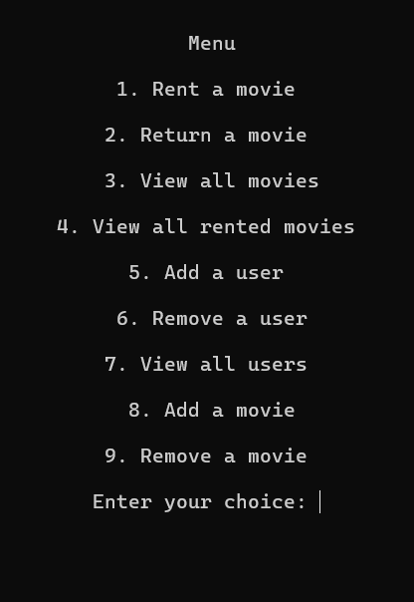
Methodology

Slide 10
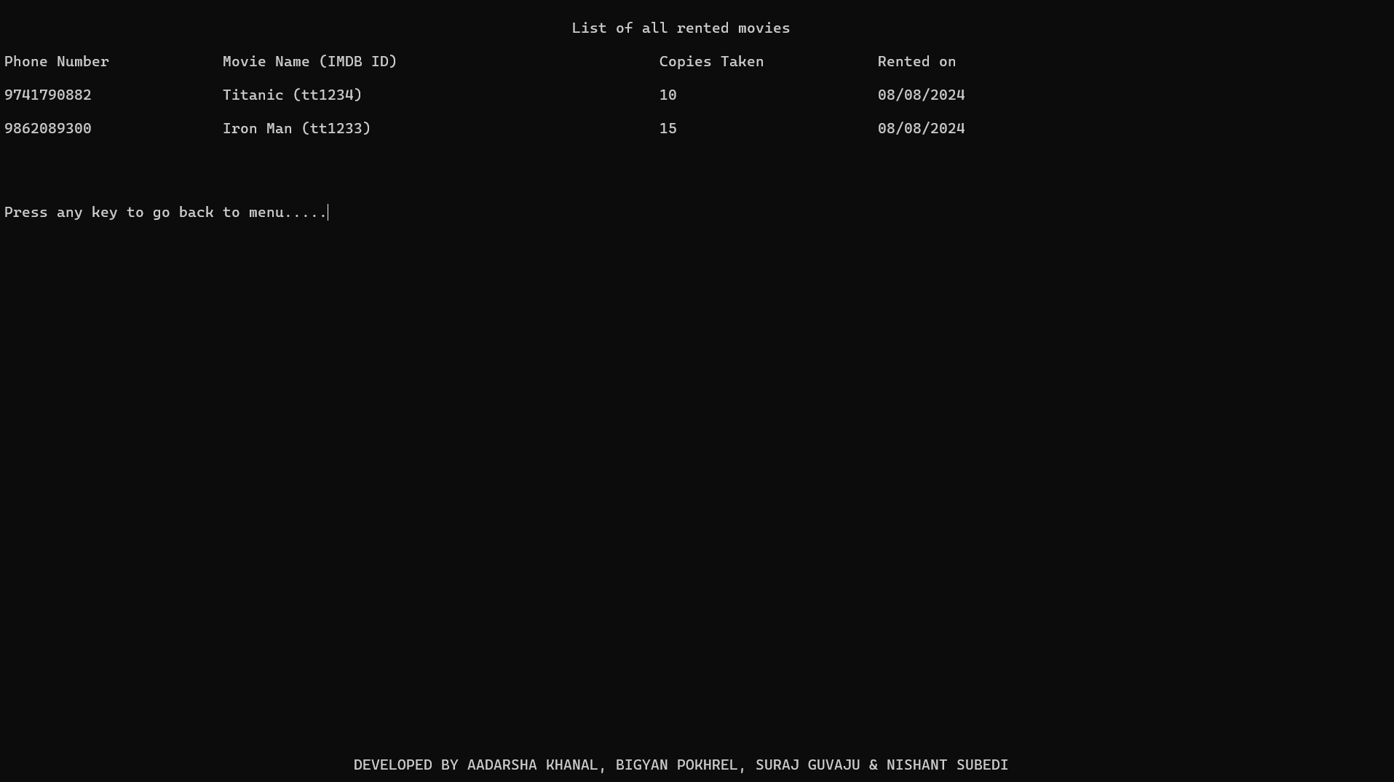

Slide 11
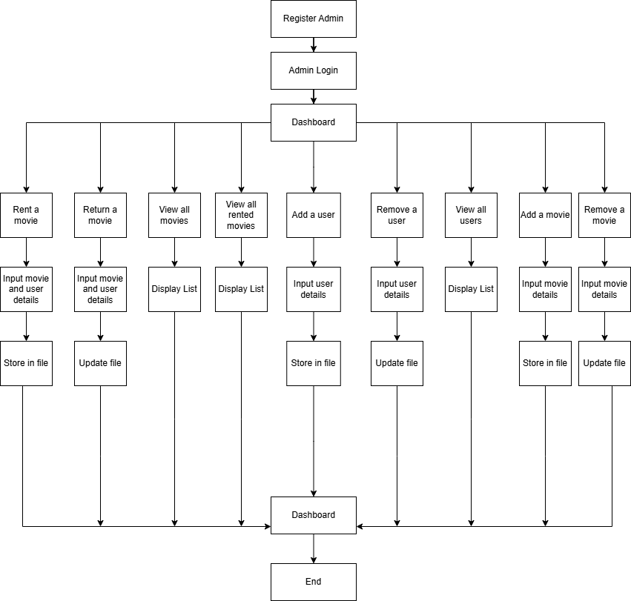
FLOWCHART

Slide 12
SDLC
ANALYSIS
Design
Implementation
Testing
Deployment
Maintenance

Slide 13
Results and Discussions
Successfully manages movie rentals and returns.
Easy addition/removal of movies and users.
Unique IDs ensure accurate tracking.
Simple and accessible for users and admins.
Minimum 2 and maximum 6 slides

Slide 14
Conclusion
It provides the management of movie data and user information, making the system accessible and practical for small-scale use.

Slide 15
Limitations
Limited to CLI; lacks a GUI.
No support for online payments or recommendations.
Manual entry can lead to errors sometimes.

Slide 16
Future Work
Develop a GUI for a better user experience.
Integrate online payment options.
Implement a recommendation system based on history.

Slide 17
References
[1] W3Schools, [Online]. Available: https://www.w3schools.com/cpp/. [Accessed 2024].
[2] E. Balagurusamy, Object Oriented Programming With C++, Tata McGraw-Hill, 2008.
[3];GeeksforGeeks [Online]. Available: https://www.geeksforgeeks.org/c-plus-plus/.[Accessed 2024].

