Slide 1
TIC-TAC-TOE GAME
Computer Networks
Sem V
(B.Tech Minor)

Slide 2
Table of Contents
Overview
Server & Client
TIC-TAC-TOE game based on Server & Client
Pseudo code
Flowchart
Conclusion

Slide 3
Overview
Python program for TIC TAC TOE.
Communicate between server and client.
Server client address in the form of IP and Port number is required.

Slide 4
How server client model works
How server client model works?
Client: When we talk of the word Client, it means to talk of a person or an organization using a particular service. Similarly in the digital world a Client is a computer (Host) i.e. capable of receiving information or using a particular service from the service providers (Servers).
Servers: When we talk of the word Servers, it means a person or medium that serves something. Similarly in the digital world a Server is a remote computer which provides information (data) or access to particular services.

Slide 5
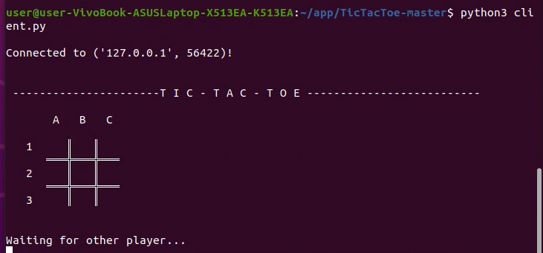
Implementation

Slide 6
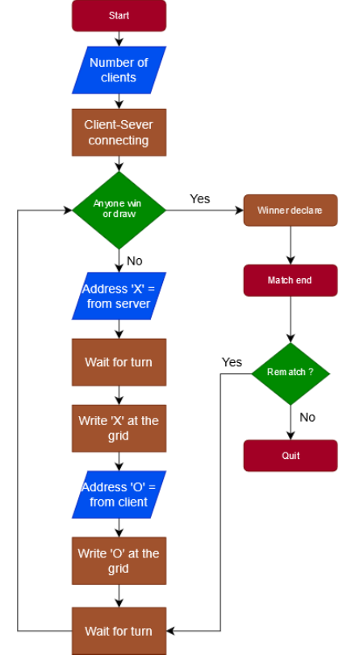
Flowchart

Slide 7
Pseudo Code
import packages;
assign ip address;
assign port number;
connect to host;
while rematch == True:
{
while(anyone win):
{
host ask for rematch;
client receive rematch request;
address = received from host;
draw gridaddress('O');
enter coordinates of ('X') = Co;
send to host(Co);
draw grid.host('X');
}
winner declare;
rematch = Yes or No;
if id == Y;
rematch = True;
else:
rematch = False;
}

Slide 8
Conclusion
Centralized system with all data in a single place.
Cost efficient as it requires less maintenance and data recovery is possible.
The capacity of the Client and Servers can be changed separately.

