Slide 1
School of Computer Science and
Engineering
B.Tech (CSE) 7th Semester
Project Title-Virtual AI Guest Experience: Strategic Plan for Smart Hospitality
Presented By – Nishant Tomar
SECTION – 4CSE5
ROLL NO. – CS-2341096
Organization Name - Cognifyz IT Solutions Pvt. Ltd.
B.Tech CSE Internship

Slide 2
• Introduction
• Hospitality is moving toward faster, personalized and digitally connected guest experiences.
• Guests increasingly expect 24/7 assistance, relevant recommendations and low-friction service.
• AI can act as a digital service layer across the guest journey, from discovery to post-stay engagement.
• The proposed Virtual AI Guest Experience combines conversational AI, personalization, service automation and smart-room support.
• The goal is not to replace staff, but to reduce repetitive work and help employees focus on empathy, judgment and service recovery.
• Problem statement
• How can AI be integrated into guest services to deliver seamless, interactive and personalized experiences while maintaining human oversight?

Slide 3
• Market Analysis
Key market observations
• AI-driven travel and hospitality experiences are becoming an important technology priority.
• Travelers increasingly use technology for informed decisions, recommendations and trip planning.
• Personalization is becoming central to guest engagement, marketing and customer service.
• Agentic AI is moving beyond answering questions toward executing bounded, multi-step tasks.
• Trust, privacy, system integration and human oversight remain important adoption requirements.
Strategic opportunity
Build one AI-enabled guest layer that connects conversations, preferences and hotel operations across the complete guest journey.

Slide 4
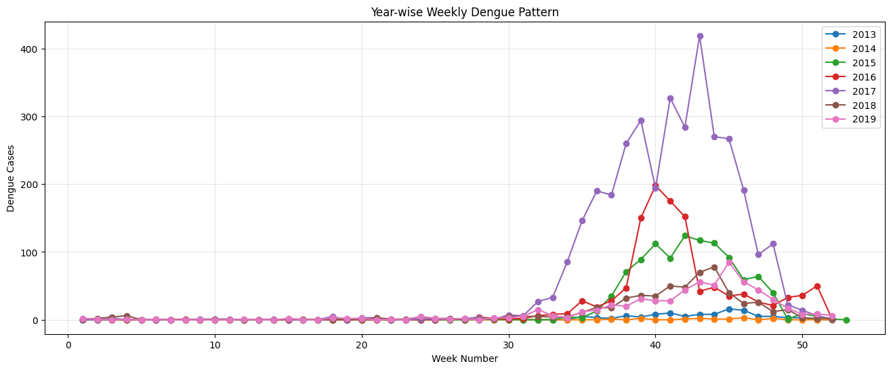
• Guest Needs & Experience Journey
Stage | Guest need | AI interaction | System support | Success metric
Discovery | Relevant room / trip options | AI trip & room advisor | Booking engine | Conversion
Pre-arrival | Easy preparation | Digital concierge | PMS + CRM | Engagement
Arrival | Fast check-in | AI-assisted guidance | PMS + identity | Check-in time
In-stay | Quick service | Service-request agent | PMS + housekeeping | Resolution time
Experience | Useful recommendations | Next-best experience | CRM + local inventory | Ancillary conversion
Departure | Simple checkout | Invoice + feedback assistant | PMS + survey | Completion

Slide 5
• Implementation / Methodology
Step-by-step strategy
Evaluation approach
• 1. Establish baseline — map guest journeys, requests, wait times and pain points.
• 2. Build knowledge foundation — create approved, current hotel information and consent rules.
• 3. Launch concierge MVP — multilingual Q&A, pre-arrival support and human escalation.
• 4. Add service actions — connect low-risk requests to hotel workflows.
• 5. Personalize — use consented preferences for relevant recommendations.
• 6. Integrate smart rooms — pilot secure, limited room controls.
• 7. Introduce bounded agentic workflows — automate only policy-defined actions.
• 8. Scale and optimize — expand using service quality, guest feedback and ROI.
• Accuracy of AI responses
• Self-service completion
• Response and resolution time
• Guest satisfaction
• Appropriate human escalation
• Security and privacy incidents
• Operational and financial impact

Slide 6
• AI Integration & Technology Stack
AI integration methods
Technology categories
• Conversational AI concierge — grounded answers from approved hotel knowledge.
• Personalization engine — consent-aware guest preferences and next-best recommendations.
• Agentic service workflows — bounded actions with validation, authorization and logging.
• Voice & multimodal support — text, voice, kiosk and visual interfaces.
• Smart-room integration — secure commands for approved room controls.
• Guest channels: Web, mobile, messaging, voice, kiosk
• AI: Enterprise LLM + agent/orchestration layer
• Knowledge: Document store + vector database + RAG
• Data: CRM/CDP + secure database
• Operations: PMS, POS, housekeeping and work-order APIs
• IoT: Secure room-control gateway
• Security: IAM, encryption, secrets management, audit logs

Slide 7
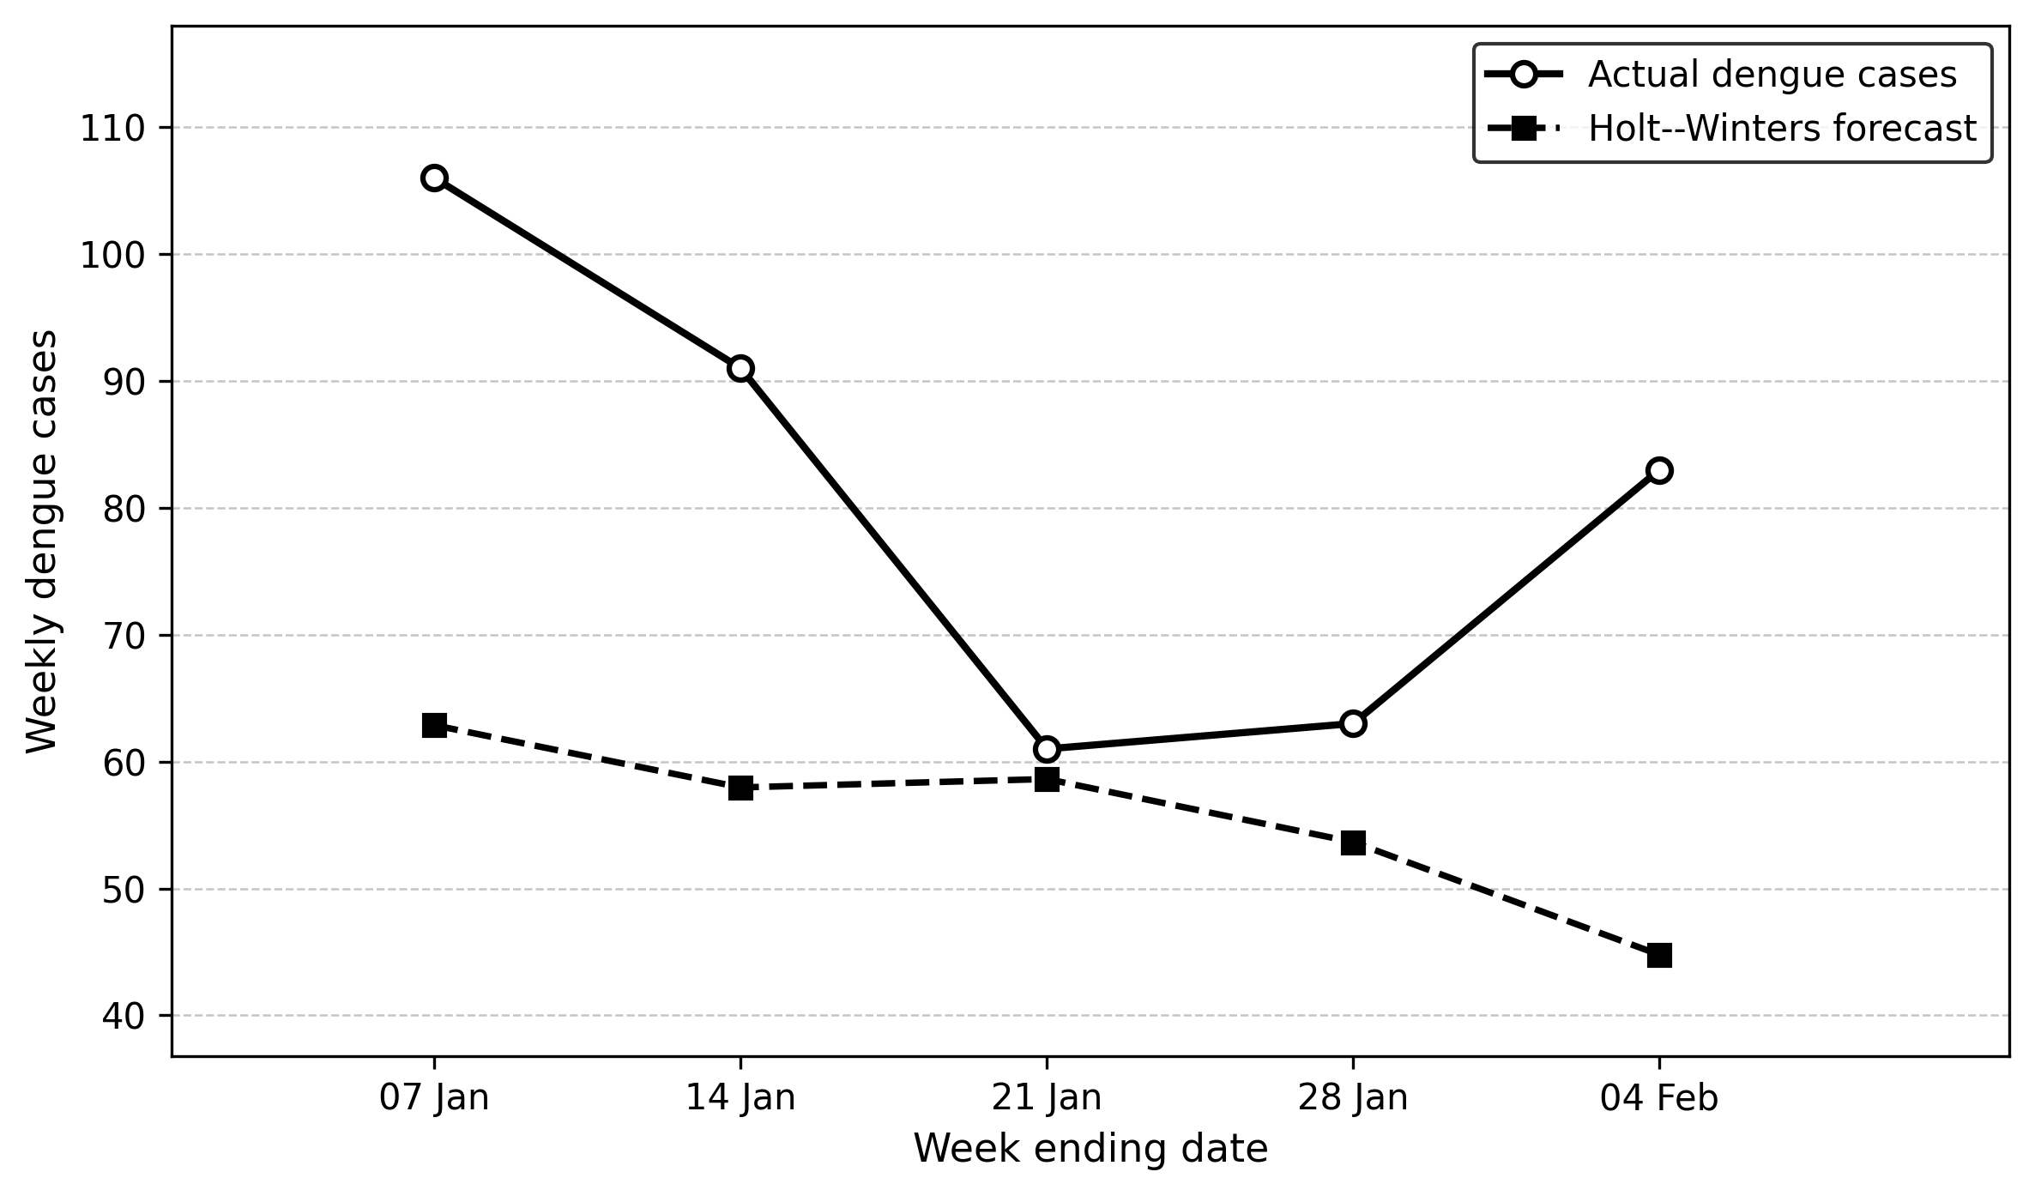
• System Architecture
Guest Channels
Web • App • Messaging • Voice
Identity & Consent
Guest Profile
AI Orchestration
Conversation + Tools
Knowledge + Personalization
RAG • CRM/CDP
Action Gateway
Validation • Authorization • Logs
Hotel Systems
PMS • POS • Housekeeping
IoT / Smart Rooms
Secure Device Gateway
Human Staff Console / Escalation
Analytics & Monitoring
Audit & Governance

Slide 8
• Challenges, Expected Outcomes & Future Work
Key challenges
Proposed solutions
• AI hallucinations / outdated information
• Privacy and consent
• Cybersecurity and unauthorized actions
• Legacy system fragmentation
• Over-automation and staff resistance
• RAG + controlled knowledge sources
• Data minimization and consent controls
• Least privilege + audit logs
• API gateway and phased integration
• Human escalation and staff co-design
Expected outcomes
Future development
• Faster guest response and service resolution
• More efficient self-service
• Improved personalization and guest satisfaction
• Reduced repetitive workload for staff
• New opportunities for ancillary revenue and loyalty
• Predictive service recovery
• Multilingual voice concierge
• Smart-room energy optimization
• Agent-to-agent travel coordination
• Digital-twin simulation and continuous experimentation
Research basis: Deloitte • McKinsey • Booking.com • Oracle/Skift • Adyen

Slide 9
Conclusion
A human-centered Virtual AI Guest Experience can make hospitality
faster, more personalized and more responsive—while keeping
staff in control of important decisions.
Thank You

