Slide 1

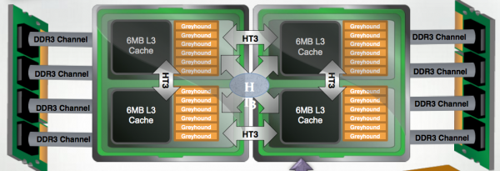
Massive Parallelization of SAT Solvers
Aditya Devarakonda, Nishant Totla (Advised by: James Demmel, Sanjit Seshia)
Motivation
Existing Solvers
Evaluation
Boolean Satisfiability forms the basis of modern constraint solving
SAT Solvers have had immense gains in efficiency during the last decade – yet many instances are still beyond the reach of modern solvers
At the same time, multicore hardware is more easily accessible, even in standard PCs
Parallel SAT Solvers present a potential for additional speedups and the ability to solve previously intractable instances
Plingeling: A shared memory parallel SAT solver that uses Pthreads as the threading model
ManySAT2.0: A shared memory parallel SAT solver that uses OpenMP as the threading model
Plingeling exhibits poor scaling when compared to Manysat2.0. We use this as motivation for using Manysat2.0 as our base solver for our MPI version
Neither solver can efficiently scale to 24 threads on a single node. Therefore, an efficient parallelization strategy is necessary to scale beyond a single node
MPI ManySAT2.0 can solve this SAT instance deterministically whereas ManySAT2.0 never finishes for deterministic and rarely finishes for non-deterministic
Hard SAT Instance (deterministic, 12 OpenMP threads)
MPI ManySAT 2.0 |  | Speedup
# of cores | Time (sec) | ~1.9x between parallel runs. Meaning our search space pruning effectively reduces work per processor.
384 | 1984.0
768 | 511.0
Hard SAT Instance (non-det.)
ManySAT2.0 |  | Note
# of threads | Time (sec) | Non-deterministic running times are highly variable. ManySAT2.0 only rarely solves this SAT instance.
12 | 2067.0
24 | 1730.0
Objectives
Demonstrating parallel scaling: Does adding more cores make the solver faster?
Speedups over existing solvers: Can we do better than existing parallel solvers?
Solving intractable instances: Can we solve instances that other solvers cannot?
Scale to large number of cores: How many cores can we scale to, while still seeing gains?
Challenges
Experimental Setup
Solver Layout
The memory footprint of parallel solvers is fairly large. One big challenge is parallelizing across nodes while keeping the memory usage under check
A second challenge is to have an efficient search space division strategy to ensure fast exploration on sub-spaces
All of our experiments were run on the Hopper system at the NERSC Center
Hopper is a Cray XE6 system with 153,216 processors, 217 Terabytes of memory with a peak performance of 1.28 Petaflops/sec
Each node of Hopper contains 24 cores partitioned into 4 NUMA regions each with 2 sockets
Future Work
Optimizing the choice of guiding paths using higher level information about the instance
Analysis of how our scaling technique affects solver parameters (propagations, restarts, decisions etc.)
Experimenting with more diversification in individual solver parameters
Work stealing
OpenMP proc1
OpenMP proc2
OpenMP proc3
OpenMP proc4
The search space is divided using “guiding paths”
Each process is a parallel portfolio for its own “path”
Acknowledgement
This research used resources of the National Energy Research Scientific Computing Center, which is supported by the Office of Science of the U.S. Department of Energy under Contract No. DE-AC02-05CH11231
Notes:
Add new feed options
Set the parameters
- Time out
- Number of retrials

