Slide 1
Large-scale Hybrid Parallel SAT Solving
Nishant Totla, Aditya Devarakonda, Sanjit Seshia

Slide 2
SAT Solving
Given a propositional logic formula in conjunctive normal form (CNF), does there exist a satisfying assignment?
(x₁∨x₂∨x₃) ∧ (¬x₁∨x₃) ∧ (¬x₂∨x₄)
The problem is NP Complete
Modern applications in various fields like verification and AI routinely turn up instances that have millions of variables and clauses
Clause 1
Clause 2
Clause 3
x₁=F, x₁=T, x₁=T, x₁=T

Slide 3
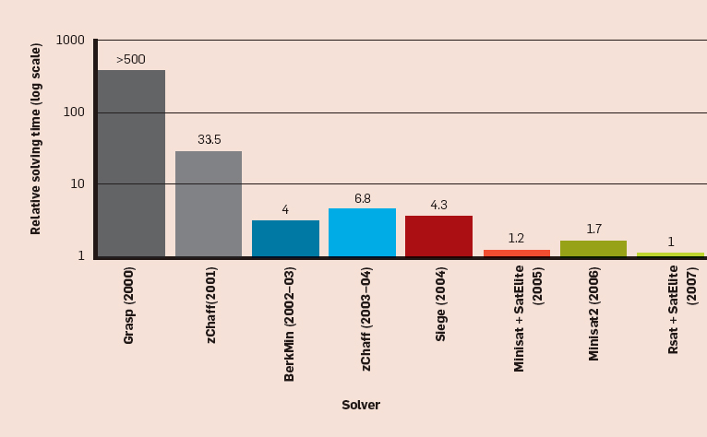
Motivation
SAT solvers have had immense gains in efficiency over the last decade
Yet, many instances are still beyond the reach of modern solvers
Some hard instances still take a long time to solve
Algorithmic/heuristic gains have been going down, so parallelization is the next step
Multicore hardware is now more easily accessible
Source: http://cacm.acm.org/magazines/2009/8/34498-boolean-satisfiability-from-theoretical-hardness-to-practical-success/fulltext

Slide 4
Parallel SAT Solving : Divide-and-Conquer
SAT solvers look for a satisfying assignment in a search space
Divided parts of this space can be assigned to each parallel worker
Challenges:
Difficult to get the division of search space right
Sharing information becomes tricky

Slide 5
Parallel SAT Solving : Portfolios
SAT solvers are very sensitive to parameter tuning
Multiple solvers can be initialized differently and run on the same problem instance
Learned clauses can be shared as the search progresses
Challenges:
Difficult to scale to large number of processors
Sharing overheads quickly increase with scaling
Portfolio solvers have performed better in practice

Slide 6
Objectives
Build a parallel SAT solver that
Scales to a large number of cores
Demonstrates parallel scaling
Provides speedups over existing solvers
Solves instances that existing solvers cannot
Uses high-level domain-specific information

Slide 7
Our approach
We combine the two approaches to create a more versatile and configurable solver
A top-level divide-and-conquer is performed along with portfolios assigned to each sub-space

Slide 8
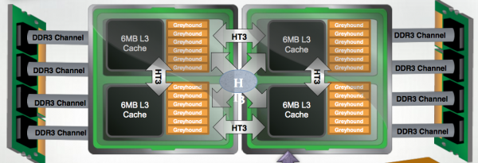
Solver Setup
All experiments are run on the Hopper system at the NERSC Center. Hopper is a Cray XE6 system
Each node has 24 cores with shared memory
Portfolios run within a single node
Search space can be divided across nodes

Slide 9
Why is this a good idea?
A hybrid approach is essential for efficient computation on high-performance computers with a clear hierarchy of parallelism
Within a node – shared memory approach is efficient
Across nodes – distributed memory approach is efficient
Our solver is highly configurable – it can emulate full divide-and-conquer, full portfolio
Notes:
Our experiments show that both pure approaches perform worse when scaling to a large number of processors
Both pure approaches perform bad:
DnC: No sharing, really hard to get search space division right. Dividing using a few bad variables hardly helps.
Portfolio: Memory usage goes up pretty quickly, not easy to create a good large portfolio
The sweet spot is somewhere in between, and our solver allows the user to easily explore this parameter space

Slide 10
Scaling Plots
(Negative slope is better)
ManySAT and Plingeling scale poorly within a node

Slide 11
Solver Operation
Say we want to run a solver that divides the search space into 8, with 12 workers per portfolio
Pick 3 variables to form the guiding path (say x₁,x₂,x₃)
Initialize portfolios with parameter configurations ψ_{i}
¬x₁¬,x_{2,} ¬x₃
¬x_{1,}x_{2,} ¬x₃
¬x_{1,} ¬x_{2,}x₃
¬x_{1,}x_{2,}x₃
ψ₁
ψ₂
ψ₃
ψ₄
x_{1,} ¬x_{2,} ¬x₃
x_{1,}x_{2,} ¬x₃
x_{1,}¬x_{2,}x₃
x_{1,}x_{2,}x₃
ψ₅
ψ₆
ψ₇
ψ₈
Notes:
Portfolio configurations include parameters like random seeds, restart policies, decision heuristics etc.
Currently we don’t share information between portfolios, opting to avoid inter-node communication overheads, but it can be done

Slide 12
Idle workers
Some portfolios may finish faster than others
Such portfolios should help other running ones by “stealing” some work
¬x₁¬,x_{2,} ¬x₃
¬x_{1,}x_{2,} ¬x₃
¬x_{1,} ¬x_{2,}x₃
¬x_{1,}x_{2,}x₃
ψ₁
ψ₂
ψ₃
ψ₄
x_{1,} ¬x_{2,} ¬x₃
x_{1,}x_{2,} ¬x₃
x_{1,}¬x_{2,}x₃
x_{1,}x_{2,}x₃
x_{1,}x_{2,} ¬x₃
x_{1,}¬x_{2,}x₃
x_{1,}x_{2,}x₃
ψ₅
ψ₆
ψ₇
ψ₈
ψ₆
ψ₇
ψ₈

Slide 13
Work Stealing
Idle workers together ask (say) the 5th portfolio for more work
If the 5th portfolio agrees, it further divides its search space and delegates some work
¬x₁¬,x_{2,} ¬x₃
¬x_{1,}x_{2,} ¬x₃
¬x_{1,} ¬x_{2,}x₃
¬x_{1,}x_{2,}x₃
ψ₁
ψ₂
ψ₃
ψ₄
x_{1,} ¬x_{2,} ¬x₃
¬x_{4,} ¬x₅
x_{1,} ¬x_{2,} ¬x₃
x_{1,}x_{2,} ¬x₃
x_{1,}¬x_{2,}x₃
x_{1,}x_{2,}x₃
x_{1,} ¬x_{2,} ¬x₃
x_{1,}x_{2,} ¬x₃
x_{4,} ¬x₅
x_{1,}¬x_{2,}x₃
¬x_{4,}x₅
x_{1,}x_{2,}x₃
x_{4,}x₅
ψ₅
x_{1,}x_{2,} ¬x₃
x_{1,}¬x_{2,}x₃
x_{1,}x_{2,}x₃
ψ₅
ψ₆
ψ₇
ψ₈
ψ₅
ψ₆
ψ₇
ψ₈
ψ₆
ψ₇
ψ₈

Slide 14
Details
Choosing the guiding path
Randomly
Internal variable ordering heuristics of the solver (such as VSIDS)
Use domain specific information
Configuring portfolios
Carefully crafted, depending on knowledge of structure of the instance
Learn based on dynamic behavior of the instance

Slide 15
Experiments
We run experiments on application instances
From previous SAT competitions
From model checking problems (self-generated)
Scaling experiments:
( 1 | 3 | 6 | 12 | 24 ) workers/portfolio
Upto 768 total workers
Testing different ways to create guiding paths
Testing different portfolio configurations

Slide 16
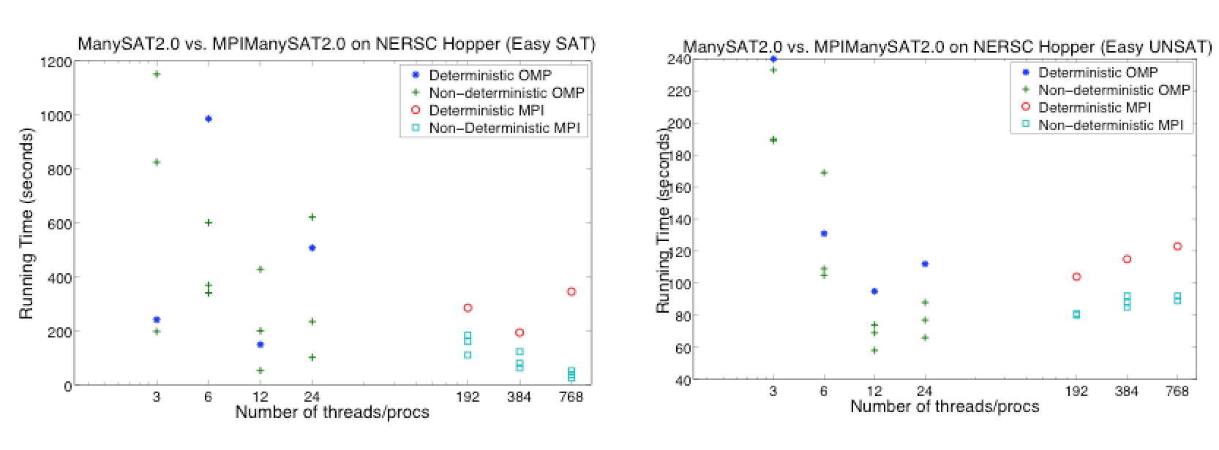
Results : Easy Instances*
Our technique performs poorly on easy instances
Large scale parallelism has significant overheads
*Results without work-stealing

Slide 17
Results : Hard Instances*
Mixed results. Depends on the guiding path
Random – 0.5 to 0.7x average scaling
Solver heuristic based – 0.6 to 0.9x average scaling
Example (Hard SAT instance; 12 workers/portfolio)
Splitting on the right variables can do better - 0.6 to 1.9x average scaling
Total cores | Time taken
384 (12 x 32) | 1984.0
768 (12 x 64) | 511.0
*Results without work-stealing

Slide 18
Improvements : In Progress
Work-stealing
Guiding paths
Use high-level information from problem domain
For example, non-deterministic inputs in model checking, or backbone variables
Portfolio configurations
Currently crafted manually
Can be tuned to the instance using machine learning

Slide 19
Thank You!

