Slide 1


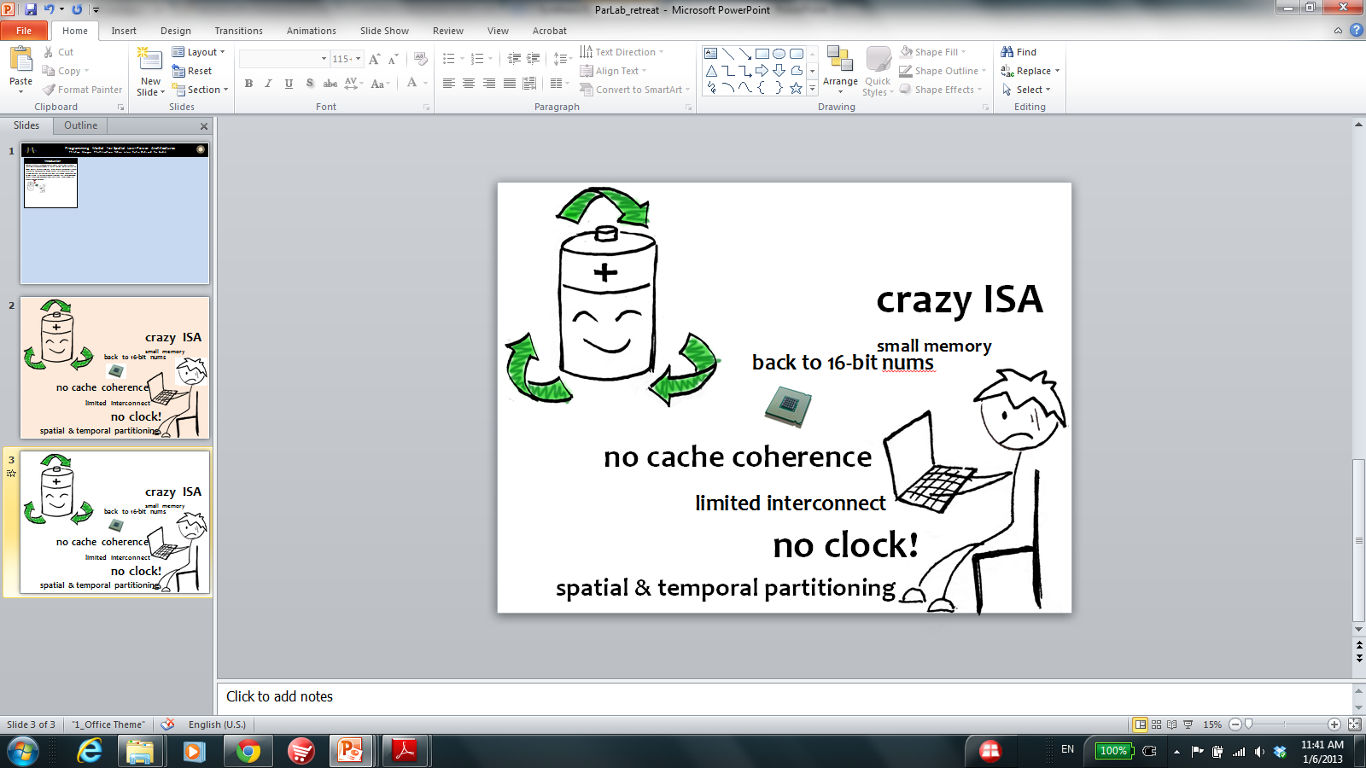
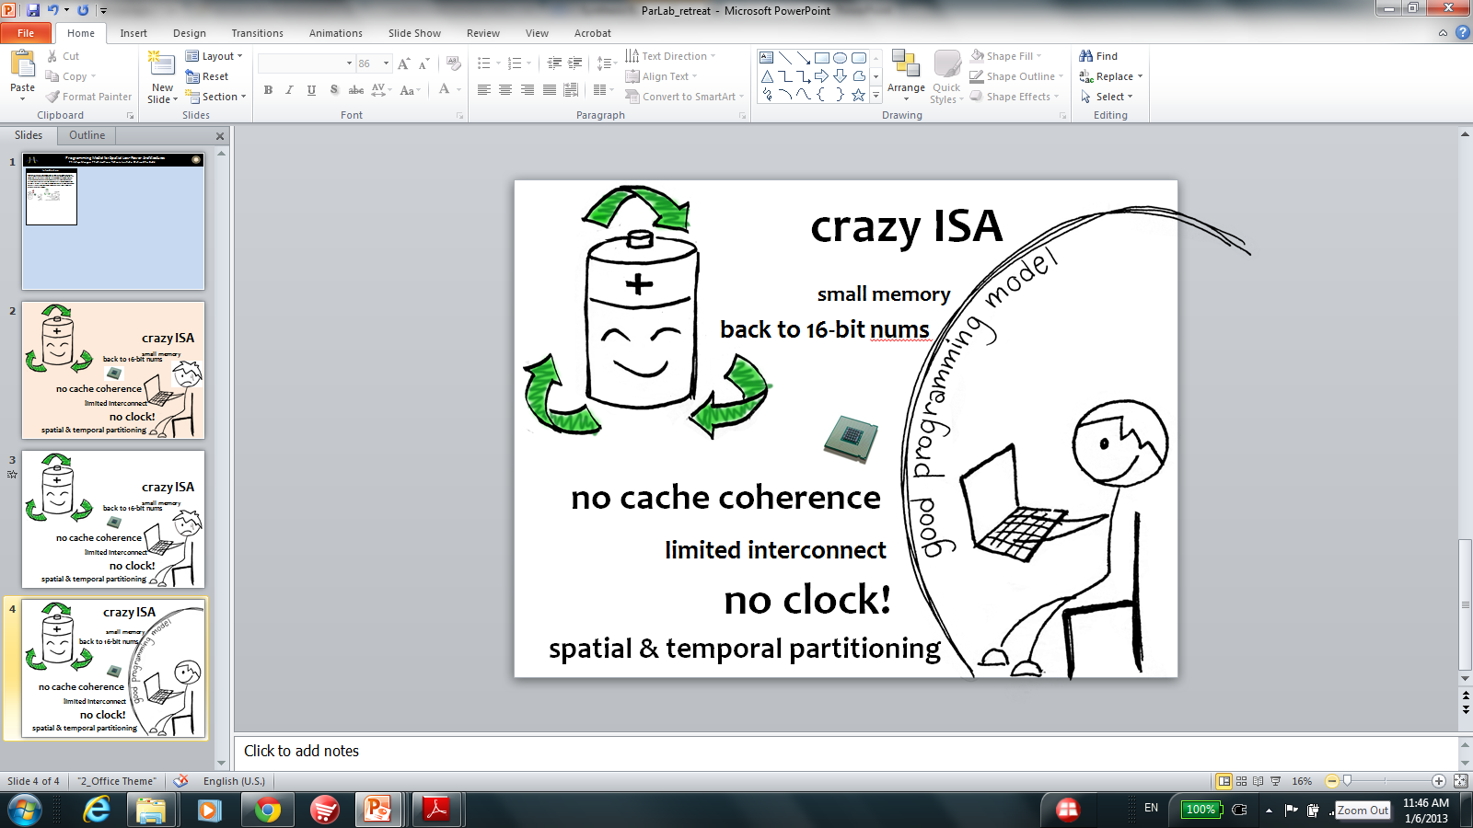
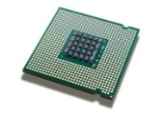

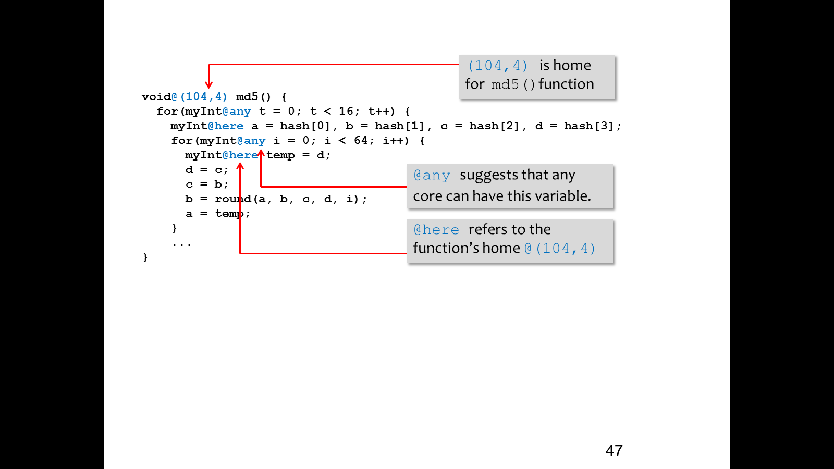
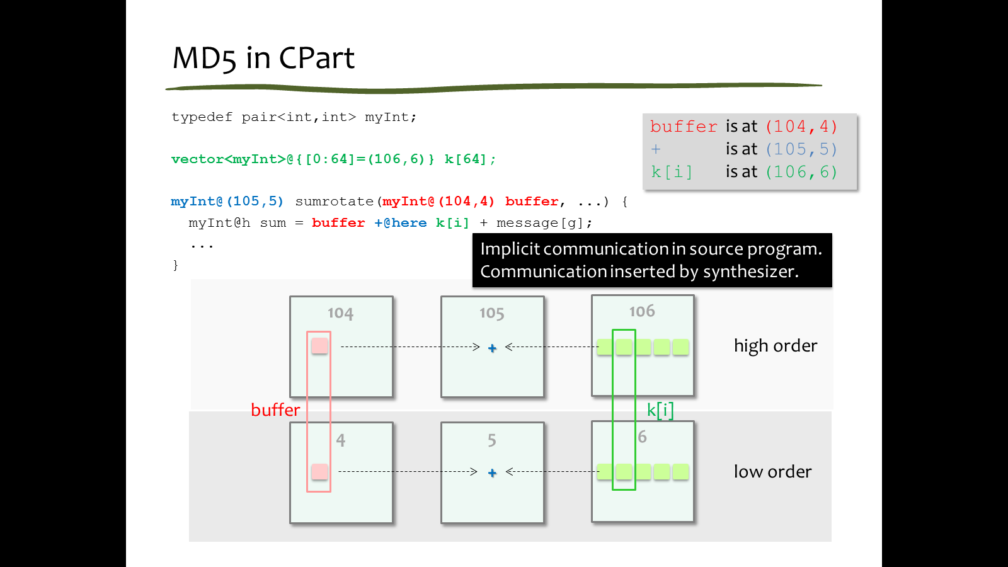
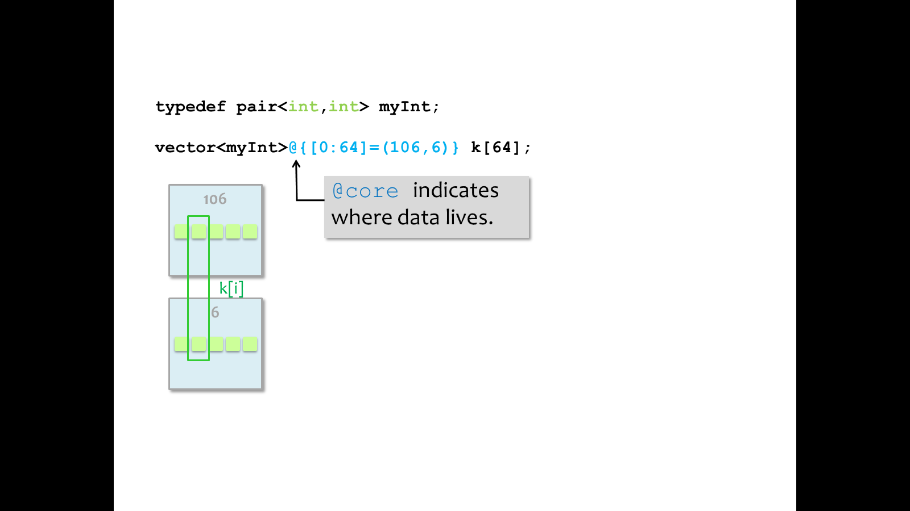
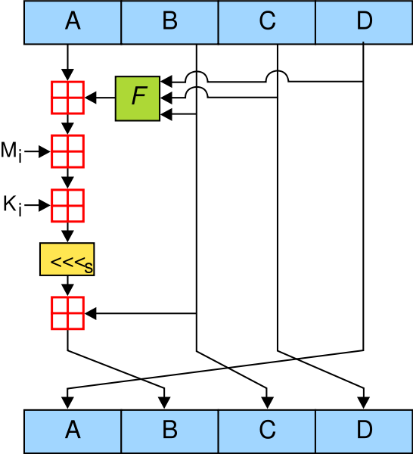



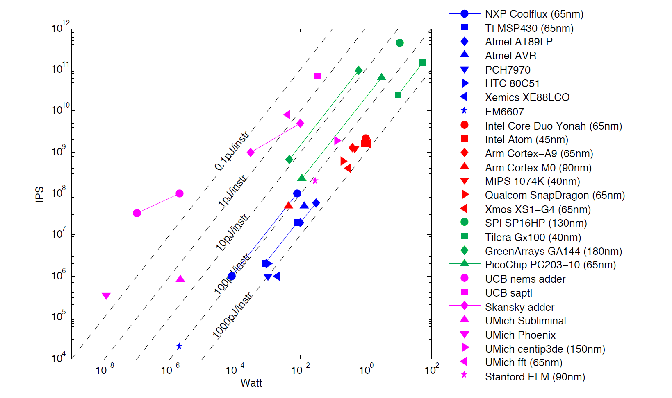
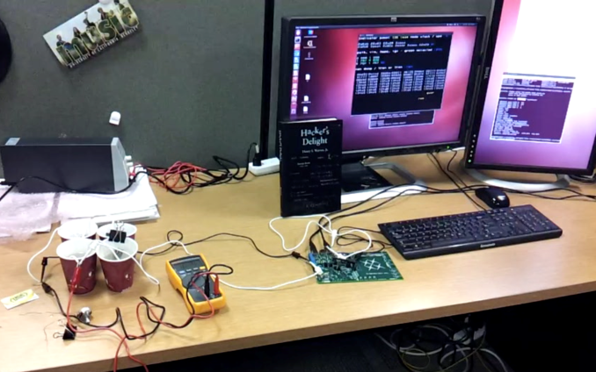
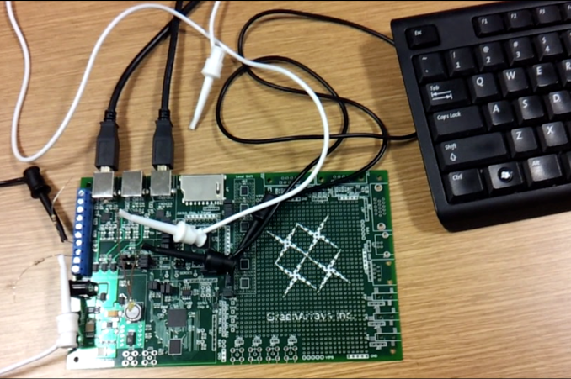
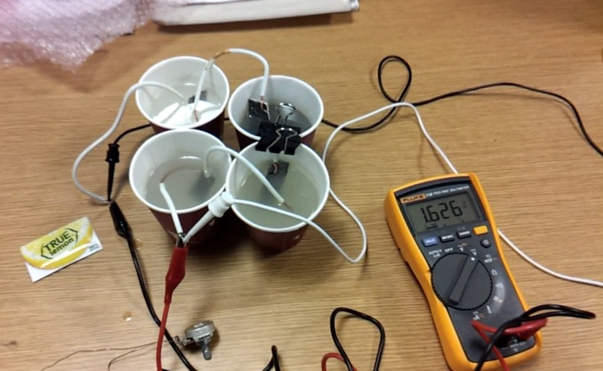
Programming Model for Spatial Low-Power Architectures
Phitchaya Mangpo Phothilimthana and Nishant Totla with Prof. Ras Bodik mentored by Dinakar Dhurjati
Introduction
Approach
Synthesis-based Code Generation
Heterogeneous CPUs are the future of mobile computing because they promise high energy efficiency without sacrificing performance. To achieve better energy efficiency, heterogeneous architectures will include minimalistic hardware: tiny cores; simple interconnects; as well as more efficient ISAs. The resulting spatial nature of the CPU and the lack of hardware support for programmability will complicate programming and will necessitate developing new programming models and compiler tools.
We are working on a high-level programming model for heterogeneous architectures and a synthesis-based compiler toolchain. Our system helps the programmer with partitioning his code onto cores and is retargetable to a range of target architectures.
High-Level Program
New Programming
Model
Current Synthesizer
Spec GreenArrays program
(sequence of instructions)
Output the fastest program
(can be modified to the most energy-efficient)
Sketch optionally, we can provide a template of the
desired GreenArrays program with holes
Our current prototype synthesizes straight line programs with no branches and loops.
Code generation Sketching-based Synthesis
Partitioner
Naïve Implementation of Division
Subtract divisor until remainder < divisor.
# of iterations = output value
Better Implementation (for constant divisors)
n - input
M - “magic” number
S - shifting value
M and s depend on the number of bits and on the (constant) divisor.
Per-core High-Level Programs
New Approach
Using
Synthesis
Code Generator
quotient = (M * n) >> s
Per-core Optimized Machine Code
Programming Model for Code Partitioning
Sketch is : ?? * n >> ??
Language allowing to define placement of data and code on cores.
Various Place Annotations
Spec | Solution
x/3 | (43691 * x) >> 17
x/5 | (209716 * x) >> 20
x/6 | (43691 * x) >> 18
x/7 | (149797 * x) >> 20
Features
Users can specify: exact places, if known; only the partitioning; or no constraints.
Unknown places will be inferred by the synthesizer such that - number of messages is minimized - code fits in each core
Users do not need to code communication explicitly.
Synthesis via Superoptimization (i.e., searching all instruction sequences)
Goals
The table shows speedup and code length reduction of the synthesized code against naïve implementation, except in the last two rows, which compare against expert-hand-optimized code.
Design and implement an easy-to-use programming model for programming heterogeneous hardware, eliminating the need for the programmer to program at the machine level.
Develop algorithms for partitioning and placement of the high-level program to maximize parallelism while minimizing the communication cost.
Apply program synthesis to generate very efficient executable code. Synthesis is an alternative to building traditional compilers that eliminates the need to implement a new compiler that targets a specific hardware.
Example Program
Program | Approx. Speedup | Code length reduction | Original Code Length | Synthesis Time
x – (x & y) | 5.2x | 4x | 8 | 2 s
(x + 7) & -8 | 1.7x | 1.8x | 9 | 30 s
(x & m) | (y & ~m) | 2x | 2x | 22 | 13 m
(y & m) | (x & ~m) | 2.6x | 2.6x | 21 | 4 m
((x & y) | (~x & z)) & 0xffff | 1.4x | 1.5x | 15 | 5h 15m
(y ^ (x | ~z)) & 0xffff | 1.1x | 1.4x | 14 | 1h 46m
Annotation at Variable Declaration
Current status and Future plans
Case Study
Current Status
Completely functioning prototype compiler
Superoptimizer for straight-line code
Data-flow language support for streaming applications
Working MD5 Program compiled by the prototype compiler
As our case-study architecture, we have selected GreenArrays (GA) 144:
18-bit stack-based architecture
8 x 18 array of asynchronous cores
no shared resources (e.g. clock, cache, memory bus)
144-byte RAM, 144-byte ROM, two 8-word stacks per core
each core can only communicate to its neighbors
V_{DD} = 1.8V. Power usage ranges from 14 uW – 650 mW
Fewer than 20k transistors per core
Partitioning Synthesizer
256-byte mem per core
initial data placement specified
Example: simplified MD5 (one iteration)
Input: initial data placement
Output: optimal computation placement that minimizes # of messages passing between cores
Example: simplified MD5 (one iteration)
Partitions are automatically generated.
Future Plan
Develop scalable superoptimizer for larger block of code
Test retargetability of synthesizer
Design reusable spatial data structures
Build low-power gadgets for audio, vision, health
Evaluate ISA performance - when deciding to add new instructions - when choosing a set of instructions
102
103
F
high
104
105
106
Computational rate vs power consumption of
different low-power devices
R_{i}
R
M
F
<<<
K
Finite Impulse Response Benchmark
low
2
3
4
5
6
Performance | MSP430 (65nm) | GA144 (180nm)
usec / FIR output | 24.25 | 2.18
nJ / FIR output | 152.80 | 17.66
M
<<<
K
~100x
512-byte mem per core
same initial data placement
512-byte mem per core
different
initial data placement
F
Data from Rimas Avizienis
102
103
F
105
202
high
<<<
104
106
GreenArrays 144 is 11x faster and simultaneously 9x more energy-efficient than MSP 430.
R
M
K
102
103
106
2
3
F
5
<<<
low
M
4
6
R
M
K
Demo: synthesized program running on GA144 with lemon-bleach battery
Figure from Per Ljung
K
Acknowledgement: Rohin Shah, Tikhon Jelvis, and Andres RioFrio

