Slide 1
Welcome to Foodie Express
An Easy Online food ordering website

Slide 2
Technology Used:
HTML
CSS
JavaScript
MongoDb Compass
React
ExpressJs

Slide 3
Future Enhancement :
➤ More interactive user interface can be added.
➤ Other activities can be added Type here to search EM Recommended
➤ Attractive user interface
➤ Online Payment
➤ Location map for users
➤ Table Reservation System
.

Slide 4
Objectives :
➤ To develop a system to properly manage the restaurant
➤ To increase the online customers
➤ To eliminate the sort of problem that have been occurs during biling, ordering and payments time
➤ To gain profit by gaining review in social media also

Slide 5
Methodology :
► A methodology is the elaboration of a clear strategy for gathering evidence, including the specific data collection methods to be used, the kinds of evidence to be collected, and the approach for analyzing the evidence.

Slide 6
Requirement Analysis:
Functional requirement is used to help the reader understanding why the requirements is needed, and to track the requirement through the development of the system.

Slide 7
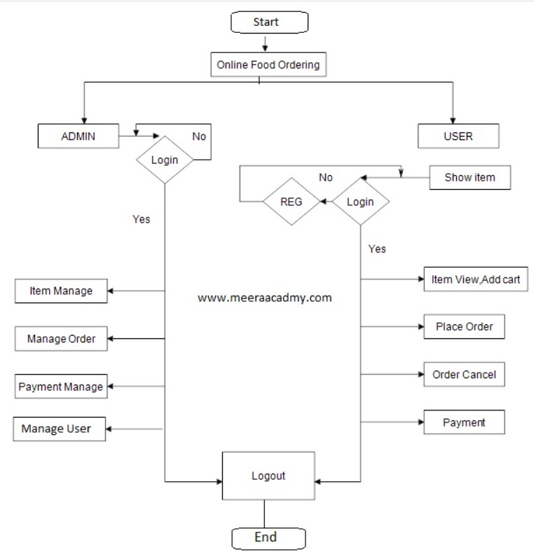
Flowchart :

Slide 8
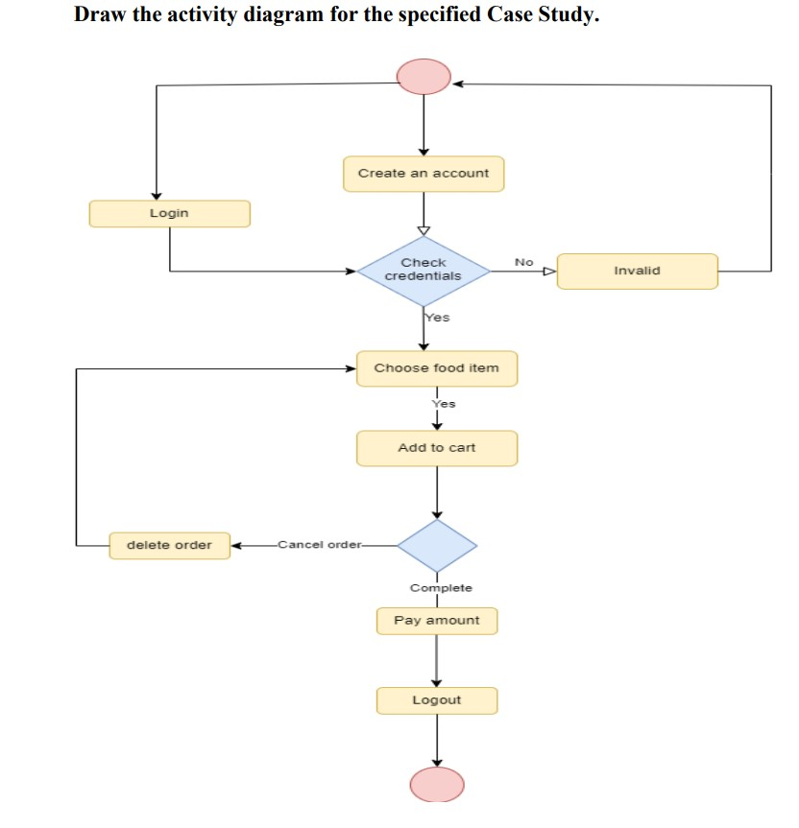
Activity Diagram:

Slide 9
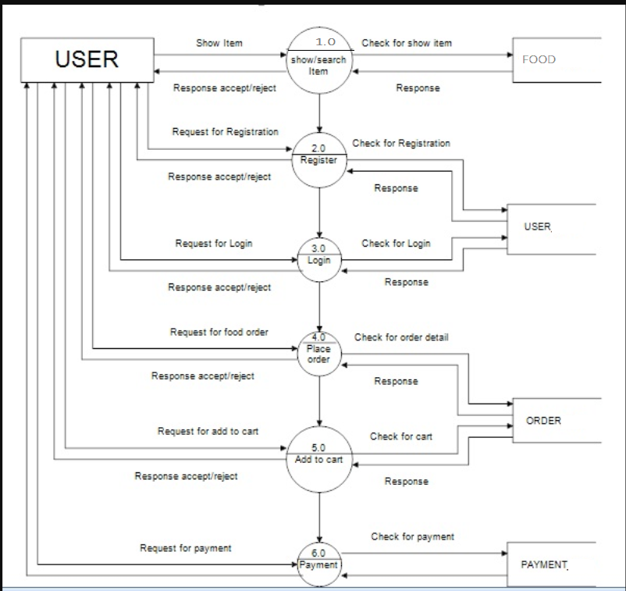
Data Flow Diagram

Slide 10
THANKYOU

