Slide 1
Sentiment Analysis / Amazon Reviews
Data Mining Project

Slide 2


Slide 3
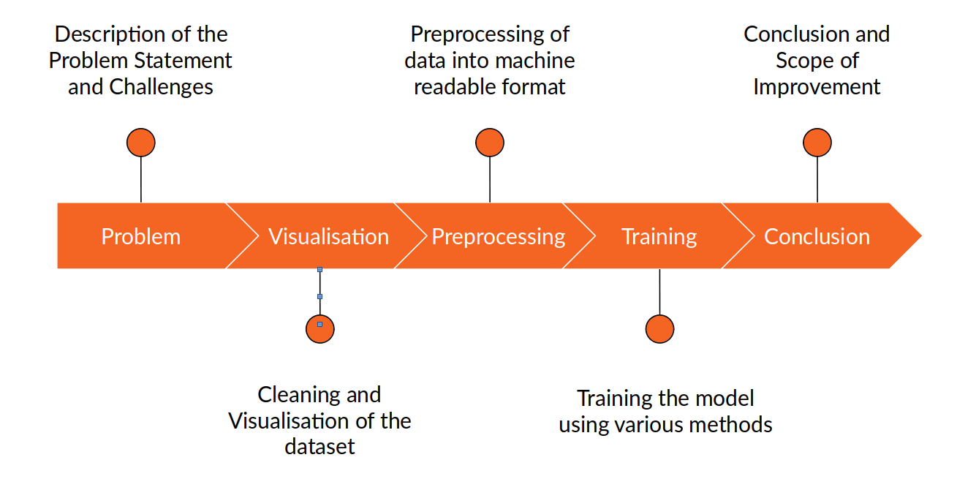

Slide 4
Business Problem
Business Solutions
Which product categories has lower reviews / maybe inferior products? (ie. electronics, iPad)
Which product have higher reviews / maybe superior products?
Which products should be kept, dropped from Amazon's product roster (which ones are junk?)
Also: can we associate positive and negative words/sentiments for each product in Amazon's Catalog
By using Sentiment analysis, can we predict scores for reviews based on certain words

Slide 5


Dataset
This dataset is based on Amazon branded/Amazon manufactured products only, and Customer satisfaction with Amazon products seem to be the main focus here.
Assumptions:
We're assuming that sample size of 30K examples are sufficient to represent the entire population of sales/reviews
We're assuming that the information we find in the text reviews of each product will be rich enough to train a sentiment analysis classifier with accuracy (hopefully) > 70%.

Slide 6
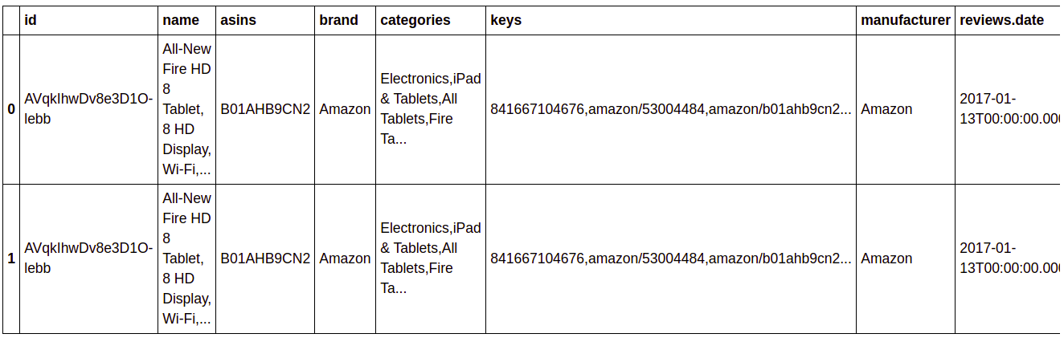
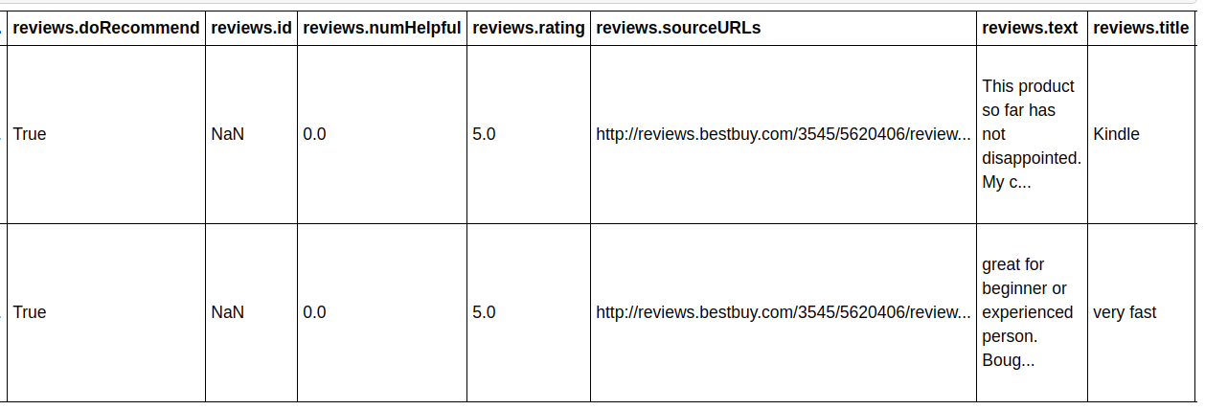
A Quick Look on Dataset

Slide 7
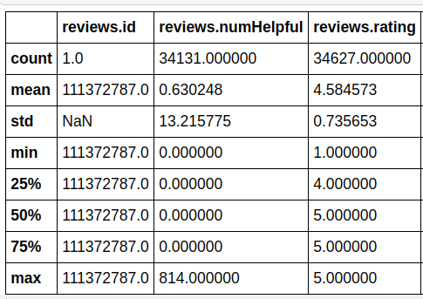
Data Analysis
Based on the descriptive statistics, we see the following:
Average review score of 4.58, with low standard deviation
Most review are positive from 2nd quartile onwards
The average for number of reviews helpful (reviews.numHelpful) is 0.6 but high standard deviation
The range of most reviews will be between 0-13 people finding helpful (reviews.numHelpful)
The most helpful review was helpful to 814 people

Slide 8
Split Train/Test Dataset
We're going to split it into training set and test sets.
Our goal is to eventually train a sentiment analysis classifier
Since the majority of reviews are positive (5 stars), we will need to do a stratified split on the reviews score to ensure that we don't train the classifier on imbalanced data
With the help of sklearn's Stratified ShuffleSplit class, we will remove all samples that have NAN in review score, then split them into training and test sets.

Slide 9
Data Exploration
We will try to explore the following columns:
Name
Asins
Reviews.rating
reviews.doRecommend

Slide 10
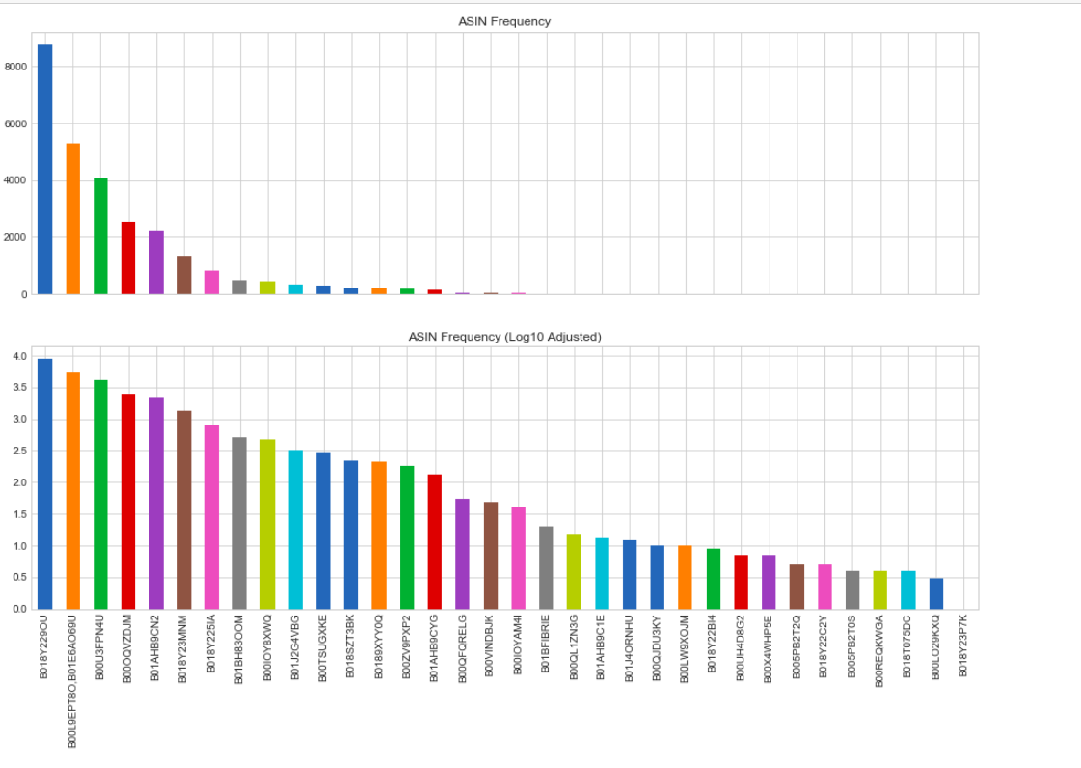
This answers the first question that certain ASINs (products) have better sales, while other ASINs have lower sale, and in turn dictates which products should be kept or dropped.

Slide 11
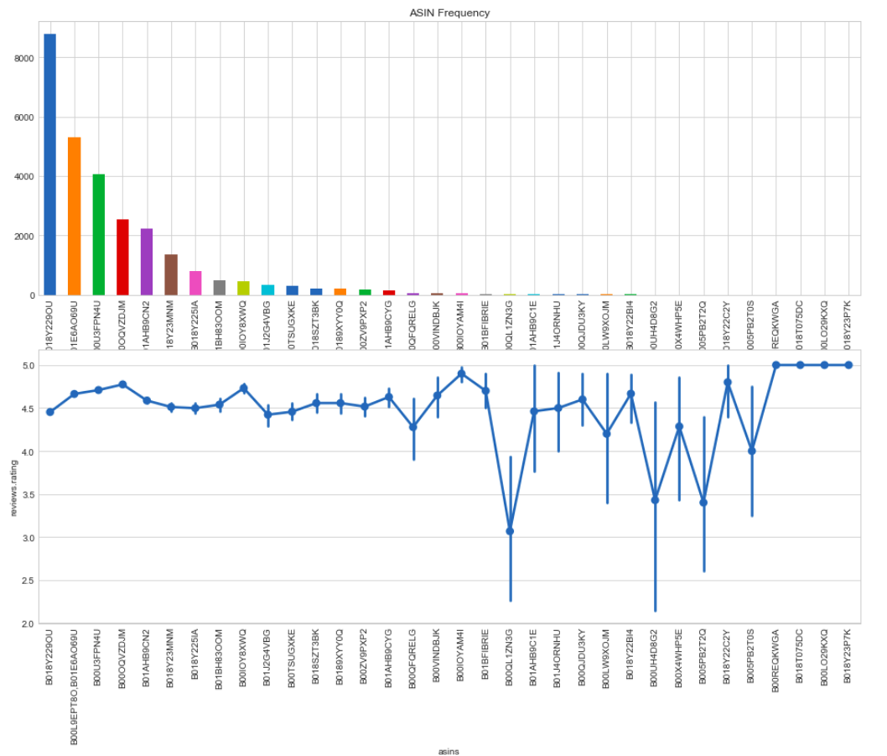
The most frequently reviewed products have their average review ratings in the 4.5 - 4.8 range, with little variance.

Slide 12
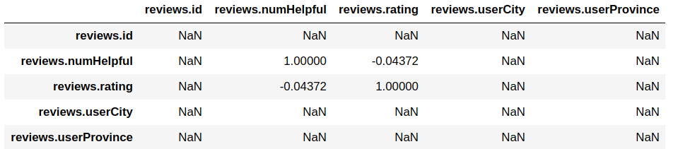
Correlation
We see that there is almost no correlation which is consistent with our findings.

Slide 13
Sentiment Analysis
Segregate ratings from 1-5 into positive, neutral, and negative.
Turn content into numerical feature vectors using the Bag of Words strategy. (Implemented using SciKit-Learn's CountVectorizer)
Text preprocessing
Tokenization (breaking sentences into words)
Stopwords (filtering "the", "are", etc)
Occurrence counting
Feature Vector

Slide 14
Different Models and their Accuracy
Algorithm | Accuracy
Multinominal Naive Bayes Classifier | 93.45%
Logistic Regression Classifier | 93.70%
Support Vector Machine Classifier | 93.94%
Decision Tree Classifier | 90.18%
Random Forest Classifier | 93.46%

Slide 15
Fine Tuning in SVM Classifier
We will run a Grid Search of the best parameters on a grid of possible values.
Then we will fit the grid search to our training data set.
Next we will use our final classifier (after fine-tuning) to test some arbitrary reviews.
Finally we will test the accuracy of our final classifier (after fine-tuning).
After running the grid search, our SVM Classifier has improved to 94.08% accuracy level.

Slide 16
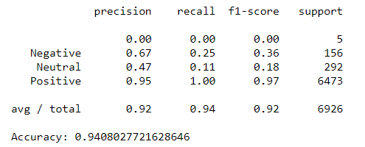
Performance Analysis
However, despite that Neutral and Negative results are not very strong predictors in this data set, it still shows a 94.08% accuracy level in predicting the sentiment analysis.

Slide 17
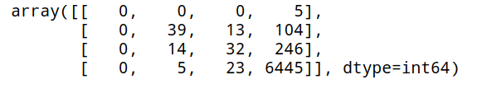
Confusion Matrix
We see that positive sentiment can sometimes be confused for one another with neutral and negative ratings, with scores of 246 and 104 respectively. However, based on the overall number of significant positive sentiment at a score 6445, then confusion score of 246 and 104 for neutral and negative ratings respectively are considered insignificant.
Therefore, we conclude that the products in this dataset are generally positively rated, and should be kept from Amazon's product roster.

Slide 18
Final Conclusions
Despite the skewed dataset, we were still able to build a Sentiment Analysis machine learning system to determine if the reviews are positive or negative. This is possible as the machine learning system was able to learn from all the positive, neutral and negative reviews, and fine tune the algorithm in order to avoid bias sentiments.
In conclusion, although we need more data to balance out the lower rated products to consider their significance, however we were still able to successfully associate positive, neutral and negative sentiments for each product in Amazon's Catalog.

Slide 19
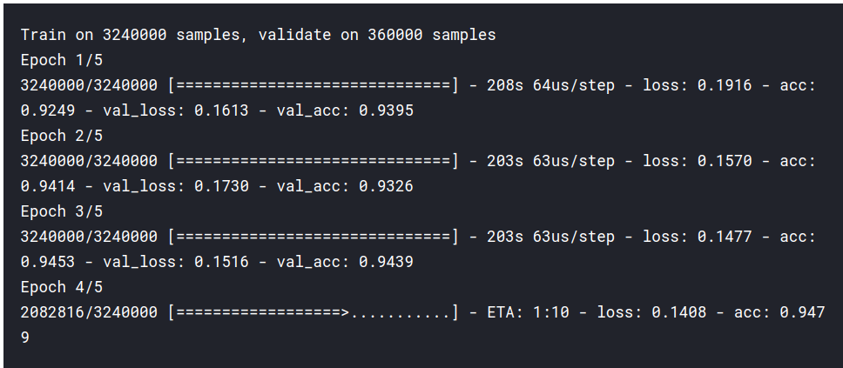
Comparison With Different Sentiment Analysis Approaches
Using Convolutional neural network (CNN)
With This approach a maximum accuracy of 94.4% was achieved.
Link :https://www.kaggle.com/kevinautin/fully-convolutional-accuracy-94-4-15-min

Slide 20
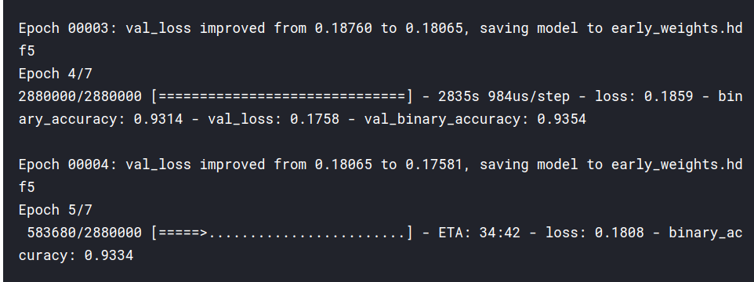
Comparison With Different Sentiment Analysis Approaches
Using Recurrent neural network (CNN) based CuDNNLSTM Implementation
With This approach a maximum accuracy of 93.7% was achieved.
Link : https://www.kaggle.com/anshulrai/cudnnlstm-implementation-93-7-accuracy

Slide 21
Thank You!
Nishant Mittal (18074013)
Mudit Bhardwaj (18074011)
Aditya Patidar (18075006)
Ayush Damele (18075014)

