Slide 1
Early Classification of MTS with different sampling rates while maintaining `Alpha` accuracy
Exploratory Project (CSE-291)
By: 18074013 - Nishant Mittal
Guided By: Dr. Hari Prabhat Gupta

Slide 2
Objective
The objective is not only to make the correct prediction but the correlation between the different readings should be taken into account.
Early Classification of the MTS with different sampling rates while maintaining the pre decided accuracy.
1

Slide 3

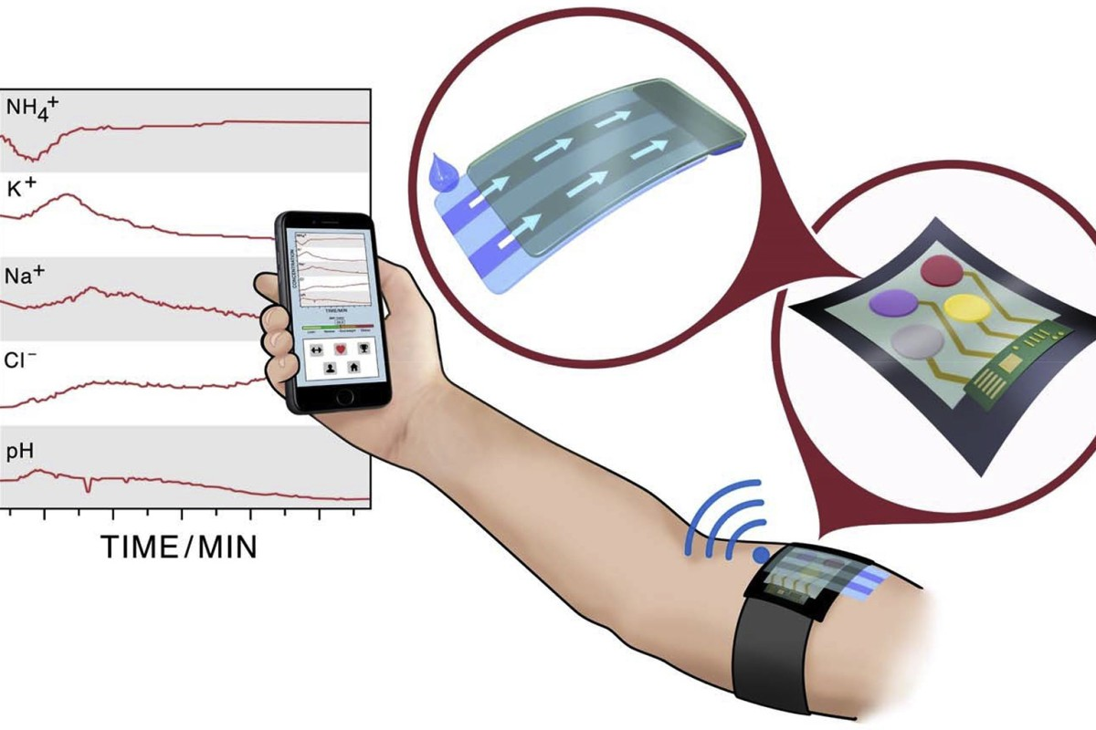
Motivation
MTS datasets are recorded by the reading of sensors in various places like Traffic sensors, Fitness sensors etc.
The readings of the different sensors may have different sampling rates. There is no reliable algorithm which can help in classification of such a series with using minimum data points.
2

Slide 4
Algorithms used in the approach
Gaussian process classifier
The prediction is probabilistic (Gaussian) so that one can compute empirical confidence intervals and decide based on those if one should refit (online fitting, adaptive fitting) the prediction in some region of interest.
Predicting the sequence of a hidden markov model using viterbi algorithm
3

Slide 5
The approach
Pre Prediction
Calculating the label-wise minimum number of data points required for each sensor while maintaining the pre-decided `Alpha` Accuracy.
Constructing GP classifiers according to the calculations above.
Creating a transition matrix based on the training dataset.
While predicting
Constructing the observation matrix based on the incoming test MTS.
Predicting the sequence using viterbi.
Predicting the final label.
4

Slide 6
Calculating the minimum required data points.
Firstly the GP classifiers are prepared on the whole data.
Then we choose a fixed length and prepare a GP classifier and see the if probability of correct classification is at least `Alpha` of the original probability.
If no, we increment the fixed length and repeat the steps.
Constructing Classifiers
Now we will construct class-wise GP classifiers for each label using the minimum data points we calculated.
5

Slide 7
Hidden Markov Model (HMM)
Calculating Transition Matrix
The states are the labels.
The observations are the readings of our sensors.
The sequence is the predicted label of each sensor.
Then the transition matrix is calculated using test dataset.
According to the number of times the predicted label changed moving from one sensor to another in the same MTS.
The already trained GP classifiers are used to do that.
6

Slide 8
Prediction
Preparing the observation matrix
Firstly we will choose the classifier with the minimum number of data points( Calculated in the first step ).
Then we will move on to the next classifier. (We will choose the classifier corresponding to the label predicted by our classifier for the previous sensor.)
Now we can build the observation matrix according to the probabilities given by the GP classifier.
Viterbi
Now we have both the transition and observation matrix. We can use the viterbi algorithm to predict the final sequence.
7

Slide 9
Final Prediction
Predicted Label
The label that appears maximum times in the viterbi sequence will be the final predicted label.
Data points Used
The maximum number of data points used while making the observation matrix will be considered to find the final percentage of data points used in the MTS.
8

Slide 10
My implementation
Dataset used - PEMS-SF dataset
Link - https://archive.ics.uci.edu/ml/datasets/PEMS-SF
The dataset provides the reading by various sensors on a road and the particular day they were recorded on.
I used those readings to predict the day they were recorded on.
My Code
Link - https://github.com/nishantwrp/exploratory-project
9

Slide 11
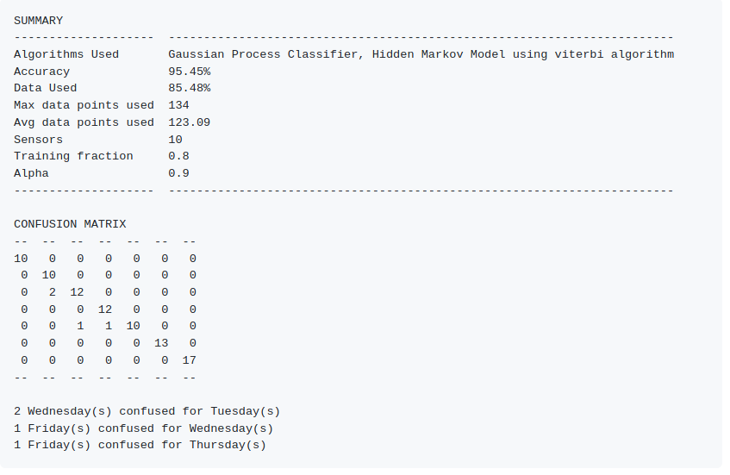
Results
10

Slide 12
Conclusion
Our accuracy and earliness of the experiments performed on PEMS-SF dataset illustrates that our approach outperforms the existing approaches of time series prediction. The proposed approach can be further extended to achieve better earliness using deep-learning models by optimizing the correlation among the components of MTD. Further, as the proposed approach is heavily dependent on the user given desired accuracy, a method can be developed to determine such accuracy based on application domain. Such a method will help to improve the effectiveness of the approach.
11

