Slide 1

Savitribai Phule Pune University
Fourth Year of Computer Engineering (2015 Course)
Project Presentation On
“Cloud Based DevOps Skill Assessment Application”
Group ID : 10
Name of Students :
1. Chetan Pawar
2. Roshan Patil
3. Nishant Kumar
4. Yogesh Mahajan
Name of Guide :
Prof. Amar More

Slide 2
Presentation Outline
Introduction and Motivation
Problem Statement
Challenges Identified
Methodology
Technologies/Platform Used
Conclusion
References

Slide 3
Introduction and Motivation
Now a day’s many online tools are available to test the programming knowledge of the person like codechef.
But in order to test the knowledge of the DevOps there is no such online tool available.
So the aim is to develop the cloud based infrastructure to test the knowledge of DevOps of the examinee.
This project aims to establish a reasonable, objective, quantized evaluation standard of analyzing examination and score, and develop the evaluation index system of examination questions and examination result analyzing.

Slide 4
Problem Statement
To develop a backend infrastructure and web based application to assess DevOps and Linux administration skills.

Slide 5
Methodology
Browser
Question
Web-Terminal
Submit
Fig : Candidate Interface

Slide 6
Challenges Identified
Web/Frontend challenges
Terminal environment on client browser Communication with backend server

Slide 7
Methodology
Terminal:
Need of live environment for a real time assessment of practical knowledge.
For this we need to provide a real system to the users. This can be provided using the terminal implemented by the “Terminado”.
Terminado:
Terminado is a open source python package library which makes use of web sockets to display real time O.S. terminal interface on web browser.
For providing real time O.S. we can make use Virtual Machines or Containers.

Slide 8
Containers
A container consists of an entire runtime environment: an application, plus all its dependencies, libraries and other binaries, and configuration files needed to run it, bundled into one package.
By containerizing the application platform and its dependencies, differences in OS distributions and underlying infrastructure are abstracted away.
Docker is the leading container platform and mainly used.
Notes:
Advantage of containers over virtualization :
With virtualization technology, the package that can be passed around is a virtual machine, and it includes an entire operating system as well as the application. A physical server running three virtual machines would have a hypervisor and three separate operating systems running on top of it.

Slide 9
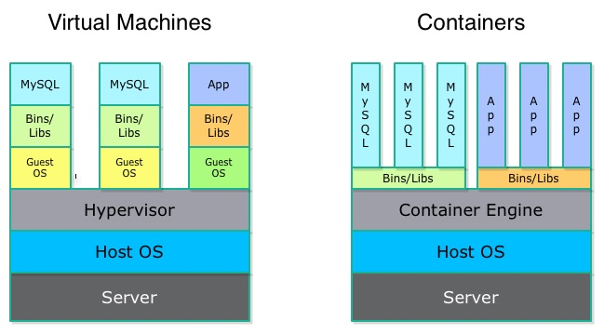
Why Containers ?

Slide 10
Docker
With Docker, you can manage your infrastructure in the same ways you manage your applications. By taking advantage of Docker’s methodologies for shipping, testing, and deploying code quickly, you can significantly reduce the delay between writing code and running it in production.
Docker provides the ability to package and run an application in a loosely isolated environment called a container. The isolation and security allow you to run many containers simultaneously on a given host.

Slide 11
Is Docker sufficient?
Now we have a great container solution, capable of handling large amounts of traffic, but it is based on an abstraction.
The containers are still running on a machine with finite resources, so we want that work to be split among multiple machines.
What if one of those machines goes down and you need to move containers?
Notes:
Container Scheduling
Container Management and Monitoring
Security
Cost Effective System

Slide 12
Container Orchestration
Container orchestration is all about managing the lifecycles of containers, especially in large, dynamic environments.
It is some sort of system to manage all of the bare metal machines or virtual machines that you need to run your containers on.
Container orchestration can be used to control and automate many tasks:
Provisioning and deployment of containers
Scaling up or removing containers to spread application load evenly across host infrastructure
Movement of containers from one host to another if there is a shortage of resources in a host, or if a host dies
Allocation of resources between containers

Slide 13
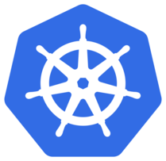
Kubernetes
Kubernetes (commonly stylized as K8s) is an open-source container-orchestration system for automating deployment, scaling and management of containerized applications.
It is based on Google’s experience of running workloads at huge scale in production over the past fifteen years. It’s not an open sourcing of Borg, their internal container orchestration system, but draws on lessons Google have learned from running Borg.
It aims to provide a "platform for automating deployment, scaling, and operations of application containers across clusters of hosts".
Notes:
Kubernetes offers a wide range of advantages: first, it poses high scalability, easier container management and helps to reduce the delay in communication, another issue which maybe be connected with Docker
Pods, or groups of containers can group together container images developed by different teams into a single deployable unit.
Kubernetes services provide load balancing, naming and discovery to isolate one microservice from another.
Namespaces provide isolation and access control so that each microservice can control the degree to which other services interact with it.

Slide 14
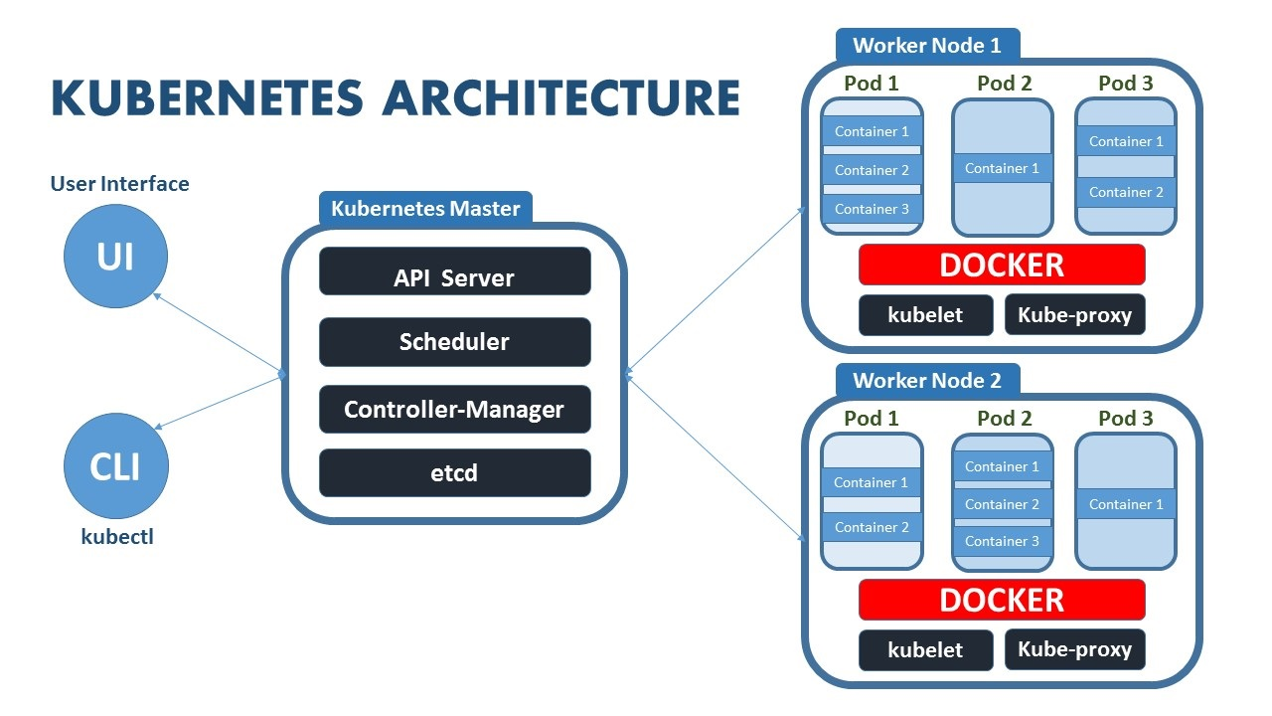
Notes:
etcd is a distributed key-value store. In fact, etcd is the primary datastore of Kubernetes; storing and replicating all Kubernetes cluster state
The kubelet is responsible for maintaining a set of pods, which are composed of one or more containers, on a local system. Within a Kubernetes cluster, the kubelet functions as a local agent that watches for pod specs via the Kubernetes API server.

Slide 15
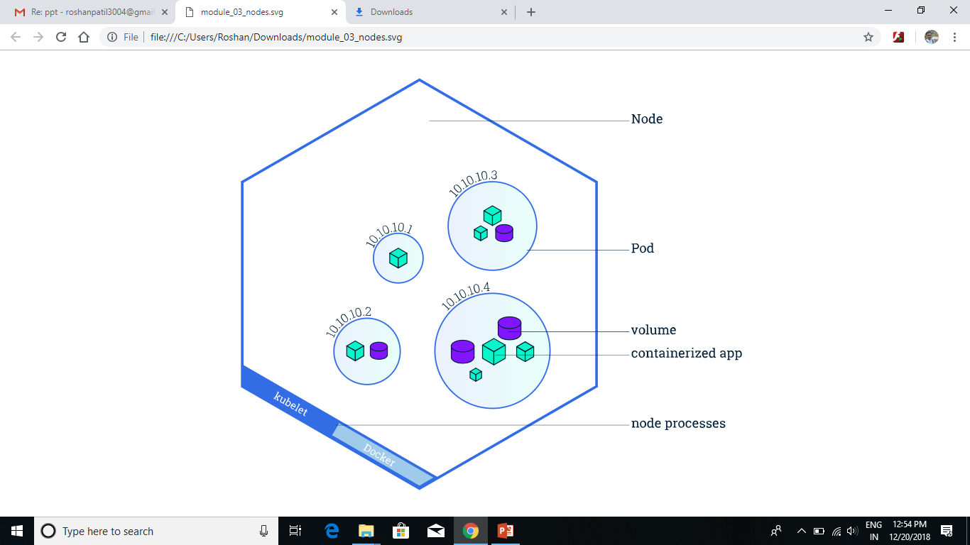
Node Structure

Slide 16

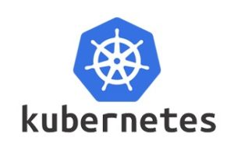
Container Scheduling
SERVER
Node 1
Node 4
C 1
Node 2
Node 3
C 2
C 3
C 4
Containers

Slide 17
Architectural View
Company
Candidate
Infrastructure

Slide 18
Organization
Request for exam
Creation of Test Structure
Test environment
Result
Candidate

Slide 19
Infrastructure
Building Cluster
CLUSTER
Load Balancer
Container Deployment
Container Creation
Monitoring

Slide 20
Technologies Used
Linux
Docker
Kubernetes
Python-Django Framework

Slide 21
Hardware Used
Server (Master) | Client (Slave)
8 GB RAM Intel core i5 processor and above Cores 8 or more CPU 2.4 GHz or faster 80 GB HDD | 2 GB RAM Intel core i3 processor and above Core 1 or more CPU 2.4 GHz or faster 120 GB HDD

Slide 22
Conclusion
A cloud-based DevOps skill assessment tool, which integrates containers and their orchestration , will be developed for the assessment of linux skills and configurations skill along with DevOps skills. This project presents computational issues of accessing terminal through web.

Slide 23
References
[1] Task Based Automatic Examination System for Sequenced Test, 2009 International Conference on Electronic Computer Technology, Macau, 2009
[2] GNU/Linux shell access through a web-browser for an embedded Linux e-learning system, 2011 3rd International Conference on Electronics Computer Technology, Kanyakumari, 2011
[3] Containerization and the PaaS Cloud, in IEEE Cloud Computing, vol. 2, no. 3,pp. 24-31, May-June 2015
Docker Documentation : https://docs.docker.com/get-started/
Kubernetes Documentation : https://kubernetes.io/docs/tutorials/

