Slide 1
Parallel
&
Asynchronous Programming
In
Modern Java
Dilip Sundarraj

Slide 2
About Me
Dilip
Building Software’s since 2008
Teaching in UDEMY Since 2016

Slide 3
What's Covered ?
Need for Parallel and Asynchronous Programming
Covers the ParallelStreams and CompletableFuture API
Techniques to write Fast Performing Code using Functional Style Concurrency APIs in Java
Covers Best Practices using ParallelStreams/CompletableFuture API in your code
NonBlocking RestFul API Client using CompletableFuture API
Testing ParallelStreams and CompletableFuture API Using JUnit5

Slide 4
Targeted Audience
Experienced Java Developers
Developers who has the need to write code that executes faster
Developers who has the need to write code that executes in Parallel
Developer who has the need to write asynchronous/non-blocking code

Slide 5
Source Code

Slide 6
Thank You!

Slide 7
Prerequisites

Slide 8
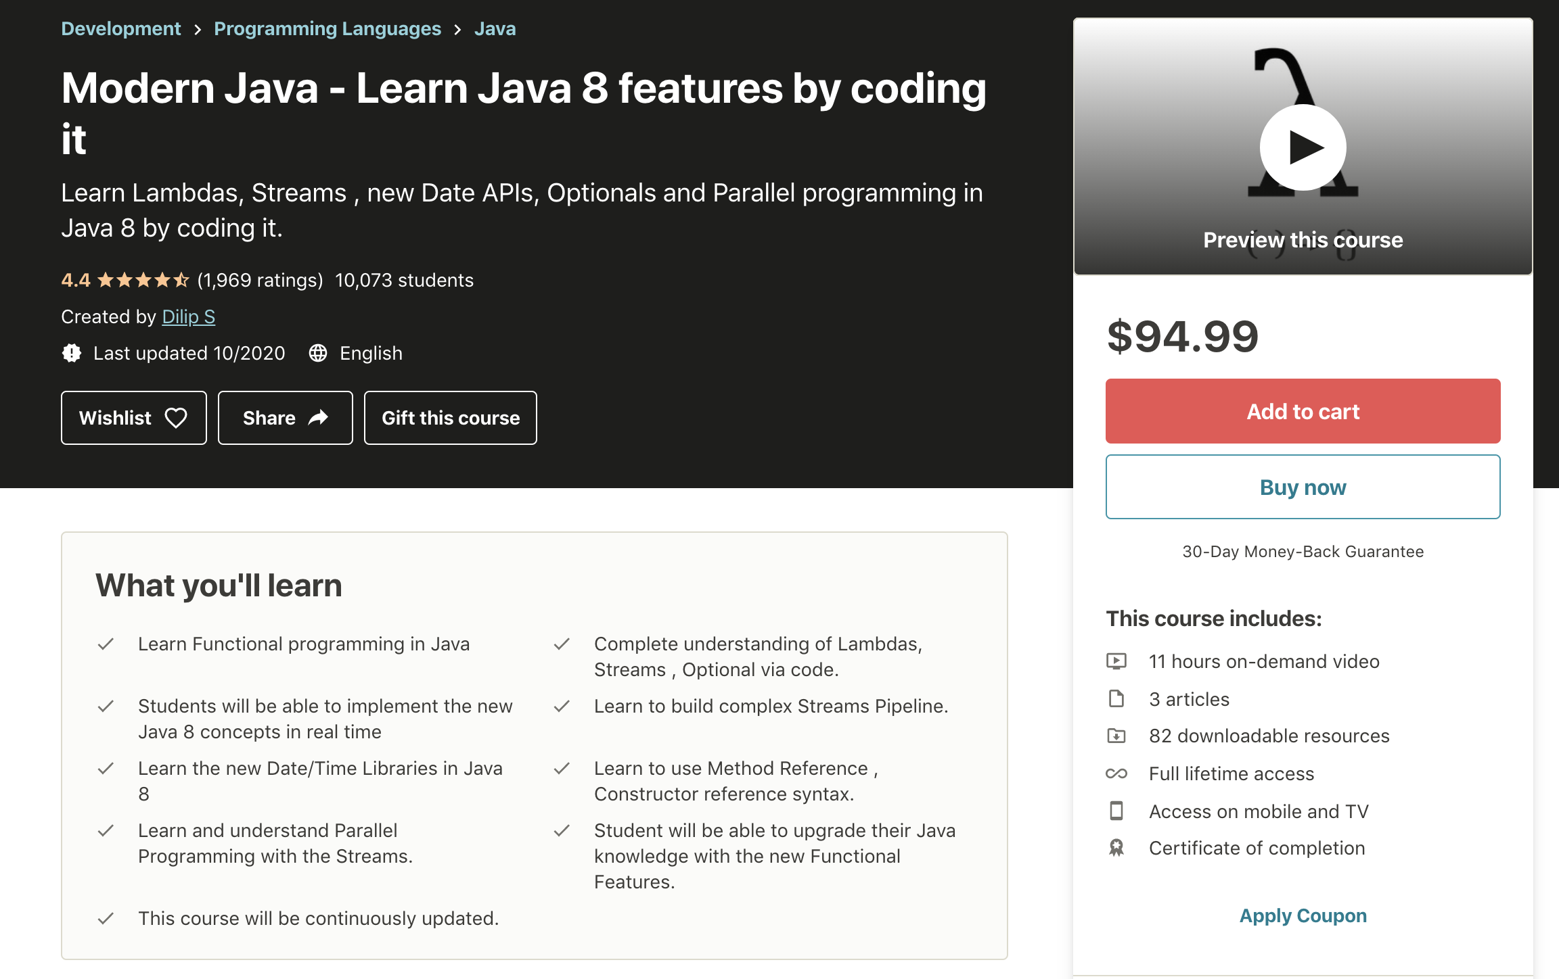
Course Prerequisites
Java 11 or Higher is needed
Prior Java knowledge is needed
Experience working with Lambdas, Streams , Method References
Experience writing JUnit tests
Intellij , Eclipse or any other IDE is needed

Slide 9
Why Parallel and Asynchronous Programming ?

Slide 10
Why Parallel and Asynchronous Programming?
We are living in a fast paced environment
In Software Programming:
Code that we write should execute faster
Goal of Asynchronous and Parallel Programming
Provide Techniques to improve the performance of the code

Slide 11
Technology Advancements
Hardware
Software
Devices or computers comes up with Multiple cores
Developer needs to learn programming patterns to maximize the use of multiple cores
Apply the Parallel Programming concepts
Parallel Streams
MicroServices Architecture style
Blocking I/O calls are common in MicroServices Architecture. This also impacts the latency of the application
Apply the Asynchronous Programming concepts
CompletableFuture
Threads
Functional Style of Programming

Slide 12
Evolution
of
Concurrency and Parallelism
APIs
in Java

Slide 13
ThreadPool,
ExecutorService,Futures,
ConcurrentCollections etc.,
Parallel Streams
CompletableFutures
Threads
Fork/Join FrameWork
Flow API
Data Parallelism
Lamdas
Streams API
Java1
Java5
Java7
Java8
Java9
Timeline
1996
2004
2011
2014
2017
Single Core
Multi Core
Current Version : Java14
https://en.wikipedia.org/wiki/Java_version_history

Slide 14
Concurrency
vs
Parallelism

Slide 15
Concurrency
Concurrency is a concept where two or more task can run simultaneously
In Java, Concurrency is achieved using Threads
Are the tasks running in interleaved fashion?
Are the tasks running simultaneously ?
Thread1
Thread2
Thread3
Thread1
Thread2
Thread3
Thread4
Core1
Core2
Core3
Core4
Single Core
MultiCore

Slide 16
Concurrency Example
In a real application, Threads normally need to interact with one another
Shared Objects or Messaging Queues
Issues:
Race Condition
DeadLock and more
Tools to handle these issues:
Synchronized Statements/Methods
Reentrant Locks, Semaphores
Concurrent Collections
Conditional Objects and More
public class HelloWorldThreadExample {
private static String result="";
private static void hello(){
delay(500);
result = result.concat("Hello");
}
private static void world(){
delay(600);
result = result.concat(“ World");
}
public static void main(String[] args) throws InterruptedException {
Thread helloThread = new Thread(()-> hello());
Thread worldThread = new Thread(()-> world());
//Starting the thread
helloThread.start();
worldThread.start();
//Joining the thread (Waiting for the threads to finish)
helloThread.join();
worldThread.join();
System.out.println("Result is : " + result);
}
}
0
0
1
}
Threads
2
3
Hello World

Slide 17
Parallelism
Fork/Join (Parallelism)
Task
Parallelism is a concept in which tasks are literally going to run in parallel
Parallelism involves these steps:
Decomposing the tasks in to SubTasks(Forking)
Execute the subtasks in sequential
Joining the results of the tasks(Join)
Whole process is also called Fork/Join
1
fork
SubTask1
SubTask2
fork
fork
SubTask1a
SubTask1b
SubTask2a
SubTask2b
2
Process Sequentially
Process Sequentially
Process Sequentially
Process Sequentially
3
join
join
join

Slide 18
Parallelism Example
Fork/Join (Parallelism)
Bob, Jamie, Jill, Rick
UseCase: Transform to UpperCase
[Bob, Jamie, Jill, Rick] -> [BOB, JAMIE, JILL, RICK]
1
[Bob,Jamie]
fork
[Jill,Rick]
fork
fork
Bob
Jamie
Jill
Rick
Bob
Jamie
Jill
Rick
Process Sequentially
Process Sequentially
Process Sequentially
2
Process Sequentially
uppercase
uppercase
uppercase
uppercase
BOB
JAMIE
JILL
RICK
Core1
Core2
Core3
Core4
[BOB, JAMIE]
[JILL, RICK]
join
3
join
BOB
JAMIE
JILL
RICK
BOB, JAMIE, JILL, RICK
join

Slide 19
Parallelism Example
public class ParallelismExample {
public static void main(String[] args) {
List<String> namesList = List.of("Bob", "Jamie", "Jill", "Rick");
System.out.println("namesList : " + namesList);
List<String> namesListUpperCase = namesList
.parallelStream()
.map(String::toUpperCase)
.collect(Collectors.toList());
System.out.println("namesListUpperCase : " + namesListUpperCase);
}
}

Slide 20
Concurrency vs Parallelism
Parallelism is a concept where two or more tasks are literally running in parallel
Parallelism can only be implemented in a multi-core machine
Parallelism is about using more resources to access the result faster
Concurrency is a concept where two or more tasks can run in simultaneously
Concurrency can be implemented in single or multiple cores
Concurrency is about correctly and efficiently controlling access to shared resources

Slide 21
Course Project Setup

Slide 22
Section Overview

Slide 23
Section Overview
Covers Asynchronous and Parallel Programming prior Java 8
Threads, Futures and ForkJoin Framework and its limitations
Covers Theory and Hands On

Slide 24
Overview
of the
Product Service

Slide 25

Product Service
ProductInfo
Service
Product Service
size, color, price
ProductId
Client
Review
Service
Product
No of reviews,
Overall rating
Product

Slide 26
Threads

Slide 27
Threads API
Threads API got introduced in Java1
Threads are basically used to offload the blocking tasks as background tasks
Threads allowed the developers to write asynchronous style of code

Slide 28
Thread API Limitations
Requires a lot of code to introduce asynchrony
Runnable, Thread
Require additional properties in Runnable
Start and Join the thread
Low level
Easy to introduce complexity in to our code

Slide 29
ThreadPool,
ExecutorService
&
Future

Slide 30
Limitations Of Thread
Limitations of Thread:
Create the thread
Start the thread
Join the thread
Threads are expensive
Threads have their own runtime-stack, memory, registers and more
Thread Pool was created specifically to solve this problem

Slide 31
Thread Pool
Thread Pool is a group of threads created and readily available
CPU Intensive Tasks
ThreadPool Size = No of Cores
I/O task
ThreadPool Size > No of Cores
What are the benefits of thread pool?
No need to manually create, start and join the threads
Achieving Concurrency in your application
ThreadPool
TQ
TQ
T1
T2
TQ
TQ
T3
T4

Slide 32
ExecutorService
Released as part of Java5
ExecutorService in Java is an Asynchronous Task Execution Engine
It provides a way to asynchronously execute tasks and provides the results in a much simpler way compared to threads
This enabled coarse-grained task based parallelism in Java

Slide 33
ExecutorService
ExecutorService
WorkQueue
ThreadPool
TQ
TQ
T1
T2
CompletionQueue
TQ
TQ
T3
T4

Slide 34
Working Of ExecutorService
ExecutorService
WorkQueue
ThreadPool
Client
Task
TQ
TQ
T1
T2
Future
CompletionQueue
TQ
TQ
T3
T4
Result

Slide 35
Limitations of ExecutorService
Designed to Block the Thread
No better way to combine futures
ProductInfo productInfo = productInfoFuture.get();
Review review = reviewFuture.get();
return new Product(productId, productInfo, review);
ProductInfo productInfo = productInfoFuture.get();
Review review = reviewFuture.get();

Slide 36
Fork/Join Framework

Slide 37
Fork/Join Framework
This got introduced as part of Java7
This is an extension of ExecutorService
Fork/Join framework is designed to achieve Data Parallelism
ExecutorService is designed to achieve Task Based Parallelism
Future<ProductInfo> productInfoFuture = executorService.submit(() -> productInfoService.retrieveProductInfo(productId));
Future<Review> reviewFuture = executorService.submit(() -> reviewService.retrieveReviews(productId));

Slide 38
What is Data Parallelism ?
Fork/Join (Parallelism)
Data Parallelism is a concept where a given Task is recursively split in to SubTasks until it reaches it leaset possible size and execute those tasks in parallel
Basically it uses the divide and conquer approach
Bob, Jamie, Jill, Rick
1
[Bob,Jamie]
fork
[Jill,Rick]
fork
fork
Bob
Jamie
Jill
Rick
Process Sequentially
Process Sequentially
Process Sequentially
Process Sequentially
2
BOB
JAMIE
JILL
RICK
[BOB, JAMIE]
[JILL, RICK]
join
3
join
Watch "Concurrency vs Parallelism”
BOB, JAMIE, JILL, RICK
join

Slide 39
How does Fork/Join Framework Works ?
ForkJoin Pool to support Data Parallelism

Slide 40
ForkJoin Pool
ForkJoin Pool
Double Ended Work Queue(deck)
Task
Task
Task
Task
T1
Task
Client
WorkStealing
Task
T2
ForkJoinTask
Worker Threads
Result
Shared Work Queue
Task
T3
Task
T4

Slide 41
ForkJoin Task
Fork/Join (Parallelism)
ForkJoin Task represents part of the data and its computation
Type of tasks to submit to ForkJoin Pool
ForkJoinTask
RecursiveTask -> Task that returns a value
RecursiveAction -> Task that does not return a value
Bob, Jamie, Jill, Rick
[Bob,Jamie]
fork
[Jill,Rick]
fork
fork
Bob
Jamie
Jill
Rick
Fork/Join
Task
Process Sequentially
Process Sequentially
Process Sequentially
Process Sequentially
BOB
JAMIE
JILL
RICK
[BOB, JAMIE]
[JILL, RICK]
join
join
BOB, JAMIE, JILL, RICK
join

Slide 42
Fork/Join Example

Slide 43
ForkJoin - UseCase
Input
Output
[Bob, Jamie, Jill, Rick] -> [3 - Bob, 5 - Jamie, 4 - Jill, 4 - Rick]

Slide 44
Streams API
&
Parallel Streams

Slide 45
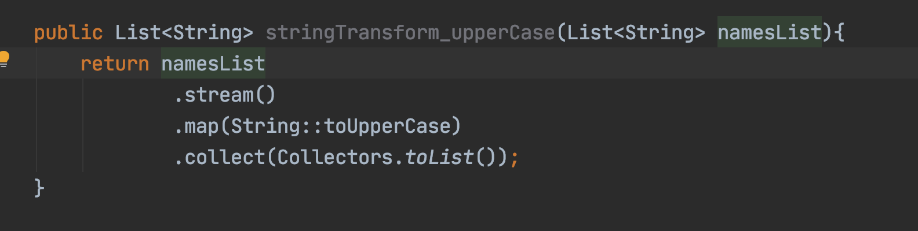
Streams API
Streams API got introduced in Java 8
Streams API is used to process a collection of Objects
Streams in Java are created by using the stream() method
]
Intermediate
1
Pipeline
2
Pipeline
3
Terminal

Slide 46
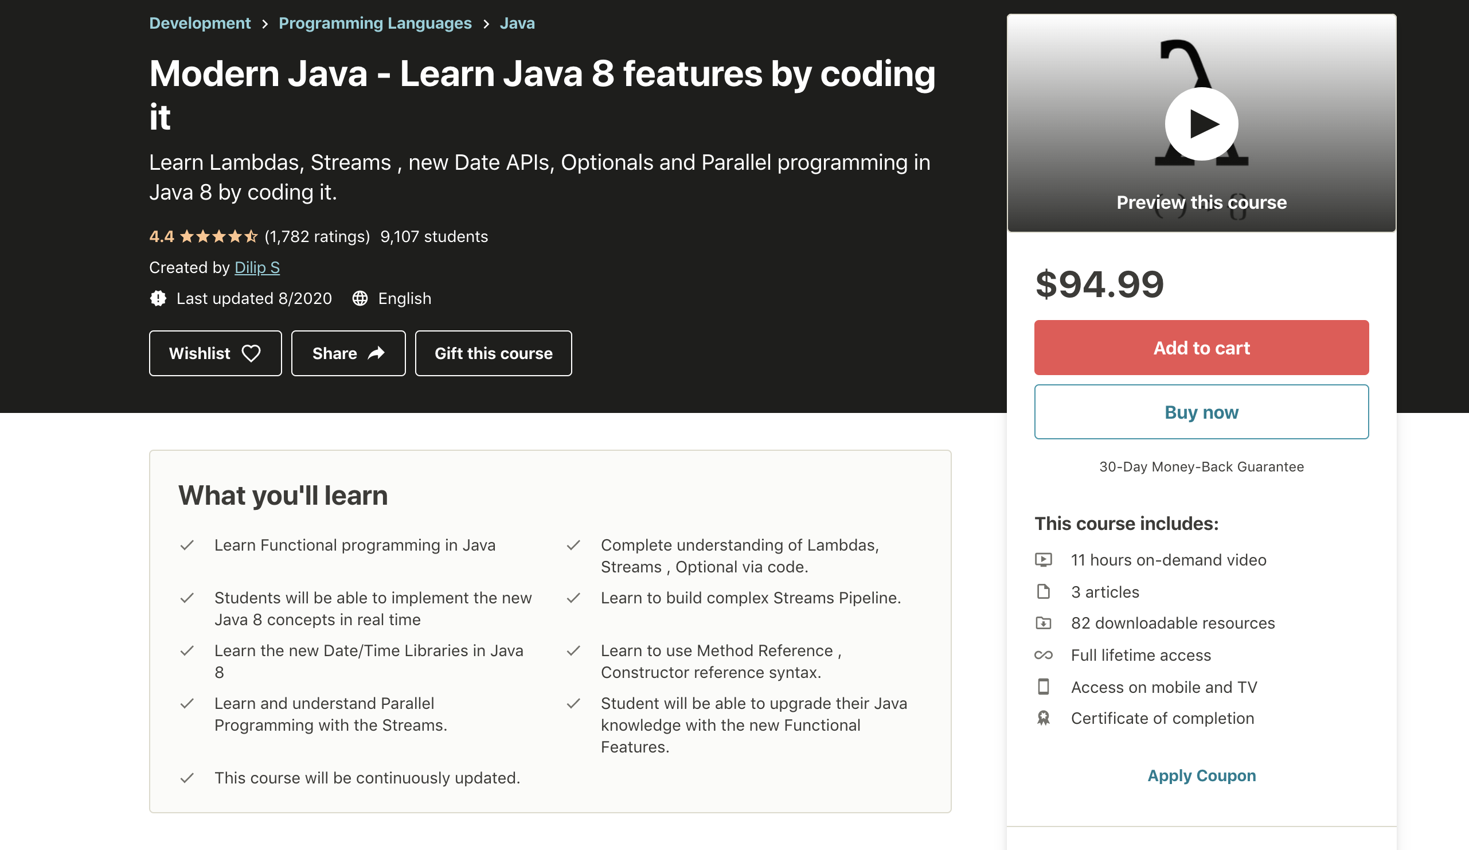

Slide 47
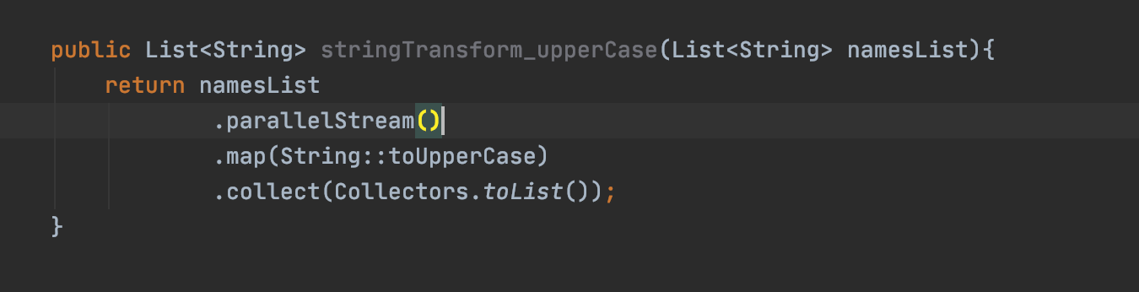
ParallelStreams
This allows your code to run in parallel
ParallelStreams are designed to solve Data Parallelism
Watch “Concurrency vs Parallelism” & “Fork-Join Framework”

Slide 48
Stream/Parallel Stream
Stream
Parallel Stream

Slide 49
Parallel Streams - UseCase
Input
Output
[Bob, Jamie, Jill, Rick] -> [3 - Bob, 5 - Jamie, 4 - Jill, 4 - Rick]

Slide 50
Unit Testing
Parallel Streams
Using
JUnit5

Slide 51
Why Unit Tests ?
Unit Testing allows you to programmatically test your code
Manual Testing slows down the development and delivery
Unit Testing allows the developer or the app team to make enhancements to the existing code easily and faster

Slide 52
Sequential/Parallel
Functions
in
Streams API

Slide 53
sequential() and parallel()
Streams API are sequential by default
sequential() -> Executes the stream in sequential
parallel() -> Executes the stream in parallel
Both the functions() changes the behavior of the whole pipeline

Slide 54
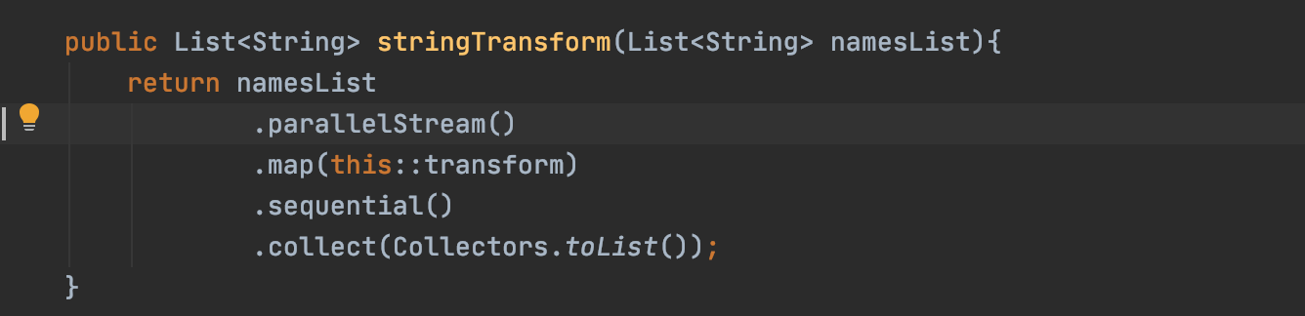
sequential()
Changing the parallelStream() behavior to sequential
Sequential

Slide 55
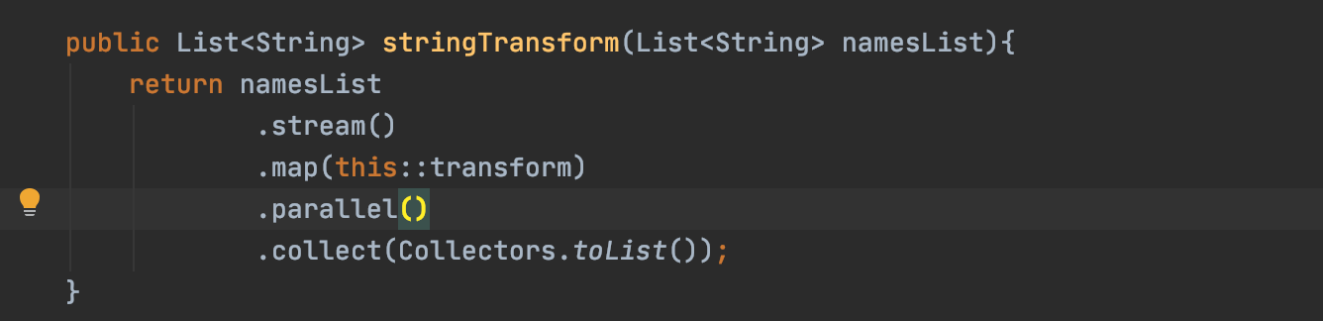
parallel()
Changing the stream() behavior to parallel
Parallel

Slide 56
When to use sequential() and parallel() ?
Used these functions when I would like to evaluate between sequential() and parallel()

Slide 57
Overview of the
Retail
Checkout
Service

Slide 58
Checkout Service(BackEnd)
Checkout Service
UP
N
Price Validator Service
CartItem
$
DOWN

Slide 59
ParallelStreams
How it works ?

Slide 60
ParallelStreams - How it works ?
parallelStream()
Split the data in to chunks
Execute the data chunks
Combine the result

Slide 61
parallelStream() - How it works ?
Split
Data Source is split in to small data chunks
Example - List Collection split into chunks of elements to size 1
This is done using Spliterators
For ArrayList, the Spliterator is ArrayListSpliterator
Execute
Data chunks are applied to the Stream Pipeline and the Intermediate operations executed in a Common ForkJoin Pool
Watch the Fork/Join FrameWork Lectures
Combine
Combine the executed results into a final result
Combine phase in Streams API maps to terminal operations
Uses collect() and reduce() functions
collect(toList())

Slide 62
parallelStream() - How it works ?
parallelStreams()
cartItemsList
CheckoutService
List<CartItem> priceValidationList = cart.getCartItemList()
//.stream()
.parallelStream()
.map(cartItem -> {
boolean isPriceValid = priceValidatorService.isCartItemInvalid(cartItem);
cartItem.setExpired(isPriceValid);
return cartItem;
})
.filter(CartItem::isExpired)
.collect(toList());
Split
1
Split
cartItemsSplit
cartItemsSplit
Split
Split
cartItem
cartItem
cartItem
cartItem
Execute
2
Process Sequentially
Process Sequentially
Process Sequentially
Process Sequentially
Common ForkJoinPool
cartItem
cartItem
cartItem
cartItem
combine
3
[cartItem, cartitem]
[cartItem, cartitem]
combine
combine
Execute
cartItemsList
combine

Slide 63
Comparing
ArrayList vs LinkedList
ParallelStreams
Performance

Slide 64
Spliterator in ParallelStreams
Data source is split in to multiple chunks by the Spliterator
Each and every collection has a different Spliterator Implementation
Performance differ based on the implementation

Slide 65
Multiply each value in the collection by a user passed value
[ 1, 2, 3, 4 ] -> [2, 4, 6, 8]
Value * 2

Slide 66
Summary - Spliterator in ParallelStreams
Invoking parallelStream() does not guarantee faster performance of your code
Need to perform additional steps compared to sequential
Splitting , Executing and Combining
Recommendation - Always compare the performance before you use parallelStream()

Slide 67
Parallel Streams
Final Computation Result Order

Slide 68
Parallel Streams - Final Computation Result Order
[Bob, Jamie, Jill, Rick]
[3 - Bob, 5 - Jamie, 4 - Jill, 4 - Rick]
90
90
90
90

Slide 69
Parallel Streams - Final Computation Result Order
The order of the collection depends on:
Type of Collection
Spliterator Implementation of the collection
Example : ArrayList
Type of Collection - Ordered
Spliterator Implementation - Ordered Spliterator Implementation
Example : Set
Type of Collection - UnOrdered
Spliterator Implementation - UnOrdered Spliterator Implementation

Slide 70
Collect
&
Reduce

Slide 71
Collect( ) vs Reduce( )
Collect
Reduce
Part of Streams API
Used as a terminal operation in Streams API
Produces a single result
Result is produced in a mutable fashion
Feature rich and used for many different use cases
Example
collect(toList()), collect(toSet())
collect(summingDouble(Double::doubleValue));
Part of Streams API
Used as a terminal operation in Streams API
Produces a single result
Result is produced in a immutable fashion
Reduce the computation into a single value
Sum, Multiplication
Example
Sum -> reduce(0.0, (x , y)->x+y)
Multiply -> reduce(1.0, (x , y)->x * y)

Slide 72
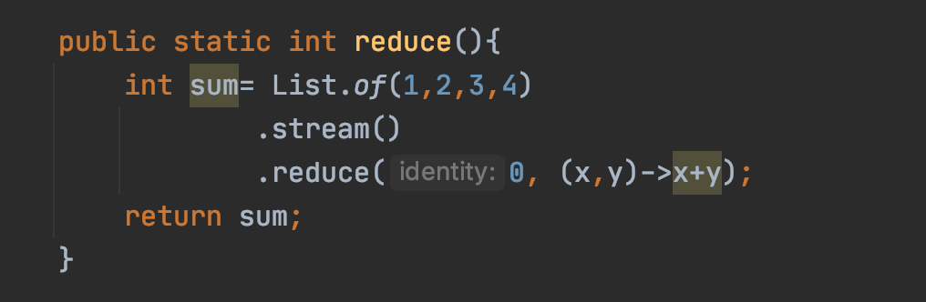
How reduce() works ?
[ 1 ,2 ,3 ,4 ]
0+1 => 1
identity
1+2 => 3
10
3+3 => 6
6+4
=>
10
The reduce( ) function performs an immutable computation throughout in each and every step.

Slide 73
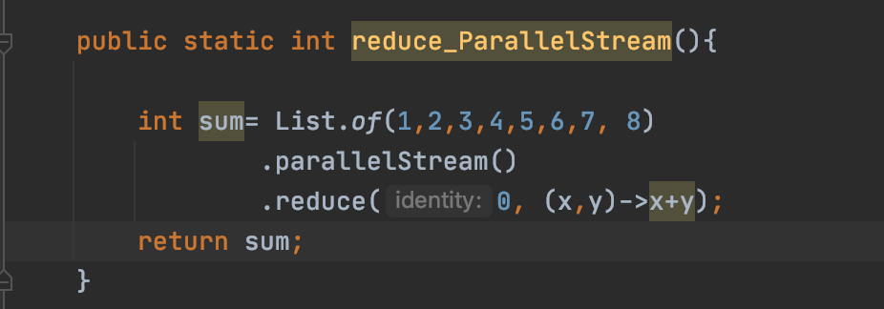
How reduce() with ParallelStream works ?
Sum of N numbers
Sum of N numbers - reduce() and parallelStream()
[1,2,3,4,5,6,7,8]
Split
Split
1
1
[ 1 ,2 ,3 ,4 ]
[ 5 ,6 ,7 ,8 ]
Split
Split
Split
Split
0
0
0
0
36
[ 1 ,2 ]
[ 3 ,4 ]
[ 5 ,6 ]
[ 7 ,8 ]
2
Process Sequentially
Process Sequentially
Process Sequentially
Process Sequentially
1
Spliterator
3
7
11
15
reduce()
reduce()
2
ForkJoinPool
3
10
26
3
Reduce
reduce()
reduce()
36

Slide 74
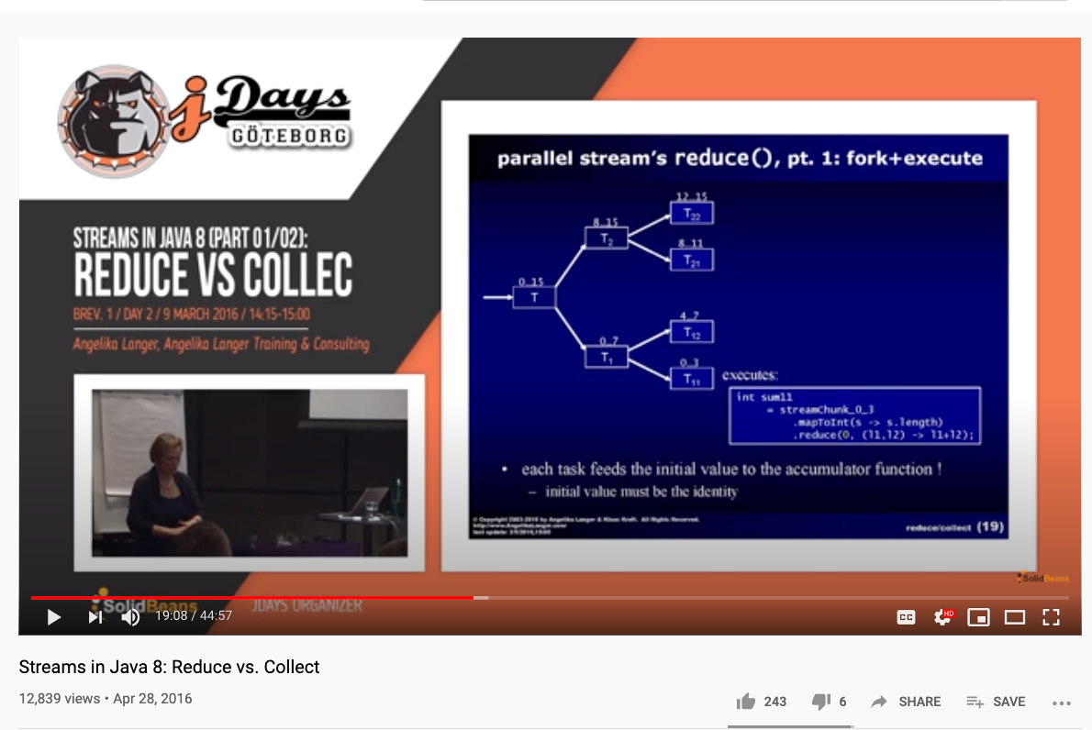
Want to learn more ?

Slide 75
Collect() & Reduce()
Hands-On

Slide 76
Identity in reduce()

Slide 77
Identity in reduce()
Identity gives you the same value when its used in the computation
Addition: Identity = 0
0 + 1 => 1
0 + 20 => 20
Multiplication : Identity = 1
1 * 1 => 1
1 * 20 => 20
Sum of N numbers - reduce() and parallelStream()
reduce() is recommended for computations that are associative

Slide 78
Parallel Stream Operations
&
Poor Performance

Slide 79
Parallel Stream Operations & Poor Performance
Stream Operations that perform poor
Impact of Boxing and UnBoxing when it comes to parallel Streams
Boxing -> Converting a Primitive Type to Wrapper class equivalent
1 -> new Integer(1)
UnBoxing -> Converting a Wrapper class to Primitive equivalent
new Integer(1) -> 1

Slide 80
Common ForkJoin Pool

Slide 81
Common ForkJoin Pool
Execution Engine for Parallel Streams

Slide 82
parallelStream() - How it works ?
parallelStreams()
cartItemsList
CheckoutService
Split
1
Split
cartItemsSplit
cartItemsSplit
Split
Split
cartItem
cartItem
cartItem
cartItem
Execute
2
Process Sequentially
Process Sequentially
Process Sequentially
Process Sequentially
Common ForkJoinPool
cartItem
cartItem
cartItem
cartItem
combine
3
[cartItem, cartitem]
[cartItem, cartitem]
combine
combine
Execute
cartItemsList
combine

Slide 83
Common ForkJoin Pool
Common ForkJoin Pool
90
Double Ended Work Queue(deck)
T1
Task
parallelStreams()
T2
Worker Threads
Result
Shared Work Queue
90
T3
Watch “Fork-Join Framework” Lecture
T4

Slide 84
Common ForkJoin Pool
Common ForkJoin Pool is used by:
ParallelStreams
CompletableFuture
Completable Future have options to use a User-defined ThreadPools
Common ForkJoin Pool is shared by the whole process

Slide 85
Parallelism
&
Threads in
Common ForkJoinPool

Slide 86
Parallelism & Threads in Common ForkJoinPool
parallelStreams()
Runs your code in parallel
Improves the performance of the code
Is there a way to look in to parallelism and threads involved ?
Yes

Slide 87
Modifying
Default parallelism
in
Parallel Streams

Slide 88
Modifying Default parallelism
System.setProperty("java.util.concurrent.ForkJoinPool.common.parallelism", "100");
OR
-Djava.util.concurrent.ForkJoinPool.common.parallelism=100

Slide 89
Parallel Streams - Summary

Slide 90
Parallel Streams - When to use them ?

Slide 91
Parallel Streams - When to use them ?
Parallel Streams do a lot compared to sequential(default) Streams
Parallel Streams
Split
Execute
Combine

Slide 92
Parallel Streams - When to use them ?
Computation takes a longer time to complete
Lots of data
More cores in your machine
Always compare the performance between sequential and parallel streams

Slide 93
Parallel Streams - When to use them ?

Slide 94
Parallel Streams - When not to use them ?
Parallel Streams
Split
Execute
Combine
Data set is small
Auto Boxing and Unboxing doesn’t perform better
Stream API operators -> iterate(), limit()

Slide 95
CompletableFuture

Slide 96
CompletableFuture
Introduced in Java 8
CompletableFuture is an Asynchronous Reactive Functional Programming API
Asynchronous Computations in a functional Style
CompletableFutures API is created to solve the limitations of Future API

Slide 97
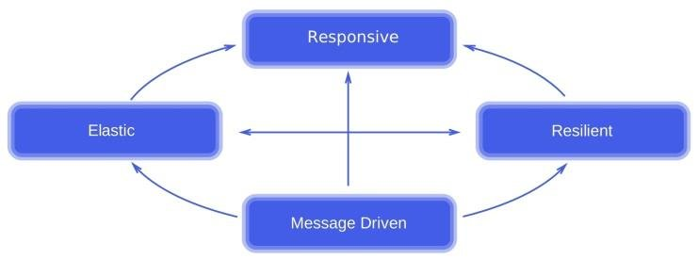
CompletableFuture and Reactive Programming
Responsive:
Fundamentally Asynchronous
Call returns immediately and the response will be sent when its available
Resilient:
Exception or error won’t crash the app or code
Elastic:
Asynchronous Computations normally run in a pool of threads
No of threads can go up or down based on the need
Message Driven:
Asynchronous computations interact with each through messages in a event-driven style
1
3
2
4

Slide 98
CompletableFuture API
Factory Methods
Initiate asynchronous computation
Completion Stage Methods
Chain asynchronous computation
Exception Methods
Handle Exceptions in an Asynchronous Computation
E

Slide 99
Lets Write
our
First CompletableFuture

Slide 100
CompletableFuture
supplyAsync()
FactoryMethod
Initiate Asynchronous computation
Input is Supplier Functional Interface
Returns CompletableFuture<T>()
thenAccept()
CompletionStage Method
Chain Asynchronous Computation
Input is Consumer Functional Interface
Consumes the result of the previous
Returns CompletableFuture<Void>
Use it at the end of the Asynchronous computation

Slide 101
thenApply()

Slide 102
thenApply()
Completion Stage method
Transform the data from one form to another
Input is Function Functional Interface
Returns CompletableFuture<T>

Slide 103
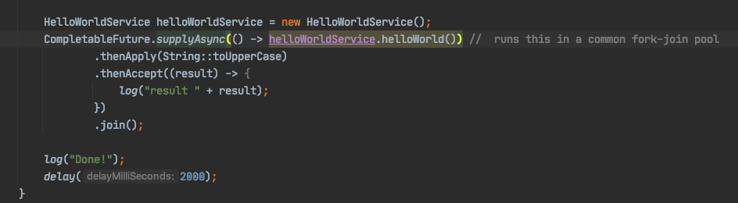
CompletableFuture
]
1
2
Pipeline
3
Pipeline

Slide 104
Unit Testing
CompletableFuture

Slide 105
Combing independent
Async Tasks
using
“thenCombine"

Slide 106
thenCombine()
This is a Completion Stage Method
Used to Combine Independent Completable Futures
Takes two arguments
CompletionStage , BiFunction
Returns a CompletableFuture
Service1
Client
Service
Latency = maxOf(Service1, Service2)
Service2

Slide 107
thenCompose

Slide 108
thenCompose()
Completion Stage method
Transform the data from one form to another
Input is Function Functional Interface
Deals with functions that return CompletableFuture
thenApply deals with Function that returns a value
Returns CompletableFuture<T>
public CompletableFuture<String> worldFuture(String input) {
return CompletableFuture.supplyAsync(()->{
delay(1000);
return input+" world!";
});
}

Slide 109
Product Service
ProductInfo
Service
Product Service
ProductId
Client
Review
Service
Product
Product

Slide 110
Combining
Streams
&
CompletableFuture

Slide 111
Product Service with Inventory
ProductInfo
Service
Product Service
ProductId
Client
Inventory
Service
Product
Product
Review
Service

Slide 112
Exception
Handling
In
CompletableFuture

Slide 113
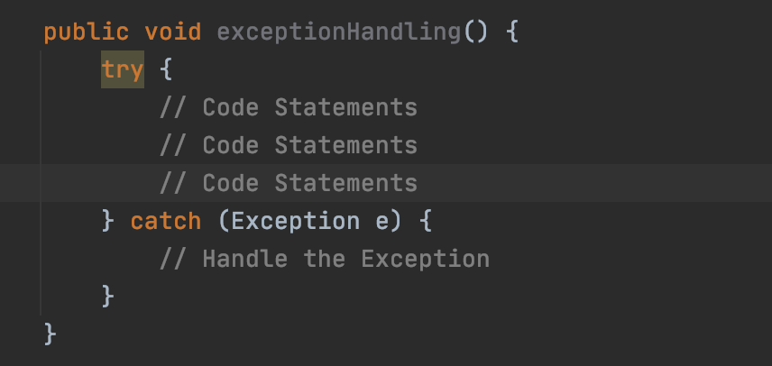
Exception Handling in Java
Exception Handling in Java is available since the inception of Java
]

Slide 114
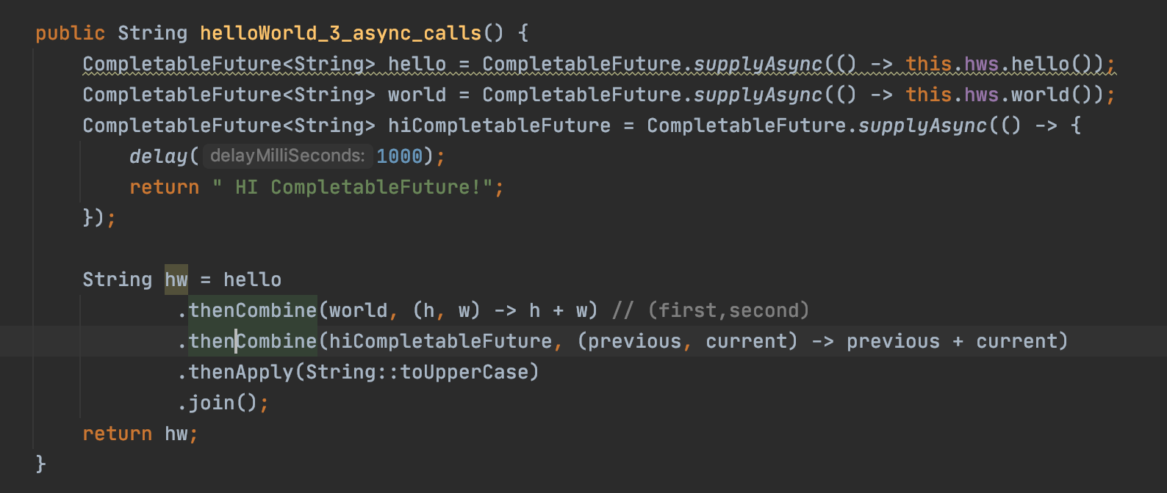
Exception Handling in CompletableFuture
CompletableFuture is a functional style API

Slide 115
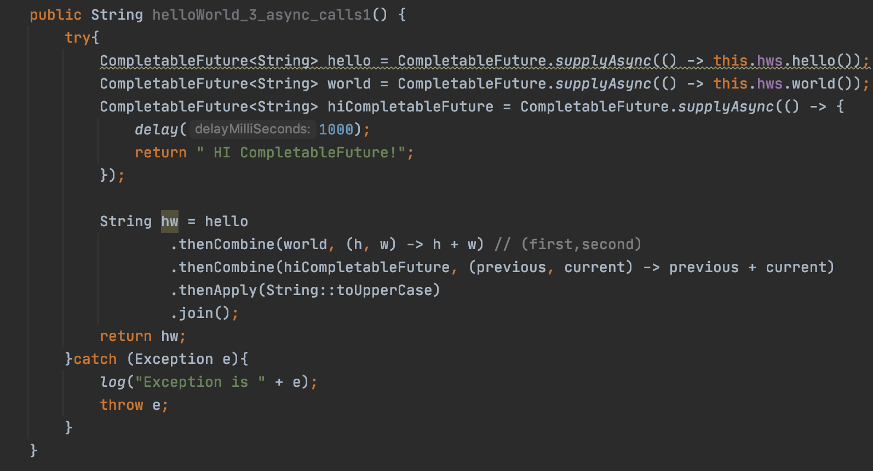
Exception Handling in CompletableFuture
try/catch

Slide 116
Exception Handling in CompletableFuture
CompletableFuture API has functional style of handling exceptions
Three options available:
handle()
exceptionally()
whenComplete()
Catch Exception and Recover
Catch Exception and Does not Recover

Slide 117
Exception Handling using handle()
hello
thenCombine
thenCombine
thenApply
Success Path
handle
handle
Failure Path
handle
handle

Slide 118
Exception Handling using exceptionally()
hello
thenCombine
thenCombine
thenApply
Success Path
Failure Path
exceptionally
exceptionally

Slide 119
whenHandle()

Slide 120
whenHandle()
Exception handler in CompletableFuture API
Catches the Exception but does not recover from the exception

Slide 121
Exception Handling using whenComplete()
hello
thenCombine
thenCombine
thenApply
Success Path
whenComplete
whenComplete
Failure Path
whenComplete
whenComplete

Slide 122
Product Service with Inventory
ProductInfo
Service
!
Product Service
ProductId
Client
Inventory
Service
Product
Product
Review
Service

Slide 123
CompletableFuture
Default ThreadPool

Slide 124
CompletableFuture - ThreadPool
By default, CompletableFuture uses the Common ForkJoinPool
The no of threads in the pool == number of cores

Slide 125
Common ForkJoin Pool
Common ForkJoin Pool
Double Ended Work Queue(deck)
T1
Task
completableFuture()
T2
Worker Threads
Result
Shared Work Queue
T3
T4
Watch “Internals of Common ForkJoin Pool” Lecture

Slide 126
CompletableFuture
&
User Defined ThreadPool
using
ExecutorService

Slide 127
Why use a different ThreadPool ?
Common ForkJoinPool is shared by
ParallelStreams
CompletableFuture
Its common for applications to use ParallelStreams and CompletableFuture together
The following issues may occur:
Thread being blocked by a time consuming task
Thread not available

Slide 128
Creating a User-Defined ThreadPool
Executors.newFixedThreadPool(Runtime.getRuntime().availableProcessors());

Slide 129
Threads
In
CompletableFuture

Slide 130
Async()
Overloaded Functions
In
CompletableFuture

Slide 131
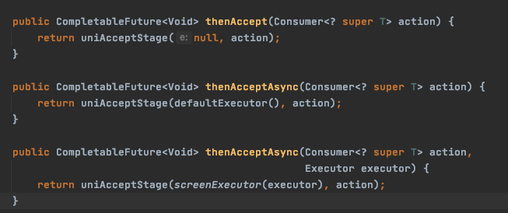
Async Overloaded Functions
thenAccept()

Slide 132
Async() Overloaded Functions
Regular Functions
Async() overloaded Functions
thenCombine()
thenApply()
thenCompose()
thenAccept()
thenCombineAsync()
thenApplyAsync()
thenComposeAsync()
thenAcceptAsync()

Slide 133
Async() Overloaded Functions
Using async() functions allows you to change the thread of execution
Use this when you have blocking operations in your Completablefuture pipeline

Slide 134
Introduction to
Spring WebClient
and
Overview of the GitHub Jobs API

Slide 135
About this section
Rest Client
Github Jobs API

Slide 136
Build Restful API
Using
Spring WebClient

Slide 137
Why Spring WebClient?
Spring is one of the popular framework in the Java Community
Spring WebClient is a rest client library that’s got released as part of Spring 5
Spring WebClient is a functional style RestClient
Spring WebClient can be used as a blocking or non blocking Rest Client

Slide 138
Github Jobs API

Slide 139
allOf()

Slide 140
allOf() - Dealing with Multiple CompletableFutures
static method that’s part of CompletableFuture API
Use allOf() when you are dealing with Multiple CompletableFuture
Service 1
Client
Service 2
Service 2

Slide 141
anyOf()

Slide 142
anyOf() - Dealing with Multiple CompletableFutures
static method that’s part of CompletableFuture API
Use anyOf() when you are dealing with retrieving data from multiple Data Sources
DB
Client
REST API
SOAP Service

Slide 143
TimeOuts
In
CompletableFuture

Slide 144
Timeouts in CompletableFuture
Asynchronous tasks may run indefinitely
Used to timeout a task in CompletableFuture
orTimeout() in CompletableFutureAPI

