Slide 1
Modeling Industrial and Cultural Heritage Data
Supervisors:
Prof. Jérôme Darmont
Prof. Sabine Loudcher
Prof. Cécile Favre
Location: ERIC Laboratory
Nishara Pathirana
July 07, 2015

Slide 2
Outline
Introduction
Goal of the Thesis
The Data Lake Concept for Organizing Heritage Data
A Metadata Model
A Prototype Ontology Based Data Retrieval
Summary

Slide 3
Introduction

Slide 4
About the Project
Proposed project takes place within a larger project called “TECTONIQ”
Collaborated with 5 partners (Laboratories)
GERiiCO
STL
TETIS
ERIC
LIVE

Slide 5
Industrial and Cultural Heritage Data
Very diverse and potentially big
Rate of data generation is very high
High % of these data are
Unstructured
Heterogeneous
Petabytes or Exabytes of data

Slide 6
Industrial and Cultural Heritage Data Ctd
Data are in different formats
Text
Image
XML
Map
Video
Audio
Web Document etc.

Slide 7
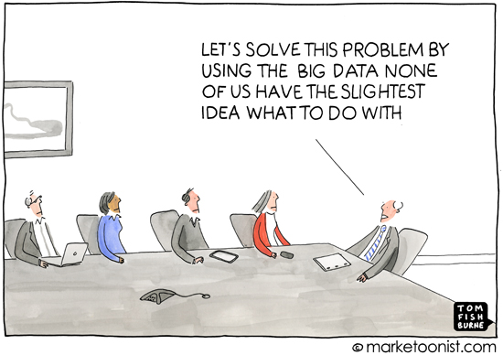
What we want?
We want to organize these data to be able to analyze them

Slide 8
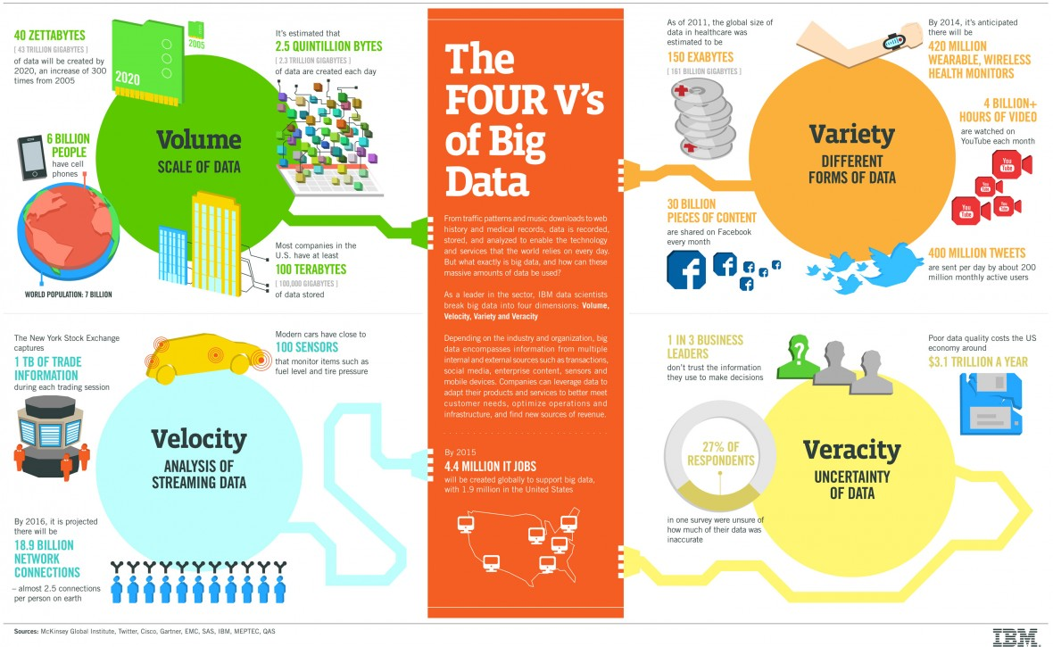
What is Big Data?

Slide 9
Textile/Cultural Heritage Data
From Lille Territory
 | Source
 | IRHiS (History Lab) | Inventory Services | La Voix Du Nord | MEL
Content Description | Images | Buildings/Inventories used for textile industry | News Articles related to textile industry | Cultural Heritage in Lille
Type and # of files | 30 xml files | 50 xml files | 1 xml file | 4 PDF documents
# of Instances | 30 | 50 | 31

Slide 10
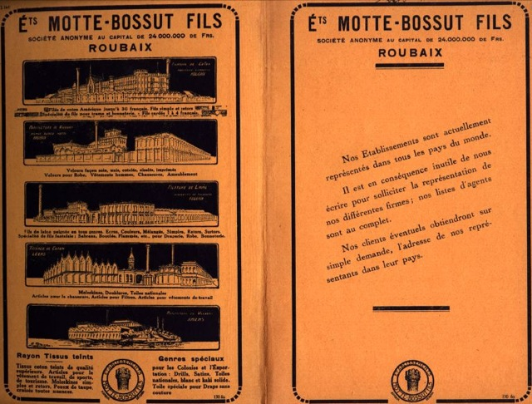
Images

Slide 11
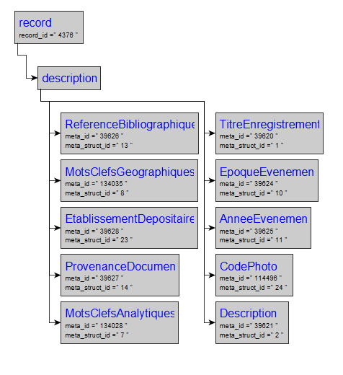
XML Structure of an Image Description

Slide 12
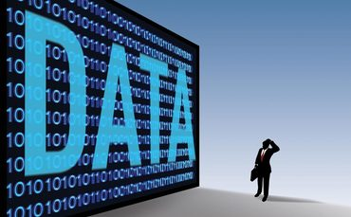
Goal of the Thesis
Organizing Cultural and Textile Industry heritage data from Lille Territory for analysis purposes
Information Broadcasting
Information Exchanging
Heritage Data Preservation

Slide 13
Related Work
Using SQL Databases as the main data storage
Using NoSQL Databases as the main data storage
NoSQL Databases alone
NoSQL databases + Semantic Technologies

Slide 14
The Data Lake Concept for Organizing Heritage Data

Slide 15
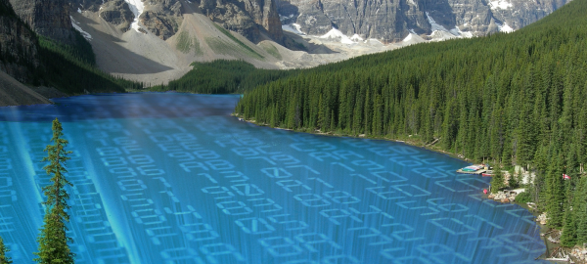
What is a Data Lake?
Data Lake is a large object-based storage where data are stored in its raw format
Data Lake accepts data from any source, in any format

Slide 16
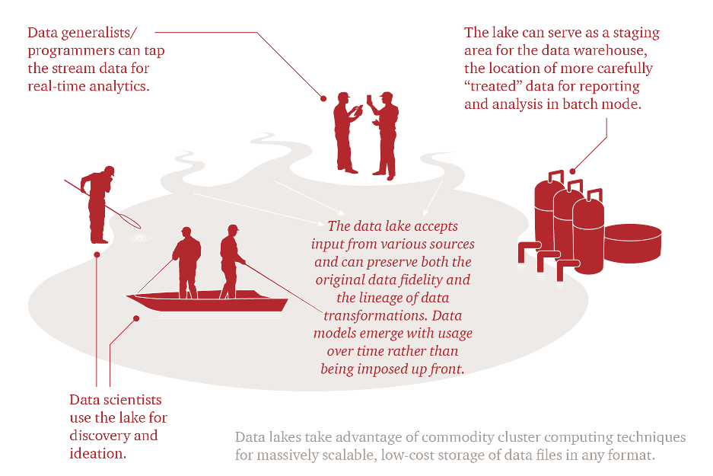
Data Lake is for Everyone…

Slide 17
Data Lake Vs Data Warehouse
Data Lake | Data Warehouse
Retains all data→ Extremely large data volumes (Petabytes) | Accepts data to some data aggregation level → Large (Terabytes)
Supports all data types | Generally consists of data extracted from transactional systems
Easily adapts to changes | Difficult to change the schema as it costs a lot
Scales horizontally | Scales vertically
Data focus is at time of use/search → schema on read | Data focus is at time of design → schema on write
Open for various questions | Designed for predefined questions

Slide 18
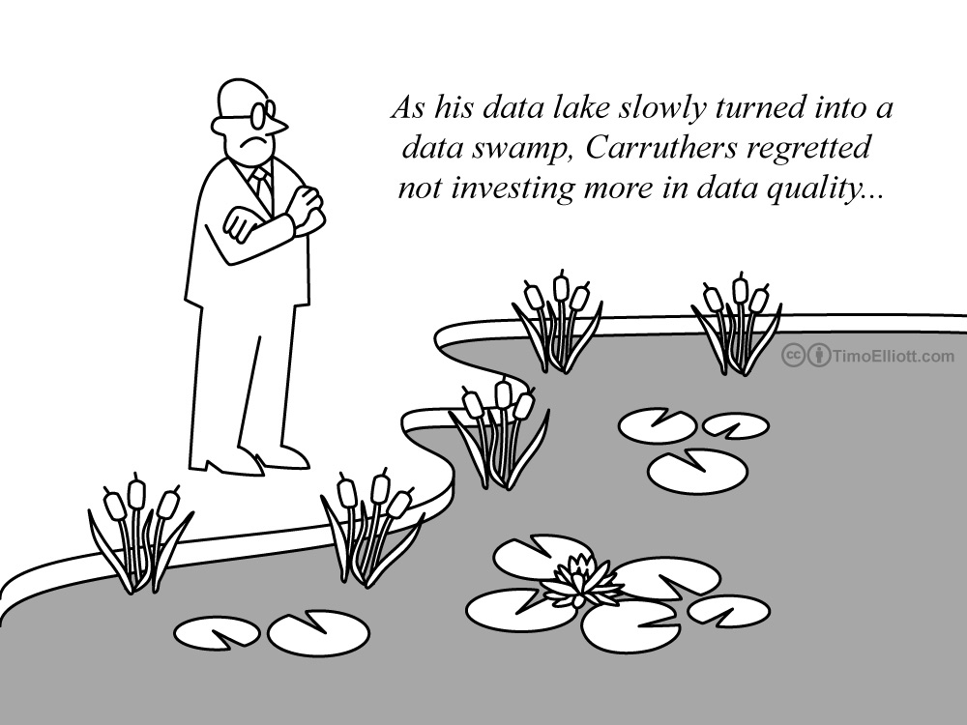
Ensuring Data Quality in a Lake

Slide 19
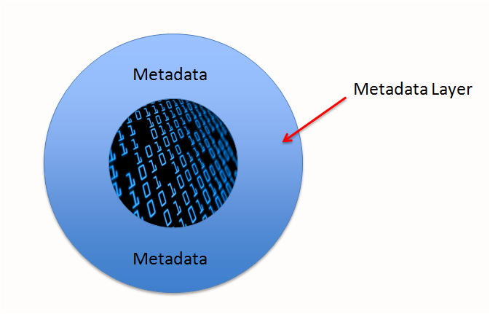
A Metadata Layer for the Lake

Slide 20








Data Lake Analytic Tools
NoSQL Databases
Parallel processing systems
Hadoop
Spark

Slide 21
A Metadata Model for Our Data

Slide 22
A Data Lake for Us
Metadata
Layer
Images
Inventories
News
MEL Texts

Slide 23
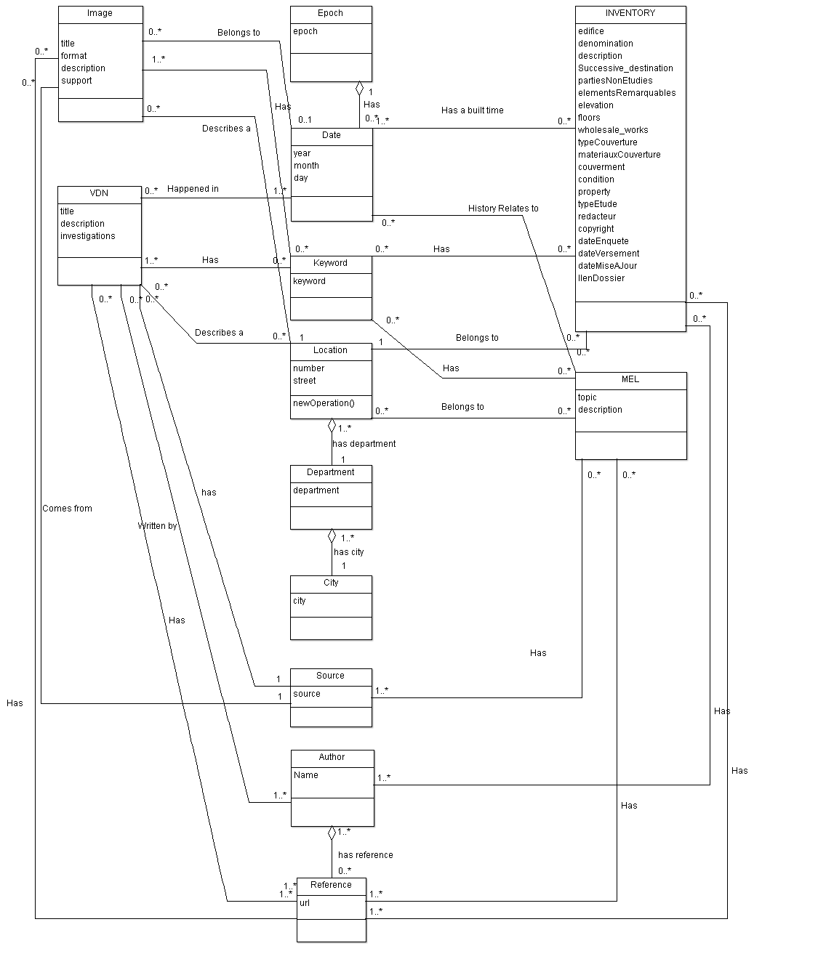

Slide 24
An Ontology Approach for Information Retrieval

Slide 25
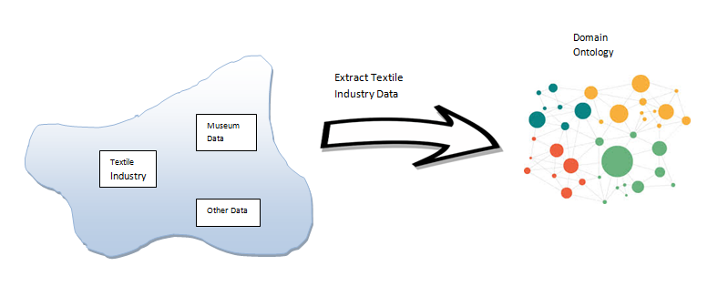
Data Lake

Slide 26
Why an Ontology?
Heritage information often have a wealth of metadata
Building a search engine on top of metadata with traditional databases is difficult
Because of accuracy and coverage problems
Because of heterogeneity problems
Because of complicated relationships that data incorporates
Ease of evolving and linking across data

Slide 27
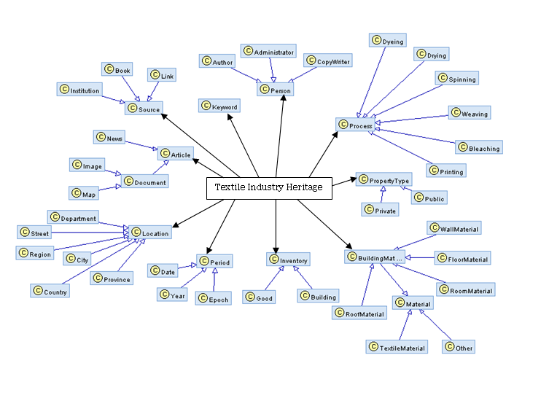

Slide 28
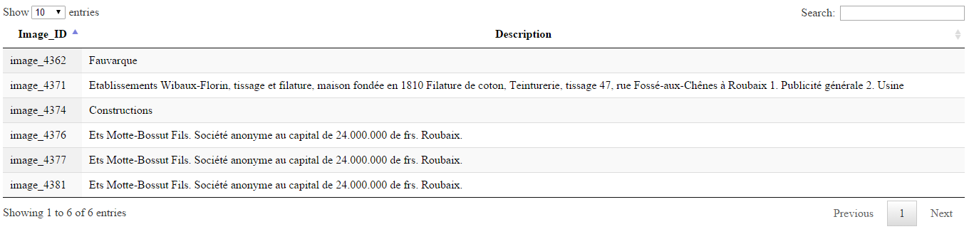
Querying
PREFIX onto: <http://url_to_tectoniq/tectoniq#>
SELECT ?name ?description
WHERE {
?name onto:hasDescription ?description
}

Slide 29
Summary
The Data Lake concept to organize industrial and cultural heritage data
A metadata model that fits the Data Lake Concept
An ontology based information retrieval system as a use case scenario of the Data Lake

Slide 30
Thank You!

Slide 31
References
http://www.ibmbigdatahub.com/infographic/four-vs-big-data
http://usblogs.pwc.com/emerging-technology/the-future-of-big-data-data-lakes/
http://www.blue-granite.com/blog/bid/402596/Top-Five-Differences-between-Data-Lakes-and-Data-Warehouses
http://blogs.teradata.com/international/metadata-management-in-the-data-lake/
http://blog.knowledgent.com/infographic-managed-data-lake/
http://spotfire.tibco.com/blog/?p=10941

