Slide 1
Spark Performance Tuning
By: Shakti Garg and Nisha Kumari

Slide 2

general purpose execution engine
batch/ iterative/ interactive jobs
fast, in-memory processing
distributed/ scalable
fault-tolerant
rich, optimized API support
Notes:
If you have less than 32 GB of RAM, set the JVM flag -XX:+UseCompressedOops to make pointers be four bytes instead of eight

Slide 3
What are we covering?
Coding Optimization
Data structures
Data format and compression
API optimization
Serialization
Cluster Optimization
Resource Allocation (executors/memory)
Dynamic Allocation
Tuning parallelism
Spark speculative execution
YARN optimization

Slide 4
Slim down data structures!
Why?
How?
Numeric or Enum keys over Strings
Java fastUtil over Java Collections
Avoid wrapper objects, nested data structures, pointers etc
JVM flag XX:+UseCompressedOops to set pointers of 4 byte size than 8

Slide 5
2. Data format and compression
Data Serialization
Avro
Protobuf
Data RC formats
Parquet
ORC
Data Compression (In Rest & In Transit)
--conf spark.io.compression.codec=snappy

Slide 6

Spark at work: Overview
Notes:
Cluster
Resource manangement
Spark application flow

Slide 7
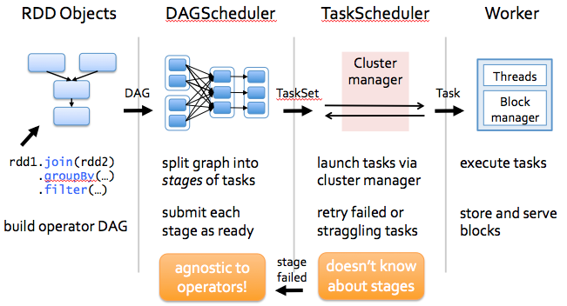
Spark at work: Detailed

Slide 8
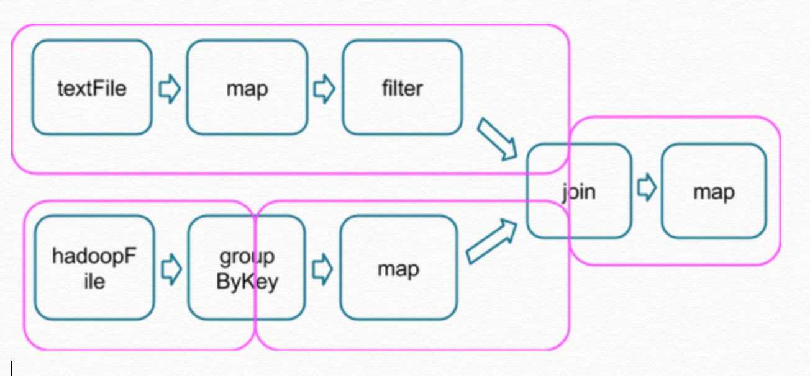
Execution: Job-Stages-Tasks
Notes:
Narrow and wide

Slide 9
3. API Optimization
“Understand execution plan of your Spark application!”
Prefer higher level Spark abstractions, DataFrame/Dataset over RDDs
Still we need RDD’s flexibility!
Don’t collect large RDDs
Avoid using count()
rdd.take / rdd.takeSampl
rdd.take / rdd.takeSample
if (dataFrame.count() == 0) {}
if (dataFrame.take(1).length == 0) {}
rdd.isEmpty

Slide 10
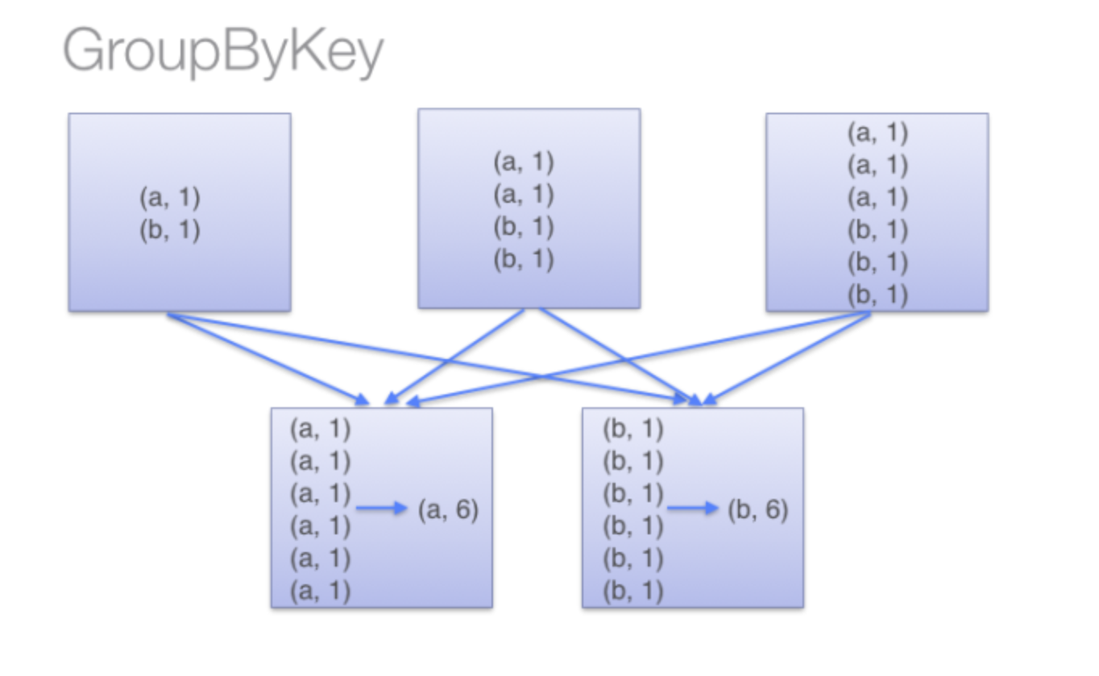
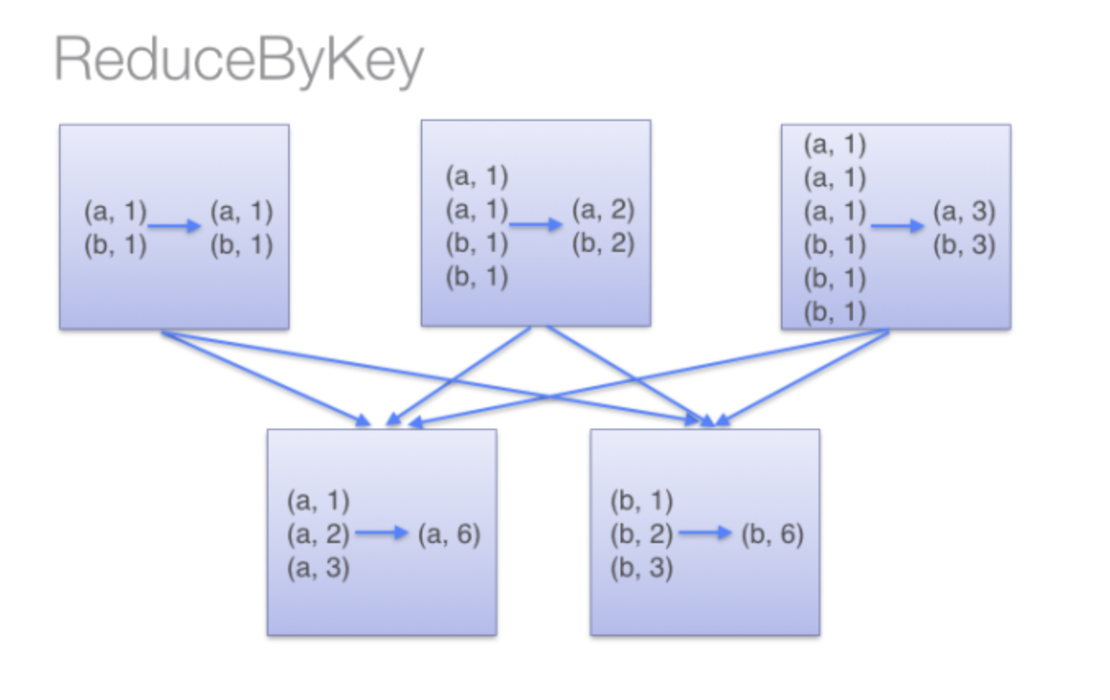
3. API Optimization ..
avoid groupBykey() for associative reductive operation
rdd.groupByKey().mapValues(_.sum)
rdd.reduceByKey(_ + _)

Slide 11
3. API Optimization ..
avoid reduceBykey() when input and output value types are different
avoid flatmap()-join()-groupBy() pattern
rdd.map(kv => (kv._1, new Set[String]() + kv._2)) .reduceByKey(_ ++ _)
rdd.aggregateByKey(new Set[String]())( (set, v) => set += v, (set1, set2) => set1 ++= set2 )
rdd1 = inputRDD1.groupByKey
rdd2 = inputRDD2.groupByKey
joinRDD = rdd1.join(rdd2) => (K, (V1,V2))
joinRDD = rdd1.cogroup(rdd2) => (K, (Iterable<V1>, Iterable<V2>))

Slide 12
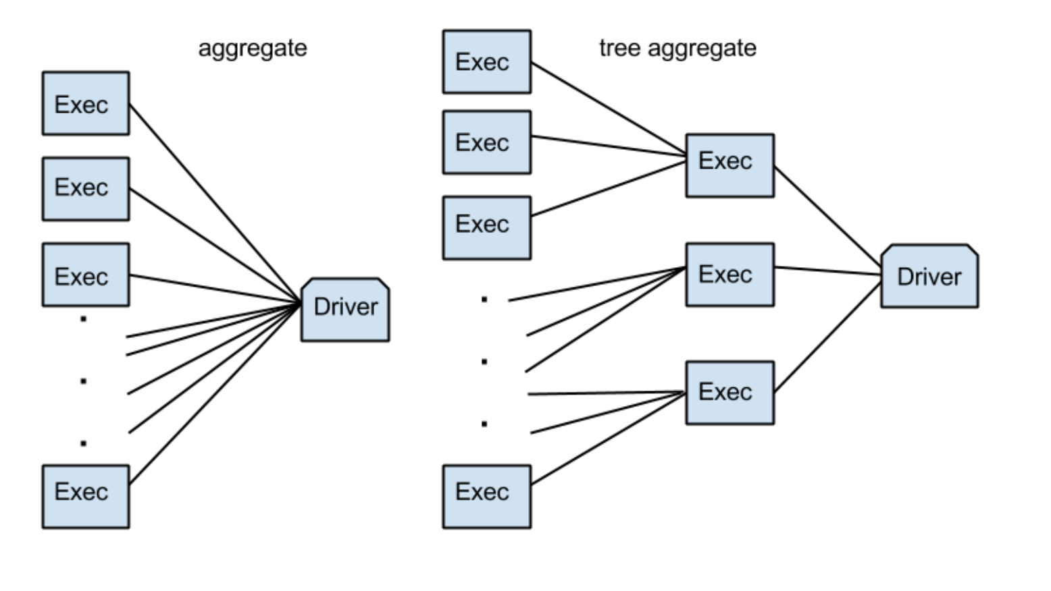
3. API Optimization ..
Use TreeReduce/TreeAggregate over reduce/aggregate
treeReduce uses function,
reduceByKey to do reduction
in parallel

Slide 13
3. API Optimization ..
Broadcast variables for efficient joins
immutable shared variable, cached on each executor
Join between a large and a small RDD
val lookupTable = sc.broadcast(smallRDD.collect.toMap)
largeRDD.flatMap( { case(key, value) => lookupTable.value.get(key).map { otherValue => (key, (value, otherValue)) } }
)

Slide 14
3. API Optimization ..
Join between a large and a medium RDD
coalesce() over repartition()
“ Shuffle less, Shuffle efficiently”
val keys = sc.broadcast(mediumRDD.map(_._1).collect.toSet)
val reducedRDD = largeRDD.filter{ case(key, value) => keys.value.contains(key) } reducedRDD.join(mediumRDD)
After filtering down a large dataset, if you want to decrease number of partitions
coalesce() do optmized local shuffling, repartition() do random shuffling

Slide 15
How much tasks?
No. of tasks processing Input RDD = number of partitions explicitly mentioned (default is number of HDFS blocks)
No. of tasks processing Join/CoGroup RDD = max(number of tasks of each input RDD)

Slide 16
Optimum # of tasks
There should be sufficient number of tasks
More Tasks = More parallelization = Better performance as each task gets less data
More Tasks = Prevents shuffle spill. (Shuffle spill can be very costly to a stage and if it is in your SparkUI’s stage metrics, you needs to increase tasks or reduce data per task)
More Tasks = More containers needed = More Resources and container warmup time

Slide 17

5. Data Serialization
Storage - RDD persistence level
MEMORY_ONLY (default)
prefer MEMORY_AND_DISK_SER over MEMORY_ONLY
2. Each stage persists its shuffle output on disk in order to prevent recomputation in case of failure.
As a result, if a stage is input to multiple stages, it is computed for one and skipped for others.
3. Persist only costly & reusable RDDs
4. Network transfer
Shuffle data between nodes
I/O tasks
Recommended: Kryo Serializer over Java Serializer
Notes:
fast
small size
extensible
language independent

Slide 18
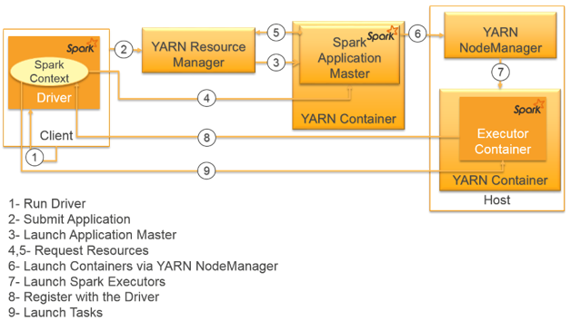
Cluster Optimization: Spark + YARN

Slide 19
Resource Allocation - Executors
Number of executors
# executors != # of cores in cluster
other applications on cluster
cores taken by application master & driver
Cores per executor
Avoid Single core executor
single core can easily handle 3-5 tasks in parallel

Slide 20
continued...
Given
10 data node cluster with 64 cores each i.e. 640 cores
and your pool has 40% resource allocation
and you need to support on average 3 jobs in parallel
Assumption
1 core per node is reserved for OS and hadoop overhead
Each job’s driver is taking 1 core
Each executor is allocated 4 cores
Solution
Number of cores per job should be ~ (10 * 64 * .4 – 1 * 10 – 3) / 3 = 81
Number of executors ~( 81 / 4 ) = 20

Slide 21
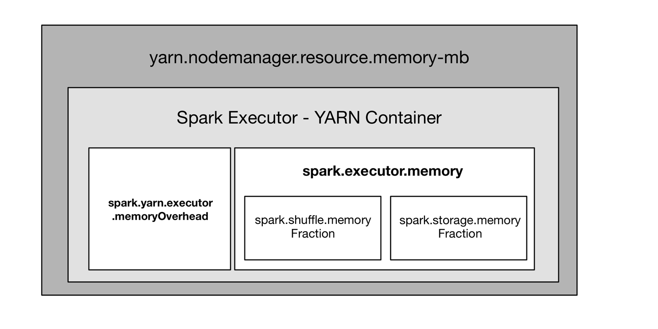
2. Resource Allocation - Memory

Slide 22
continued...
Given
10 data node cluster with each having 64 GB of RAM
And # of executor = 20 i.e. 2 executor per node
And memory reserved for OS and hadoop processes = 4 GB
Solution
Memory available for each YARN container ~(64 - 4) / 2 = 30
Memory available for each Spark Executor ~(30 - 0.1 * 30) = 27
If we include Default 10% overhead in 30 GB,
Executor memory should be 27 GB
“Running executors with too much memory often results in excessive garbage-collection delays.”

Slide 23
3. Dynamic allocation
Assign executors to a job based on workload
Scale up policy
Scale down policy
External shuffle service should be enabled (to safely persist task output in case executor is scaled down)
spark-submit ..
--conf spark.shuffle.service.enabled=”true”
--conf “spark.dynamicAllocation.enabled”=”true”
--conf “spark.dynamicAllocation.minExecutors”=”1”
--conf “spark.dynamicAllocation.maxExecutors”=”5”
--conf “spark.dynamicAllocation.executorIdleTimeout”=”30”
--conf “spark.dynamicAllocation.cachedExecutorIdleTimeout”=”30”

Slide 24
3. Dynamic allocation...
MaxExecutors can be skipped if we are not sure on upper limit of data. (If no of task > (maxExecutor * tasks per executor), performance worsens as it tries to launch more tasks per executor and hence more failure retries)
cachedExecutorIdleTimeout is infinity by default. In case of cached RDD, tune it to scope time of cached RDD. If not, it will result in recomputation.

Slide 25
4. Spark Speculative Execution
Turn on to prevent Straggler Tasks...
spark-submit ..
--conf “spark.speculation”=”true”
--conf “spark.speculation.interval”=”5000”
--conf “spark.speculation.multiplier”=”5”
--conf “spark.speculation.quantile”=”0.90”

Slide 26
5. YARN Optimization
where
default value of
spark.yarn.executor.memoryOverhead
= max(384 MB, 0.10*spark.executor.memory)
or can be explicitly set in configuration
YARN container size
= spark.executor.memory + spark.yarn.executor.memoryOverhead

Slide 27

Thank You!
QUESTIONS?

