Slide 1
Addressing

Slide 2
Internet Protocol (IP)
Standards on “how data packets moves through a network”
Protocol defines mainly:
IP Address
IP Routing
Notes:
Means of communicating between 2 devices using internet
To send data on web, a data packet must be transferred across the network from one host to other using their IP addresses (uniquely identify the host).

Slide 3
IP Routing
Packet Switching
Break data into chunks at source node, called “Packets”
Packet contents or payload has
Data
Control info:
Source and destination IP Addr
Sequence number
No pre-known path.
Each packet is forwarded by the nodes towards destination node.
Packets are reassembled at destination node.
https://giphy.com/gifs/packnetwork-112f41tQK1G1ag

Slide 4
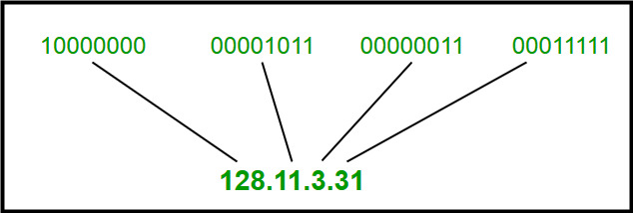
IP Address
Unique number to identify any device in network (Host or Router).
IP Address = Network address + Host address
Represented as:
32 bits in 4 octets
4 decimal digits dot separated
https://www.geeksforgeeks.org/wp-content/uploads/IP_addressing_1.jpg
Notes:
A numerical label assigned to each device connected to a computer network using IP for communication.

Slide 5
Port Numbers
www.b.com
Number to identify the process on host.
Part of TCP payload header.
16 bit number
www.a.com
Types:
Well known ports (20 & 21, 25, 80 & 443)
Ephemeral/ Temporary(till the time the process is running), eg: Host my python web app at 1234 port
Local Computer
Notes:
Process addresses. Since communication takes place between processes rather than computers.
Well known:
Data FTP: 20
SSH : 22
SMTP : 25
HTTP/s: 80 and 443

Slide 6
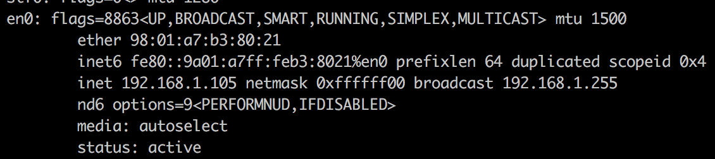
ifconfig
System admin utility in Unix like systems.
Configure/ Control/ Query network interfaces, eg:
set IP and network mask of a machine.
enable/ disable interface
Set network interface at system startup
Tags: eth or lo(127.0.0.1) or wlan

Slide 7
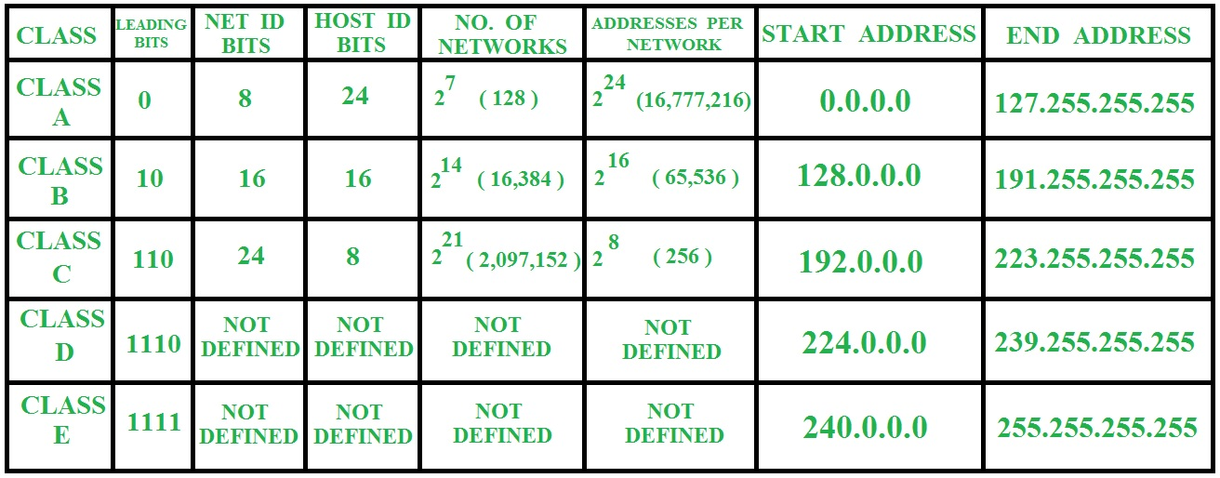
Network classes
IP = Network ID + Host ID
https://www.geeksforgeeks.org/wp-content/uploads/gq/2015/07/nethostdata.jpg
Notes:
Class A: 0-127 (2**7 =128)
Class B: 128 - 191 (128 + 2**6)
Class C: 192 - 223( 192 + 2**5)
Class D: 224 - 239 (224 + 2**4)
Class E: 240 - 255 ( 240 + 2**4)

Slide 8
Network Mask
32 bit number to identify network and host part in an IP Address.
Eg: Find net ID and host ID for given mask:
(8.20.15.1 255.0.0.0) or ( 8.20.15.1 /8 )
A = 8.20.15.1 = 00001000 . 00010100 . 00001111 . 00000001 M = 255.0.0.0 = 11111111 . 00000000 . 00000000 . 00000000 ------------------------------------------------------------ -- NET ID --|---------------HOST ID ---------------- netid = 00001000 = 8
( address bits which have corresponding mask bits set to 1 )
hostid = 00010100.00001111.00000001 = 20.15.1
( address bits that have corresponding mask bits set to 0 )
Default masks:
Class A: 255.0.0.0 or /8
Class B : 255.255.0.0 or /16
Class C : 255.255.255.0 or /32
Notes:
Any address bits which have corresponding mask bits set to 1 represent the network ID. Any address bits that have corresponding mask bits set to 0 represent the node ID.

Slide 9
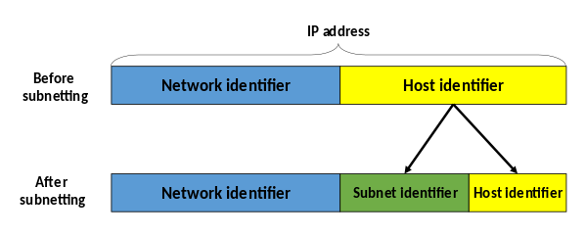
Subnetting
Logically partitioning any class A, B or C networks.
Network = Group of Subnets, where every
Subnet = Group of Hosts
Why?
Avoid congestion inside network. Within subnet traffic does not impact outside subnet.
Security.
Different physical media.
https://en.wikipedia.org/wiki/File:Subnetting_Concept-en.svg
Notes:
Subnet
What: Logical partition within a network,
How?
Routing
Within subnet(LOCAL): People within this room. Can talk to each other directly. “local” route communication
Outside subnet(ROUTER): People outside this room. Can talk via someone if the next hop is known and the next hop knows the further hop for the destination IP

Slide 10
Subnet Mask
It is a Class C network with:
# Subnet bits = 3
# Subnets = (2^3) = 8
# Host bits = (8-3) = 5
# Host/subnet = (2^5) = 32
# Usable host ids/ subnet
= # Host/subnet - 2 = 30
32 bit number to identify Subnet and Host ID from IP
Extension of natural mask of the class
Eg: Find net ID and host ID for subnet mask:
(204.17.5.0 255.255.255.224) or (204.17.5.0/27)
204.17.5.0 - 11001100 . 00010001 . 00000101 . 00000000 255.255.255.224 - 11111111 . 11111111 . 11111111 . 11100000 --------------------------Network----------------------------------------.--------sub-------
So, what are the possible net IDs and host IDs inside this network?

Slide 11
Solution: address/mask is ( 204.17.5.0 255.255.255.224 ) or ( 204.17.5.0/27 )
Subnets | Subnet Mask = /27 Subnet octet = 4 Subnet bits = 3 | Subnet Address | Subnet Mask | # Hosts = 32 Possible Host IDs | Host address Start | Host address End
1 | "000 00000" | 204.17.5.0 | 255.255.255.224 | 0-31 | 204.17.5.1 | 204.17.5.30
2 | "001 00000" | 204.17.5.32 | 255.255.255.224 | 32-63 | 204.17.5.33 | 204.17.5.62
3 | "010 00000" | 204.17.5.64 | 255.255.255.224 | 64-95 | 204.17.5.65 | 204.17.5.94
4 | "011 00000" | 204.17.5.96 | 255.255.255.224 | 96-127 | 204.17.5.97 | 204.17.5.126
5 | "100 00000" | 204.17.5.128 | 255.255.255.224 | 128-159 | 204.17.5.129 | 204.17.5.158
6 | "101 00000" | 204.17.5.160 | 255.255.255.224 | 160-191 | 204.17.5.161 | 204.17.5.190
7 | "110 00000" | 204.17.5.192 | 255.255.255.224 | 192-223 | 204.17.5.193 | 204.17.5.222
8 | "111 00000" | 204.17.5.224 | 255.255.255.224 | 224-256 | 204.17.5.225 | 204.17.5.254

Slide 12
Special Addresses in Subnet
First host address in subnet = Network Address
Last host address in subnet = Broadcast Address
Notes:
NA: First address of Subnet. NA | IP -> IP
BA: Last address of Subnet. BA & IP -> IP
Possibilities of more special addresses: AWS, routing and DNS

Slide 13
Problem Statement 1
What is the subnet address for IP: 172.16.17.30/20?
Subnet address = Network address of subnet
IP/mask:
172.16.17.30 - 10101100 . 00010000 . 00010001 . 00011110 /20 - 11111111 . 11111111 . 11110000 . 00000000 --------------------------------------------------------------------------------------------------------------------- Subnet - 10101100 . 00010000 . 00010000 . 00000000
- 172 . 16 . 16 . 0

Slide 14
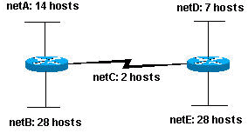
Problem Statement 2
Given the Class C network of 204.15.5.0/24, subnet the network in order to create the network in given figure with the host requirements shown:
# Subnets = 5
# Subnet bits = 3
# Host bits = 5
# Hosts/subnet = 2^5 = 32
Hence possible!
netA: 204.15.5.0/27 host address range 1 to 30 netB: 204.15.5.32/27 host address range 33 to 62 netC: 204.15.5.64/27 host address range 65 to 94 netD: 204.15.5.96/27 host address range 97 to 126 netE: 204.15.5.128/27 host address range 129 to 158

Slide 15
VLSM & CIDR
Same subnet mask applied to each subnet
# hosts/ subnet is same for all hosts.
Unused IPs in subnets
VLSM
Variable Length Subnet Masks
Use different masks for every subnet based on number of hosts needed in that subnet
CIDR
Classless Inter Domain Routing
No classes in IP, [ IP = Prefix /length of mask ], eg:
( 172.16.17.30 255.255.240.0 ) = 172.16.17.30/20, since d240 = b11110000
Benefits:
Improves address space utilization
Hierarchical network architecture
Routing scalability
Notes:
Eg: if an ISP owns network 172.16.0.0/16, then the ISP can offer 172.16.1.0/24, 172.16.2.0/24, and so on to customers. Yet, when advertising to other providers, the ISP only needs to advertise 172.16.0.0/16.

Slide 16
Problem Statement 2 - Using VLSM
Given the Class C network of 204.15.5.0/24, subnet the network in order to create the network in given figure with the host requirements shown:
netA, 14 hosts: or 16 hosts, 4 bit host ID, 28 bit net ID, requires a /28 (255.255.255.240) mask
netB, 28 hosts: or 30 hosts, 5 bit host ID, 27 bit net ID, requires a /27 (255.255.255.224) mask
netC, 2 hosts: or 4 hosts, 2 bit host ID, 30 bit net ID, requires a /30 (255.255.255.252) mask
netD, 7 hosts: or 9 hosts, 4 bit host ID, 28 bit net ID, requires a /28 (255.255.255.240) mask
netE, 7 hosts: same as netB
Assign address starting from largest subnet:
netB: 204.15.5.0/27 host address range (32, 0-31) 1 to 30 netE: 204.15.5.32/27 host address range (32, 32-63) 33 to 62 netA: 204.15.5.64/28 host address range (16, 64-79) 65 to 78 netD: 204.15.5.80/28 host address range (16, 80-95) 81 to 94 netC: 204.15.5.96/30 host address range (4, 96-99) 97 to 98

Slide 17
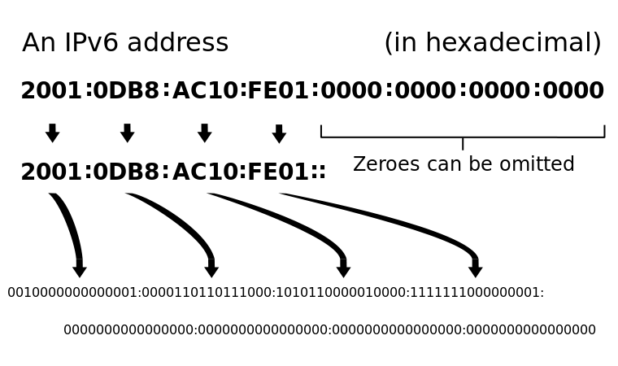
IPv6
Upgraded version of IPv4.
128 bit address, (8 groups, each group is 16 bits or 4 hexadecimal bits)
Benefits?
Increased addr space
No NAT required, each device has its IP (IOT)
IPSec built in
No DHCP required, auto-configurable
https://en.wikipedia.org/wiki/IPv6_address#/media/File:Ipv6_address_leading_zeros.svg
Notes:
128-bit vs 32-bit in IPv4
Why? -
more addresses
IPv6 addresses are different because it was designed with mobility in mind.
no NAT needed, each device has its IP
IPSec security built in.
Manual configuration (Static) of IPV4 addresses or DHCP (Dynamic configuration) is required to configur IPV4 addresses while in IPV6 auto-configuration of a addresses are available.

Slide 18
Private IP address ranges
The private IP addresses are the reserved IP address blocks that cannot be routed through the internet. Since private IP addresses are only intended to be used in private networks, they are not globally unique.
The private IP address must be unique within its network (usually LAN) so that there is no conflict between two computers within its network.
10.0.0.0 - 10.255.255.255
172.16.0.0 - 172.31.255.255
192.168.0.0 - 192.168.255.255

Slide 19
Public IP address ranges
Public IP address is the address that is assigned to a computing device to allow direct access over the Internet. (e.g: web server, email server and any server device directly accessible from the Internet)
A public IP address is globally unique, and can only be assigned to a unique device.

Slide 20
DHCP
Dynamic Host Configuration Protocol (DHCP) is a network management protocol used to dynamically assign an IP address to any new node entering the network.
DHCP permits a node to be configured automatically.
DHCP clients to dynamically configure the network configuration data without any manual setup process.
DHCP minimizes configuration errors caused by manual IP address configuration
Notes:
https://www.netmanias.com/en/post/techdocs/5998/dhcp-network-protocol/understanding-the-basic-operations-of-dhcp

Slide 21
DNS
Domain Name System (DNS) translates Internet domain and host names to IP addresses and vice versa.
DNS is a client/server network communication systems.
DNS clients send requests to and receive responses from DNS servers.
Requests containing a name, that result in an IP address being returned from the server, are called forward DNS lookups.
Requests containing an IP address and resulting in a name, called reverse DNS lookups
Notes:
nslookup
DNS Server IP in the network is hardcoded
Global DNS
Local DNS
A Record vs CNAME record
Sony example of CNAME
Hosts file

