Slide 1
Image Inpainting Using Image Processing and Computer Vision
Supervised By:
Dr. Sk. Md. Masudul Ahsan
Professor,
Department of Computer Science and Engineering
Presented By:
Nishat Tasnim Sithy
Roll: 1807033
4th year
1st semester
Khulna University of Engineering & Technology, Khulna-9203
Bangladesh

Slide 2
Contents of Presentation
Introduction
Related Works
Problem Statement
Objective

Slide 3
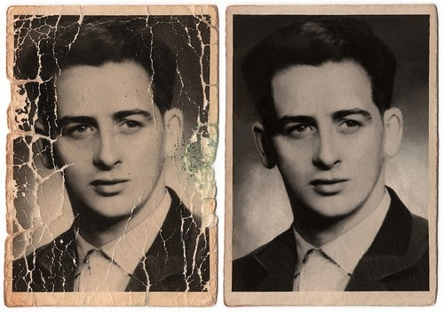
Introduction
Common applications of image inpainting include:
Restoring damaged artwork.
Removing unwanted objects.
Filling gaps in the satellite image.
Restoration of damaged photograph
Figure 1: Restoring damaged photograph.

Slide 4
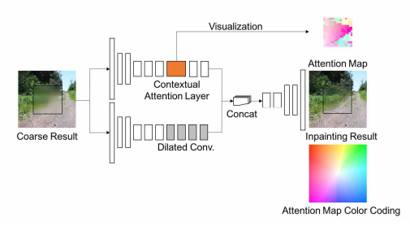
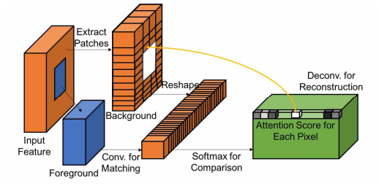
Related Works (Cont’d)
Generative Image Inpainting with Contextual Attention[2].
Unified feed-forward generative network with contextual attention layer
Includes two parallel encoders and a single decoder
Trained end to end with reconstruction loss and WGAN-loss
Figure 2: Contextual attention layer.
Figure 3: Refinement network

Slide 5
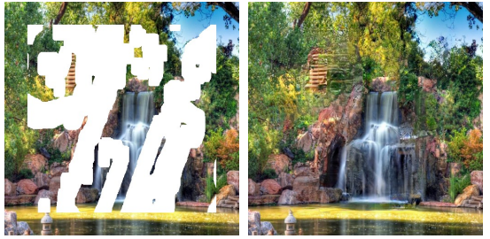
Related Works (Cont’d)
Image Inpainting for Irregular Holes Using Partial Convolutions [3]
Partial convolution layer with automatic mask update step.
Incorporates U-Net architecture.
Per-pixel loss loss , perceptual loss, style loss and total variation loss functions are used
Figure 4: Input and output for the method

Slide 6
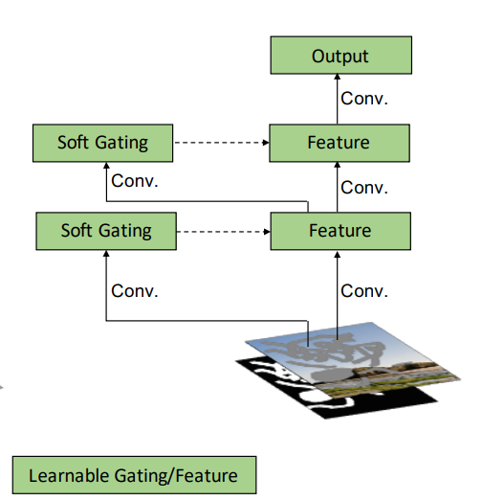
Related Works (Cont’d)
Free-Form Image Inpainting with Gated Convolution[9]
Generative network with gated-convolution.
Patch-based GAN loss known as SNPatchGAN
Can take user input
Figure 5: Gated Convolution Method

Slide 7
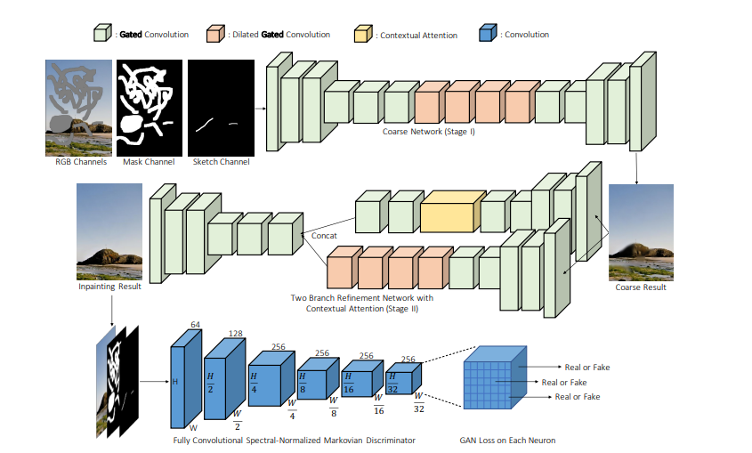
Proposed Methodology (Cont’d ):
Figure 17: Overview of framework with gated convolution and SN-PatchGAN for free-form image inpainting

Slide 8
Related Works (Cont’d)
Approach | Model | Cons | Remarks
Generative Image Inpainting with Contextual Attention | Attention mechanism | Generative network with contextual attention. | Handle narrow hole Handle small color and texture variance Can not handle irregularly shaped holes.
Image Inpainting for Irregular Holes Using Partial Convolutions | Convolution with dynamic mask | UNet-like architecture with partial convolutions | Can handle holes of varying size and shape Better border handling than prev. method Fails for sparsely structured images
Free-Form Image Inpainting with Gated Convolution | Free-form inpainting, gated convolutions | Gated convolutions and SN-PatchGAN loss. | Suitable for creative editing, object removal Can work with user input.
Table 1: Comparison between the studied literature

Slide 9
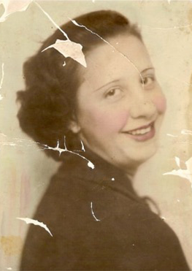
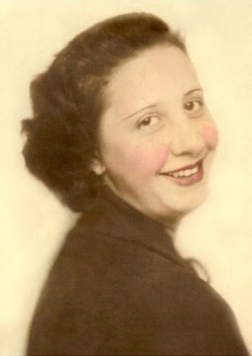
Problem Statement
Complex structure is difficult to generate.
Restoring high-resolution photographs remains a challenge.
Reconstructing large areas in images is difficult.
Figure 6: Target input-output

Slide 10
Objective
To develop a method that can:
Reconstruct the damaged region of the image without compromising the resolution.
Handle irregular and larger masked regions realistically.
Evaluate the performance on a benchmark dataset.
Asses the performance on real-life applications.

Slide 11
Proposed Methodology:
Data preparation
Model architecture
-Contextual attention at lower level
-Generative Networks (GANs) at higher level
Pre-trained feature extraction
Data Augmentation and Synthesis
Iterative Training and Experimentation
Evaluation and Refinement
Testing and Practical Deployment
Figure 12: Flow Diagram of Proposed Methodology of the model

Slide 12
Proposed Methodology (Cont’d) :
Model Architecture
Contextual Attention at a lower level
GANs at higher level
generator reconstructs missing or damaged image regions
Encoder-decoder architecture is preferable.
Discriminator evaluates the realism of the generated content
PatchGAN architecture is preferable.

Slide 13
Proposed Methodology (Cont’d ):
1st Stage:
Coarse Network (Stage 1)
Raw image
Masked input
Coarse Result
Figure 14: Simple conv. Net to rough out the missing content

Slide 14
Proposed Methodology (Cont’d ):
2nd Stage:
Refinement Network (Stage 2)
Dilated Gated Convolution and Gated Convolution
Coarse Result
Concat.
Inpainting Result
Gated Convolution and Contextual Attension
Figure 15: Architecture of Patch-GAN discriminator

Slide 15
Proposed Methodology (Cont’d ):
Final Stage:
H
H-
2
H
-
4
H
-
8
Inpainting Result
H/16
H/32
W/32
W/16
W/8
GAN Loss on Each Function
W/4
W/2
W
Figure 15: Architecture of Patch-GAN discriminator

Slide 16
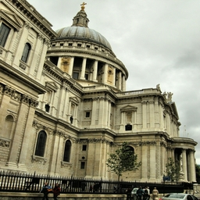
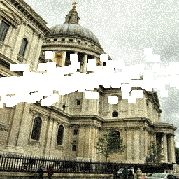
Implementation and Progress
Dataset Acquisition:
A dataset of 16502 distorted images is synthesized from:
Public Dataset
CelebA HQ
Places2
Binary Mask of Irregular Shape.
Figure 9.1: Sample images from public dataset and their corresponding distorted image

Slide 17
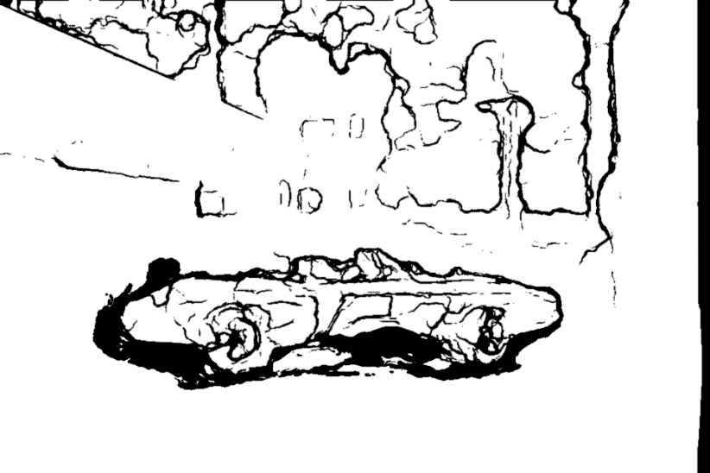
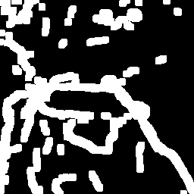
Implementation and Progress (Cont’d)
Step1: Generate Mask
Input: Two consecutive frames from a video, t and (t+1)
Convert to grayscale
Compute absolute difference
Apply adaptive threshold
Apply dilation
Negate the image
Resize
Get output
Apply threshold
Morphological operations
Figure 9.1: After occlusion/de-occlusion
Figure 9.2: After thresholding, dilating and negating

Slide 18
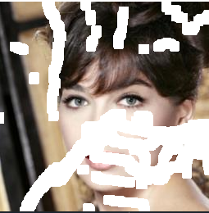
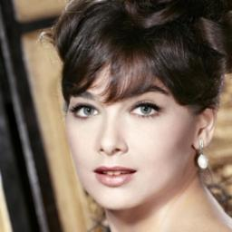
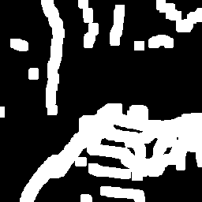
Implementation and Progress (Cont’d)
Step2: Apply on Image
Randomly select a mask
Randomly select a photo from Dataset
Blend two images
Generate a random noise array
Create a dust layer by thresholding the noise array
Blend the dust layer with the input image
Figure 8: Method to create the damaged dataset

Slide 19
Gantt Chart
2023
‘24
Number of Week
Feb Mar April May Jun July Aug Sep Oct Nov Dec Jan
Complete Work
Topic Selection
Topic Confirmation
Study Literature
Dataset Acquisition
Study Preceding Methodology Pre-Defense Preparation
Developing Model
Evaluation and Modification
Result Analysis and Fine Tuning
Currently working
Future Work

Slide 20
Financial Budget Planning
Table 4.1: Financial Budget Plan
Budget Category | Estimated Cost Range
Equipment and Software | 10,000 - 30,000 BDT
Dataset | 5,000 - 10,000 BDT
Travel and Conferences | 2,000 - 5,000 BDT
Publication Fees | 1,000 - 3,000 BDT
Miscellaneous | 1,000 - 3,000 BDT
Total Estimated Budget Range | 19,000 - 51,000 BDT

Slide 21
Socio-Economic Impact
Accurate diagnosis from corrupted medical images.
Reduces the need for new content creation
Saving resources and energy.
Preserves historical artifacts and artworks
Cultural heritage conservation
Minimizes wasteful content recreation
Reduces carbon footprint
Extends the usability of visual assets
Increases cost-efficiency
Figure 8: Restoration of painting

Slide 22
Conclusions
Aiming to contribute to the advancement of image inpainting in the practical field.
Attempting to provide results that are more accurate and effective.
The study will be conducted using the evaluated literature as a guide.

Slide 23
Related Works (Cont’d)
Findings:
A large amount of training data is required.
Improved accuracy & faster training time.
Can only handle narrow holes, where the color and texture variance is small.
Focuses on rectangular-shaped holes.
Can not handle irregularly shaped holes.

Slide 24
Related Works (Cont’d)
Findings:
Reduce the computational cost and memory requirements of the network.
Can robustly handle holes of any shape, size location, or distance from the image borders.
Fails for some sparsely structured images.

Slide 25
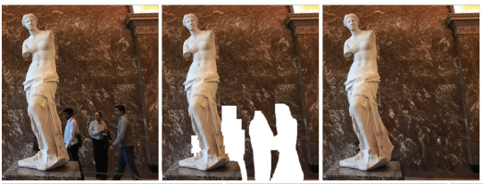
Related Works (Cont’d)
Findings:
Good for object removal and creative editing.
Has the ability to work with user input.
Provides poor results when holes appear close to the boundary.
Figure 5: Input-output of the mentioned method

Slide 26
Programming Environment:
Programming Language: Python
IDE: Google Collab/Anaconda
Deep Learning Frameworks:
PyTorch
TensorFlow
Keras

Slide 27
Programming Environment (Cont’d) :
Libraries and Packages:
numpy: For numerical computations.
matplotlib or seaborn: For visualization.
scipy: For various scientific computations.
pillow: For image handling.
scikit-learn: For machine learning utilities

Slide 28
References
Ulyanov, Dmitry, Andrea Vedaldi, and Victor Lempitsky. "Deep image prior." Proceedings of the IEEE conference on computer vision and pattern recognition. 2018.
Yu, Jiahui, et al. "Generative image inpainting with contextual attention." Proceedings of the IEEE conference on computer vision and pattern recognition. 2018.
Liu, Guilin, et al. "Image inpainting for irregular holes using partial convolutions." Proceedings of the European conference on computer vision (ECCV). 2018.

Slide 29
References (Cont’d)
Yu, Jiahui, et al. "Free-form image inpainting with gated convolution." Proceedings of the IEEE/CVF international conference on computer vision. 2019.
Yeh, Raymond A., et al. "Semantic image inpainting with deep generative models." Proceedings of the IEEE conference on computer vision and pattern recognition. 2017.
Xu, Runsheng, et al. "Pik-Fix: Restoring and Colorizing Old Photos." Proceedings of the IEEE/CVF Winter Conference on Applications of Computer Vision. 2023.

Slide 30
References (Cont’d)
Wan, Ziyu, et al. "Old photo restoration via deep latent space translation." IEEE Transactions on Pattern Analysis and Machine Intelligence (2022).
Karras, T., Aila, T., Laine, S., & Lehtinen, J. (2018). Progressive Growing of GANs for Improved Quality, Stability, and Variation. In International Conference on Learning Representations.
Wang, M., Lu, W., Lyu, J., Shi, K., & Zhao, H. (2022, December). Generative image inpainting with enhanced gated convolution and Transformers. Displays, 75, 102321.

Slide 31
References (Cont’d)
Yeh, R. A., Chen, C., Lim, T. Y., Schwing, A. G., Hasegawa-Johnson, M., & Minh, N. (2016). Semantic Image Inpainting with Deep Generative Models. arXiv (Cornell University). https://doi.org/10.48550/arxiv.1607.07539

Slide 32
Thank You

