Slide 1
Image Inpainting on Irregular Region using Conditional Generative Network
Presented By:
Nishat Tasnim Sithy
Roll: 1807033
4th year
1st semester
Supervised By:
Dr. Sk. Md. Masudul Ahsan
Professor,
Department of Computer Science and Engineering
Khulna University of Engineering & Technology, Khulna-9203
Bangladesh

Slide 2
Contents of Presentation
Introduction
Related Works
Problem Statement
Objective
Proposed Methodology
Implementation and Progress
Work Progress
Financial Budget Planning
Socio-Economic Impact
Conclusion

Slide 3
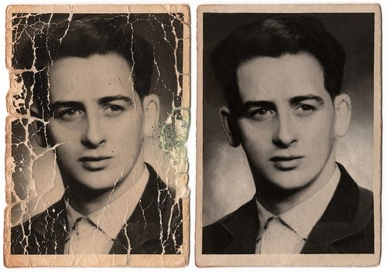
Introduction
Image Inpainting: Filling in missing regions using information surrounding the image.
Common applications of image inpainting include:
Removing unwanted objects.
Filling gaps in the satellite image.
Restoration of damaged photograph.
Augmented reality.
Figure 1: Restoring damaged photograph.

Slide 4
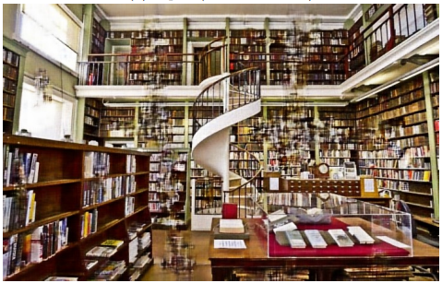
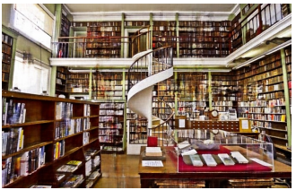
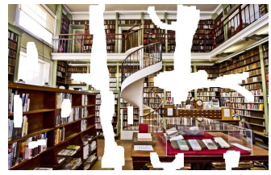
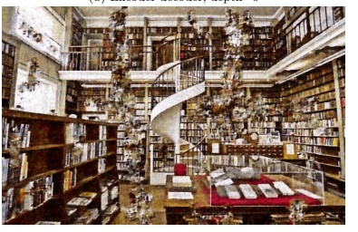
Related Works
Deep Image Prior[1].
Randomly-initialized neural network.
The network weight serves as a parameter
Non-trainable.
Can capture low-level statistics before learning.
Different set of hyperparameters for every image.
Figure 2: Damaged input
Figure 3: Better output can be generated by deeper network

Slide 5
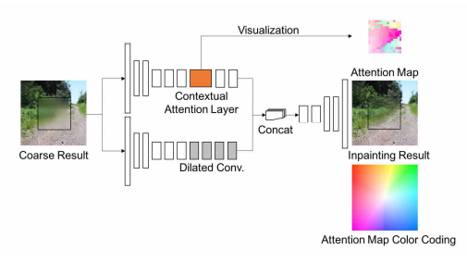
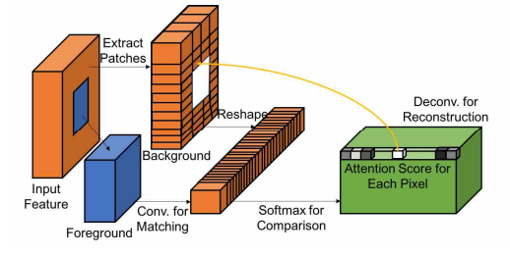
Related Works (Cont’d)
Generative Image Inpainting with Contextual Attention[2].
Unified feed-forward generative network with contextual attention layer
Includes two parallel encoders and a single decoder
Trained end to end with reconstruction loss and WGAN-loss
Figure 4: Contextual attention layer.
Figure 5: Refinement network

Slide 6
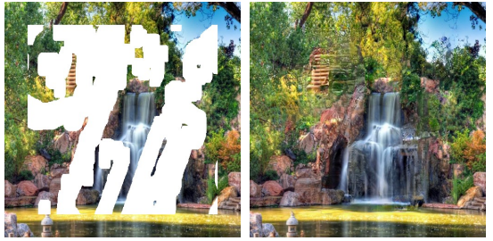
Related Works (Cont’d)
Image Inpainting for Irregular Holes Using Partial Convolutions [3]
Partial convolution layer with automatic mask update step.
Incorporates U-Net architecture.
Per-pixel loss loss, perceptual loss, style loss and total variation loss functions are used
Figure 6: Input and output for the method

Slide 7
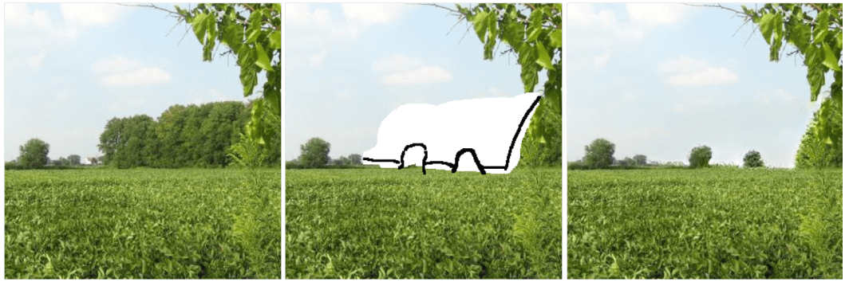
Related Works (Cont’d)
Free-form image Inpainting with Gated Convolution[9]
Generative network with gated convolution.
Patch-based GAN loss known as SNPatchGAN
Can take user input
Gated Convolution is used:
Learnable dynamic feature selection mechanism
Network can handle valid and masked pixels separately
Figure 7: Image inpainting from user input

Slide 8
Related Works (Cont’d)
Table 1: Comparison between the studied literature
Approach | Method | Architecture | Remarks
Deep Image Prior | Randomly initialized generator network | U-Net type hourglass architecture with optional skip connections. | Limited for nonstationary data Can not handle complex structures well. Comparatively slower
Generative Image Inpainting with Contextual Attention | Attention mechanism | Generative network with contextual attention. | Handle narrow hole, small color and texture variance Can not handle irregularly shaped holes.
Image Inpainting for Irregular Holes Using Partial Convolutions | Convolution with dynamic mask | UNet-like architecture with partial convolutions | Can handle holes of varying size and shape Better border handling than prev. method Fails for sparsely structured images
Free-Form Image Inpainting with Gated Convolution | Free-form inpainting, gated convolutions | Encoder –decoder architecture with Gated convolutions and SN-PatchGAN loss. | Suitable for creative editing, object removal Can work with user input.

Slide 9
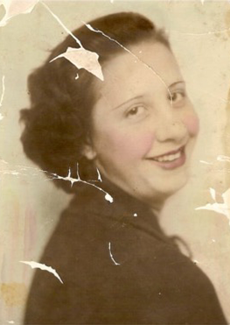
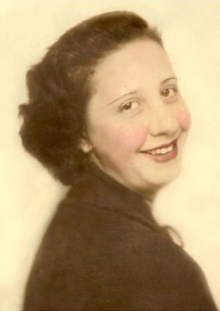
Problem Statement
Complex structure is difficult to generate.
Restoring high-resolution photographs remains a challenge.
Reconstructing large areas in images is difficult.
Requires a large amount of dataset to be trained on
Figure 8: Target input-output

Slide 10
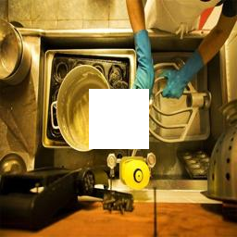
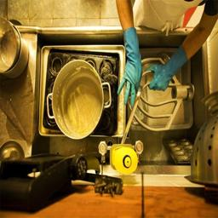
Objective
To develop a method that can:
Employ cGAN to restore damaged region seamlessly.
Compare the effects of prioritizing the mask’s border.
Develop a model suitable enough to be trained on a smaller dataset.
Evaluate the method against state-of-the-art methods.

Slide 11
Proposed Methodology:
Image Dataset Collection
Binary Mask Generator
Pre- Processing of Dataset
Calculation of Loss Function
Training the generator and discriminator
Extract the generator
Figure 9: Flow diagram of proposed methodology of the model

Slide 12
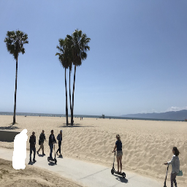
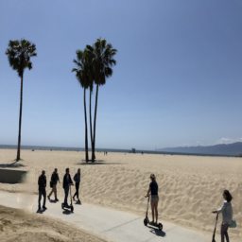
Proposed Methodology (Cont’d) :
Then use the generator to perform inpainting
Extracted generator
Figure 9: Input and Targeted Output

Slide 13
Proposed Methodology (Cont’d) :
Then use the generator to perform inpainting
Figure 9: Input and Targeted Output

Slide 14
Proposed Methodology (Cont’d) :
Image
Mask
Dilation
Dilated Mask
Remove original mask
Concatenate
Masked Image
Weight Map
Generated Image
Generator
Generator Loss
True / False
Discriminator
Loss
Discriminator
Pixel Loss

Slide 15
Proposed Methodology (Cont’d) :
Discriminator Architecture
16 x 16 x 512
1 x 1
32 x 32 x 256
64 x 64 x 128
128 x 128 x 64
256 x256 x3

Slide 16
Proposed Methodology (Cont’d) :
Generator Architecture
256 x 256 x 3
256 x 256 x 3
128 x 128 x 64
128 x 128 x 64
64 x 64 x
128
32 x 32 x
256
64 x 64 x
128
16 x 16 x
512
32 x 32 x
256
8 x 8 x
1024
8 x 8 x
1024
16 x 16 x
512

Slide 17
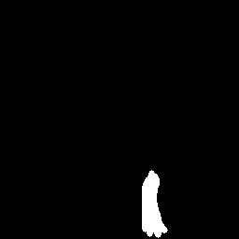
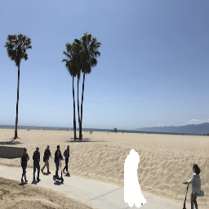
Implementation and Progress
Dataset Acquisition:
A dataset of 48000 distorted images is synthesized from:
Public Dataset
Places2
Binary Mask of Irregular Shape.
Figure 13: Sample images from public dataset and their corresponding distorted image
Notes:
hkhkj

Slide 18
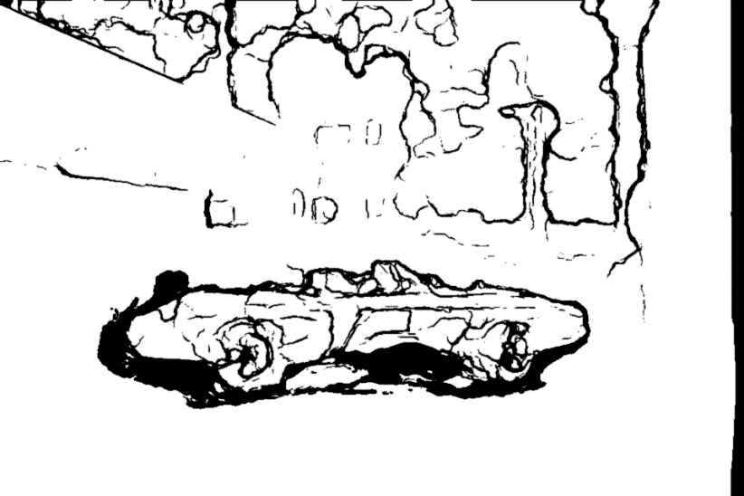
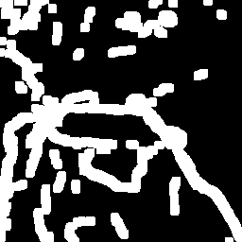
Implementation and Progress (Cont’d)
Step1: Generate Mask
Input: Two consecutive frames from a video, t and (t+1)
Convert to grayscale
Compute absolute difference
Apply adaptive threshold
Apply dilation
Negate the image
Resize
Get output
Apply threshold
Morphological operations
Figure 16 : After occlusion/dis-occlusion
Figure 17: After thresholding, dilating and negating
Figure 15: Procedure of generating binary mask

Slide 19
Implementation and Progress (Cont’d)
Step2: Apply on Image
Randomly select a mask
Randomly select a photo from Dataset
Blend two images
Generate a random noise array
Create a dust layer by thresholding the noise array
Blend the dust layer with the input image
Figure 18: Method to create the damaged dataset

Slide 20
Work Progress
2023
2024
Months
Feb Mar April May Jun July Aug Sep Oct Nov Dec Jan Feb
Topic Selection and Confirmation
Study Literature
Dataset Acquisition
Study Preceding Methodology Pre-Defense Preparation
Developing Model
Evaluation and Modification
Result Analysis and Fine Tuning
Preparation for Defense
Complete Work
Currently working
Future Work

Slide 21
Financial Budget Planning
Table 2: Financial Budget Plan
Budget Category | Estimated Cost Range
Equipment and Software | 10,000 - 30,000 BDT
Dataset | 5,000 - 10,000 BDT
Travel and Conferences | 2,000 - 5,000 BDT
Publication Fees | 1,000 - 3,000 BDT
Miscellaneous | 1,000 - 3,000 BDT
Total Estimated Budget Range | 19,000 - 51,000 BDT

Slide 22
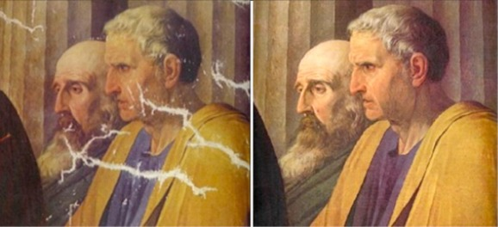
Socio-Economic Impact
Accurate diagnosis from corrupted medical images.
Reduces the need for new content creation
Saving resources and energy.
Preserves historical artifacts and artworks
Cultural heritage conservation
Minimizes wasteful content recreation
Reduces carbon footprint
Extends the usability of visual assets
Increases cost-efficiency
Figure 19: Restoration of painting

Slide 23
Conclusions
Aiming to contribute to the advancement of image inpainting in the practical field.
Attempting to provide results that are more accurate and effective.
The study will be conducted using the evaluated literature as a guide.

Slide 24
References
Ulyanov, Dmitry, Andrea Vedaldi, and Victor Lempitsky. "Deep image prior." Proceedings of the IEEE conference on computer vision and pattern recognition. 2018.
Yu, Jiahui, et al. "Generative image inpainting with contextual attention." Proceedings of the IEEE conference on computer vision and pattern recognition. 2018.
Liu, Guilin, et al. "Image inpainting for irregular holes using partial convolutions." Proceedings of the European conference on computer vision (ECCV). 2018.
Yu, Jiahui, et al. "Free-form image inpainting with gated convolution." Proceedings of the IEEE/CVF international conference on computer vision. 2019.
Yeh, Raymond A., et al. "Semantic image inpainting with deep generative models." Proceedings of the IEEE conference on computer vision and pattern recognition. 2017.

Slide 25
Thank You

Slide 26
Why PatchGAN?
it focuses on smaller patches or pieces of an image rather than the entire image.
capture fine-grained features and textures within specific regions.
more sensitive to local inconsistencies or inaccuracies

Slide 27
Programming Environment:
Programming Language: Python
IDE: Google Collab/Anaconda
Deep Learning Frameworks:
PyTorch
TensorFlow
Keras

Slide 28
Programming Environment (Cont’d) :
Libraries and Packages:
numpy: For numerical computations.
matplotlib or seaborn: For visualization.
scipy: For various scientific computations.
pillow: For image handling.
scikit-learn: For machine learning utilities

