Slide 2
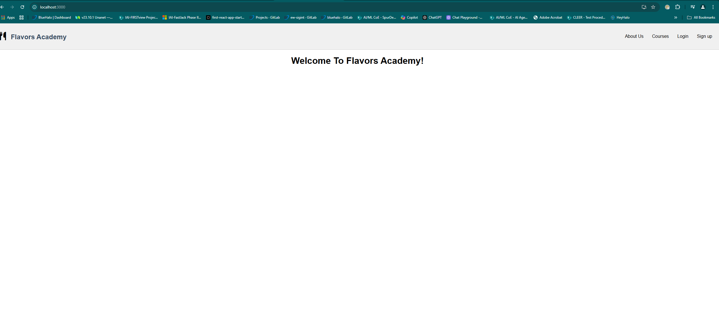
Home page

Slide 3
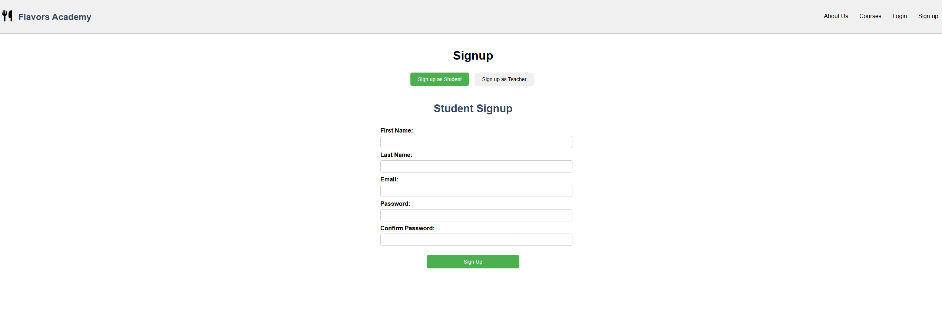
signup

Slide 4
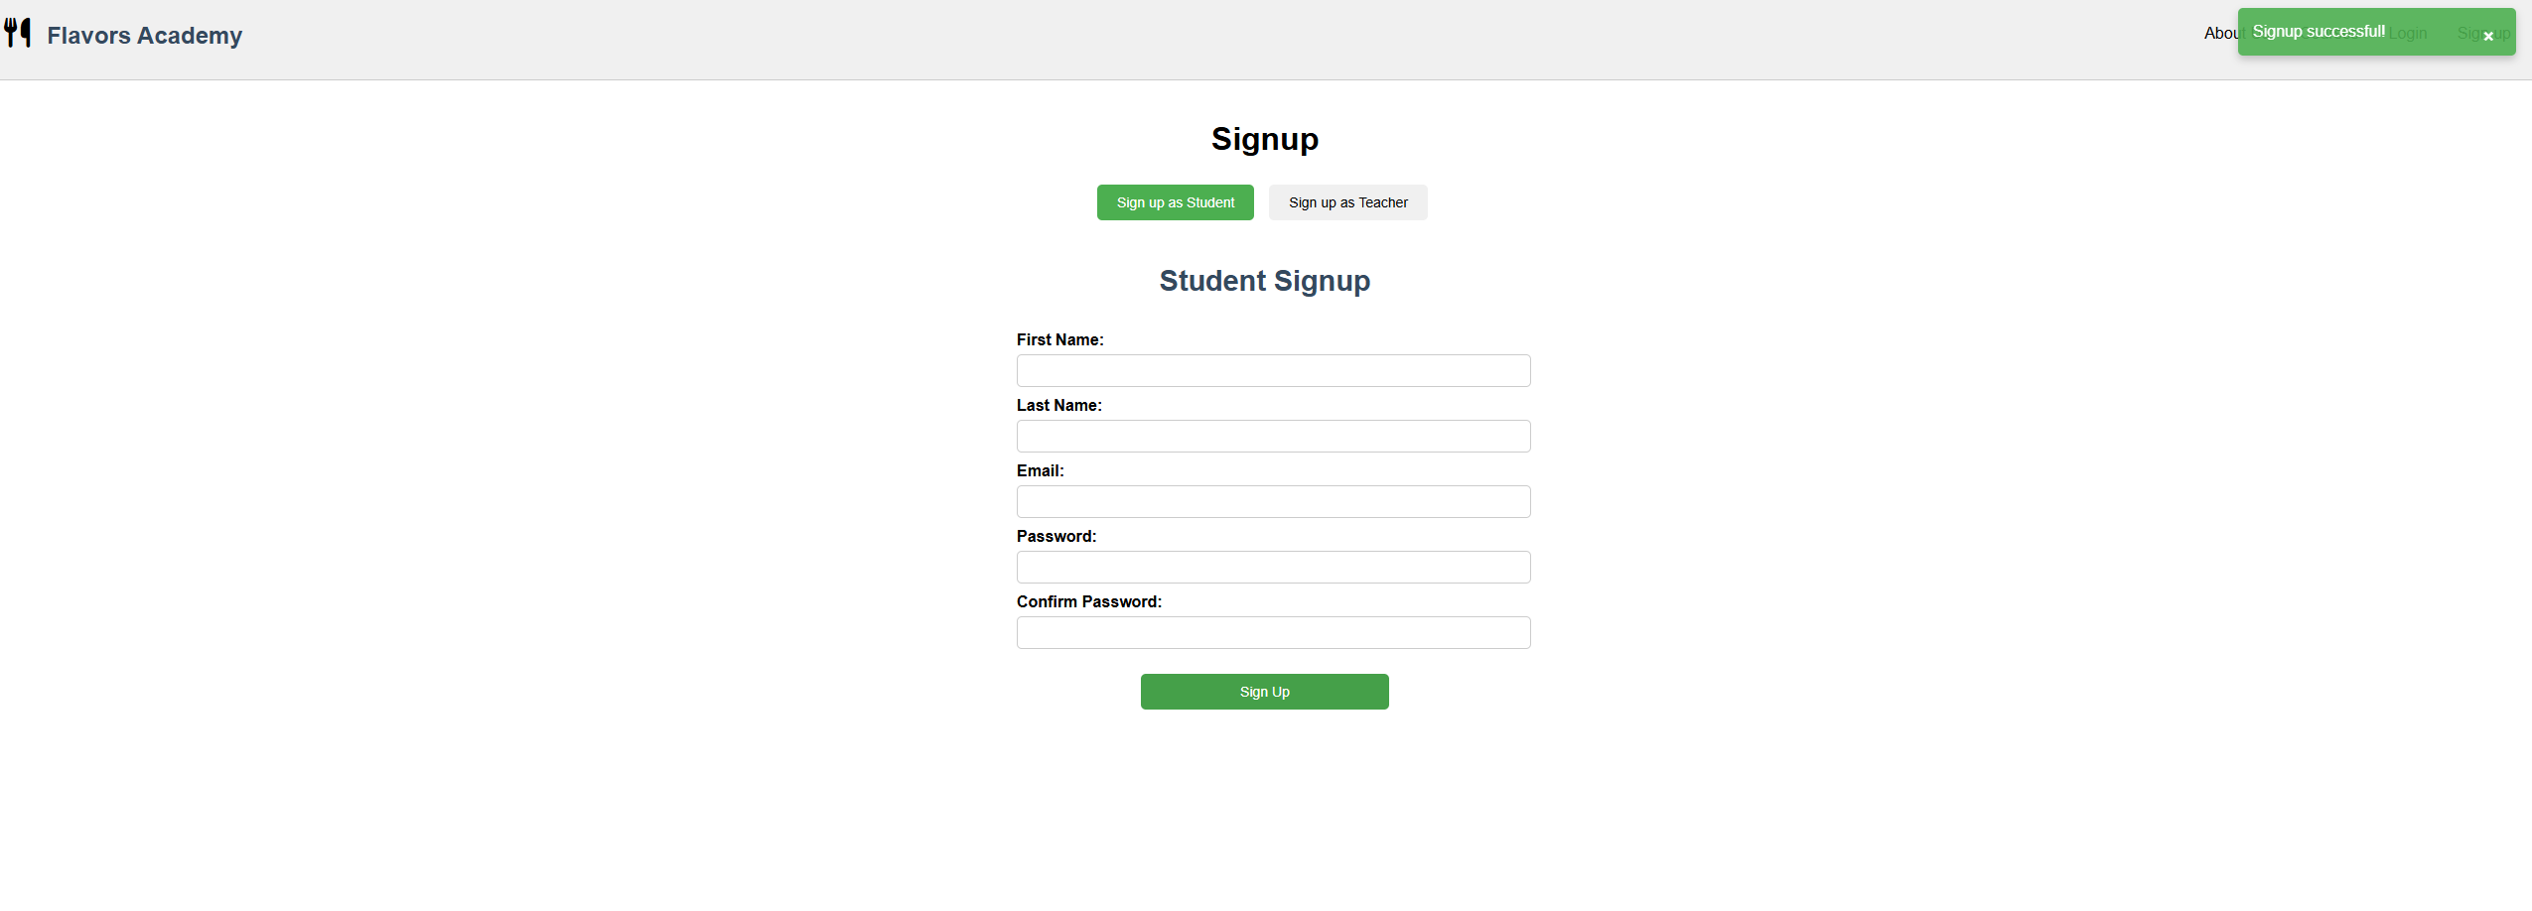
Successful signup student

Slide 5
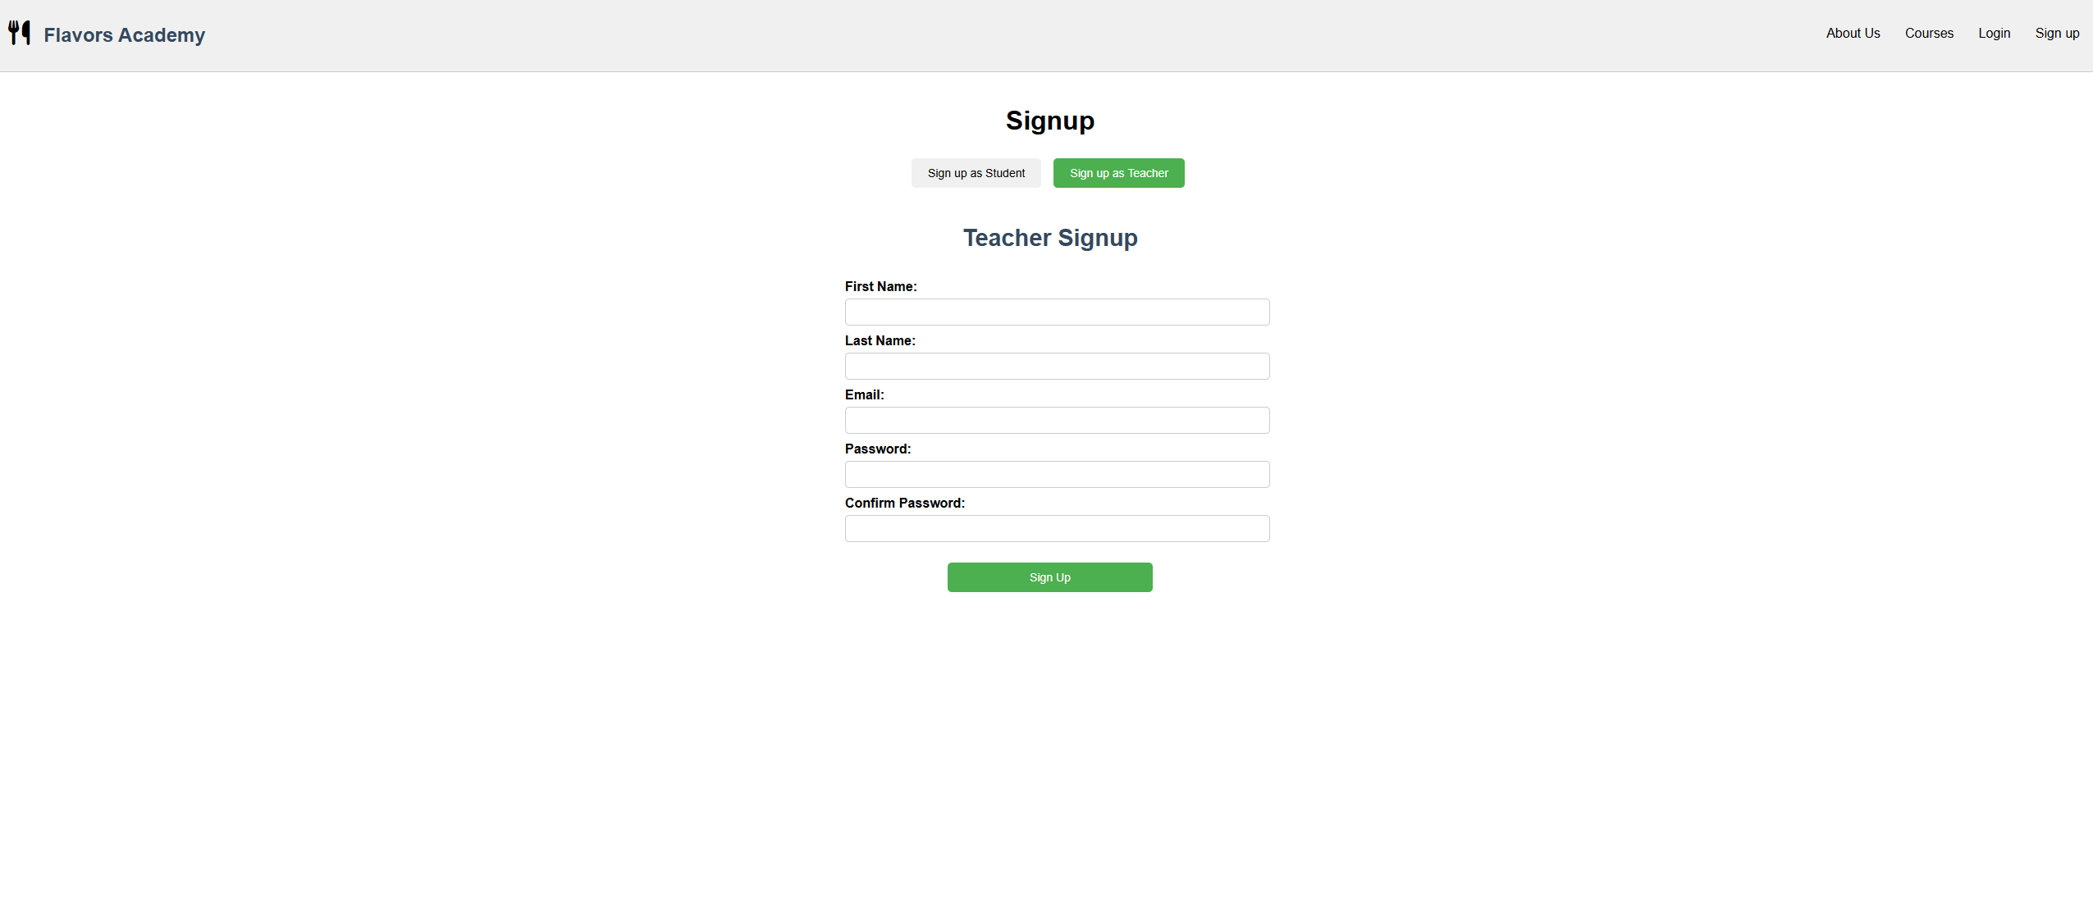
Teacher signup

Slide 6
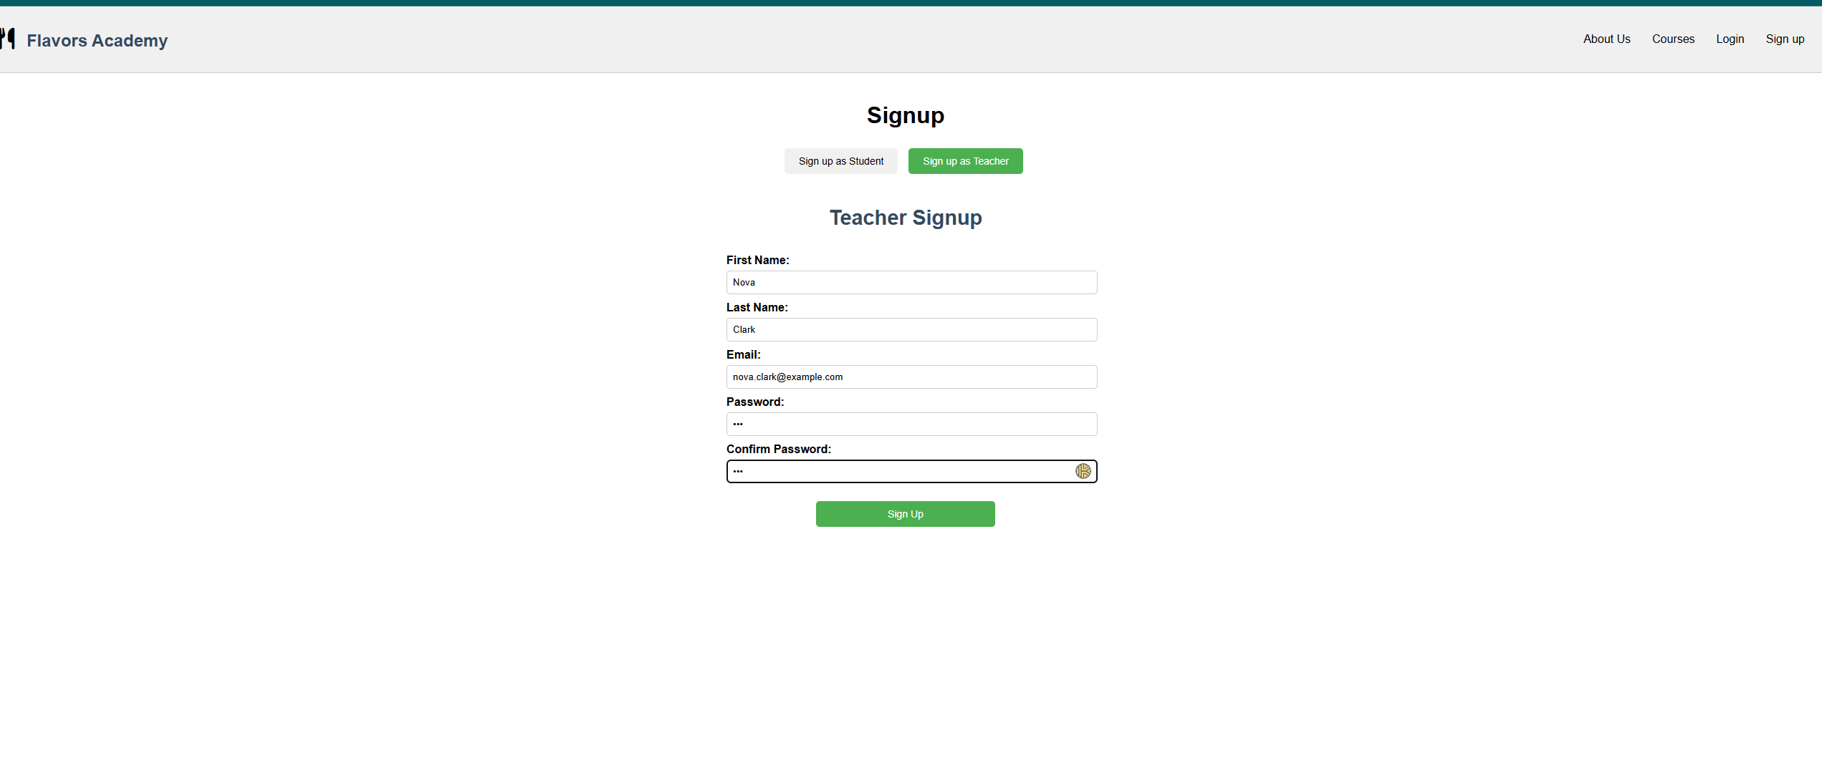
Teacher signup

Slide 7

Teacher sign up success

Slide 8

Login

Slide 9

Teacher dashboard

Slide 10

Teacher courses

Slide 11

Course click

Slide 12
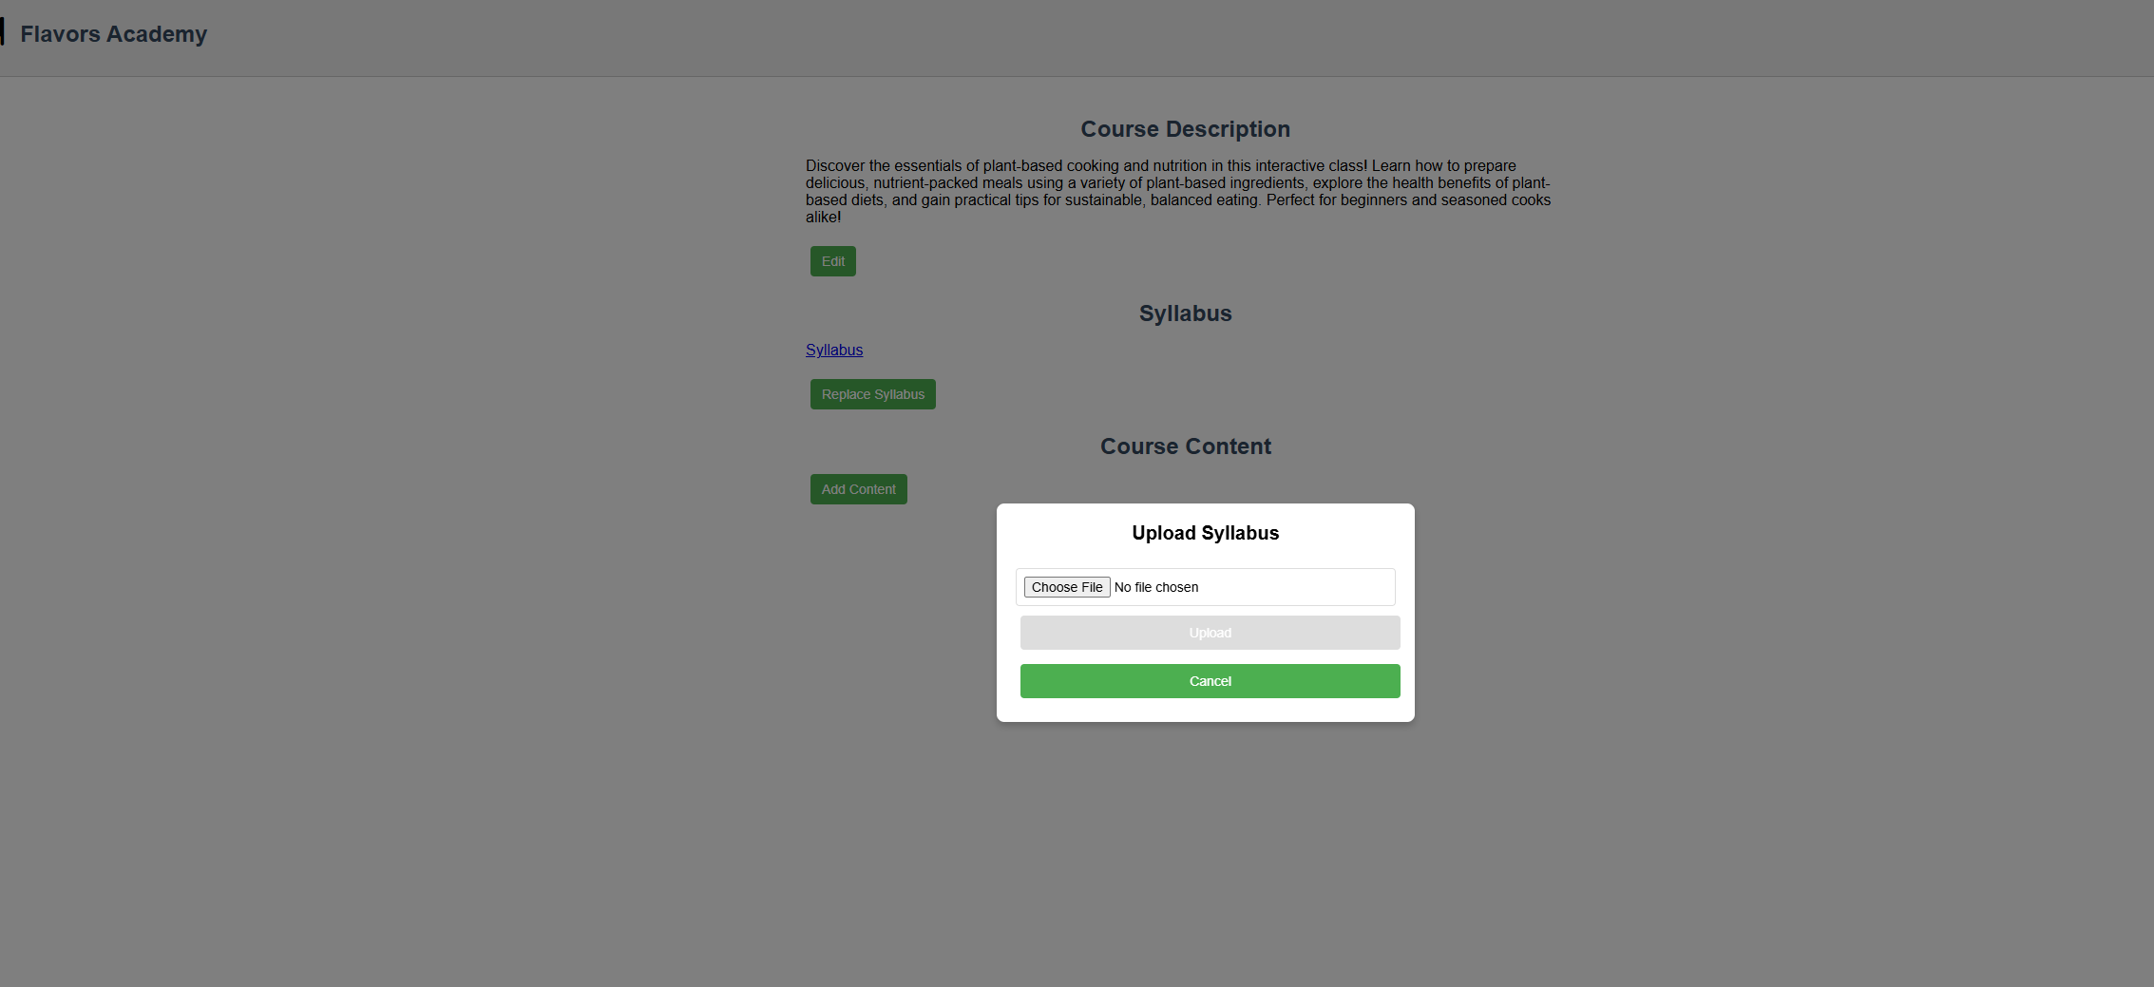
Syllabus replace

Slide 13
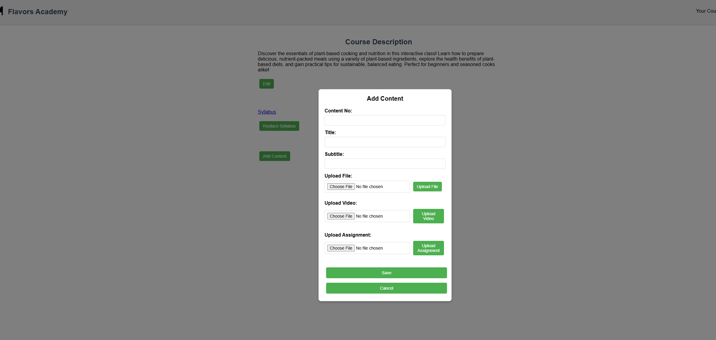
Add content

Slide 14
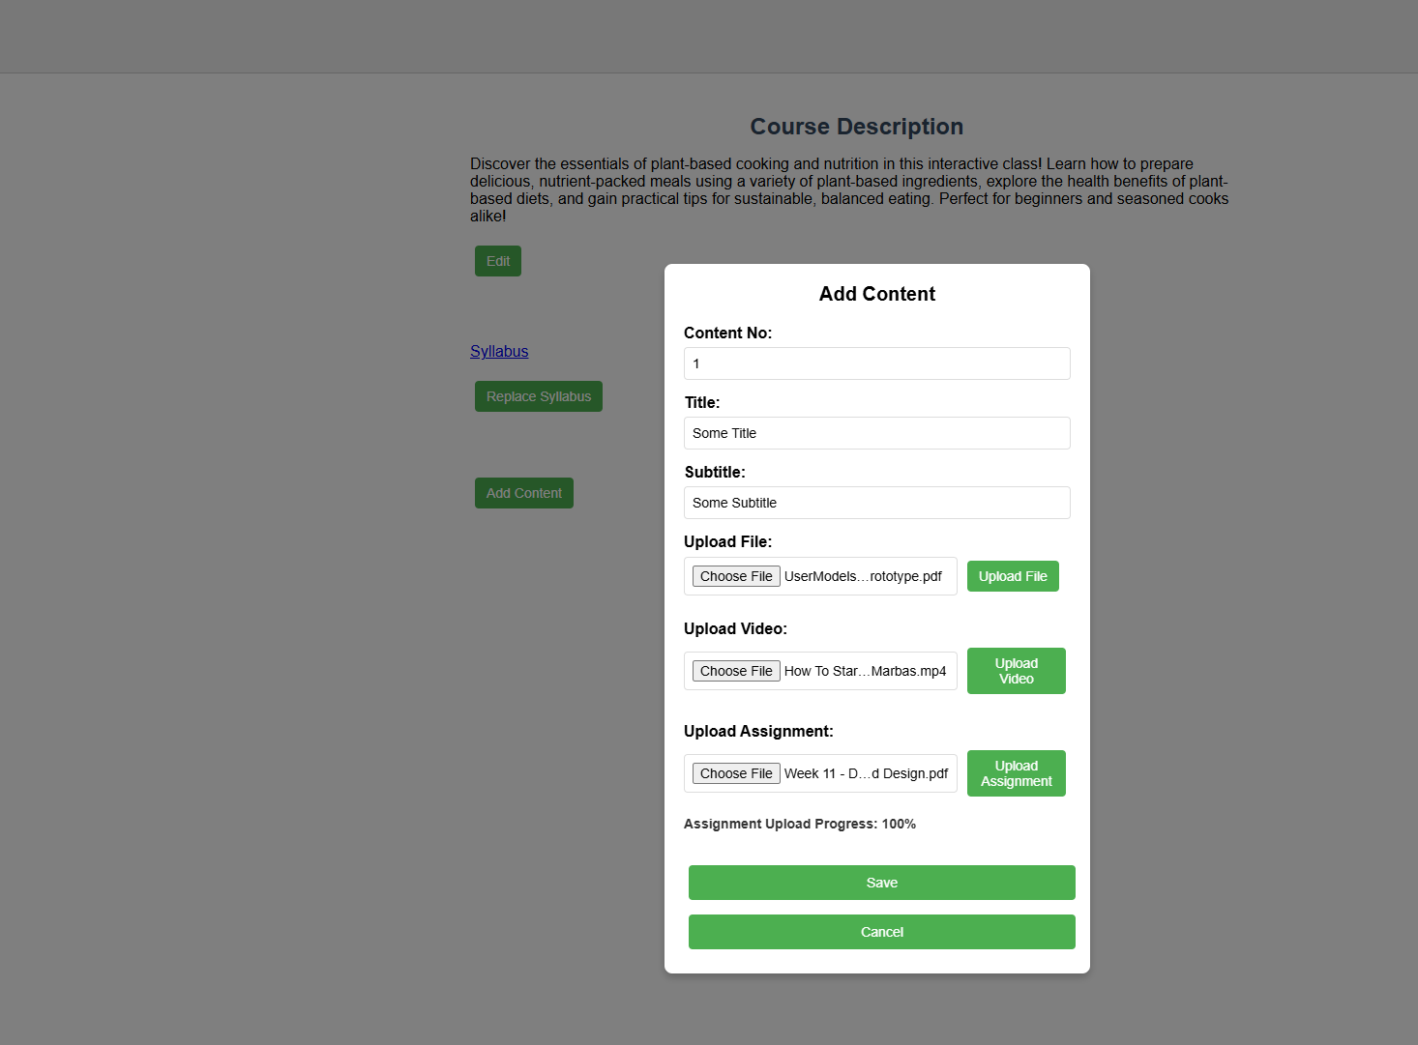
Content progress

Slide 15
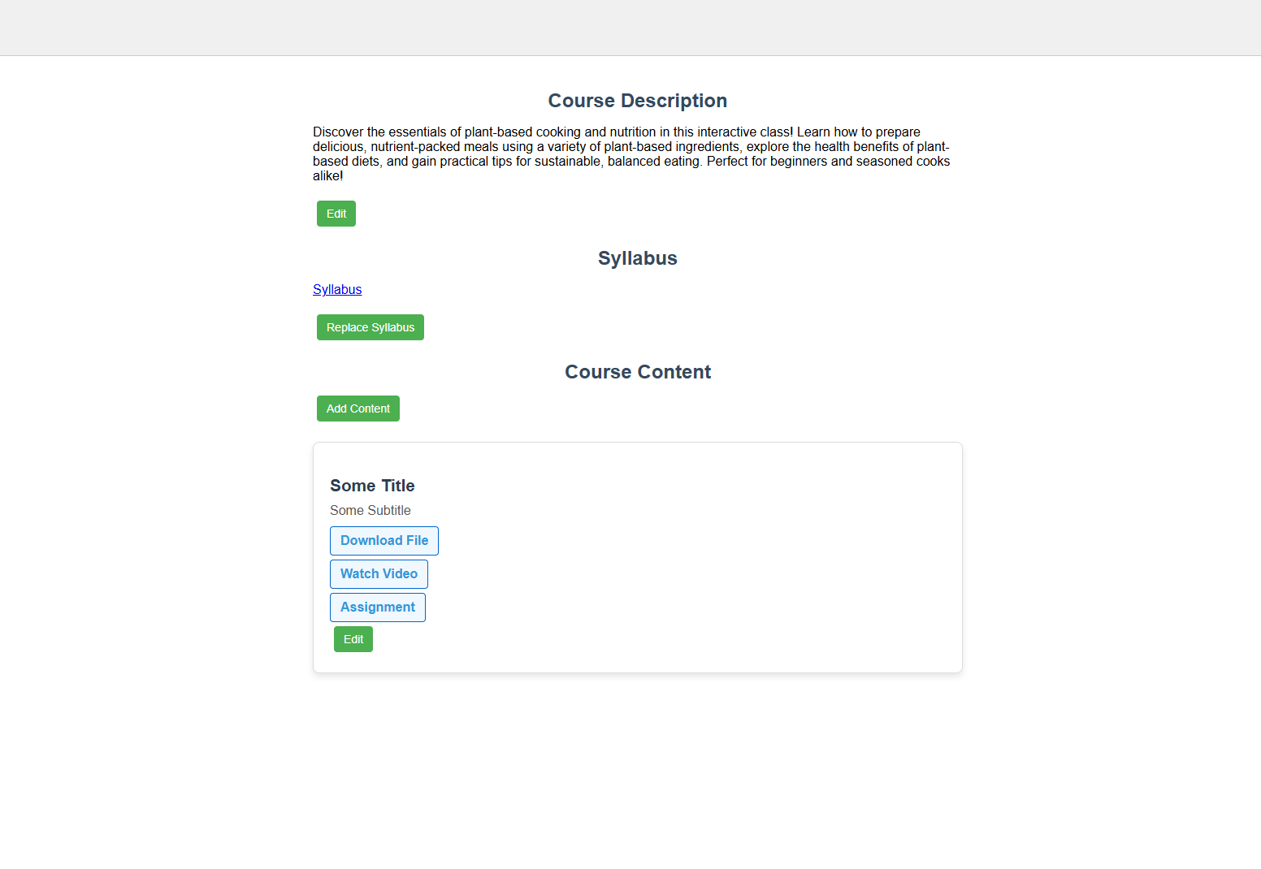
Content creation

Slide 16
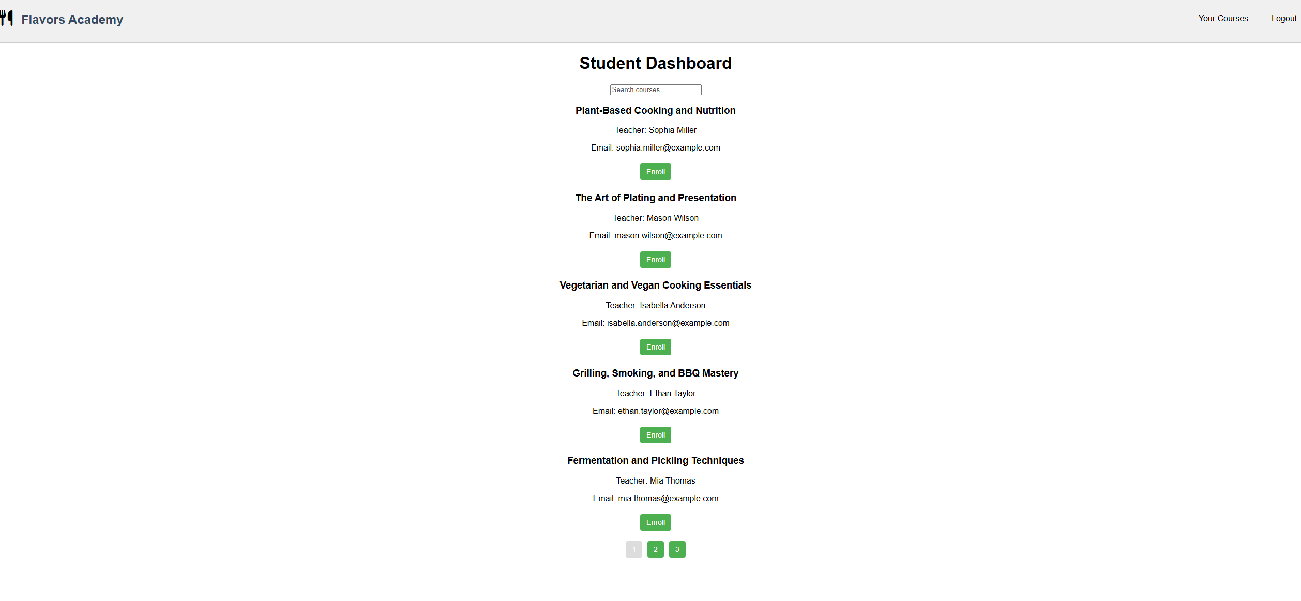
Student dashboard

Slide 17
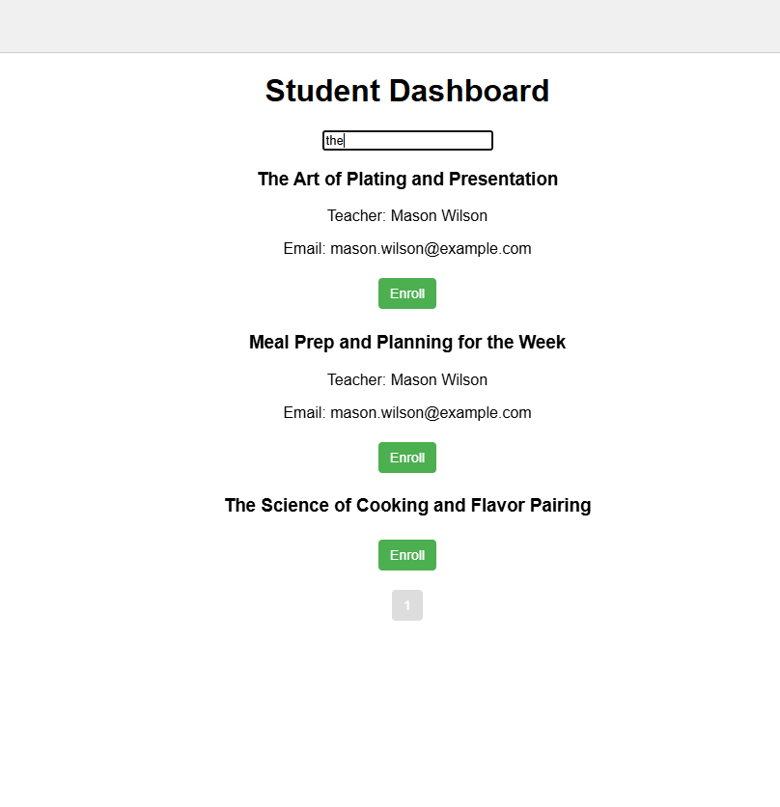
Search results

Slide 18

Enrolled Courses

Slide 19
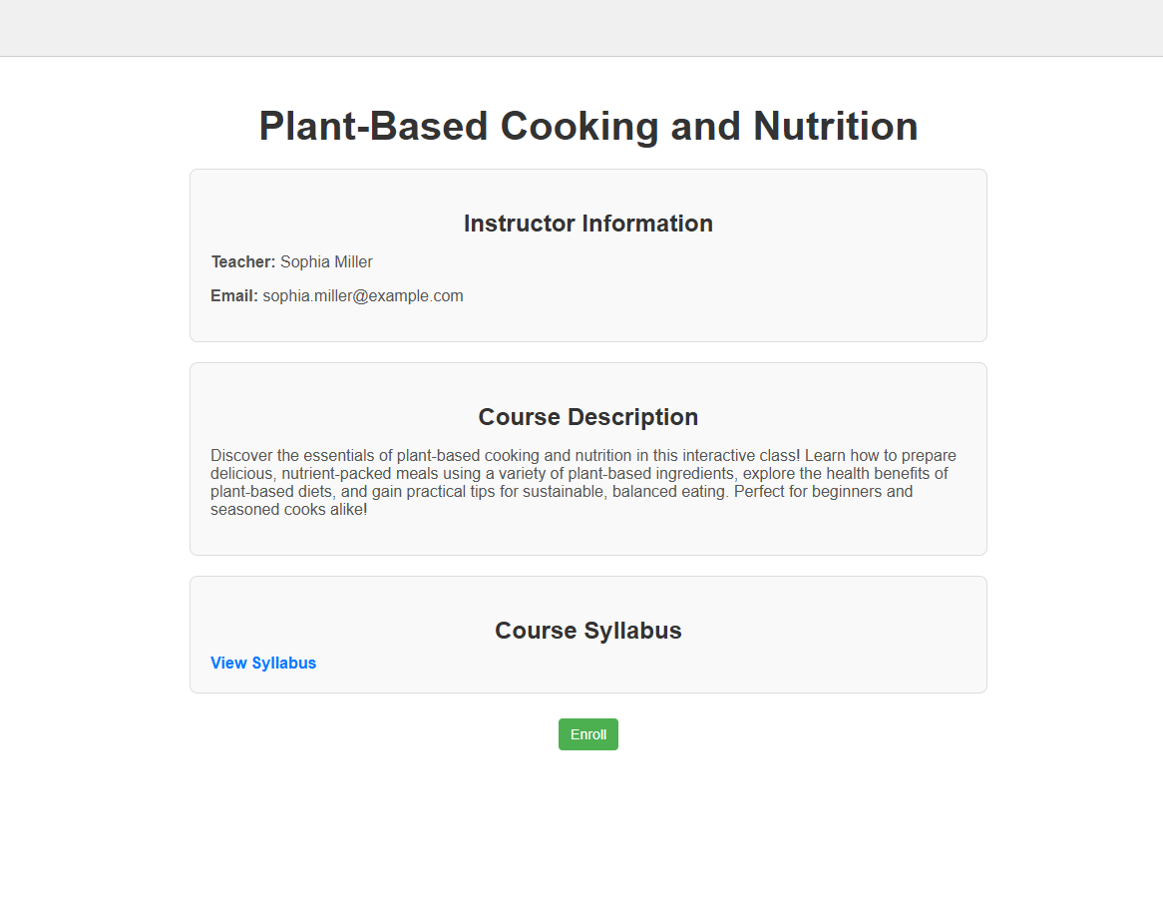
Enroll course page

