Slide 1
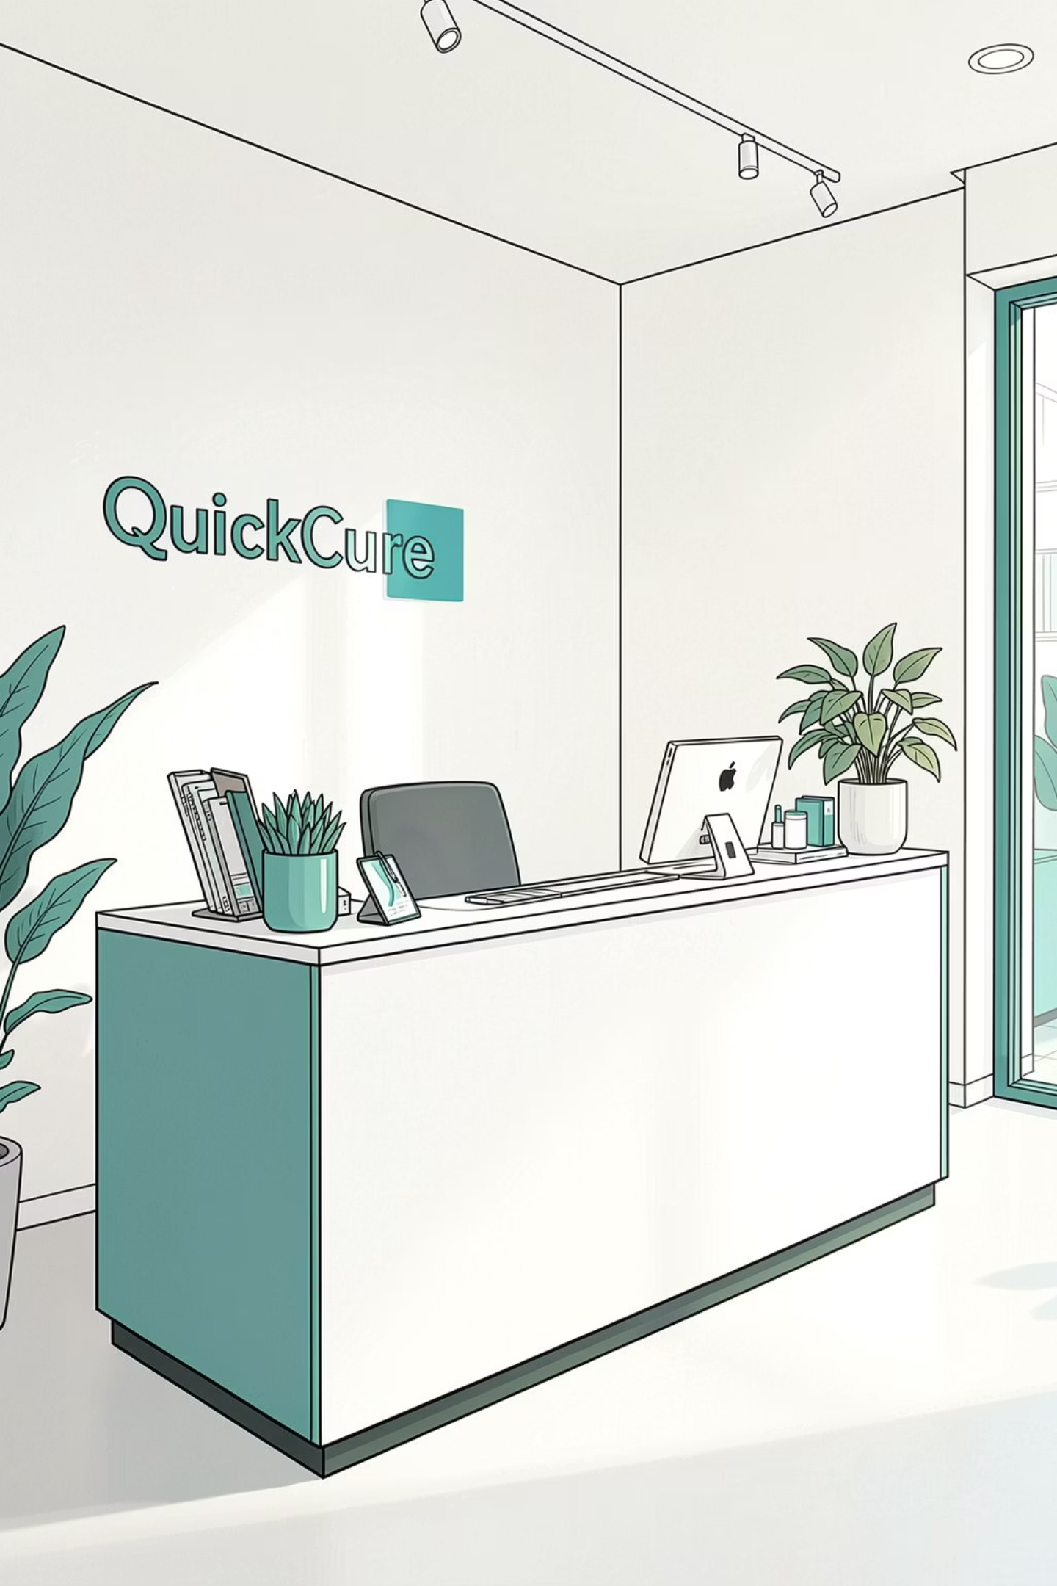

QuickCure
Digital Healthcare Appointment Platform
Tasnim Jahan & Md. Nishat Mahzabin
1

Slide 2
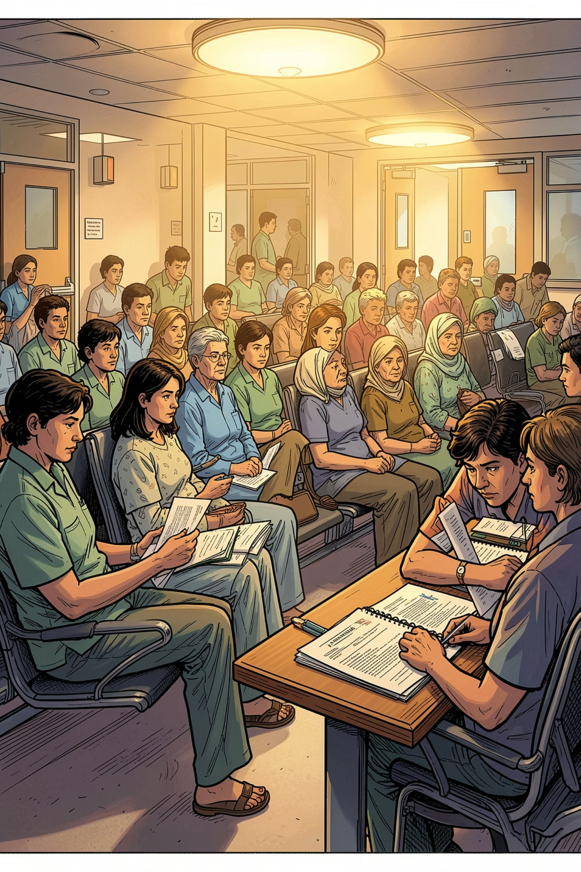
The Problem
Long Queues & Wasted Time
Manual appointment scheduling forces patients to wait in line or call repeatedly, creating frustration and inefficiency.
Double Bookings & Errors
Without a centralized system, overlapping appointments and clerical mistakes are common and difficult to resolve.
Poor Records & Communication Gaps
Patient histories are fragmented across paper files, and patients rarely receive timely updates or confirmations.
2

Slide 3

Our Solution
QuickCure — One Platform, Three Users
QuickCure is a web-based appointment platform that removes manual bottlenecks entirely. Patients browse verified doctors and book in seconds. Doctors view their daily schedule at a glance. Administrators oversee everything from a unified dashboard — no double bookings, no paperwork, no gaps.
Designed for simplicity. Built for reliability.
3

Slide 4
Key Features
User Registration & Login
Admin Panel
Secure sign-up and authentication for patients, doctors, and administrators.
Centralized control for managing users, doctors, and appointment records.
Doctor Listing
Appointment Tracking
Browse verified doctors by specialty, availability, and location.
Patients and doctors can view, modify, or cancel appointments in real time.
Online Booking
Secure Data Storage
Real-time slot selection eliminates double bookings and manual errors.
Patient records and medical history stored safely with role-based access.
4

Slide 5
How It Works
Three User Roles
Tech Stack
Patient
Doctor
HTML & CSS
PHP
Register, search doctors, book & track appointments
View schedule, manage availability, review patient details
Frontend structure and responsive styling
Server-side logic and session handling
Admin
MySQL
VS Code
Manage users, oversee all bookings
Relational database for all records
Development environment
5

Slide 6
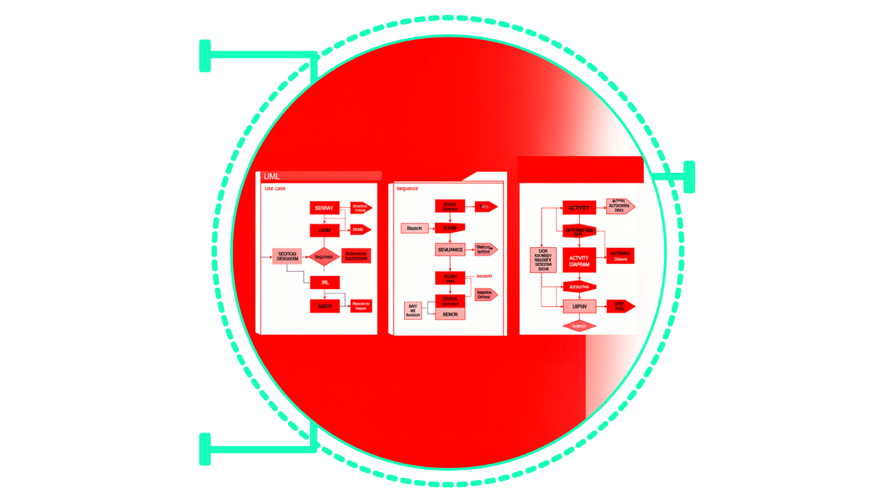
System Design
QuickCure's architecture is documented through three core UML diagrams that capture user interactions, system flows, and process sequences.
Use Case Diagram
Sequence Diagram
Use Case
User–system interactions and actor goals
User interactions and goals
System message exchange and timing
Sequence
Message exchanges over time
Activity
System process flows
Activity Diagram
Appointment booking flow and decision points
6

Slide 7
Challenges & Limitations
No Real-Time Notifications
Limited to Local Deployment
Users do not receive instant updates for appointment changes or reminders.
The current system is designed for single-instance, on-premise use.
No Payment Integration
No Telemedicine Support
Appointments cannot be paid for directly through the platform.
Virtual consultations or remote care features are not integrated.
Mobile App Not Yet Available
Basic Security Model
The platform is currently web-based; no dedicated mobile application exists.
Security features are fundamental and lack advanced threat protection.
7

Slide 8
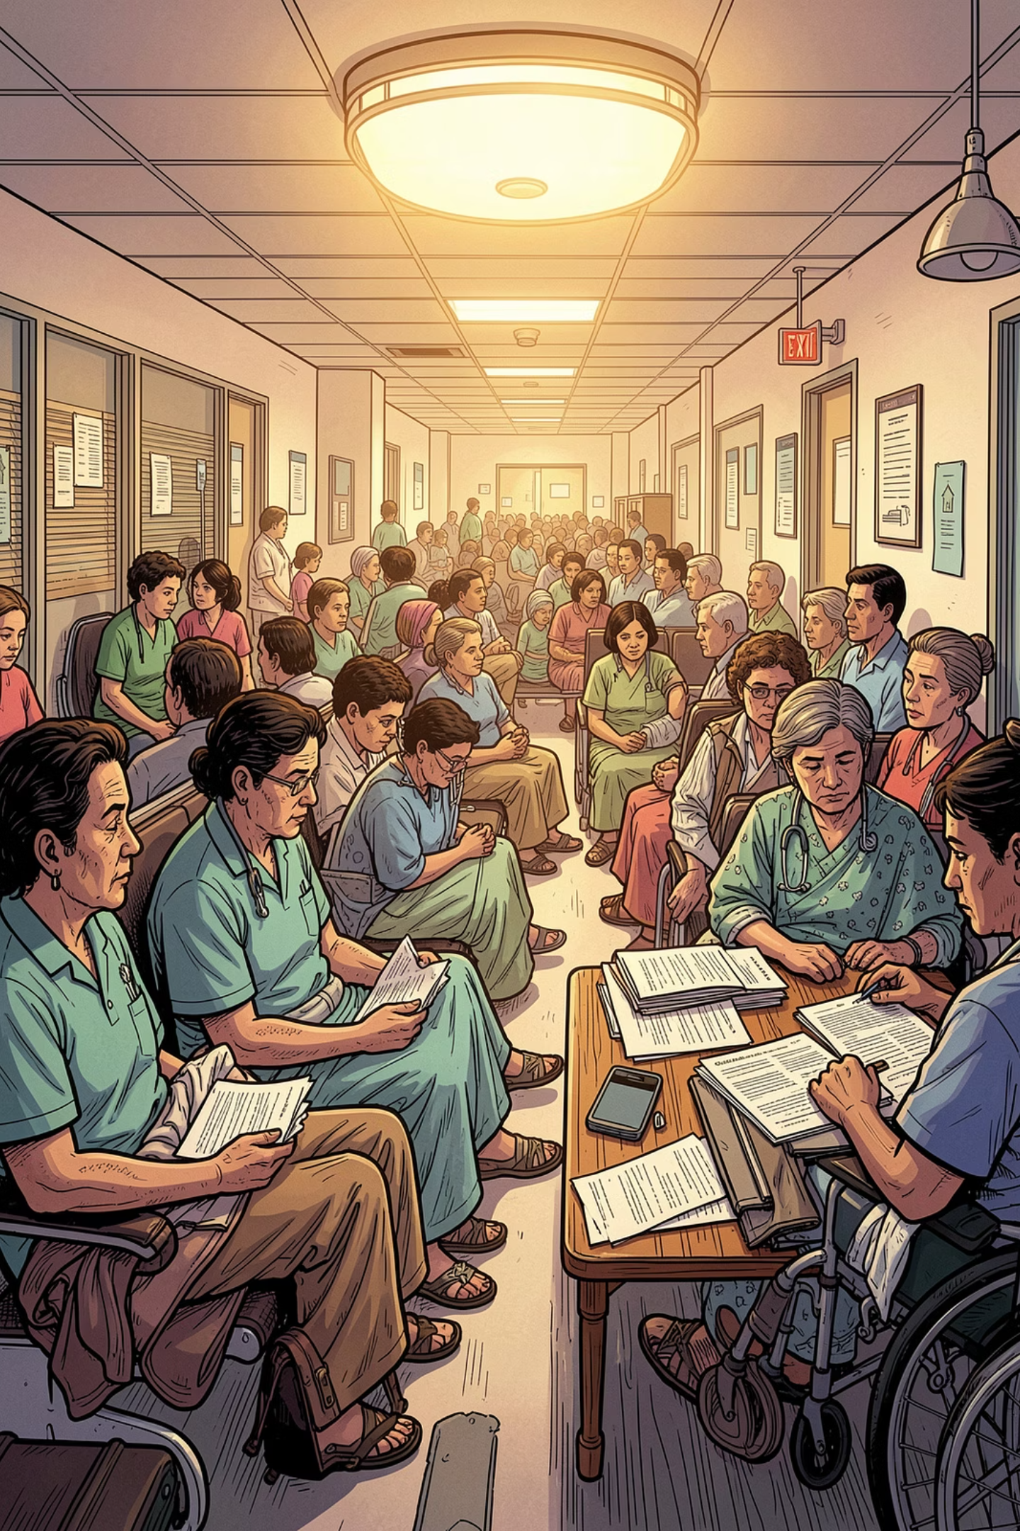
Impact & Benefits
Faster Access to Care
Patients can find and book appointments instantly, eliminating long wait times and frustrating phone calls.
Reduced Administrative Burden
Automated scheduling, reminders, and record-keeping free up staff to focus on patient care, minimizing manual errors.
Better Doctor-Patient Coordination
Real-time updates, secure messaging, and accessible medical histories ensure seamless communication and informed consultations.
8

Slide 9
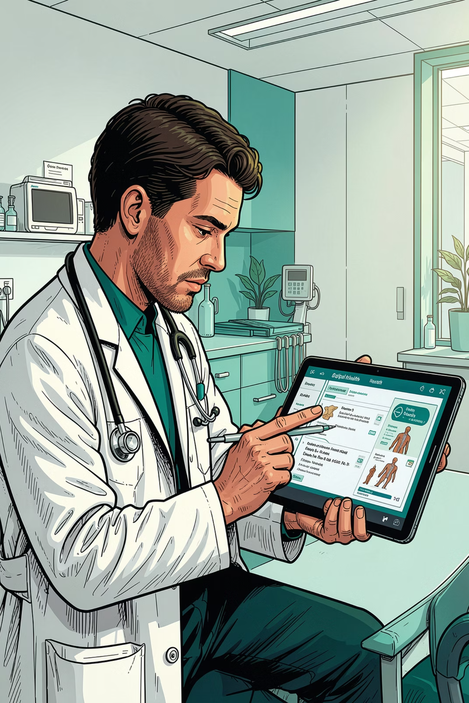
Conclusion
QuickCure addresses a real and widespread challenge in healthcare delivery — replacing slow, error-prone manual processes with a streamlined digital experience for patients, doctors, and administrators alike.
What's Next
Mobile App
Online Payment
Notifications
Video Consultation
"Bringing smarter healthcare, one appointment at a time."
9

