Slide 1
Maximum Flow
Maximum Flow Problem
The Ford-Fulkerson method
Maximum bipartite matching

Slide 2
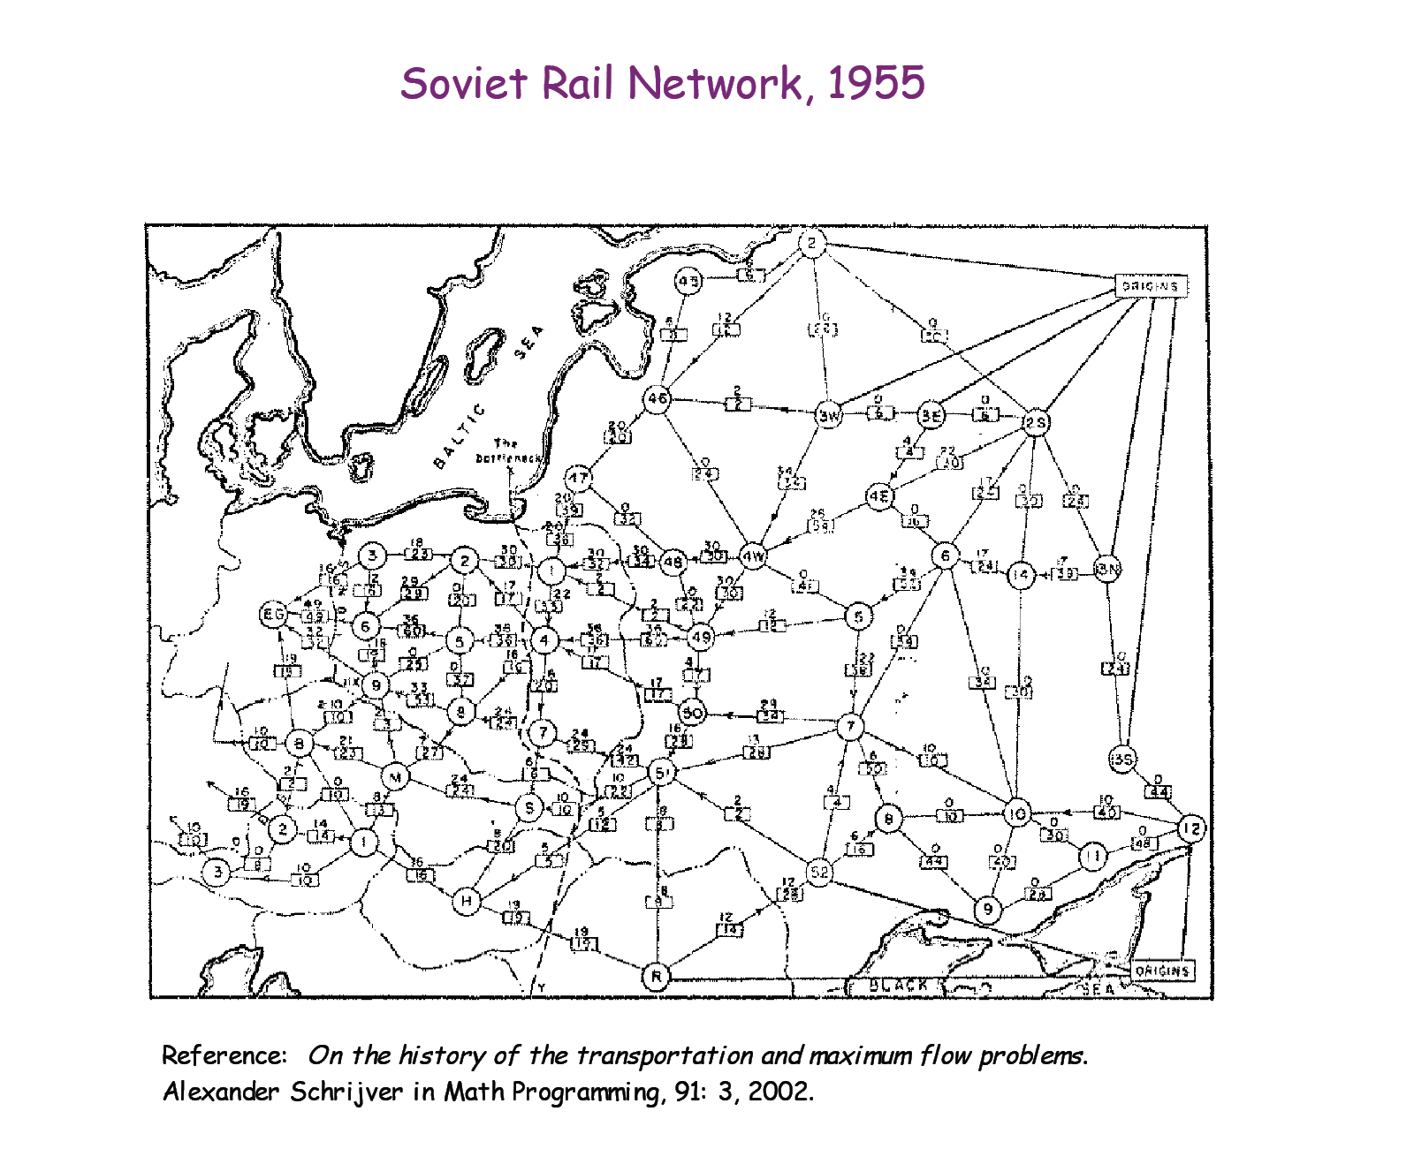
material coursing through a system from a source to a sink

Slide 3
Logistics supply problem: Example 2
Legend:
Node: Sub-station
Edge: Power line
Weight: Line capacity
WanChai
NorthPoint
Western
5
Central
20
10
15
20
15
15
25
PokFuLam
HappyValley
40
20
40
20
Aberdeen
30
20
50
20
RepulseBay
40
Power Station
Lamma
What is the maximum power we can supply to Wan Chai for a Light-n-Sound Show?

Slide 4
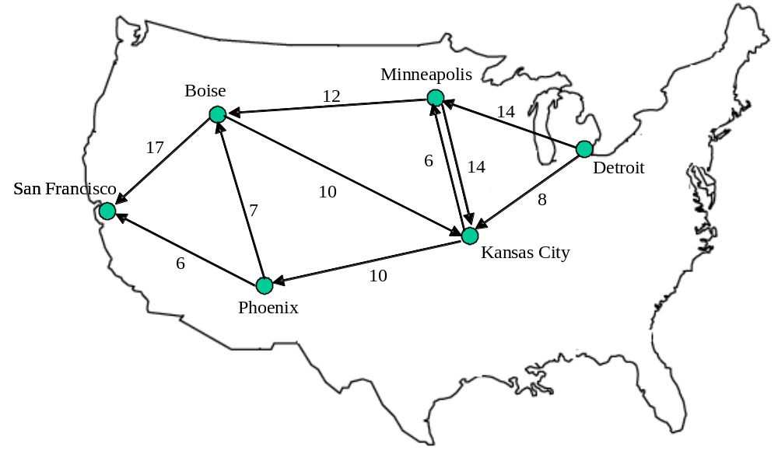
Logistics supply problem:
Example 3
Legend:
nodes: train line junctions;
edges: rail line;
weights: max no. of compartments/day
Maximum number of compartments per day from Detroit→ SF ?

Slide 5
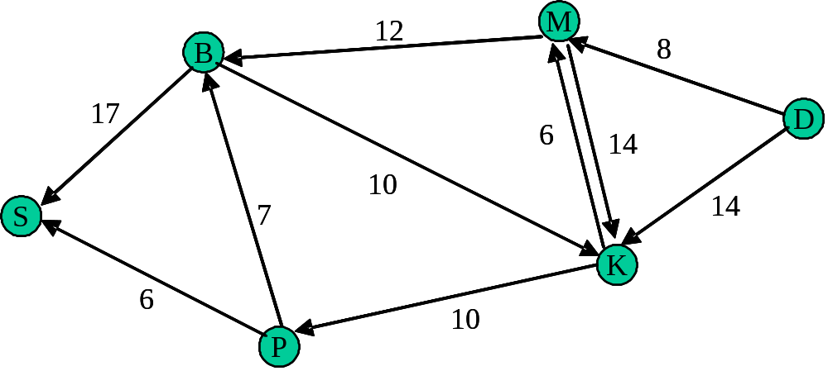
Maximum Flow Problem: definitions
SINK:
Node with net inflow;
Consumption point
CAPACITY:
Maximum flow
on an edge
SOURCE:
Node with net outflow:
Production point
Efficient method to solve such problems: Ford-Fulkerson Method

Slide 6
Flow networks:
A flow network G=(V,E): a directed graph, where each edge (u,v)∈E has a nonnegative capacity c(u,v)>=0.
If (u,v)∉E, we assume that c(u,v)=0.
two distinct vertices :a source s and a sink t.
12
16
20
s
10
9
7
t
4
13
4
14

Slide 7
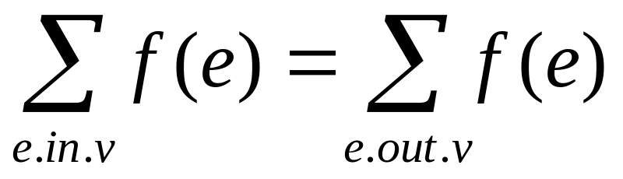
Flow:
G=(V,E): a flow network with capacity function c.
s-- the source and t-- the sink.
A flow in G: a real-valued function f:V*V → R satisfying the following two properties:
Capacity constraint: For all u,v ∈V,
we require f(u,v) ≤ c( u,v).
Flow conservation: For all u ∈V-{s,t}, we require

Slide 8
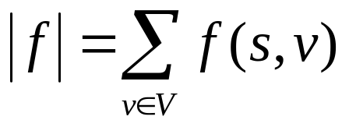
Net flow and value of a flow f:
The quantity f (u,v) is called the net flow from vertex u to vertex v.
The value of a flow is defined as
  The total flow from source to any other vertices.
  The same as the total flow from any vertices to the sink.

Slide 9
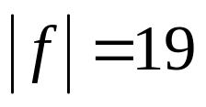
12/12
11/16
15/20
s
10
t
1/4
4/9
7/7
8/13
4/4
11/14
A flow f in G with value .

Slide 10

Maximum-flow problem:
Given a flow network G with source s and sink t
Find a flow of maximum value from s to t.
How to solve it efficiently?

Slide 11
The Ford-Fulkerson method:
This section presents the Ford-Fulkerson method for solving the maximum-flow problem. We call it a “method” rather than an “algorithm” because it encompasses several implementations with different running times.
The Ford-Fulkerson method depends on three important ideas that transcend the method and are relevant to many flow algorithms and problems: residual networks, augmenting paths, and cuts.
These ideas are essential to the important max-flow min-cut theorem, which characterizes the value of maximum flow in terms of cuts of the flow network.

Slide 12
Continue:
FORD-FULKERSON-METHOD(G,s,t)
initialize flow f to 0
while there exists an augmenting path p
do augment flow f along p
return f

Slide 13
Residual networks:
Given a flow network and a flow, the residual network consists of edges that can admit more net flow.
G=(V,E) --a flow network with source s and sink t
f: a flow in G.
The amount of additional net flow from u to v before exceeding the capacity c(u,v) is the residual capacity of (u,v), given by: c_{f}(u,v)=c(u,v)-f(u,v)
in the other direction: c_{f}(v, u)=c(v, u)+f(u, v).

Slide 14
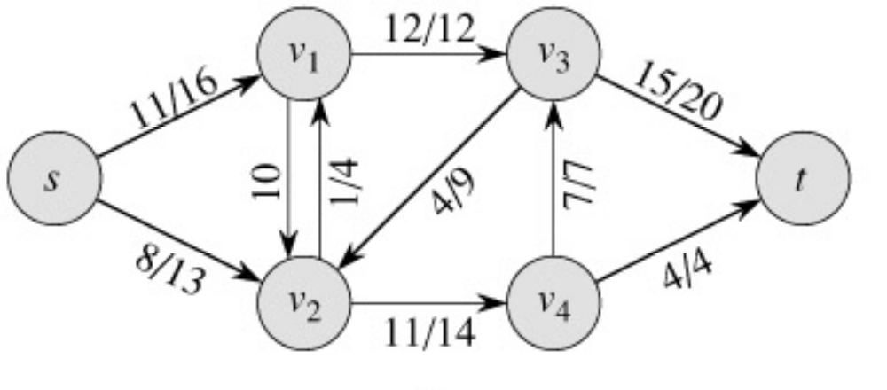
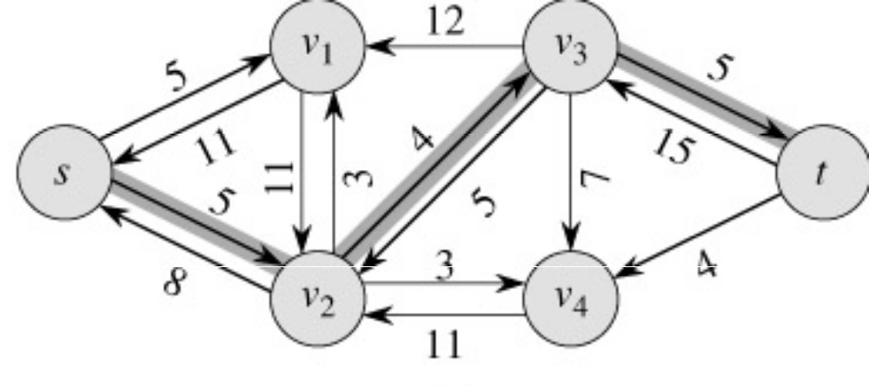
Example of residual capacities
Network:
Residual Network:
Augmenting path

Slide 15
The residual network
The edges of the residual network are the edges on which the residual capacity is positive.

Slide 16
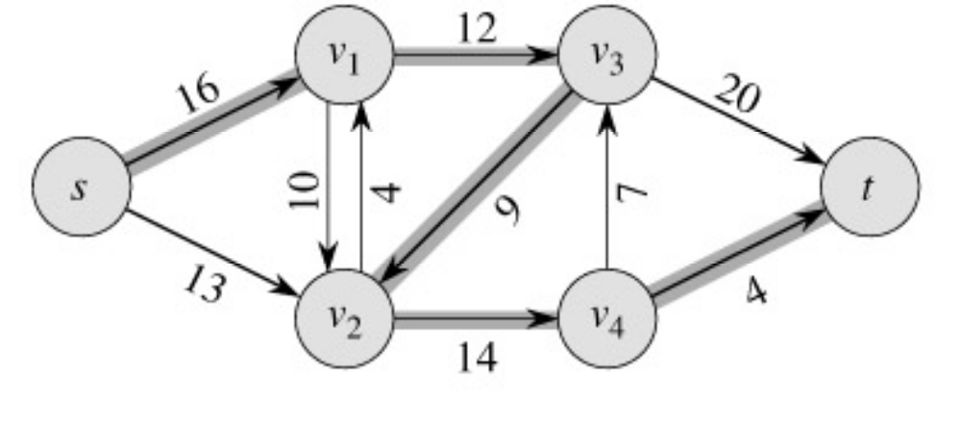
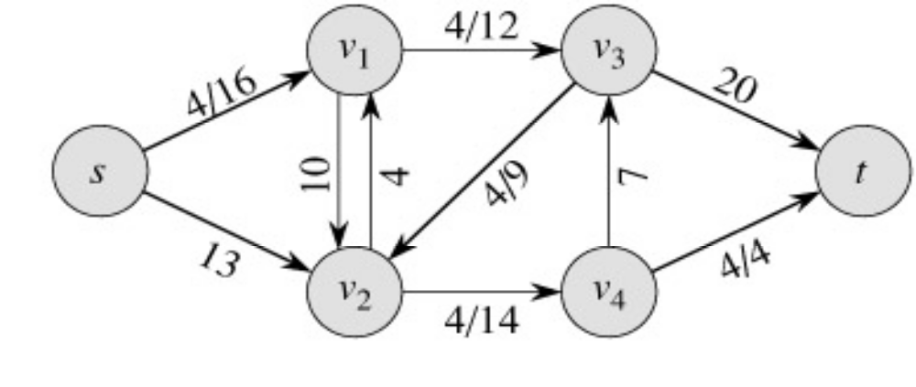
Example
augmenting path
Original Network
Resulting Flow =4

Slide 17
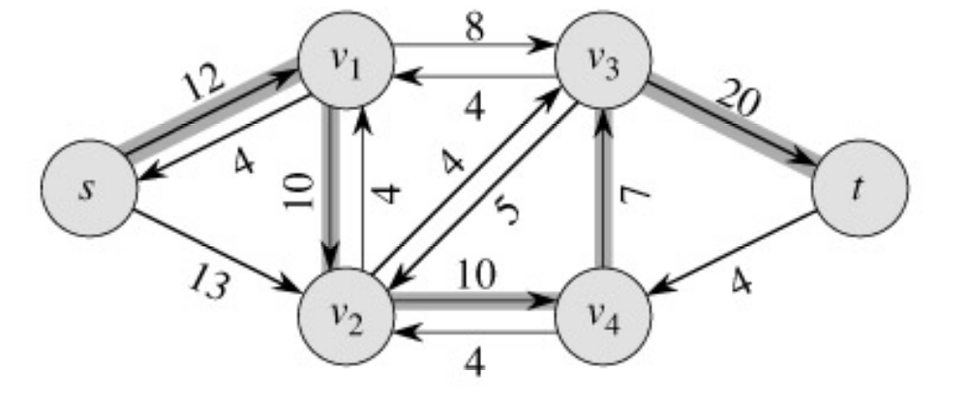
Example
Resulting
Flow = 4
augmenting path
Residual Network

Slide 18
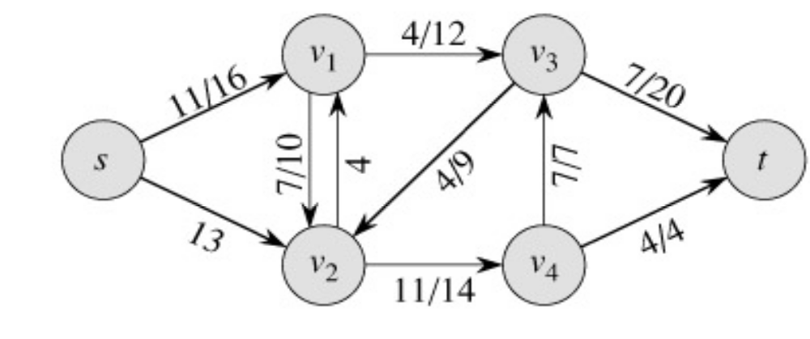
Example
Residual Network
Resulting Flow =11

Slide 19
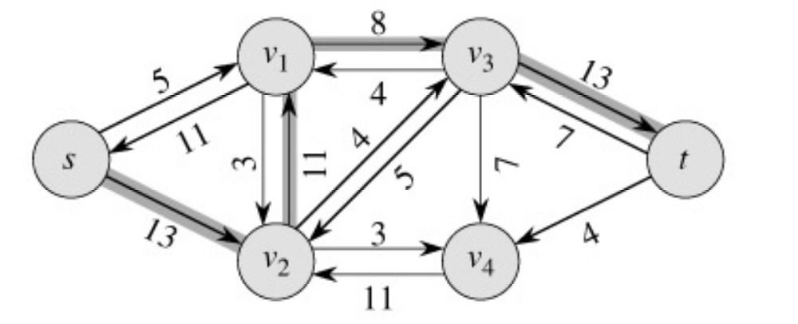
Example
Resulting
Flow =11
augmenting path
Residual Network

Slide 20
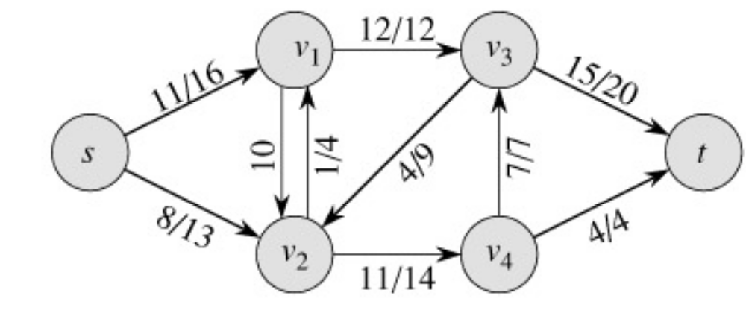
Example
Residual Network
Resulting
Flow =19

Slide 21
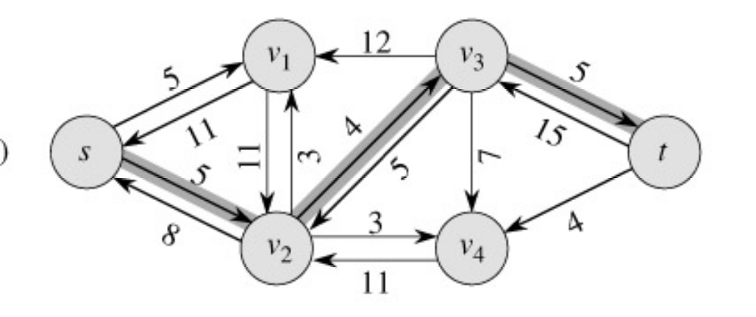
Example
Resulting
Flow = 19
augmenting path
Residual Network

Slide 22
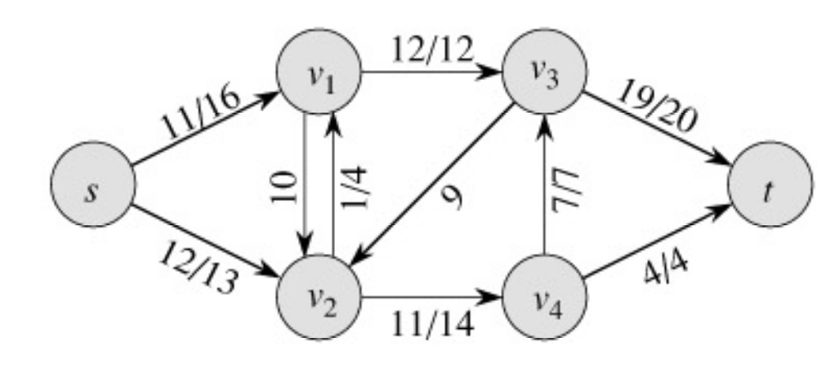
Example
Residual Network
Resulting
Flow = 23

Slide 23
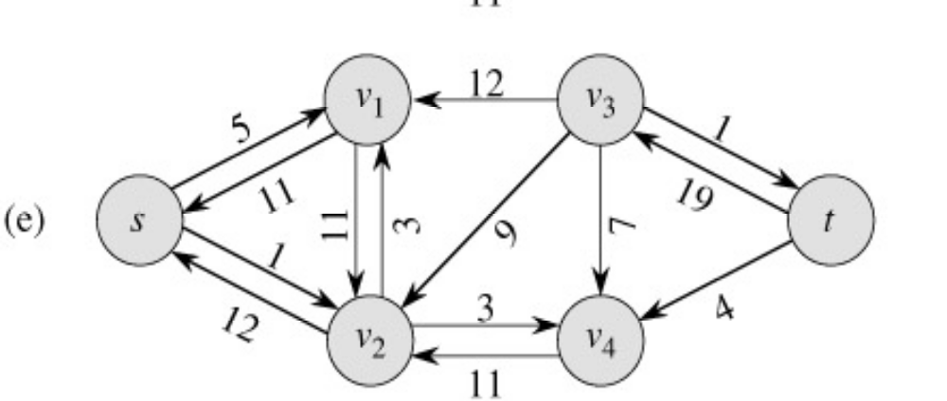
Example
Resulting
Flow = 23
No augmenting path:
Maxflow=23
Residual Network
  The residual network Gf contains no
  augmented paths. So f is a maximum
  flow in G.

Slide 24
Example of residual network
12
4/12
v₁
v₃
v₁
v₃
16
20
4/16
20
s
10
4
7
t
s
7
9
10
4
t
4/9
13
4
13
4/4
v₂
v₄
v₂
v₄
14
4/14
(a)

Slide 25
Example of Residual network (continued)
8
12
v₁
v₃
20
4
s
4
4
10
4
t
7
5
13
10
4
v₂
v₄
4
(b)

Slide 26
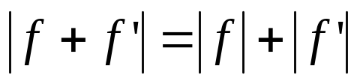
Fact 1:
Let G=(V,E) be a flow network with source s and sink t, and let f be a flow in G.
Let G_{f} be the residual network of G induced by f,and let f’ be a flow in G_{f}.Then, the flow sum f+f’ is a flow in G with value .
f+f’: the flow in the same direction will be added.
the flow in different directions will be cnacelled.

Slide 27
Augmenting paths:
Given a flow network G=(V,E) and a flow f, an augmenting path is a simple path from s to t in the residual network G_{f}.
Residual capacity of p : the maximum amount of net flow that we can ship along the edges of an augmenting path p, i.e., c_{f}(p)=min{c_{f}(u,v):(u,v) is on p}.
2
3
1
The residual capacity is 1.

Slide 28
Example of an augment path (bold edges)
8
12
v₁
v₃
20
4
s
4
4
10
4
t
7
5
13
10
4
v₂
v₄
4
(b)

Slide 29

The basic Ford-Fulkerson algorithm:
FORD-FULKERSON(G,s,t)
for each edge (u,v) ∈E[G]
do f[u,v] 0
f[v,u] 0
while there exists a path p from s to t in the residual network G_{f}
do c_{f}(p) min{c_{f}(u,v): (u,v) is in p}
for each edge (u,v) in p
do f[u,v] f[u,v]+c_{f}(p)

Slide 30
Example:
The execution of the basic Ford-Fulkerson algorithm.
(a)-(d) Successive iterations of the while loop: The left side of each part shows the residual network G_{f} from line 4 with a shaded augmenting path p.The right side of each part shows the new flow f that results from adding f_{p} to f.The residual network in (a) is the input network G.(e) The residual network at the last while loop test.It has no augmenting paths,and the flow f shown in (d) is therefore a maximum flow.

Slide 31
12
4/12
v₁
v₃
v₁
v₃
16
20
4/16
20
s
10
4
7
t
s
7
9
10
4
t
4/9
13
4
13
4/4
v₂
v₄
v₂
v₄
14
4/14
(a)

Slide 32
8
12
4/12
v₁
v₃
v₁
v₃
20
7/20
4
11/16
s
4
4
10
4
t
s
4
7/7
t
7
7/10
4/9
5
13
10
4
13
4/4
v₂
v₄
v₂
v₄
4
11/14
(b)

Slide 33
8
12/12
5
v₁
v₃
13
v₁
v₃
4
11/16
15/20
11
4
s
3
11
7
7
t
s
7/7
10
1/4
t
5
4/9
13
3
8/13
4/4
v₂
v₄
4
v₂
v₄
11
11/14
(c)

Slide 34
12
12/12
5
v₁
v₃
5
v₁
v₃
11/16
19/20
11
4
s
7
15
t
s
5
11
3
10
1/4
7/7
t
5
9
8
3
12/13
4/4
v₂
v₄
4
v₂
v₄
11
11/14
(d)

Slide 35
12
5
v₁
v₃
1
s
3
7
19
t
1
11
9
12
3
4
v₂
v₄
11
(e)

Slide 36
Time complexity:
If each c(e) is an integer, then time complexity is O(|E|f*), where f* is the maximum flow.
Reason: each time the flow is increased by at least one.
This might not be a polynomial time algorithm since f* can be represented by log (f*) bits. So, the input size might be log(f*).

Slide 37
The Edmonds-Karp algorithm
Find the augmenting path using breadth-first search.
Breadth-first search gives the shortest path for graphs (Assuming the length of each edge is 1.)
Time complexity of Edmonds-Karp algorithm is O(VE²).
The proof is very hard and is not required here.

Slide 38
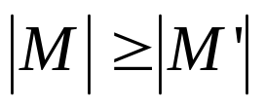
Maximum bipartite matching:
Bipartite graph: a graph (V, E), where V=L∪R, L∩R=empty, and for every (u, v)∈E, u ∈L and v ∈R.
Given an undirected graph G=(V,E), a matching is a subset of edges M⊆E such that for all vertices v∈V,at most one edge of M is incident on v.We say that a vertex v ∈V is matched by matching M if some edge in M is incident on v;otherwise, v is unmatched. A maximum matching is a matching of maximum cardinality,that is, a matching M such that for any matching M’, we have .

Slide 39
L
R
L
R
(a)
(b)
A bipartite graph G=(V,E) with vertex partition V=L∪R.(a)A matching with cardinality 2.(b) A maximum matching with cardinality 3.

Slide 40
Finding a maximum bipartite matching:
We define the corresponding flow network G’=(V’,E’) for the bipartite graph G as follows. Let the source s and sink t be new vertices not in V, and let V’=V∪{s,t}.If the vertex partition of G is V=L ∪R, the directed edges of G’ are given by E’={(s,u):u∈L} ∪{(u,v):u ∈L,v ∈R,and (u,v) ∈E} ∪{(v,t):v ∈R}.Finally, we assign unit capacity to each edge in E’.
We will show that a matching in G corresponds directly to a flow in G’s corresponding flow network G’. We say that a flow f on a flow network G=(V,E) is integer-valued if f(u,v) is an integer for all (u,v) ∈V*V.

Slide 41
s
t
L
R
L
R
(a)
(b)
(a)The bipartite graph G=(V,E) with vertex partition V=L∪R. A
maximum matching is shown by shaded edges.(b) The corresponding
flow network.Each edge has unit capacity.Shaded edges have
a flow of 1,and all other edges carry no flow.

Slide 42
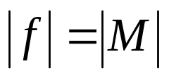
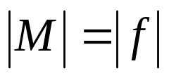
Continue:
Lemma .
Let G=(V,E) be a bipartite graph with vertex partition V=L∪R,and let G’=(V’,E’) be its corresponding flow network.If M is a matching in G, then there is an integer-valued flow f in G’ with value .Conversely, if f is an integer-valued flow in G’,then there is a matching M in G with cardinality .
Reason: The edges incident to s and t ensures this.
  Each node in the first column has in-degree 1
  Each node in the second column has out-degree 1.
  So each node in the bipartite graph can be involved once in the flow.

Slide 43
Example:

Slide 44
Aug. path:

Slide 45
1
1
1
1
1
1
1
Residual network. Red edges are new edges in the residual network. The new aug. path is bold. Green edges are old aug. path. old flow=1.

