Slide 1

Recurrance
Recurrences
Instructor: Tanvir Ahammad

Slide 2
Recurrences and Running Time
An equation or inequality that describes a function in terms of its value on smaller inputs.
T(n) = T(n-1) + n
Recurrences arise when an algorithm contains recursive calls to itself
What is the actual running time of the algorithm?
Need to solve the recurrence
  Find an explicit formula of the expression
  Bound the recurrence by an expression that involves n

Slide 3
Example Recurrences
T(n) = T(n-1) + n Θ(n²)
  Recursive algorithm that loops through the input to eliminate one item
T(n) = T(n/2) + c Θ(lgn)
  Recursive algorithm that halves the input in one step
T(n) = T(n/2) + n Θ(n)
  Recursive algorithm that halves the input but must examine every item in the input
T(n) = 2T(n/2) + 1 Θ(n)
  Recursive algorithm that splits the input into 2 halves and does a constant amount of other work

Slide 4
Recurrent Algorithms
BINARY-SEARCH
for an ordered array A, finds if x is in the array A[lo…hi]
Alg.: BINARY-SEARCH (A, lo, hi, x)
if (lo > hi)
return FALSE
mid ← ⎣(lo+hi)/2⎦
if x = A[mid]
return TRUE
if ( x < A[mid] )
BINARY-SEARCH (A, lo, mid-1, x)
if ( x > A[mid] )
BINARY-SEARCH (A, mid+1, hi, x)
1
2
3
4
5
6
7
8
2
3
5
7
9
10
11
12
mid
lo
hi

Slide 5
Example
A[8] = {1, 2, 3, 4, 5, 7, 9, 11}
  lo = 1 hi = 8 x = 7
1
2
3
4
5
6
7
8
1
2
3
4
5
7
9
11
mid = 4, lo = 5, hi = 8
5
6
7
8
1
2
3
4
5
7
9
11
mid = 6, A[mid] = x Found!

Slide 6
Another Example
A[8] = {1, 2, 3, 4, 5, 7, 9, 11}
  lo = 1 hi = 8 x = 6
1
2
3
4
5
6
7
8
1
2
3
4
5
7
9
11
mid = 4, lo = 5, hi = 8
low
high
1
2
3
4
5
7
9
11
mid = 6, A[6] = 7, lo = 5, hi = 5
low
high
1
2
3
4
5
7
9
11
mid = 5, A[5] = 5, lo = 6, hi = 5
NOT FOUND!
1
2
3
4
5
7
9
11
high
low

Slide 7
Analysis of BINARY-SEARCH
Alg.: BINARY-SEARCH (A, lo, hi, x)
if (lo > hi)
return FALSE
mid ← ⎣(lo+hi)/2⎦
if x = A[mid]
return TRUE
if ( x < A[mid] )
BINARY-SEARCH (A, lo, mid-1, x)
if ( x > A[mid] )
BINARY-SEARCH (A, mid+1, hi, x)
T(n) = c +
  T(n) – running time for an array of size n
constant time: c₁
constant time: c₂
constant time: c₃
same problem of size n/2
same problem of size n/2
T(n/2)

Slide 8
Methods for Solving Recurrences
Iteration method
Substitution method
Recursion tree method
Master method

Slide 9
The Iteration Method
Convert the recurrence into a summation and try to bound it using known series
  Iterate the recurrence until the initial condition is reached.
  Use back-substitution to express the recurrence in terms of n and the initial (boundary) condition.

Slide 10
The Iteration Method
T(n) = c + T(n/2)
T(n) = c + T(n/2)
= c + c + T(n/4)
= c + c + c + T(n/8)
Assume n = 2^{k}
T(n) = c + c + … + c + T(1)
= clgn + T(1)
= Θ(lgn)
T(n/2) = c + T(n/4)
T(n/4) = c + T(n/8)
k times

Slide 11
Iteration Method – Example
T(n) = n + 2T(n/2)
T(n) = n + 2T(n/2)
= n + 2(n/2 + 2T(n/4))
= n + n + 4T(n/4)
= n + n + 4(n/4 + 2T(n/8))
= n + n + n + 8T(n/8)
… = in + 2^{i}T(n/2^{i})
= kn + 2^{k}T(1)
= nlgn + nT(1) = Θ(nlgn)
Assume: n = 2^{k}
T(n/2) = n/2 + 2T(n/4)

Slide 12
The substitution method
Guess a solution
Use induction to prove that the solution works

Slide 13
Substitution method
Guess a solution
  T(n) = O(g(n))
  Induction goal: apply the definition of the asymptotic notation
    T(n) ≤ d g(n), for some d > 0 and n ≥ n₀
  Induction hypothesis: T(k) ≤ d g(k) for all k < n
Prove the induction goal
  Use the induction hypothesis to find some values of the constants d and n₀ for which the induction goal holds
(strong induction)

Slide 14
Example: Binary Search
T(n) = c + T(n/2)
Guess: T(n) = O(lgn)
  Induction goal: T(n) ≤ d lgn, for some d and n ≥ n₀
  Induction hypothesis: T(n/2) ≤ d lg(n/2)
Proof of induction goal:
T(n) = T(n/2) + c ≤ d lg(n/2) + c
= d lgn – d + c ≤ d lgn
if: – d + c ≤ 0, d ≥ c
Base case?

Slide 15
Example 2
T(n) = T(n-1) + n
Guess: T(n) = O(n²)
  Induction goal: T(n) ≤ c n², for some c and n ≥ n₀
  Induction hypothesis: T(n-1) ≤ c(n-1)² for all k < n
Proof of induction goal:
T(n) = T(n-1) + n ≤ c (n-1)² + n
= cn² – (2cn – c - n) ≤ cn²
if: 2cn – c – n ≥ 0 ⇔ c ≥ n/(2n-1) ⇔ c ≥ 1/(2 – 1/n)
  For n ≥ 1 ⇒ 2 – 1/n ≥ 1 ⇒ any c ≥ 1 will work

Slide 16
Example 3
T(n) = 2T(n/2) + n
Guess: T(n) = O(nlgn)
  Induction goal: T(n) ≤ cn lgn, for some c and n ≥ n₀
  Induction hypothesis: T(n/2) ≤ cn/2 lg(n/2)
Proof of induction goal:
T(n) = 2T(n/2) + n ≤ 2c (n/2)lg(n/2) + n
= cn lgn – cn + n ≤ cn lgn
if: - cn + n ≤ 0 ⇒ c ≥ 1
Base case?

Slide 17
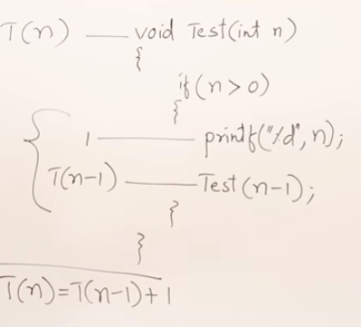

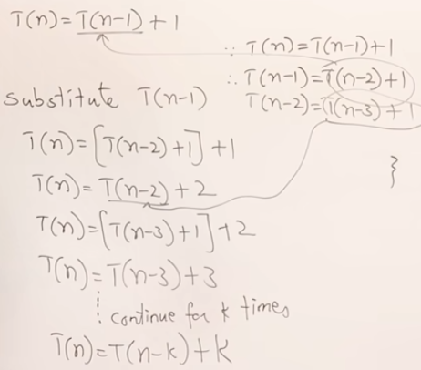
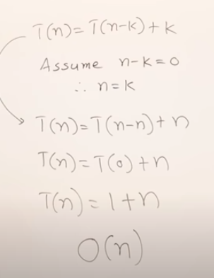
Example-3

Slide 18
The recursion-tree method
Convert the recurrence into a tree:
  Each node represents the cost incurred at various levels of recursion
  Sum up the costs of all levels
Used to “guess” a solution for the recurrence

Slide 19
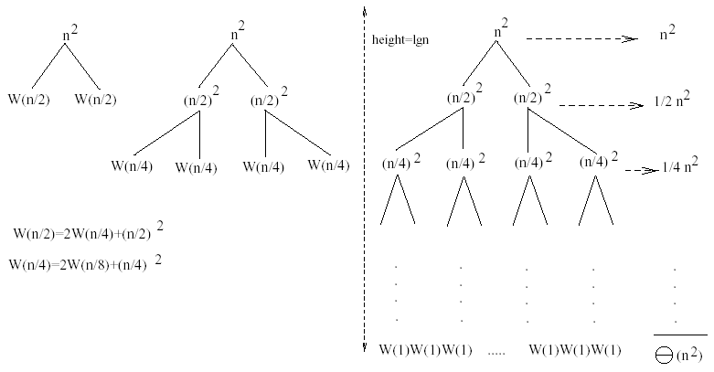
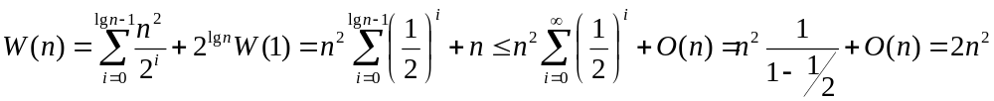
Example 1
W(n) = 2W(n/2) + n²
Subproblem size at level i is: n/2^{i}
Subproblem size hits 1 when 1 = n/2^{i} ⇒ i = lgn
Cost of the problem at level i = (n/2^{i})² No. of nodes at level i = 2^{i}
Total cost:
⇒ W(n) = O(n²)

Slide 20
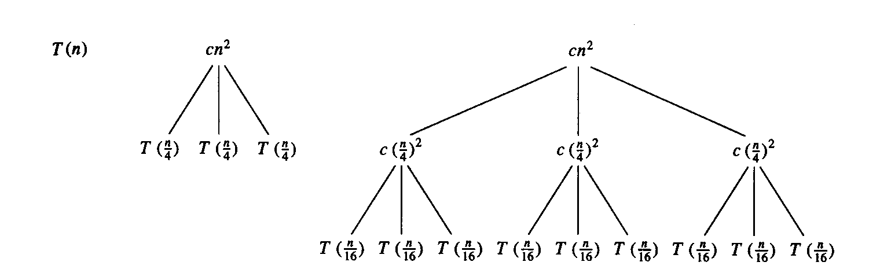
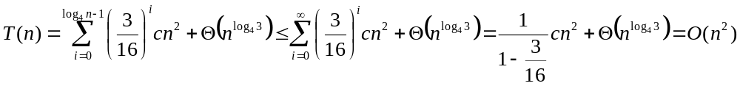
Example 2
E.g.: T(n) = 3T(n/4) + cn²
Subproblem size at level i is: n/4^{i}
Subproblem size hits 1 when 1 = n/4^{i} ⇒ i = log₄n
Cost of a node at level i = c(n/4^{i})²
Number of nodes at level i = 3^{i} ⇒ last level has 3^{log}₄^{n} = n^{log}₄³ nodes
Total cost:
⇒ T(n) = O(n²)

Slide 21
Example 2 - Substitution
T(n) = 3T(n/4) + cn²
Guess: T(n) = O(n²)
  Induction goal: T(n) ≤ dn², for some d and n ≥ n₀
  Induction hypothesis: T(n/4) ≤ d (n/4)²
Proof of induction goal:
T(n) = 3T(n/4) + cn²
≤ 3d (n/4)² + cn²
= (3/16) d n² + cn²
≤ d n² if: d ≥ (16/13)c
Therefore: T(n) = O(n²)

Slide 22
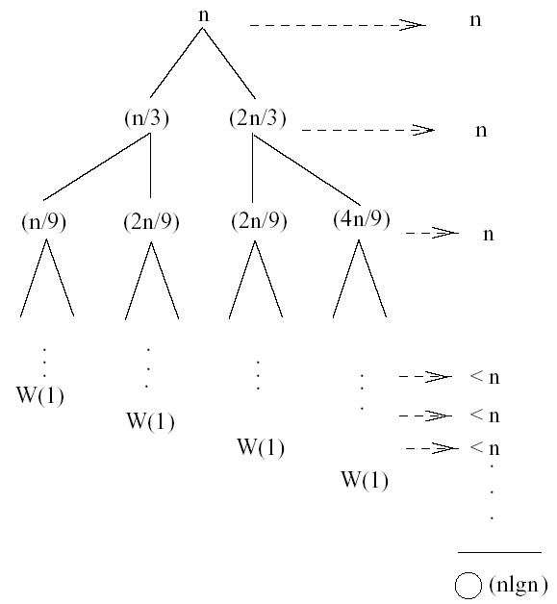
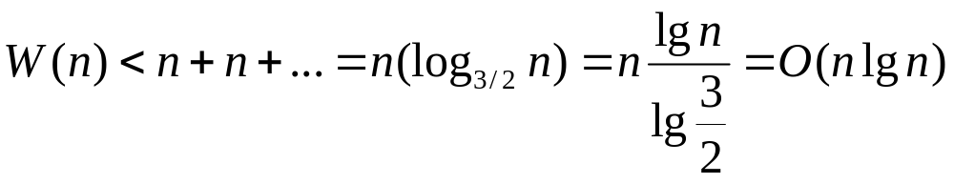
Example 3 (simpler proof)
W(n) = W(n/3) + W(2n/3) + n
The longest path from the root to a leaf is: n → (2/3)n → (2/3)² n → … → 1
Subproblem size hits 1 when 1 = (2/3)^{i}n ⇔ i=log_{3/2}n
Cost of the problem at level i = n
Total cost:
⇒ W(n) = O(nlgn)

Slide 23
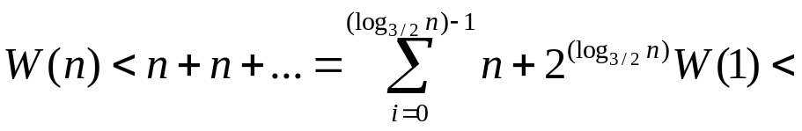
Example 3
W(n) = W(n/3) + W(2n/3) + n
The longest path from the root to a leaf is: n → (2/3)n → (2/3)² n → … → 1
Subproblem size hits 1 when 1 = (2/3)^{i}n ⇔ i=log_{3/2}n
Cost of the problem at level i = n
Total cost:
⇒ W(n) = O(nlgn)

Slide 24
Example 3 - Substitution
W(n) = W(n/3) + W(2n/3) + O(n)
Guess: W(n) = O(nlgn)
  Induction goal: W(n) ≤ dnlgn, for some d and n ≥ n₀
  Induction hypothesis: W(k) ≤ d klgk for any K < n (n/3, 2n/3)
Proof of induction goal:
Try it out as an exercise!!
T(n) = O(nlgn)

Slide 25
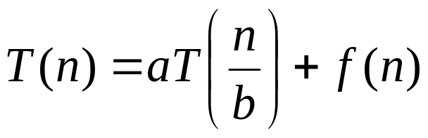
Master’s method
“Cookbook” for solving recurrences of the form:
where, a ≥ 1, b > 1, and f(n) > 0

Slide 26
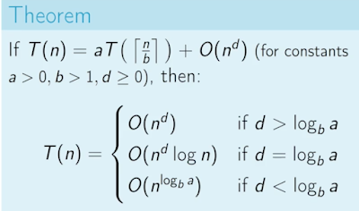
Master’s method
“Cookbook” for solving recurrences of the form: (3 cases)

Slide 27
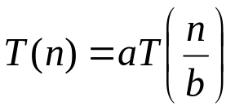
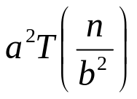
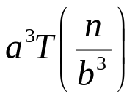
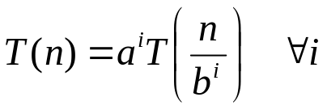
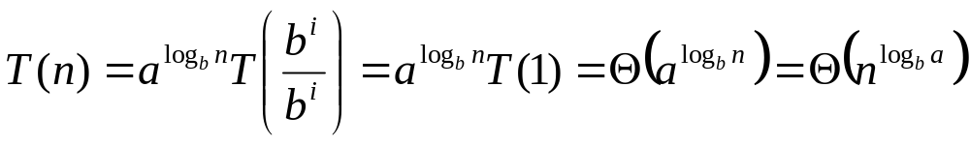
Why n^{log}_{b}ª?
Case 1:
  If f(n) is dominated by n^{log}_{b}ª:
    T(n) = Θ(n^{log}_{b}^{n})
Case 3:
  If f(n) dominates n^{log}_{b}ª:
    T(n) = Θ(f(n))
Case 2:
  If f(n) = Θ(n^{log}_{b}ª):
    T(n) = Θ(n^{log}_{b}ª logn)
Assume n = b^{k} ⇒ k = log_{b}n
At the end of iteration i = k:

Slide 28
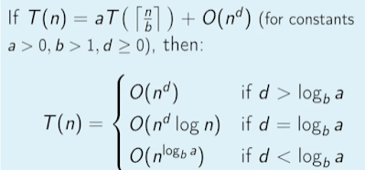
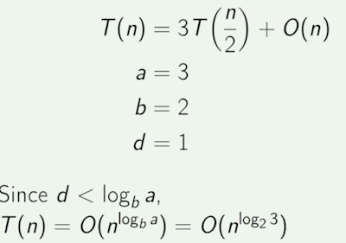
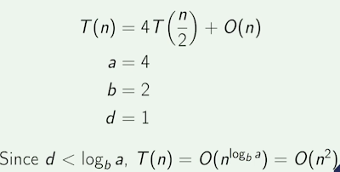
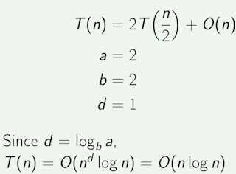
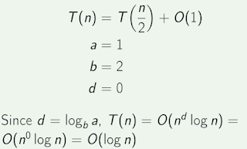
Examples

Slide 29
Examples
T(n) = 2T(n/2) + n
a = 2, b = 2, log₂2 = 1
Compare n^{log}₂² with f(n) = n
⇒ f(n) = Θ(n) ⇒ Case 2
⇒ T(n) = Θ(nlgn)

Slide 30
Examples
T(n) = 2T(n/2) + n²
a = 2, b = 2, log₂2 = 1
Compare n with f(n) = n²
⇒ f(n) = Ω(n^{1+ε}) Case 3 ⇒ verify regularity cond.
a f(n/b) ≤ c f(n)
⇔ 2 n²/4 ≤ c n² ⇒ c = ½ is a solution (c<1)
⇒ T(n) = Θ(n²)

Slide 31

Examples (cont.)
T(n) = 2T(n/2) +
a = 2, b = 2, log₂2 = 1
Compare n with f(n) = n^{1/2}
⇒ f(n) = O(n^{1-ε}) Case 1
⇒ T(n) = Θ(n)

Slide 32
Examples
T(n) = 3T(n/4) + nlgn
a = 3, b = 4, log₄3 = 0.793
Compare n^{0.793} with f(n) = nlgn
f(n) = Ω(n^{log}₄^{3+ε}) Case 3
Check regularity condition:
3∗(n/4)lg(n/4) ≤ (3/4)nlgn = c ∗f(n), c=3/4
⇒T(n) = Θ(nlgn)

Slide 33
Examples
T(n) = 2T(n/2) + nlgn
a = 2, b = 2, log₂2 = 1
Compare n with f(n) = nlgn
  seems like case 3 should apply
f(n) must be polynomially larger by a factor of n^{ε}
In this case it is only larger by a factor of lgn

Slide 34
Master method
See more examples on chapter 4, section 4.5

