Slide 1
The P vs. NP question, NP-Completeness
Backtracking

Slide 2
Admin
Homework 6 is posted
Due next Wednesday
No partners

Slide 3
Algorithm Design Techniques
Greedy
Shortest path, minimum spanning tree, …
Divide and Conquer
Divide the problem into smaller subproblems, solve them, and combine into the overall solution
Often done recursively
Quick sort, merge sort are great examples
Dynamic Programming
Brute force through all possible solutions, storing solutions to subproblems to avoid repeat computation
Backtracking
A clever form of exhaustive search

Slide 4

Backtracking: Idea
Backtracking is a technique used to solve problems with a large search space, by systematically trying and eliminating possibilities.
A standard example of backtracking would be going through a maze.
At some point, you might have two options of which direction to go:
Portion A
Junction
Portion B

Slide 5
Backtracking
Junction
One strategy would be to try going through Portion A of the maze.
If you get stuck before you find your way out, then you "backtrack" to the junction.
At this point in time you know that Portion A will NOT lead you out of the maze,
so you then start searching in Portion B
Portion B
Portion A

Slide 6

Backtracking
Clearly, at a single junction you could have even more than 2 choices.
The backtracking strategy says to try each choice, one after the other,
if you ever get stuck, "backtrack" to the junction and try the next choice.
If you try all choices and never found a way out, then there IS no solution to the maze.
Junction
C
B
A

Slide 7
Backtracking (animation)
dead end
?
dead end
dead end
?
start
?
?
dead end
dead end
?
success!

Slide 8
Backtracking
Dealing with the maze:
From your start point, you will iterate through each possible starting move.
From there, you recursively move forward.
If you ever get stuck, the recursion takes you back to where you were, and you try the next possible move.
Make sure you don't try too many possibilities,
Mark which locations in the maze have been visited already so that no location in the maze gets visited twice.
If a place has already been visited, there is no point in trying to reach the end of the maze from there again.

Slide 9
Backtracking
The neat thing about coding up backtracking is that it can be done recursively, without having to do all the bookkeeping at once.
Instead, the stack of recursive calls does most of the bookkeeping
(i.e., keeps track of which locations we’ve tried so far.)

Slide 10
On to Complexity theory!

Slide 11
The $1M question
The Clay Mathematics Institute
Millennium Prize Problems
Birch and Swinnerton-Dyer Conjecture
Hodge Conjecture
Navier-Stokes Equations
P vs NP
Poincaré Conjecture
Riemann Hypothesis
Yang-Mills Theory

Slide 12
The P versus NP problem (informally)
Can every problem whose solution can be quickly verified by a computer also be quickly solved by a computer?
Notes:
What do we mean by quickly here?

Slide 13
What is an efficient algorithm?
Is an O(n) algorithm efficient?
How about O(n log n)?
polynomial time
O(n^{c}) for some
constant c
O(n²) ?
O(n¹⁰) ?
O(n^{log n}) ?
non-polynomial
time
O(2^{n}) ?
O(n!) ?

Slide 14
The Class P (polynomial time)
Binary Search
Dijkstra’s Algorithm
Breadth-First Search
P
Sorting Algorithms
Notes:
the class of problems that can be solved and whose solutions can be verified in polynomial time

Slide 15
NP (Nondeterministic Polynomial Time)
Hamilton Cycle
NP
Sudoku
Binary Search
SAT
P
Dijkstra’s Algorithm
Breadth-First Search
…
Sorting Algorithms
…
Notes:
The class of all sets that can be verified in polynomial time (if solution is fast to verify, can try all solutions with nondeterministic paths).
It can be solved in polynomial time with a non-deterministic algorithm (deterministic algorithm can only follow one path when presented with a choice, non-deterministic can choose multiple paths)

Slide 16
The P versus NP problem
Is one of the biggest open problems in computer science (and mathematics) today
It’s currently unknown whether there exist polynomial time algorithms for NP-complete problems
We know P ⊆ NP, but does P = NP?
People generally believe P ≠ NP, but no proof yet
What do these NP problems look like?
Notes:
P is a problem that can be solved in polynomial time
NP is a problem that can be verified in polynomial time (non deterministic polynomial time)

Slide 17
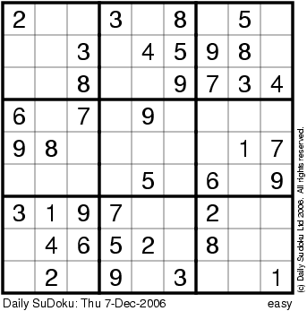
Sudoku
3x3x3

Slide 18
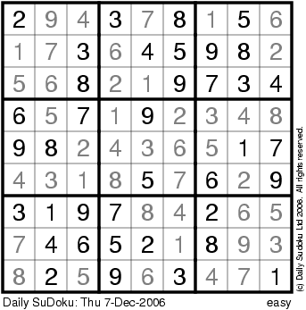
Sudoku
3x3x3

Slide 19
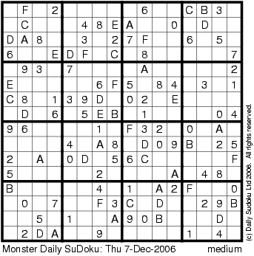
Sudoku
4x4x4

Slide 20
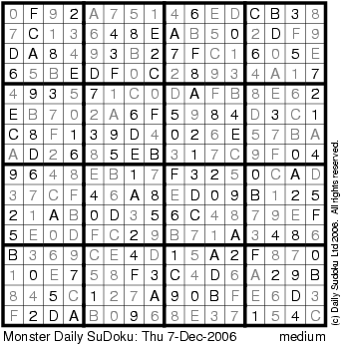
Sudoku
4x4x4

Slide 21
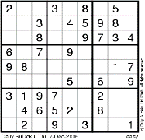
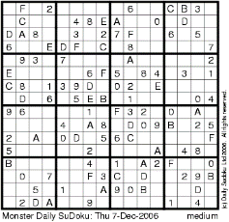
Sudoku
Suppose you have an algorithm S(n) to solve n x n x n
V(n) time to verify the solution
Fact: V(n) = O(n² x n²)
Question: is there some constant such that
...
S(n) = O(n^{constant})?
n x n x n

Slide 22
Sudoku
P vs NP problem
=
Does there exist an algorithm for solving n x n x n Sudoku that runs in time p(n) for some polynomial p( ) ?
...
n x n x n

Slide 23
The P versus NP problem (informally)
Can every problem whose solution can be verified in polynomial time by a computer also be solved in polynomial time by a computer?
Notes:
phrase a problem as a yes/no question
a problem is in NP if in polynomial time we can prove any yes instance is correct

Slide 24
To check if a problem is in NP
Phrase the problem as a yes/no question
If we can prove any yes instance is correct (in polynomial time), it is in NP
If we can also answer yes or no to the problem (in polynomial time) without being given a solution, it is in P
Notes:
frame as decision problems
with
Sets of solutions (yes instances)

Slide 25
The Class P
The class of all sets that can be verified in polynomial time.
AND
The class of all decision problems that can be decided in polynomial time.
Binary Search
Dijkstra’s Algorithm
Breadth-First Search
P
Sorting Algorithms

Slide 26
NP
The class of all sets that can be verified in polynomial time.
Hamilton Cycle
NP
Sudoku
Binary Search
SAT
P
Dijkstra’s Algorithm
Breadth-First Search
…
Sorting Algorithms
…

Slide 27
Sudoku
Input: n x n x n sudoku instance
Output:
YES if this sudoku has a solution
NO if it does not
The Set “SUDOKU”
SUDOKU = { All solvable sudoku instances }

Slide 28
Hamilton Cycle
Given a graph G = (V,E), is there a cycle that visits all the nodes exactly once?
YES if G has a Hamilton cycle
NO if G has no Hamilton cycle
The Set “HAM”
HAM = { graph G | G has a Hamilton cycle }
Notes:
Does it have a cycle? is in NP
Prove it doesn’t have a cycle is not in NP
phrase a problem as a yes/no question
a problem is in NP if in polynomial time we can prove any yes instance is correct

Slide 29
Circuit-Satisfiability
Input: A circuit C with one output
Output:
YES if C is satisfiable
NO if C is not satisfiable
AND
NOT
The Set “SAT”
SAT = { all satisfiable circuits C }
AND
Notes:
Boolean satisfiability: problem of determining if there exists an interpretation that satisfies a boolean formula
can you give an input so the circuit evaluates to true
First problem shown to be NP-complete!
every problem in NP can be solved in polynomial time using a nondeterministic computer/Turing machine

Slide 30
Verifying Membership
Is there a short “proof” I can give you to verify that:
G ∈ HAM?
G ∈ Sudoku?
G ∈ SAT?
Yes: I can just give you the cycle, solution, circuit

Slide 31
The Class NP
The class of sets for which there exist “short” proofs of membership (of polynomial length) that can “quickly” verified (in polynomial time).
Recall: The algorithm doesn’t have to find the proof; it just needs to be able to verify that it is a “correct” proof.
Fact: P ⊆ NP

Slide 32
Summary: P versus NP
NP: “proof of membership” in a set can be verified in polynomial time.
P: in NP (membership verified in polynomial time)
AND membership in a set can be decided in polynomial time.
Fact: P ⊆ NP
Question: Does NP ⊆ P ?
i.e. Does P = NP?
People generally believe P ≠ NP, but no proof yet

Slide 33
Why Care?

Slide 34
NP Contains Lots of Problems We Don’t Know to be in P
Classroom Scheduling
Packing objects into bins
Scheduling jobs on machines
Finding cheap tours visiting a subset of cities
Finding good packet routings in networks
Decryption
…
OK, OK, I care...

Slide 35
How could we prove that NP = P?
We would have to show that every set in NP has a polynomial time algorithm…
How do I do that?
It may take a long time!
Also, what if I forgot one of the sets in NP?

Slide 36
How could we prove that NP = P?
We can describe just one problem L in NP, such that if this problem L is in P, then NP ⊆ P.
It is a problem that can capture all other problems in NP.
The “Hardest” Set in NP
We call these problems NP-complete
Notes:
every problem in NP is reducible to an NP-complete problem

Slide 37
Theorem [Cook/Levin]
SAT is one problem in NP, such that if we can show SAT is in P, then we have shown NP = P.
SAT is a problem in NP that can capture all other languages in NP.
We say SAT is NP-complete.

Slide 38

Poly-time reducible to each other
Answer
Takes polynomial time
Instance of problem Y
Map instance of Y into instance of X
Oracle for problem Y
Oracle for problem X
Answer
can be reduced (in polytime to)
an instance of
can be reduced (in polytime to)
an instance of
Any problem in NP
SAT
Sudoku
hence SAT is NP-complete
hence Sudoku is NP-complete

Slide 39
NP-complete: The “Hardest” problems in NP
Sudoku
Clique
SAT
Independent-Set
3-Colorability
HAM
These problems are all “polynomial-time equivalent”
i.e., each of these can be reduced to any of the others in polynomial time
If you get a polynomial-time algorithm for one, you get a polynomial-time algorithm for ALL.
(you get millions of dollars, you solve decryption, … etc.)

