Slide 1
Database Management System
Md. Manowarul Islam
Lecturer
Dept. of CSE
Jagannath University.

Slide 2
SQL TOP Clause
The TOP clause is used to specify the number of records to return.
The TOP clause can be very useful on large tables with thousands of records.
Returning a large number of records can impact on performance.
SELECT TOP number|percent column_name(s)
FROM table_name

Slide 3
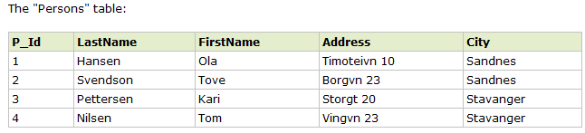
SQL TOP Clause
We want to select only the two first records in the table below.

Slide 4
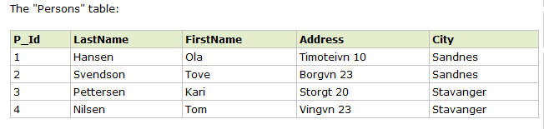

SQL TOP Clause
SELECT TOP number|percent column_name(s)
FROM table_name
We want to select only the first two records in the table.
SELECT TOP 2 * FROM Persons

Slide 5
SQL TOP Clause
SELECT TOP number|percent column_name(s)
FROM table_name
we want to select only 50% of the records in the table
SELECT TOP 50 PERCENT * FROM Persons

Slide 6
MySQL LIMIT Clause
The MySQL's LIMIT clause does the same work as SQL TOP clause
SELECT column_list
FROM table_name
LIMIT number;
Number: the number of rows returned

Slide 7
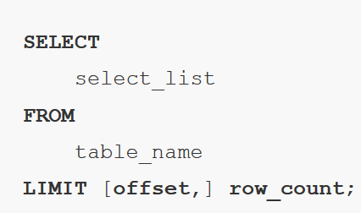
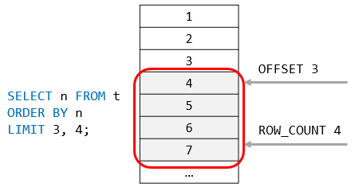
MySQL LIMIT Clause
The MySQL's LIMIT clause does the same work as SQL TOP clause

Slide 8
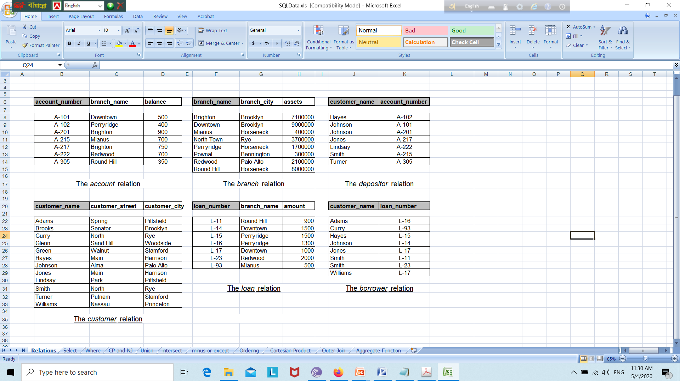
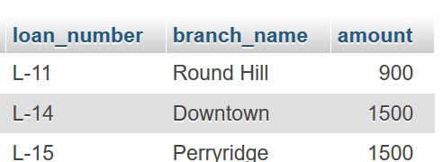
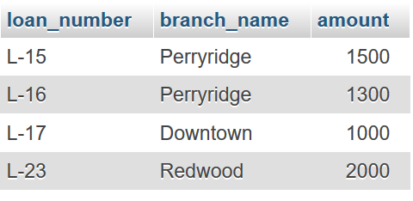
Find first three rows from loan.
SELECT *
FROM loan LIMIT 3
Setting Row Offset in LIMIT Clause
SELECT *
FROM loan LIMIT 2,4

Slide 9
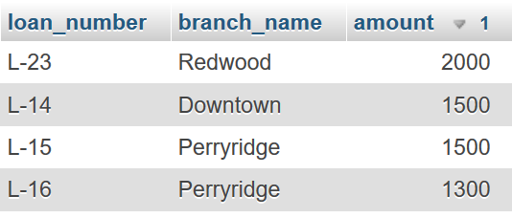
LIMIT and ORDER BY clauses
SELECT *
FROM loan
ORDER BY amount DESC
LIMIT 4
SELECT --→ FROM ---→ WHERE ---→ORDER BY --→LIMIT

Slide 10
String operation
    Patterns can be described by using two special characters:
      Percentage ( % ) : The % character matches any substring.
      Underscore( _ ) : The _ character matches any character.
    ‘Perry%’ matches any string beginning with “Perry”.
    ‘%idge%’ matches any string containing “idge” as a substring.
      For example, ‘Perryridge’, ‘Rock Ridge’, ‘Mian Bridge’.

Slide 11
String operation
    Patterns can be described by using two special characters:
      ‘_ _ _’ matches any string of exactly 3 characters.
      ‘_ _%’ matches any string of at least 2 characters.

Slide 12
SQL LIKE Operator
The LIKE operator is used in a WHERE clause to search for a specified pattern in a column.
SELECT column_name(s)
FROM table_name
WHERE column_name LIKE pattern

Slide 13
SQL LIKE Operator
we want to select the persons living in a city
that starts with "s" from the table above
SELECT * FROM Persons
WHERE City LIKE 's%'
The "%" sign can be used to define wildcards
(missing letters in the pattern)
both before and after the pattern.

Slide 14

SQL LIKE Operator
we want to select the persons living in a city
that starts with "s" from the table above
SELECT * FROM Persons
WHERE City LIKE 's%'

Slide 15

SQL LIKE Operator
we want to select the persons living in a city that
ends with an "s" from the "Persons" table
SELECT * FROM Persons
WHERE City LIKE '%s'

Slide 16
SQL LIKE Operator
we want to select the persons living in a city that contains
the pattern "tav" from the "Persons" table.
SELECT * FROM Persons
WHERE City LIKE '%tav%'

Slide 17

SQL LIKE Operator
It is also possible to select the persons living in a city that does NOT contain the pattern "tav" from the "Persons" table by using the NOT keyword.
SELECT * FROM Persons
WHERE City NOT LIKE '%tav%'

Slide 18
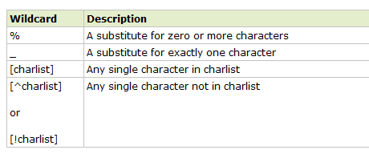
SQL Wildcards
SQL wildcards can be used when searching for data in a database.
SQL wildcards can substitute for one or more characters when searching for data in a database.
SQL wildcards must be used with the SQL LIKE operator.

Slide 19

SQL Wildcards
we want to select the persons living in a city that starts with "sa" from the "Persons" table
SELECT * FROM Persons
WHERE City LIKE 'sa%'

Slide 20

SQL Wildcards
we want to select the persons living in a city that contains the pattern "nes" from the "Persons" table.
SELECT * FROM Persons
WHERE City LIKE '%nes%'

Slide 21
SQL Wildcards (Using the _ Wildcard)
we want to select the persons with a first name that starts with any character, followed by "la" from the "Persons" table.
SELECT * FROM Persons
WHERE FirstName LIKE '_la'

Slide 22
SQL Wildcards (Using the _ Wildcard)
we want to select the persons with a last name that starts with "S", followed by any character, followed by "end", followed by any character, followed by "on" from the "Persons" table.
SELECT * FROM Persons
WHERE LastName LIKE 'S_end_on'

Slide 23
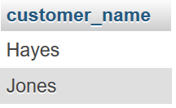

Lets do some exercises
Find the names of all customers whose street address includes the substring ‘Main’
select customer_name
from customer
where customer_street like '%Main%'
Find the names of all customers whose name start with ‘Jo’
select customer_name
from customer
where customer_name like 'Jo%'

Slide 24
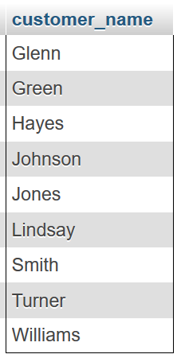
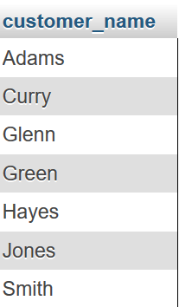
Lets do some exercises
Find the names of all customers whose name has exactly 5 characters.
select customer_name
from customer
where customer_name like '_____'
select customer_name
from customer
where customer_name not like 'A%' and customer_name not like 'B%' and customer_name not like 'C%'

Slide 25
SQL IN Operator
The IN operator allows you to specify multiple values in a WHERE clause.
SELECT column_name(s)
FROM table_name
WHERE column_name IN (value1,value2,...)

Slide 26

SQL IN Operator
we want to select the persons with a last name equal to "Hansen" or "Pettersen" from the table
SELECT * FROM Persons
WHERE LastName IN ('Hansen','Pettersen')

Slide 27
Thanks a lot

