Slide 1
Database Management
Systems

Slide 2
Contents:
Entity-Relationship Model

Slide 3
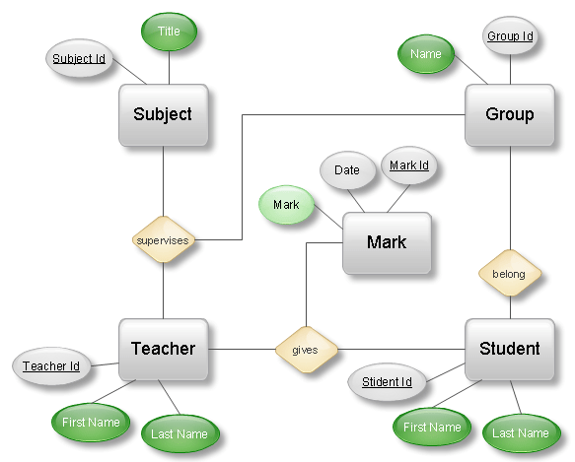
ER Model
The entity-relationship model (or ER model) is a way of graphically representing the entities and the logical relationships among entities in order to create a database.
  ER model represents the overall logical structure of DB.
In ER modeling, the structure for a database is portrayed as a diagram, called an entity-relationship diagram (or ER diagram or ERD).
Figure: An Example of ERD

Slide 4
There are three terms related to ER model
Entity & Entity Set
An entity is an object that exists and is distinguishable from other objects. For example, Johnson Derris with S.S.N. 890-12-3456 is an entity, as he can be uniquely identified as one particular person.
An entity may be concrete (a person or a book, for example) or abstract (like a holiday).
An entity set is a set of entities of the same type (e.g., all persons having an account at a bank).
Entity sets need not be disjoint. For example, the entity set employee (all employees of a bank) and the entity set customer (all customers of the bank) may have members in common.

Slide 5
Attributes
An entity is represented by a set of attributes.
Example: an entity account has attributes account_no and balance.
Each attribute has a set of permitted values which is called Domain of Attribute.
Formally, an attribute is a function which maps an entity set into a domain.
Types of Attribute
(i) Simple versus Composite Attributes
- Simple attributes can not be divided into subparts.
- Example: loan_no can not be divided into subparts.
- Composite attributes can be divided into subparts.
- Example: customer_name consists of First_name, Middle-initial and Last_name.

Slide 6
(ii) Single-valued versus Multi-valued Attributes
- Single-valued attribute has one value. Example: loan_no.
- Multi-valued attribute can have multiple values. Example: phone-no, an employee
can have 0, 1 or several phone numbers.
(iii) Derived Attributes
- The value of derived attribute is derived from the values of other attributes.
- Example: suppose the customer entity has three attributes which are name, age and
date_of_birth. The value of the attribute “age” can be derived from the value
“date_of_birth” and the current date.
(iv) NULL Attributes
- An attribute takes NULL value when an entity does not have a value for it.
- Example: middle_name, a customer may have no middle name.

Slide 7


Relationship Set
A relationship is an association among several entities. Example: a relationship can be defined that associates customer Jamal with loan L-15. This relationship specifies that Jamal is a customer having a loan with loan_no L-15.
A relationship set is a set of relationships of the same type.
An n-ary relationship set R relates n entity sets E₁, E₂,….E_{n}.
Formally it is a mathematical relation on >= 2 (possibly non-distinct) entity sets.
Same entity set could participate in different relationship sets.
Most relationship is binary (degree = 2). If more than 2 entity sets are associated through relationship, it is called multiway relationship.
Example:
Sub-Id
Title
Supervises
T-Id
Teacher
Subject
Name
Figure: “Supervises” is binary relationship set.

Slide 8
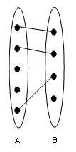
ER Model Constraints
Two of the most important types of constraints:
Mapping Cardinalities
- It expresses the number of entities to which another entity can be associated via a
relationship set.
- For a binary relationship set R between the entity sets A and B, the mapping
cardinality can be one of the following four:
(i) One to one: An entity in A is associated with at most one entity in B and an
entity in B is associated with at most one entity in A .
Example:
Figure: One to one

Slide 9
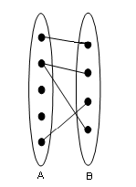
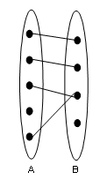
(ii) One to many: An entity in A is associated with any no. of entities in B but an entity
in B is associated with at most one entity in A.
Example:
Figure: One to many
(iii) Many to one: An entity in A is associated with at most one entity in B but an entity
in B is associated with any no. of entities in A.
Example:
Figure: Many to one

Slide 10
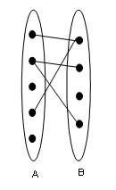
(iv) Many to many: An entity in A is associated with any no. of entities in B and an entity
in B is associated with any no. of entities in A .
Example:
Figure: Many to many

Slide 11
END

